Slide 1
The Great Internet

Slide 2
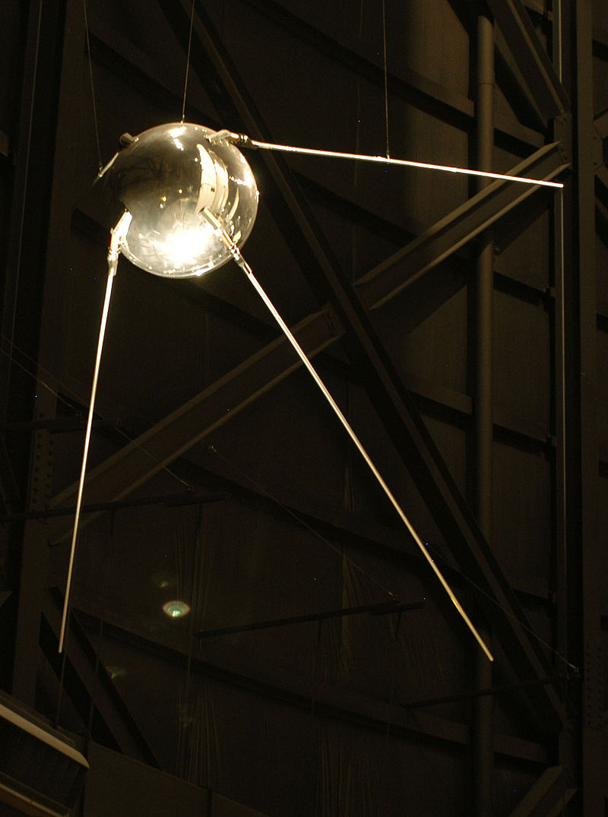

Slide 3
Sputnik – 1957
Creation of ARPA

Slide 4
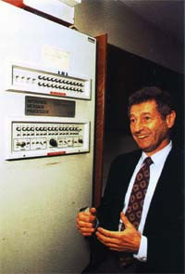
From Circuit Switching
to Packet Switching
Leonard Kleinrock

Slide 5
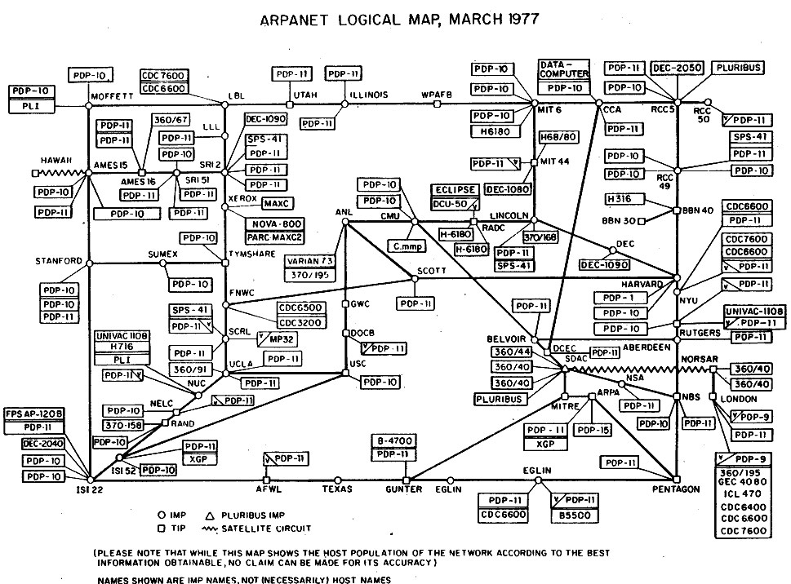
Notes:
Advanced Research Projects Agency Network

Slide 6
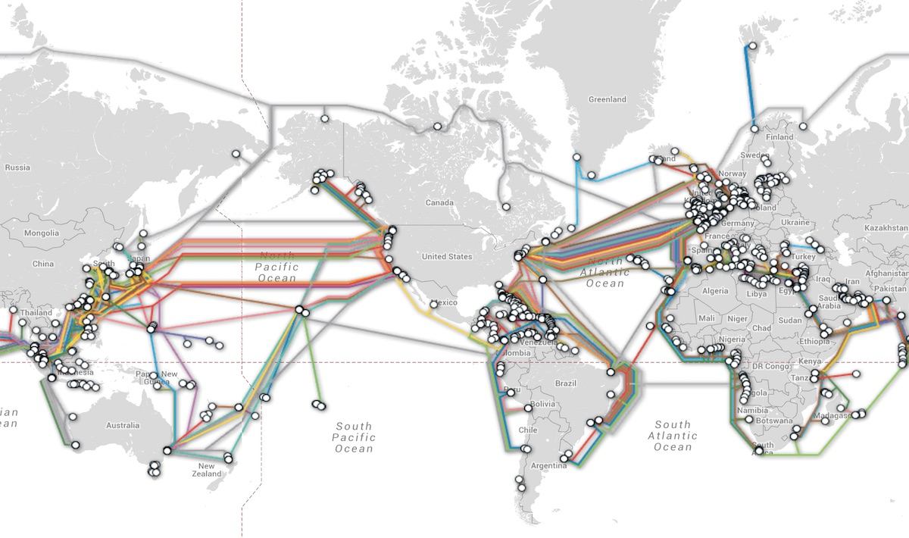
http://submarinecablemap.com/

Slide 7
References
http://www.20thingsilearned.com/en-US/what-is-the-internet/
http://www.computerhope.com/history/internet.htm

