Slide 1
The Great Internet
Protocols

Slide 2
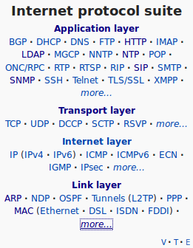

Slide 3

Encapsulation
Application
“Hello PW”
Application
“Hello PW”
TCP
“Hello PW”
TCP
Transport
Transport
“Hello PW”
Network
IP
Network
TCP
“Hello PW”
IP
TCP
“Hello PW”
Link
MAC
IP
Link
TCP
“Hello PW”
MAC
IP
TCP
“Hello PW”

Slide 4

Encapsulation
Application
Application
Transport
Transport
Network
Network
Network
Link
Link
Link

Slide 5
IP
123.123.123.123
Notes:
Unique
Like a postal address

Slide 6
DNS
123.123.123.123
cats.com

Slide 7

DNS
cats.com
123.123.123.123
123.123.123.123
Alice
Bob

Slide 8
Routing
1.1.1.1
1.1.1.2
1.1.1.3

Slide 9
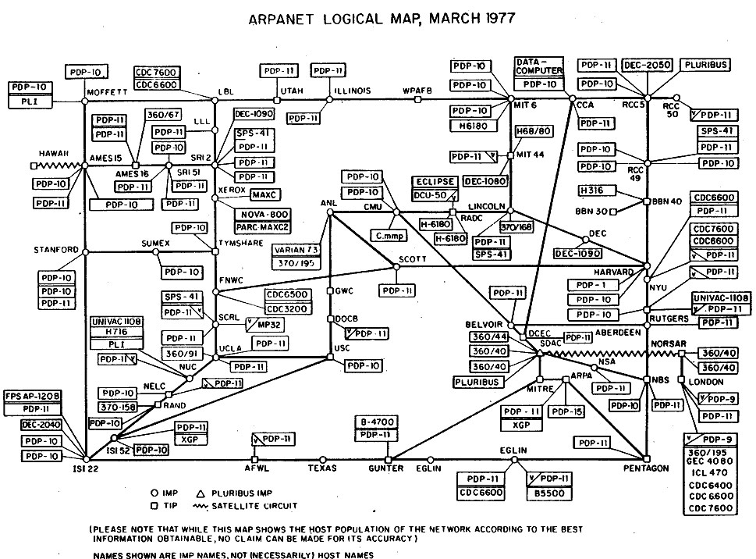

Slide 10

Routing
1.1.1.0
1.1.2.0
1.1.1.5
1.1.2.1
1.1.2.2

Slide 12
DHCP
MAC
IP
DHCP server
48-2C-6A-1E-59-3D
123.123.123.123
123.123.123.123
Alice
Bob

Slide 14
TCP | UDP
Reliable (ACK) | Unreliable
Connection oriented | Connectionless
Web page | Video

Slide 15
Next steps

