Slide 1

SUMMER SCHOOL OF SCIENCE
S3++
Connecting a flower to the Internet

Slide 2
Main Teaching Goals
What is Internet really ?
How can we contribute ?
Arduino & basic eletronic (analog/digital)

Slide 3
Connected Plant Project
Connect sensors to a plant
Connect actuators to a plant
Build a local server
Send data to a local server
Make data accessible from the Internet

Slide 4
Internet
History
Topologies:
    Mesh topology
    Star topology
Current issues and privacy concern

Slide 5
Self-Hosting
Web server
    OS and platforms
    Applications
        dynamic graph
Protocols: IP, VPN, Proxy, FTP, SSH ?
Security

Slide 6
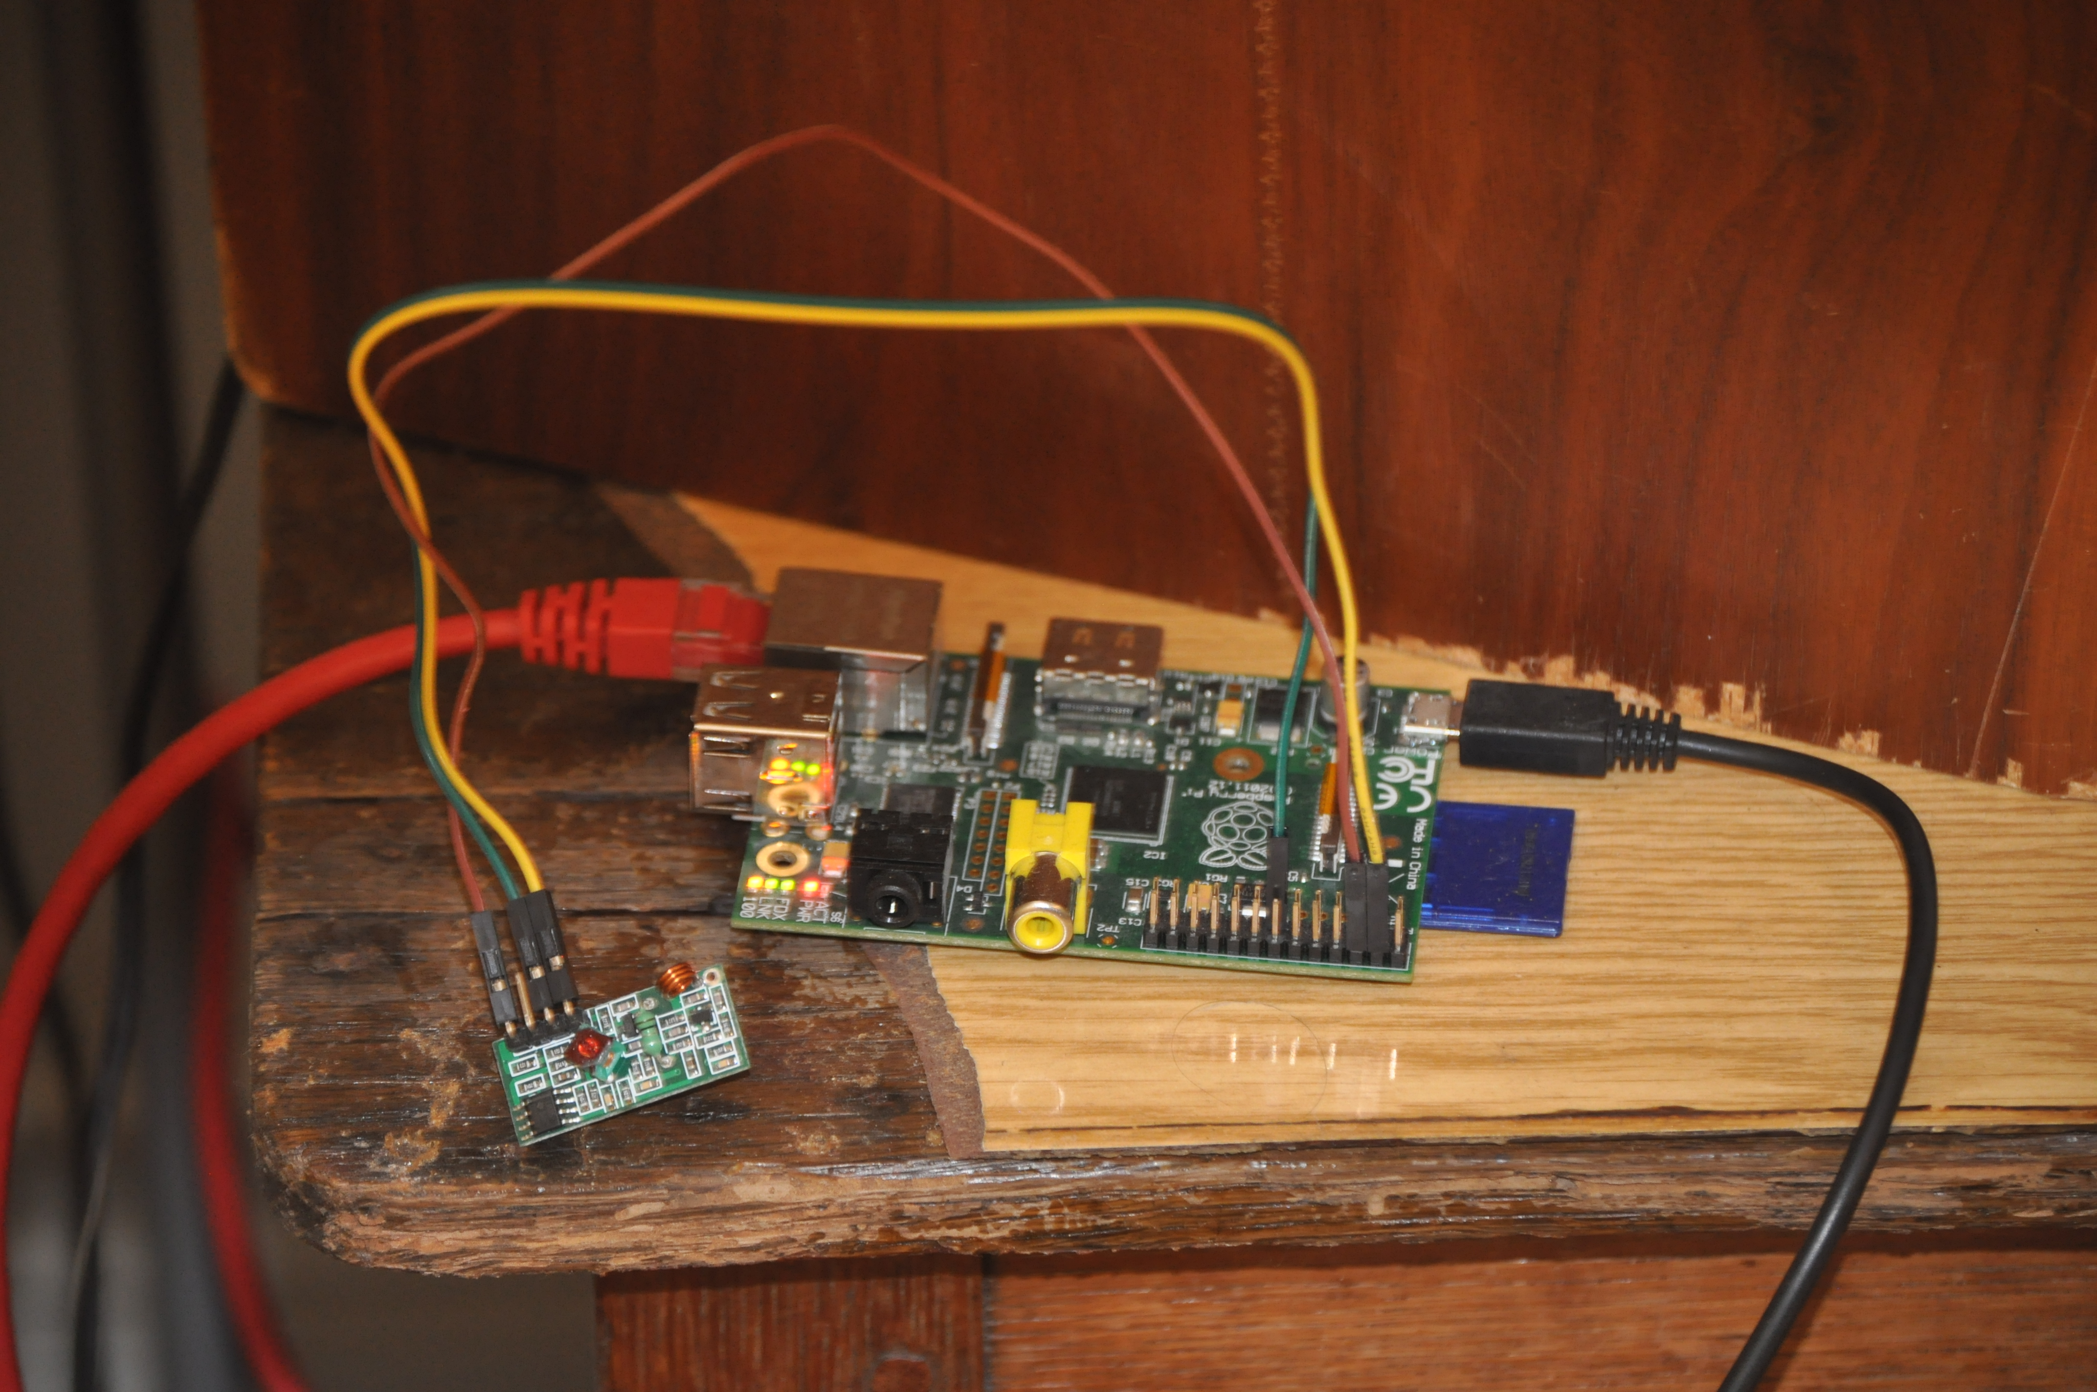
Self-Hosting

Slide 7
Sensing
Building Temperature/humidity sensors
Communication:
  Wifi
  Cables ?
Analog and Digital concepts & challenges

Slide 8
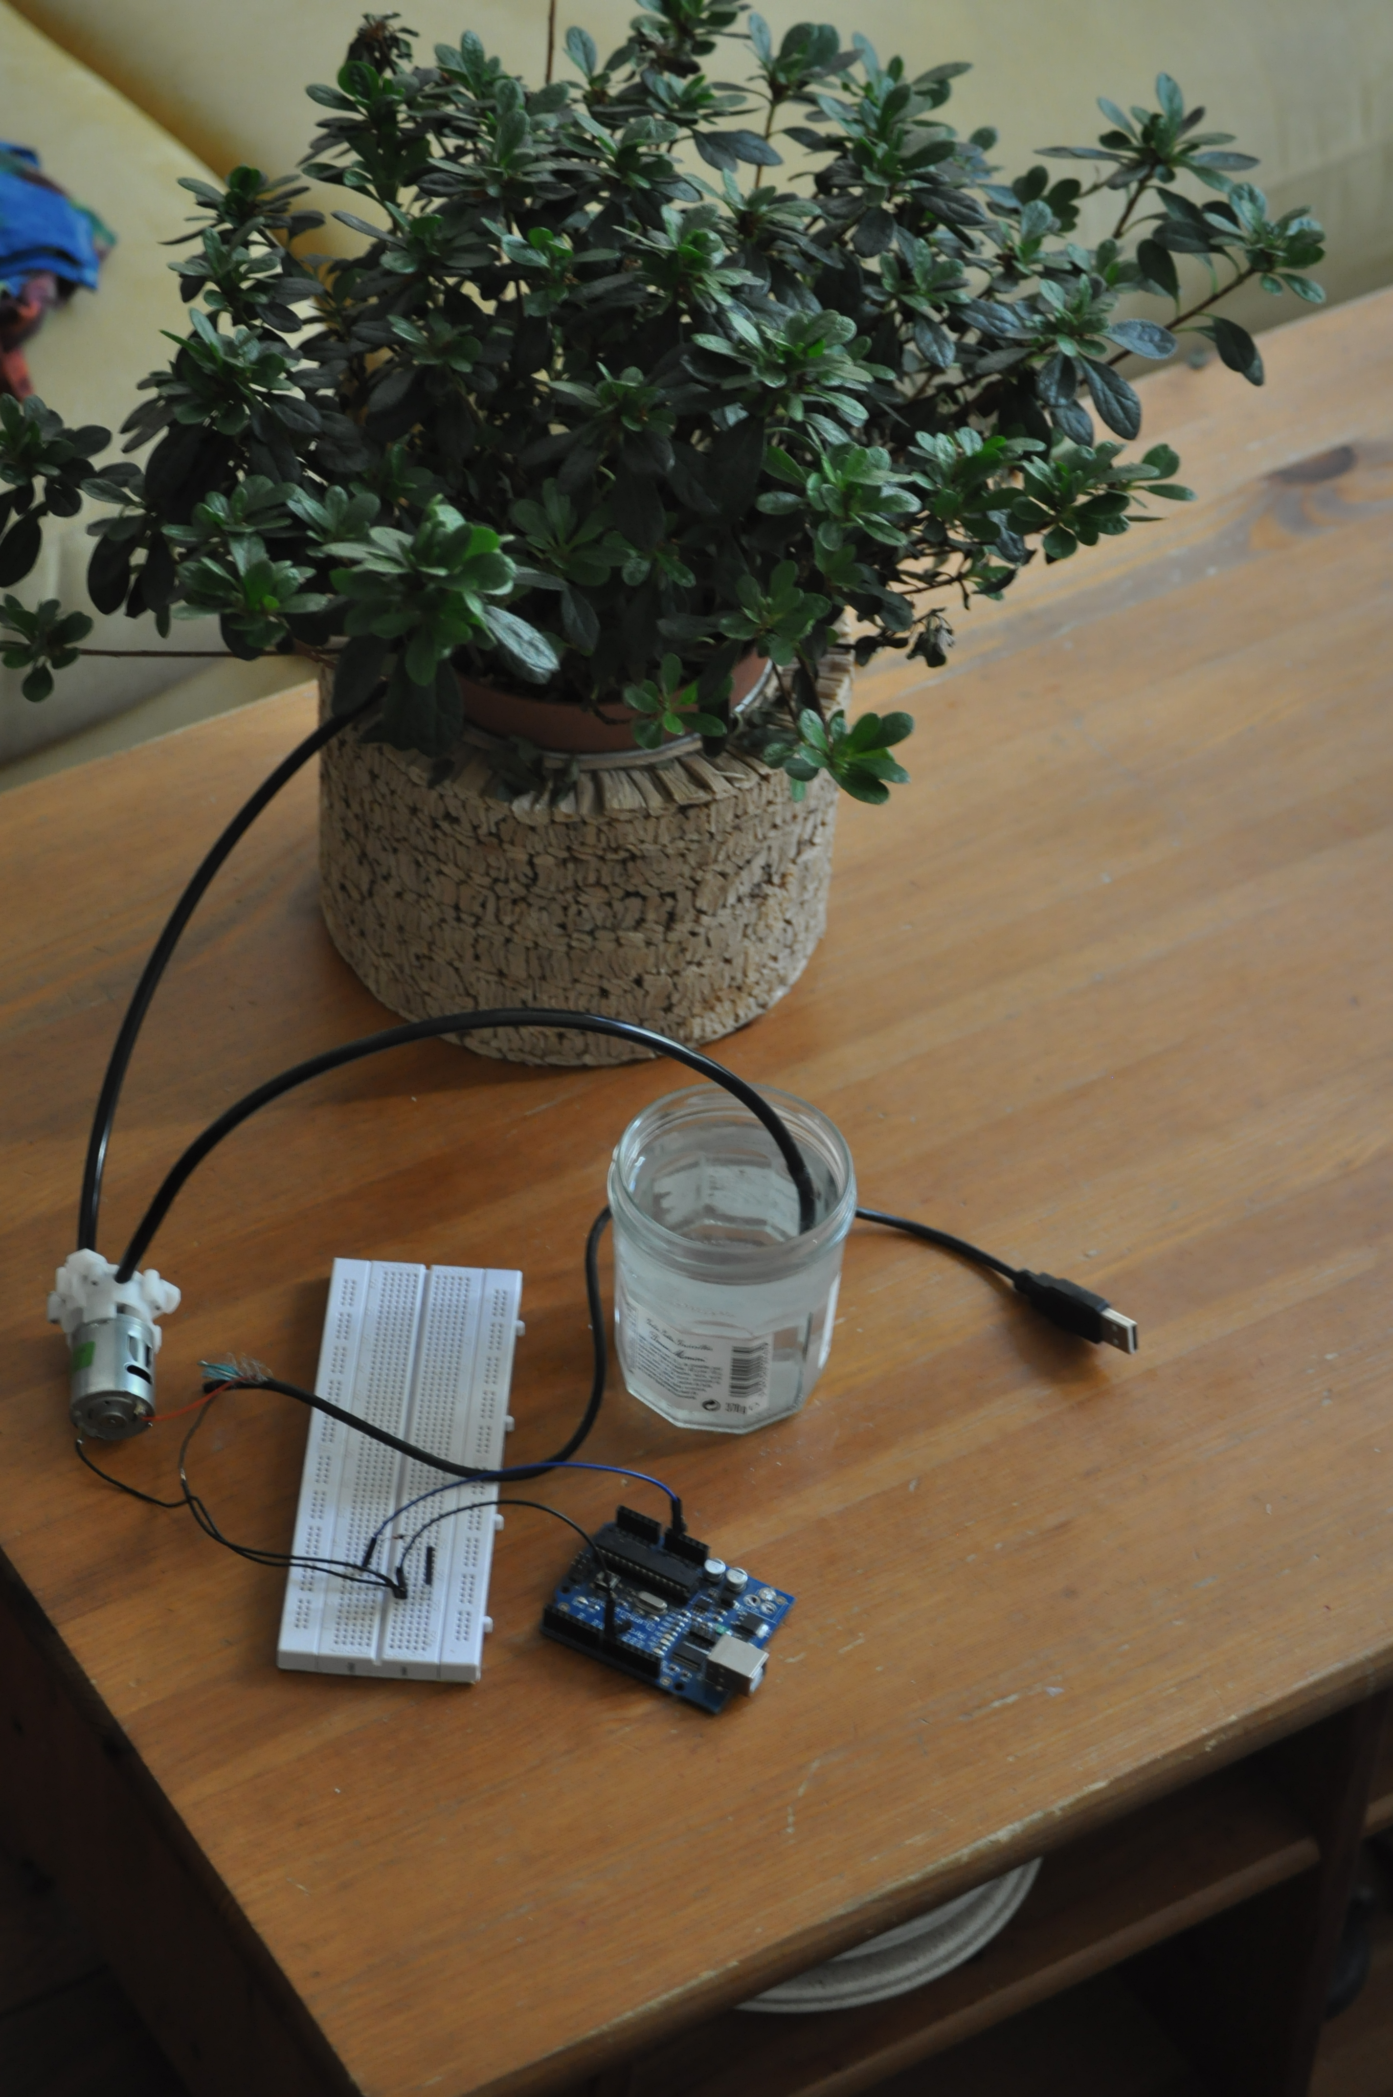
Sensing
Arduino Board
3.6V water pump
Resistor
Transistor
Diode

