Slide 1

Talk to a flower to become a part of the Internet
Hello world!

Slide 2
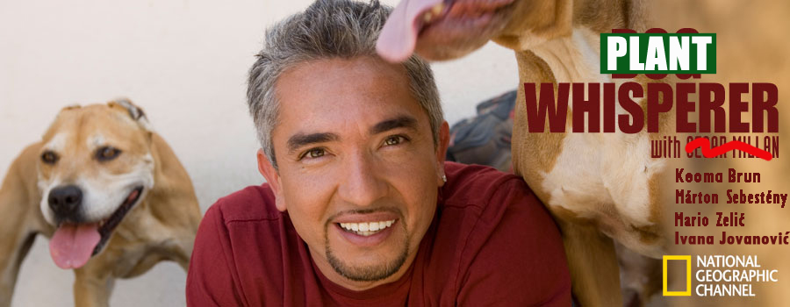
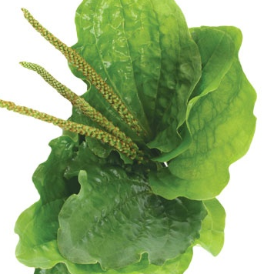

Slide 3
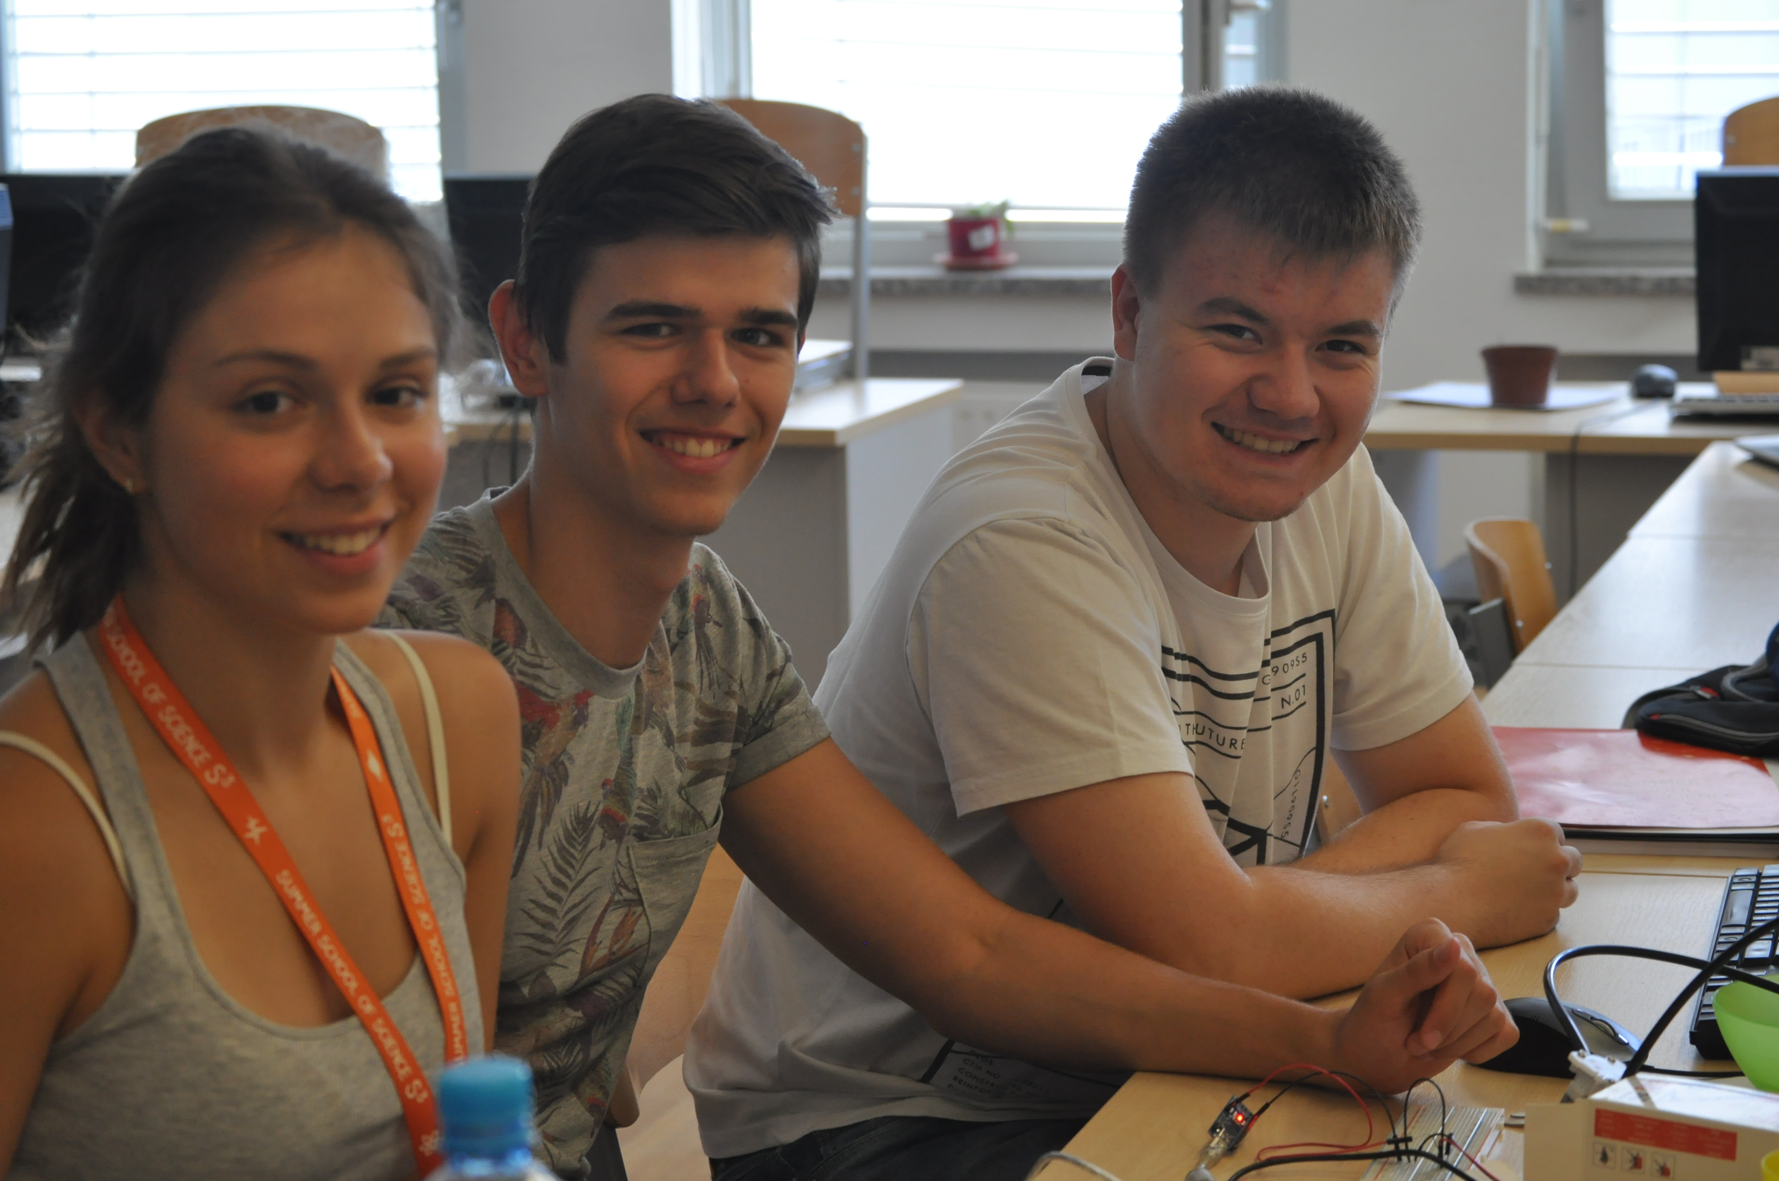
Biochemistry
Physics
Medicine

Slide 4
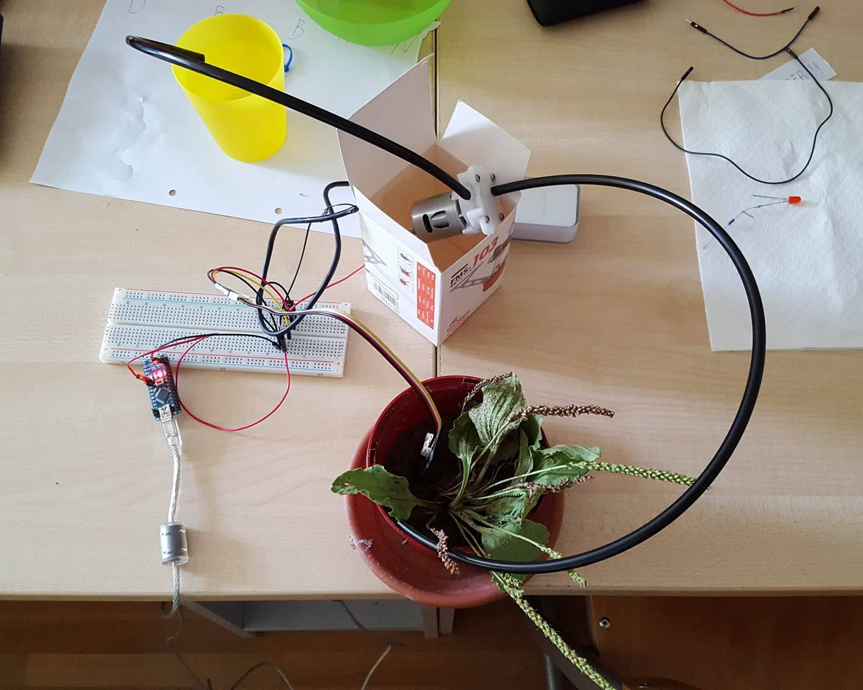
Equipment
Water pump
Battery
Arduino
Moisture sensor

Slide 5
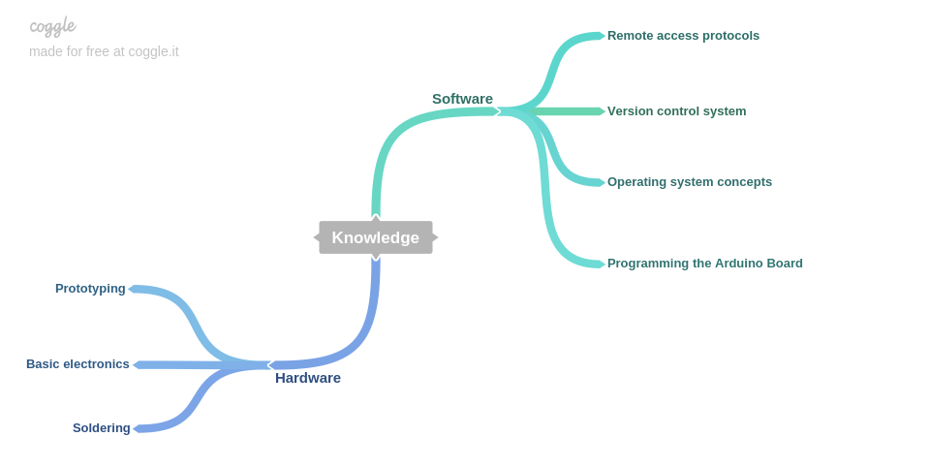
What did we learn?

Slide 6
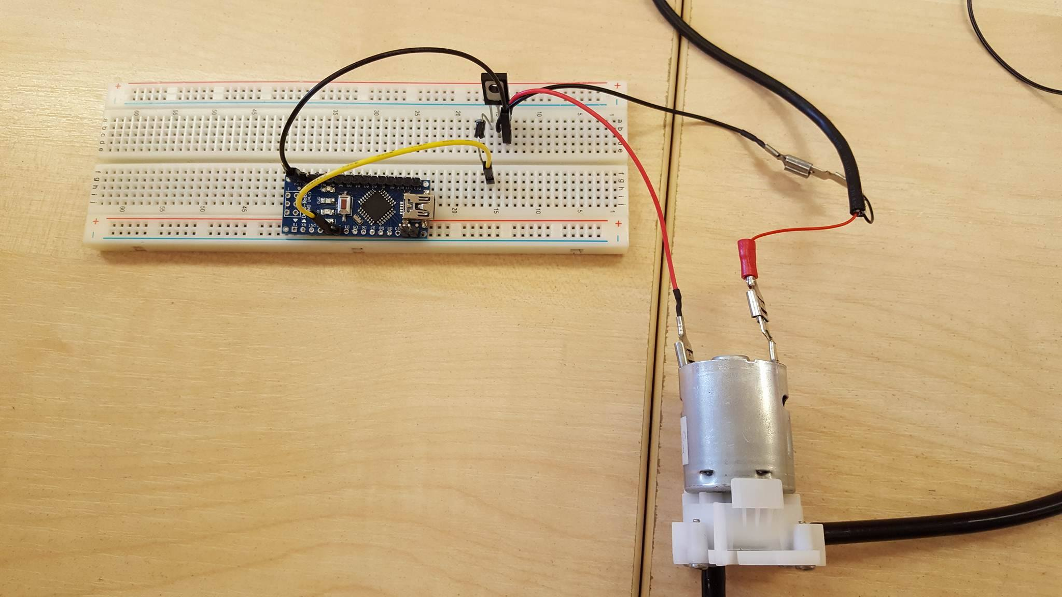
First Prototype
Automated system

Slide 7
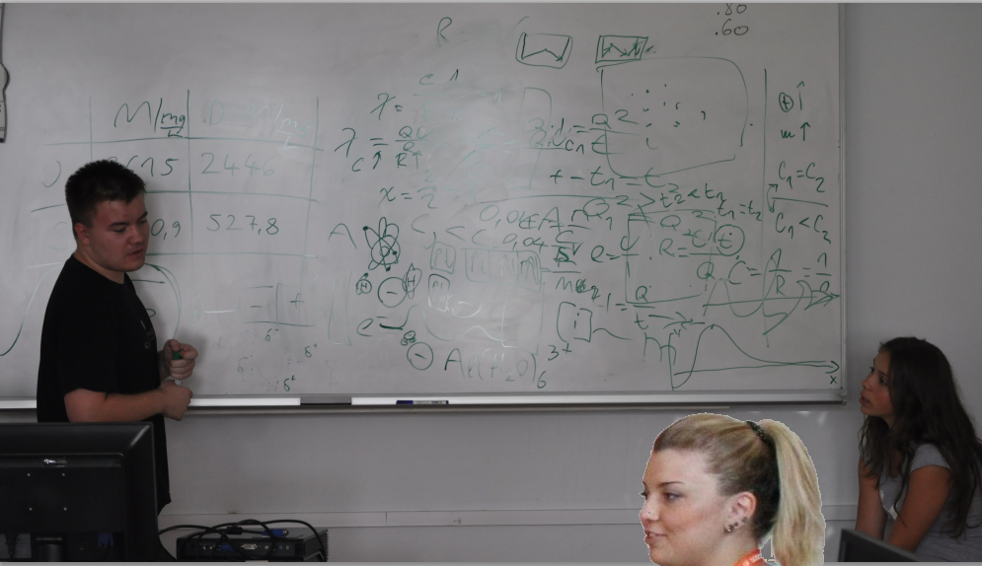
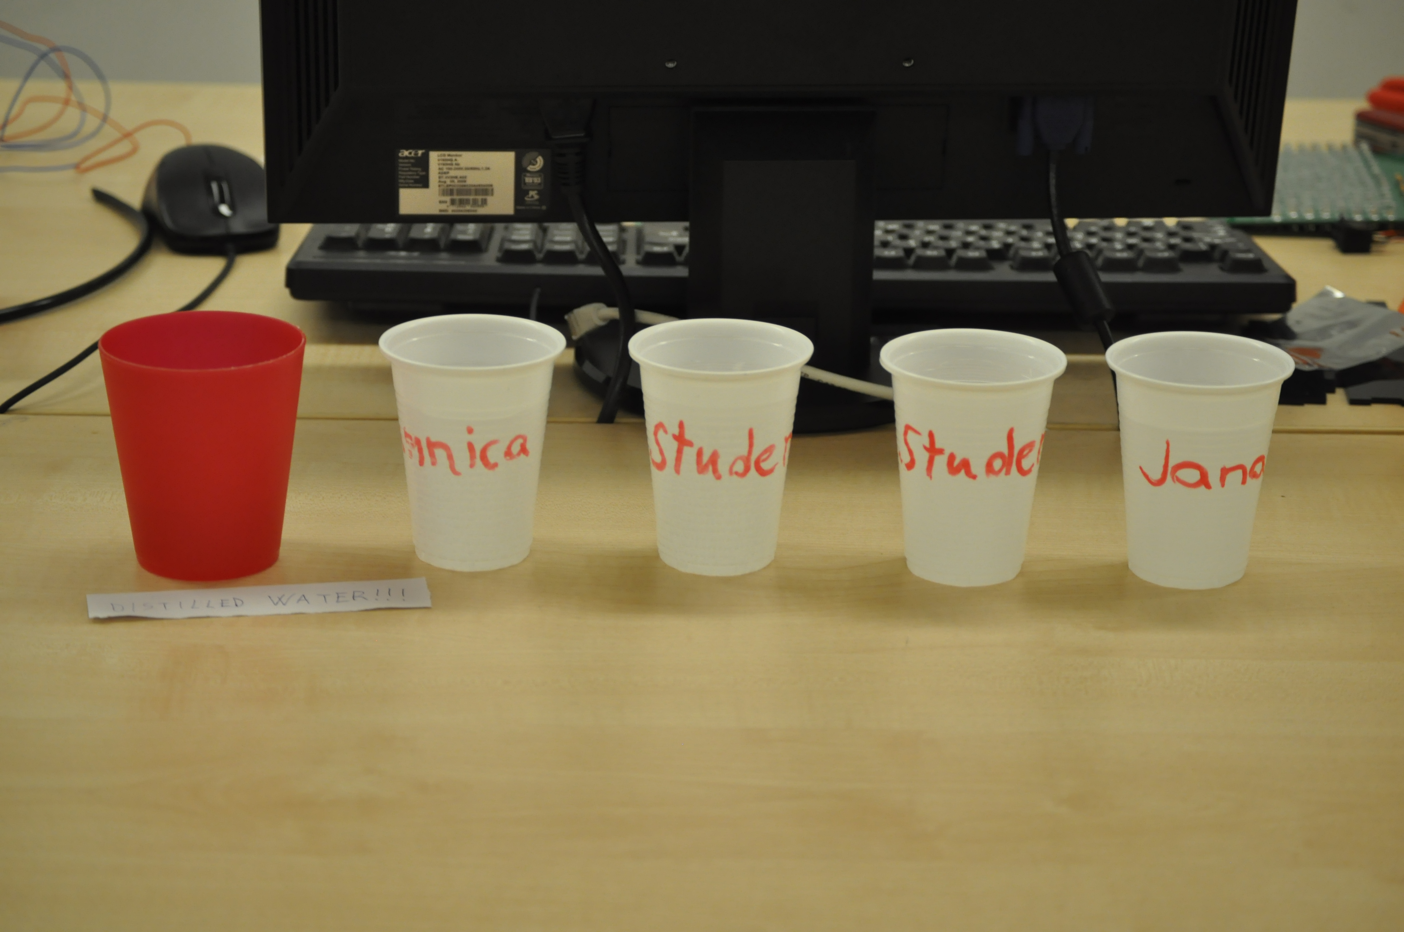
Water testing

Slide 8
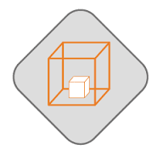
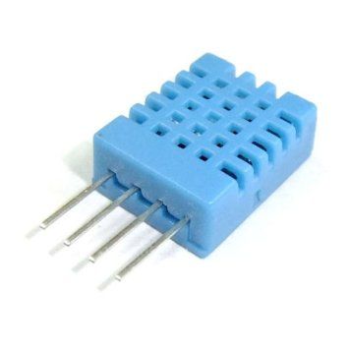
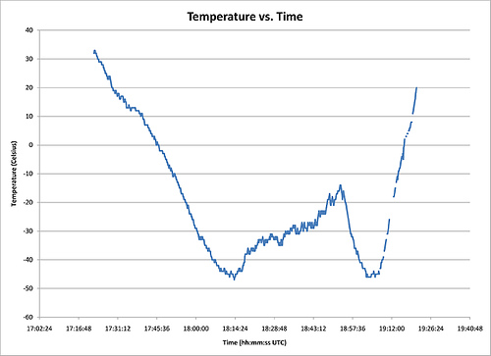
Next steps
Additional sensors
Hosting and sending data to a server
Optimization and design

Slide 9
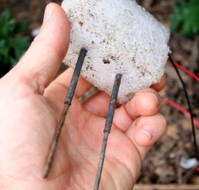
Future improvements
Building our own moisture sensor
Data analysis
Improve the Arduino code

Slide 10
Thank you! Questions?

