Slide 1
Agentic AI
Trends & Landscape · 2025–2026
Research Report · March 2026
Source: Perplexity API · Keonhee Executive Assistant

Slide 2
Key Takeaways
01
Multi-agent orchestration is the defining architecture
Single agents are being replaced by coordinated squads of specialized agents
02
Market growing at 43% CAGR
82% of Global 2000 companies plan dedicated AI orchestration budgets in 2026
03
LangGraph is the production-grade framework
Graph-based state machines — faster and more debuggable than plain LangChain
04
MCP is the "USB-C for AI"
Standardizes agent-tool connectivity — embedded in healthcare, finance, enterprise
05
Only 11% of enterprises are in production today
40%+ of agentic projects may fail by 2027 — governance is the bottleneck

Slide 3
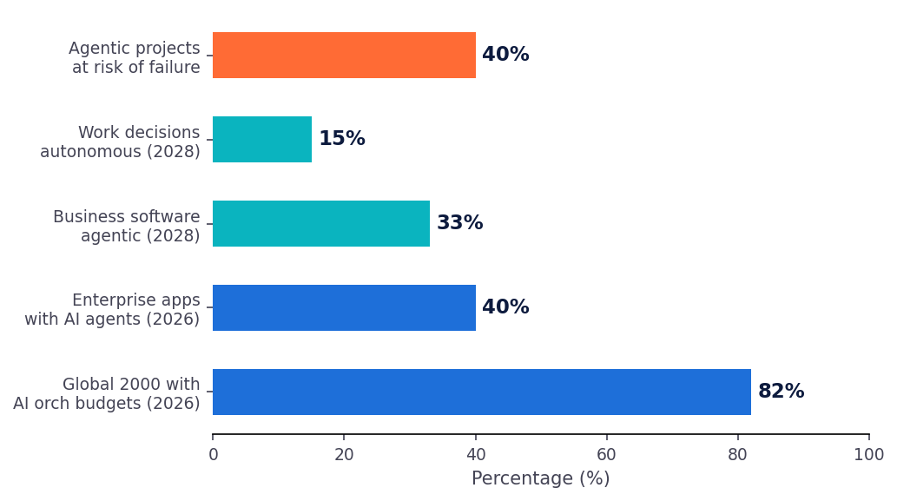
Market Outlook
$7.8B → $52B
Market size by 2030
43% CAGR
Projected growth rate
1.3B agents
Active by 2028

Slide 4
Framework Comparison
Framework
Architecture
Best For
Status
LangGraph
Graph state machine (nodes + edges)
Production agentic workflows Complex multi-step reasoning
✅ Active — preferred
LangChain
Composable chains & retrievers
Broad LLM apps Ecosystem entry point
✅ Active — foundational
CrewAI
Role-based orchestration
Structured team-like multi-agent tasks
✅ Active — strong
AutoGen
Conversation-based agent dialogue
Human-in-the-loop reasoning
⚠️ Merging into MS Agent Framework
→ Recommendation: Learn LangGraph specifically — it extends LangChain and is the production path for agentic AI in 2026

Slide 5
Model Context Protocol
The "USB-C for AI" — how agents connect to tools, data, and the world
97M
5,800+
300+
75%
Monthly SDK downloads
MCP servers available
MCP clients available
Gateway vendors integrating by 2026
Timeline
You are already building with MCP
Nov 2024
Anthropic launches MCP
Notion is connected via MCP in this project. This is the same protocol now adopted by OpenAI, Google, Microsoft, AWS, Azure, and GCP. Being able to explain MCP — what it is, why it matters, how it works — is a strong differentiator in any AI interview or consulting conversation.
Mar 2025
OpenAI officially adopts MCP
Dec 2025
Donated to Linux Foundation (Agentic AI Foundation)
2026
75% of gateway vendors expected to integrate
Source: Perplexity API · Keonhee Executive Assistant · March 2026

Slide 6
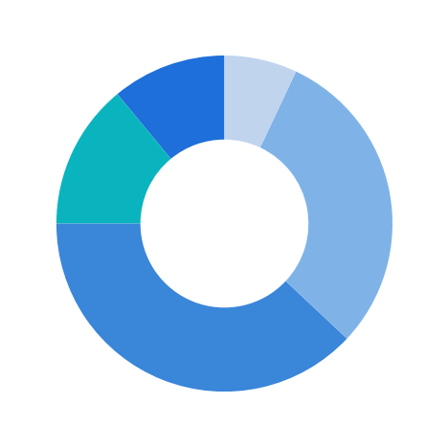
2026 Outlook & So What
So What — for Kearney
In production (11%)
The gap between exploration and production is large — firms need people who can bridge it
Ready to deploy (14%)
Piloting (38%)
Multi-agent architecture is the new org design question for strategy consultants
Exploring (30%)
No strategy (7%)
MCP is infrastructure — understanding protocols separates AI-literate advisors from AI users
2026 is when patterns come out of the lab into real business — the right moment to enter
Enterprise Readiness (Deloitte 2025)

