Slide 1
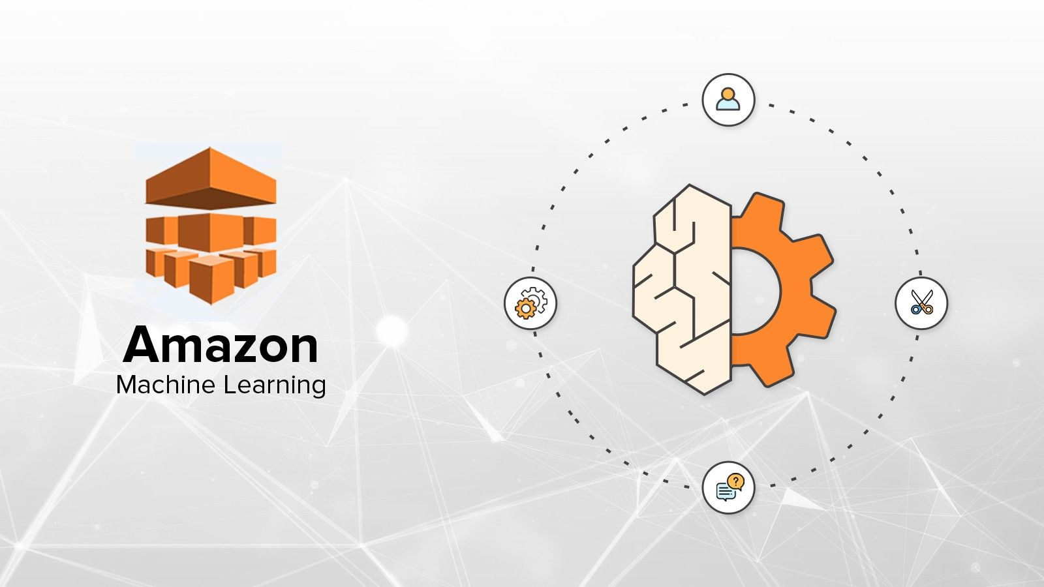
Module 9 Elective – 1 ML with AWS
By, Tahir Mirji
MTech CS

Slide 2
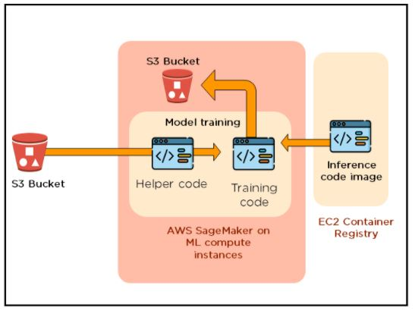
AWS SageMaker Studio to access datasets from S3 & Perform data analysis functions using AWS tools
Amazon SageMaker is a powerful, cloud-hosted Jupyter Notebook service offered by Amazon Web Services (AWS).
It’s used to create, train, and deploy machine learning models, but it’s also great for doing exploratory data analysis and prototyping.

Slide 3
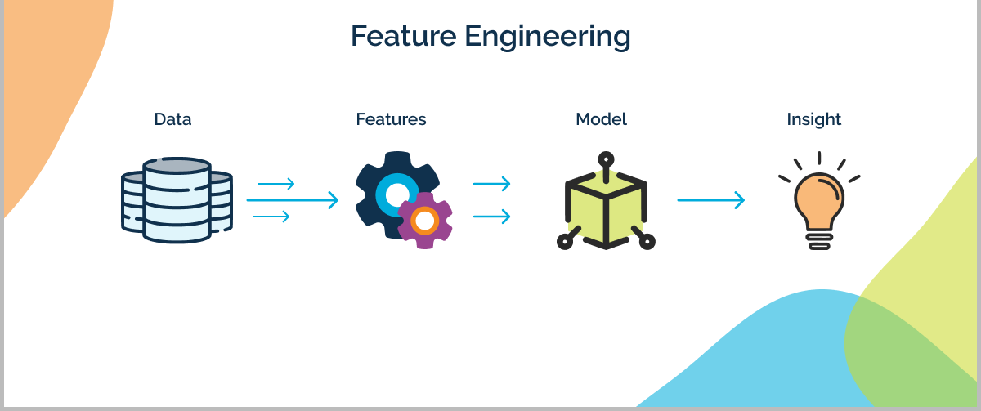
Data analysis and feature engineering with Data Wrangler
Data Wrangling is the process of gathering, collecting, and transforming Raw data into another format for better understanding, decision-making, accessing, and analysis in less time.

Slide 4
Data Wrangling in Python
Data Wrangling is a crucial topic for Data Science and Data Analysis. Pandas Framework of Python is used for Data Wrangling.
Pandas is an open-source library in Python specifically developed for Data Analysis and Data Science. It is used for processes like data sorting or filtration, Data grouping, etc.
Data wrangling in Python deals with the below functionalities:
Data exploration: In this process, the data is studied, analyzed, and understood by visualizing representations of data.
Dealing with missing values: Most of the datasets having a vast amount of data contain missing values of NaN, they are needed to be taken care of by replacing them with mean, mode, the most frequent value of the column, or simply by dropping the row having a NaN value.

Slide 5
Data Wrangling in Python
Reshaping data: In this process, data is manipulated according to the requirements, where new data can be added or pre-existing data can be modified.
Filtering data: Some times datasets are comprised of unwanted rows or columns which are required to be removed or filtered
Other: After dealing with the raw dataset with the above functionalities we get an efficient dataset as per our requirements and then it can be used for a required purpose like data analyzing, machine learning, data visualization, model training etc.

Slide 6
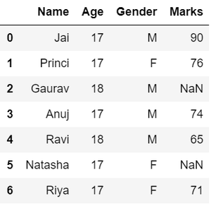
Data exploration in Python
# Import pandas package
import pandas as pd
# Assign data
data = {'Name': ['Jai', 'Princi', 'Gaurav',
'Anuj', 'Ravi', 'Natasha', 'Riya'],
'Age': [17, 17, 18, 17, 18, 17, 17],
'Gender': ['M', 'F', 'M', 'M', 'M', 'F', 'F'],
'Marks': [90, 76, 'NaN', 74, 65, 'NaN', 71]}
# Convert into DataFrame
df = pd.DataFrame(data)
# Display data
df

Slide 7
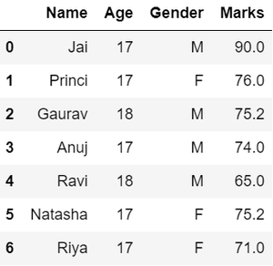
Dealing with missing values in Python
# Compute average
c = avg = 0
for ele in df['Marks']:
if str(ele).isnumeric():
c += 1
avg += ele
avg /= c
# Replace missing values
df = df.replace(to_replace="NaN", value=avg)
# Display data
df

Slide 8
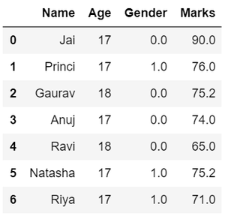
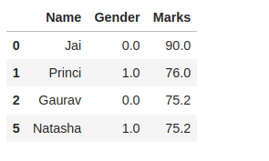
Data Replacing in Data Wrangling
# Categorize gender
df['Gender'] = df['Gender'].map({'M': 0, 'F': 1, }).astype(float)
# Display data
df
Filtering data in Data Wrangling
# Filter top scoring students
df = df[df['Marks'] >= 75].copy()
# Remove age column from filtered DataFrame
df.drop('Age', axis=1, inplace=True)
# Display data
df

Slide 9
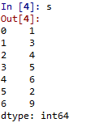
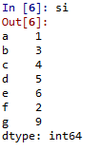
Perform data analysis and feature engineering with Pandas in SageMaker Studio
Pandas are the most popular python library that is used for data analysis. It provides highly optimized performance with back-end source code purely written in C or Python.
We can analyze data in Pandas with:
Pandas Series
Pandas DataFrames
Create Series from List
# Numeric data
Data = [1, 3, 4, 5, 6, 2, 9]
# Creating series with default index values
s = pd.Series(Data)
# predefined index values
Index = ['a', 'b', 'c', 'd', 'e', 'f', 'g']
si = pd.Series(Data, Index)

Slide 10
Label new data for a dataset with SageMaker ground truth
Amazon Sagemaker provides various services that offer labelling datasets, training the models, hyperparameters tuning, and creating inference for us to deploy.
Sagemaker offers the following services:
Ground truth
Notebook Instances
Training Jobs/Hyperparameters.
Inferences
1] Ground truth provides three services namely
Mechanical Turk workers which are useful in labelling small datasets and the labelling can be done by human workers.
Private labelling workforce, in which you have an option that the employees from your organization label the dataset
Third part vendors, as the name, implies that the datasets be labelled by some other vendors.

Slide 11
Code: Labelling job looks like which was performed on a bird image
[
{
"boundingBox": {
"boundingBoxes": [
{
"height": 845,
"label": "Bird",
"left": 54,
"top": 19,
"width": 765
}
],
"inputImageProperties": {
"height": 1024,
"width": 968
}
}
}
]

Slide 12
Load new dataset, create 3 data set types, and identify features/values in SageMaker
1. Load new dataset
import pandas as pd
import sagemaker
# Define your S3 bucket and file path for the new dataset
bucket = 'your-s3-bucket'
file_path = 'path/to/your/new_dataset.csv'
# Load the new dataset using Pandas
s3 = sagemaker.Session().default_bucket()
data_location = f's3://{bucket}/{file_path}'
new_df = pd.read_csv(data_location)
# Display the first few rows of the new dataset
new_df.head()

Slide 13
2. Create Three Dataset Types (Training, Validation, and Test)
from sklearn.model_selection import train_test_split
# Split the new dataset into training, validation, and test sets
train_df, temp_df = train_test_split(new_df, test_size=0.4, random_state=42)
val_df, test_df = train_test_split(temp_df, test_size=0.5, random_state=42)
# Display the shape of each dataset
print("Training dataset shape:", train_df.shape)
print("Validation dataset shape:", val_df.shape)
print("Test dataset shape:", test_df.shape)

Slide 14
3. Identify Features and Values
# List the column names (features) of the new dataset
features = new_df.columns.tolist()
print("Features in the new dataset:", features)
# List unique values in a specific column (e.g., 'target_column')
unique_values_target = new_df['target_column'].unique()
print("Unique values in 'target_column':", unique_values_target)

Slide 15
Train (fit) a regression/classification model using scikit-learn
# load the iris dataset as an example
from sklearn.datasets import load_iris
iris = load_iris()
# store the feature matrix (X) and response vector (y)
X = iris.data
y = iris.target
# store the feature and target names
feature_names = iris.feature_names
target_names = iris.target_names
# printing features and target names of our dataset
print("Feature names:", feature_names)
print("Target names:", target_names)
# X and y are numpy arrays
print("\nType of X is:", type(X))
# printing first 5 input rows
print("\nFirst 5 rows of X:\n", X[:5])

Slide 16
Example given below uses KNN (K nearest neighbors) classifier.
# load the iris dataset as an example
from sklearn.datasets import load_iris
iris = load_iris()
# store the feature matrix (X) and response vector (y)
X = iris.data
y = iris.target
# splitting X and y into training and testing sets
from sklearn.model_selection import train_test_split
X_train, X_test, y_train, y_test = train_test_split(X, y, test_size=0.4, random_state=1)
# training the model on training set
from sklearn.neighbors import KNeighborsClassifier
knn = KNeighborsClassifier(n_neighbors=3)
knn.fit(X_train, y_train)
# making predictions on the testing set
y_pred = knn.predict(X_test)
# comparing actual response values (y_test) with predicted response values (y_pred)
from sklearn import metrics
print("kNN model accuracy:", metrics.accuracy_score(y_test, y_pred))
# making prediction for out of sample data
sample = [[3, 5, 4, 2], [2, 3, 5, 4]]
preds = knn.predict(sample)
pred_species = [iris.target_names[p] for p in preds]
print("Predictions:", pred_species)
# saving the model
from sklearn.externals import joblib
joblib.dump(knn, 'iris_knn.pkl')

Slide 17
Evaluate a trained model using methods like mse, rmse, r2, accuracy, f1, and precision
Mean Absolute Error (MAE) MAE represents the average error between your predictions and the true values. It is expressed on the same scale as your dependent variable. For example, if your dependent variable is monthly salary and MAE = $1000, then on average your predictions are off by $1000. This may sound obvious, but it is not the case for all evaluation metrics.
scikit-learn implementation:
from sklearn.metrics import mean_absolute_error
mean_absolute_error(y_true, y_pred)
Mean Squared Error (MSE) MSE represents the variance of the residuals. In general, the smaller variance the better, however, MSE is not expressed on the same scale as the depended variable, making this metric somewhat difficult to interpret.
scikit-learn implementation:
from sklearn.metrics import mean_squared_error
mean_squared_error(y_true, y_pred)

Slide 18
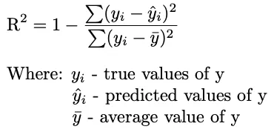
Root Mean Squared Error (RMSE)
RMSE is simply the root square of MSE, therefore, it represents the standard deviation of the residuals. RMSE is expressed on the same scale as the dependent variable, making it easier to interpret. For this reason RMSE is much more widely used than MSE.
scikit-learn implementation:
from sklearn.metrics import mean_squared_error
mean_squared_error(y_true, y_pred, squared=False)
R-squared (R²)
The coefficient of determination or R² represents the proportion of the variance in the dependent variable which is explained by the linear regression model. This metric is slightly different than the above three. It ranges from 1 to 0 (although it is possible for R² to be negative), 1 meaning your model explains all the variance, while 0 means it explains none of the variance. Negative values mean the model is doing a worse job than simply guessing the average every time.
scikit-learn implementation:
from sklearn.metrics import r2_score
r2_score(y_true, y_pred)

Slide 19
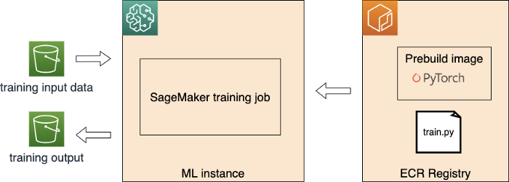
Building ML workflows
Launch training jobs within SageMaker
Prepare Your Training Script: Before you start a training job, you need to prepare a training script that defines how your model should be trained. This script should include the necessary code for loading data, defining the model architecture, specifying hyperparameters, and running the training process.
Upload Data to S3: Your training data should be stored in an S3 bucket. Upload the data to your designated S3 location.
Open SageMaker Studio:
Open Amazon SageMaker Studio.
Create a New Notebook:
In SageMaker Studio, create a new Jupyter notebook where you'll initiate and manage your training job.
Start the Training Job

Slide 20
Create Lambda functions
Creating AWS Lambda functions involves several steps, including defining the function's code, configuring triggers, and setting up permissions. Here's a general guide to creating a Lambda function:
Sign in to AWS Console: Log in to your AWS Management Console.
Open Lambda Service:
Navigate to the "Services" menu and select "Lambda" under the "Compute" section.
Create a Lambda Function:
Click on the "Create function" button.
Configure Function:
Choose the "Author from scratch" option.
Fill in the following details:
Function name: Give your function a unique name.
Runtime: Choose the programming language runtime for your function (e.g., Python, Node.js, etc.).
Role: Create a new role with basic Lambda permissions to start, and you can customize it later.
Click "Create function."
Edit Function Code:
In the "Function code" section, you can write or paste your code.
You can either directly edit the inline code editor or upload a ZIP file with your code.
Once you're done, click "Save" at the top of the page.
Configure Triggers:
In the "Designer" section, you can configure triggers that initiate your Lambda function. Triggers can be services like Amazon S3, API Gateway, Cloud Watch Events, etc.
Click "Add trigger" and configure the trigger settings as needed.

Slide 21
Set Environment Variables (Optional):
In the "Function overview" section, you can set environment variables if your Lambda function requires them.
Configure Basic Settings:
In the "Basic settings" section, you can configure memory, timeout, and other basic settings for your function.
Test the Function:
You can test your Lambda function by using the "Test" button. You can create a test event or use a sample event template.
Save and Deploy:
Once you've configured all the settings, click "Save" to save your Lambda function configuration.
Set Up Permissions:
You need to set up appropriate permissions for your Lambda function to access other AWS resources.
You can do this by configuring the function's role to have the necessary permissions.
Deploy the Function:
After completing all the necessary configurations, your Lambda function is ready to be deployed and triggered by the configured triggers

Slide 22
Trigger Lambda functions utilizing both the SDK and other AWS Services
Use the AWS SDK for Python (Boto3) to trigger a Lambda function:
1.Install Boto3: Install the Boto3 SDK using pip if you haven't already:
pip install boto3
2.Invoke Lambda Function: Use the following Python code to invoke a Lambda function:
import boto3
# Initialize the Boto3 Lambda client
lambda_client = boto3.client('lambda')
# Specify the function name and payload (input data)
function_name = 'your-lambda-function-name'
payload = '{"key": "value"}'
# Replace with your payload
response = lambda_client.invoke(
FunctionName=function_name,
InvocationType='RequestResponse', # Use 'Event' for asynchronous invocation
Payload=payload
)
print(response['StatusCode'])
print(response['Payload'].read().decode('utf-8'))

Slide 23
Triggering Lambda Functions Using Other AWS Services:
You can also trigger Lambda functions using various AWS services. Some common services that can trigger Lambda functions include:
Amazon S3: Set up an S3 bucket to trigger a Lambda function whenever a new object is uploaded.
Amazon DynamoDB: Configure a Lambda function to be triggered when items are inserted, updated, or deleted from a DynamoDB table.
Amazon API Gateway: Create an API and link it to a Lambda function, allowing HTTP requests to trigger the function.
Amazon CloudWatch Events: Schedule a Lambda function to run at specific intervals using CloudWatch Events.
Amazon SNS: Use SNS topics to publish messages that trigger Lambda functions.
Amazon SQS: Set up an SQS queue as a Lambda trigger to process messages from the queue.

Slide 24
Design and execute a workflow utilizing State Machines
Step 1: Design the State Machine
Identify States: Break down your workflow into individual steps or states. Each state represents a specific action or task.
Define Transitions: Define how the states are connected to each other. You'll specify the conditions for transitioning from one state to another.
Add Error Handling: Include error handling states to handle potential failures or exceptions in your workflow.
Choose Input/Output Data: Determine what data needs to be passed between states and how data transformations occur.
Here's an example state machine definition in Amazon States Language (ASL) that demonstrates a simple workflow:
{
"StartAt": "FetchData",
"States": {
"FetchData": {
"Type": "Task",
"Resource": "arn:aws:lambda:REGION:ACCOUNT_ID:function:FetchDataFunction",
"End": true
}
}
}

Slide 25
Step 2: Create and Execute the State Machine
Open AWS Step Functions Console:
Navigate to the AWS Management Console.
Under "Services," select "Step Functions."
Create State Machine:
Click the "Create state machine" button.
Enter a name for the state machine.
In the "Definition" section, enter the ASL definition for your state machine.
Configure Execution Role:
You'll need to define or choose an IAM role that Step Functions can assume to execute your workflow.
Start Execution:
Click the "Create state machine" button to create the state machine.
Once created, you can start an execution by clicking the "Start execution" button.
Provide any input data required for the execution.
Monitor Execution:
You can monitor the execution of your state machine in the AWS Step Functions console.
View details, logs, and state transitions

Slide 26
Use SageMaker Feature Store to serve and monitor model data
Step 1: Store Features in SageMaker Feature Store
Create a Feature Group:
In the SageMaker console, navigate to the "Feature Store" section and create a new feature group.
Define the feature group's schema, specifying the feature names, data types, and other metadata.
Ingest Feature Data:
Ingest feature data into the feature group from various sources such as Amazon S3, Redshift, and more.
You can batch ingest data or set up automatic ingestion from your data sources.
Step 2: Model Training and Serving
Retrieve Features for Model Training:
When training your machine learning model, you can retrieve features from the feature group using the SageMaker Python SDK
from sagemaker.feature_store.feature_group import FeatureGroup
# Create a FeatureGroup object
feature_group = FeatureGroup(name="your-feature-group-name")
# Load features into a DataFrame
feature_data = feature_group.load_feature_definitions()

Slide 27
Step 3: Monitor and Analyze Feature Data
Enable Data Capture:
Enable data capture for the deployed SageMaker endpoint. This will capture incoming requests and responses.
from sagemaker.model_monitor import DataCaptureConfig
data_capture_config = DataCaptureConfig(
enable_capture=True,
sampling_percentage=100,
destination_s3_uri="s3://your-bucket/captured-data"
)
predictor.update_data_capture_config(data_capture_config=data_capture_config)
Analyze Captured Data:
You can use Amazon S3 and Amazon Athena to analyze the captured data and monitor the quality and distribution of your features.
Set Up Model Monitoring:
Use SageMaker Model Monitor to set up monitoring for your deployed model's endpoints.
Monitor data quality, data drift, and other metrics over time.

Slide 28
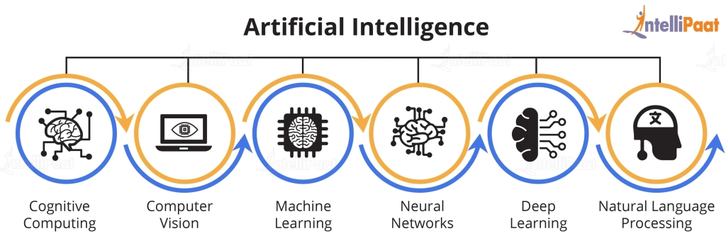
Deep Learning with Computer Vision and NLP
Fine-Tuning Image Classification Model:
Data Preparation:
Organize your image dataset into appropriate directories for different classes.
Use image augmentation techniques to create variations of your training data.
Create an Image Classification Model:
Use a pre-trained deep learning model (e.g., ResNet, MobileNet) available in SageMaker's built-in algorithms or bring your own model.
Fine-Tuning:
Use transfer learning to fine-tune the pre-trained model on your specific image classification task.
Define your output layer with the appropriate number of classes.
Training:
Set up a SageMaker training job, specifying the model, hyperparameters, data channels, etc.
Model Deployment:
Deploy the trained model using SageMaker endpoint.
Inference:
Use the deployed endpoint to perform inference on new images

Slide 29
Fine-Tuning Text Classification Model:
Data Preparation:
Prepare your text data, tokenize it, and create appropriate labels.
Create a Text Classification Model:
Use a pre-trained embedding model like Word2Vec, GloVe, or use SageMaker's built-in text models.
Fine-Tuning:
Fine-tune the pre-trained model using your labeled text data.
Adjust the model architecture and hyperparameters as needed.
Training:
Set up a SageMaker training job, specifying the model, hyperparameters, data channels, etc.
Model Deployment:
Deploy the trained model using SageMaker endpoint.
Inference:
Use the deployed endpoint to perform inference on new text samples.

Slide 30
Debug and profile training jobs using SageMaker Debugger
Amazon SageMaker Debugger is a tool that helps you debug, profile, and monitor machine learning training jobs to identify and diagnose issues that might affect training performance or convergence.
Here's how you can use SageMaker Debugger to debug and profile your training jobs:
Step 1: Import Required Libraries
In your SageMaker training script or notebook, import the necessary libraries:
import sagemaker
from sagemaker.debugger import DebuggerHookConfig, CollectionConfig

Slide 31
Step 2: Configure Debugger Hook
Configure the SageMaker Debugger hook with the desired debugging and profiling configurations. You can collect various types of data during training, such as weights, gradients, tensors, and more.
# Create a DebuggerHookConfig
debugger_hook_config = DebuggerHookConfig(
collection_configs=[
CollectionConfig("weights"),
CollectionConfig("gradients"),
CollectionConfig("biases"),
# Add more collections as needed
]
)
Step 3: Create an Estimator with Debugger
When creating your SageMaker Estimator, include the DebuggerHookConfig in the estimator's hyperparameters.
# Create a SageMaker Estimator with Debugger
estimator = sagemaker.estimator.Estimator(
role="your-role",
instance_count=1,
instance_type="ml.m5.large",
image_uri="your-training-image-uri",
debugger_hook_config=debugger_hook_config,
# Other hyperparameters
)

Slide 32
Step 4: Start Training with Debugger
Start the training job as you normally would. The Debugger hook will automatically start collecting the specified data during training.
# Start the training job
estimator.fit(inputs=data_channels)
Step 5: Analyze Debugger Outputs
After the training job is completed, you can analyze the collected data using the SageMaker Debugger analysis tools:
SageMaker Debugger Analysis Notebook:
Open the SageMaker Debugger Analysis Notebook in SageMaker Studio.
Select the training job and the desired collections to analyze.
SageMaker Debugger Analysis SDK:
Use the SageMaker Debugger Analysis SDK to programmatically analyze the data collected during training.

Slide 33
Package a model in a Dockerfile for deployment
Packaging a machine learning model in a Docker container is a common way to deploy models consistently across different environments. Here's a general guide on how to create a Docker container for deploying your machine learning model:
Step 1: Prepare Your Model and Dependencies
Export Your Model:
Save or export your trained machine learning model in a format that can be loaded by your deployment code. Common formats include TensorFlow SavedModel, ONNX, or serialized model files.
Create Deployment Code:
Write the deployment code that loads the model and exposes an interface for making predictions.
Create a Requirements File:
Create a requirements.txt file listing the dependencies required for your deployment code to run.

Slide 34
Step 2: Create a Dockerfile
Create a Dockerfile in your project directory. This file defines the steps to build your Docker image.
# Use a base image with the required dependencies
FROM python:3.8-slim
# Set the working directory inside the container
WORKDIR /app
# Copy the requirements file into the container
COPY requirements.txt .
# Install the required dependencies
RUN pip install --no-cache-dir -r requirements.txt
# Copy the deployment code and model files into the container
COPY . .
# Set the command to run when the container starts
CMD ["python", "app.py"]

Slide 35
Step 3: Build the Docker Image
In the same directory as your Dockerfile, open a terminal and run the following command to build your Docker image:
docker build -t your-image-name .
Step 4: Run the Docker Container
Once the image is built, you can run the Docker container using the following command:
docker run -p 8080:8080 your-image-name
Step 5: Access the Model Endpoint
Your deployment code inside the Docker container should expose a REST API or some form of interface for making predictions. You can access this API by sending HTTP requests to http://localhost:8080 or the appropriate URL if you're deploying the container to a remote environment

Slide 36
Thank
you

