Slide 1

BotCatch: A Behavior and Signature
Correlated Bot Detection Approach
Yuede Ji, Qiang Li, Yukun He and Dong Guo
Jilin University
11/13/2013

Slide 2
OUTLINE
INTRODUCTION
THE PROPOSED APPROACH
EXPERIMENTAL EVALUATION
DISCUSSION
CONCLUSION

Slide 3
OUTLINE
INTRODUCTION
THE PROPOSED APPROACH
EXPERIMENTAL EVALUATION
DISCUSSION
CONCLUSION

Slide 4



What is botnet and bot?
Botnet is a network composed by a large scale of infected hosts under the control of botmaster through Command and Control (C&C) channel.
Bot is the infected host.
Bot
Bot
Bot
Botmaster
C&C Infrastructure
Infected Hosts

Slide 5
What is botnet and bot?
3 basic elements:
Bot, C&C channel, botmaster
Various C&C channels
Centralized: IRC, HTTP
Decentralized: peer-to-peer(P2P)
A major threat to Internet security
DDoS, spam, identity theft, phishing

Slide 6
Existing Detection Approaches
Network-based
Analyze network traffic to filter out the bot host
Host-based
Signature-based approach
extracts the feature information of the suspicious program to match with a knowledge database
Behavior-based approach
Monitors the abnormal behaviors on host to determine whether the host is infected

Slide 7
The Problem
Signature VS. Behavior
 | Advantage | Disadvantage
Signature-based | Low risk Low false positives Low overhead | Unable to detect novel bots Unable to deal with obfuscations Require a lot of prior knowledge
Behavior-based | Can detect novel bots Can deal with obfuscations Perform real-time detection | High risk Low detection accuracy High overhead
A question occurred
-Is it better if we combine these two approaches?
BotCatch
-Combine behavior and signature detection to overcome their drawbacks.

Slide 8
OUTLINE
INTRODUCTION
THE PROPOSED APPROACH
EXPERIMENTAL EVALUATION
DISCUSSION
CONCLUSION

Slide 9
System architecture of BotCatch

Slide 10
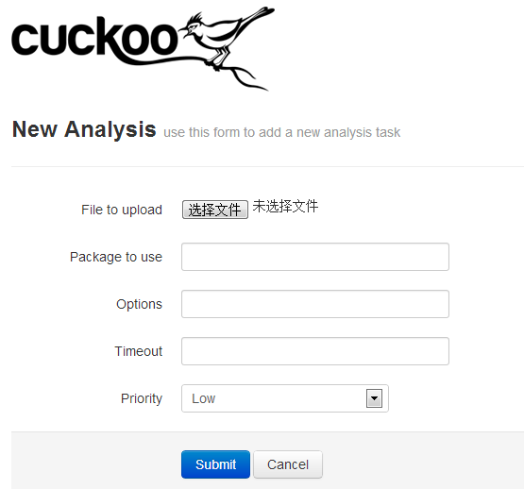
M1: Analysis Engine
Submission interface
3 ways: web, submission API, database interface
Schedule
Assigns the sample to signature and behavior analysis engine.

Slide 11
M2: Signature Analysis Engine
Submit the sample to virustotal
a free online service that analyzes files and URLs using popular antivirus engines and website scanners.
return the result of about 47 different antivirus engines
Signature result: d/47

Slide 12
M3: Behavior Analysis Engine
Run the suspicious sample in an isolated environment.
Monitor the Registry, file system, and network behaviors to generate the behavior feature vector.
Index | Feature Description
1 | Creation or Modification of AutoRun Key in Registry
2 | Creation or Modification of Process Injection Key in Registry
3 | Creation or Modification of Other Critical Registry Key
4 | DLL Creation into System Directory
5 | EXE Creation into System Directory
6 | Modification of Files in System Directory
7 | Creation of Other Files in System Directory
8 | Number of Ports Opened
9 | Number of Suspicious Ports
10 | Number of Unique IPs Contacted
11 | Number of Suspicious IP

Slide 13

M3: Behavior Analysis Engine
Use Support Vector Machine (SVM)
Need a more accurate value about how likely a feature vector belongs to a particular class, not only the label result (malicious or benign)
Calibrate the distance score to a posterior classification probability.
Three variants: A, B, f

Slide 14
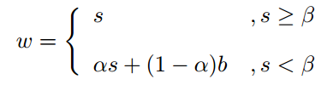
M4: Correlation Engine
Input
behavior suspicion value b
signature suspicion value s
Output
Compare w with a threshold to determine malicious or benign

Slide 15
Feedback mechanism
Object
Dynamic guide the learning procedure of behavior analysis engine.
Procedure
between behavior and correlation engine
Specifically for the samples, signature returns high ratio, while behavior returns a low value.
Then we can flag the samples as malicious and add it to the retraining set.
Gradually make our approach more accurate

Slide 16
OUTLINE
INTRODUCTION
THE PROPOSED APPROACH
EXPERIMENTAL EVALUATION
DISCUSSION
CONCLUSION

Slide 17
Implementation
Use cuckoo as our analysis system
a leading open source automated malware analysis system.
http://www.cuckoosandbox.org/
Binaries
collected from Open Malware
http://www.cuckoosandbox.org/
625 binaries, about 237 are ineffective, 388 samples (338 bots and 50 benign)

Slide 18
Experiments
We make three experiments:
signature-based bot detection
behavior-based bot detection
behavior and signature correlated bot detection
In behavior-based bot detection experiment, we divide the samples into 10 groups, 9 of them are used for training, and the rest 1 is for evaluation.

Slide 19
Experiment Results
 | False Positive Rate (FP) | False Negative Rate(FN)
Signature Detection | 0% | 1.78%
Behavior Detection | 16.7% | 0%
Correlated Detection | 5.56% | 0%
Signature has 0% FP;
Correlated approach decreases FP to 5.56%
Correlated approach can have a better detection accuracy

Slide 20
OUTLINE
INTRODUCTION
THE PROPOSED APPROACH
EXPERIMENTAL EVALUATION
DISCUSSION
CONCLUSION

Slide 21
Discussion
Correlation engine
Can get a well detection result
A little straightforward
Not well enough to balance the weights of signature and behavior in different situations
Feedback mechanism
An interesting mechanism
Can get a well imaginable result
Need further theoretical proof and evaluation

Slide 22
OUTLINE
INTRODUCTION
THE PROPOSED APPROACH
EXPERIMENTAL EVALUATION
DISCUSSION
CONCLUSION

Slide 23
CONCLUSION
Correlated detection approach can get a better detection result than pure signature or pure behavior.
Need a lot of further works…

Slide 24
Thanks!
Questions?

