Slide 1

GNNExplainer: Generating Explanations for Graph Neural Networks
Rex Ying, Dylan Bourgeois, Jiaxuan You, Marinka Zitnik, Jure Leskovec

Slide 2

Introduction
GNN
Graph Neural Network (GNN) is a family of powerful machine learning (ML) models for graphs that can combine node information with the structural information.
One downside of GNNs is that their predictions are hard to interpret.
The paper proposes GNN Explainer model for solving the problem of interpretability.

Slide 3
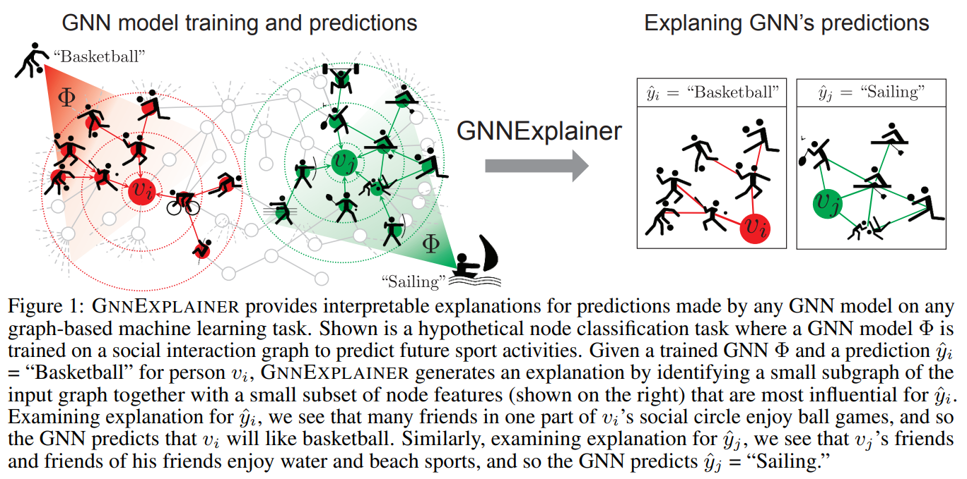
Introduction

Slide 4
Desiderata for GNN explanations
Local edge fidelity
Local node fidelity
Identify the subgraph structure (ideally the smallest) that significantly affected the predictions of the GNN. i.e. identify the important edges in the graph (for a given prediction).
Identify the import node features and correlations in the features of the neighboring nodes.
Single instance and multi-instance explanations
Model/task agnostic
Support a large family of models/tasks (ideally all)
Support both single instance prediction tasks and multi-instance prediction tasks.

Slide 5
Approach
Input
Trained GNN, a single instance whose prediction is to be explained.
Task
Identify the small subgraph and the small subset of features that explain the prediction.
Idea
Maximize the mutual information (MI) between the GNN and the explanation by learning a graph mask which can be used for selecting the relevant subgraph (from the GNN’s computational graph) and features (from all layers of the GNN).

Slide 6
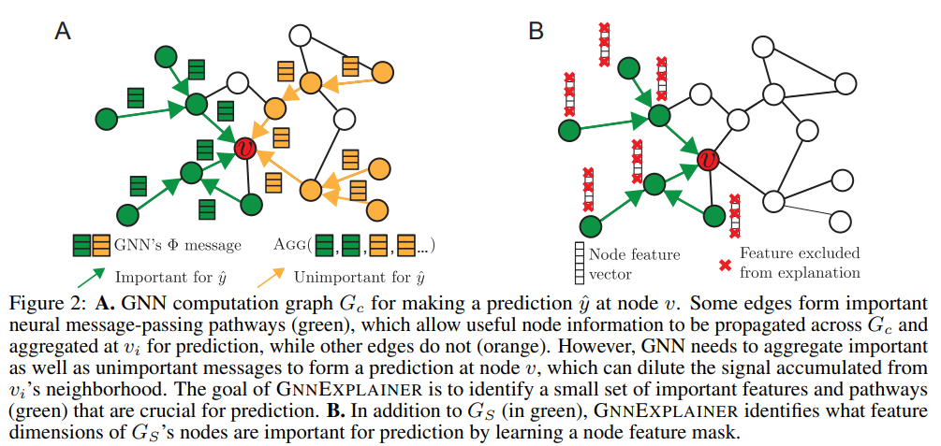
Approach
Computational graph of GNN (corresponding to a node) refers to the approximately L-hop neighborhood of the node in the graph i.e. the subgraph formed by nodes and edges whose representation affected the representation of the given node.

Slide 7
Single-Instance Explanations
For a node v, the information used to predict its label y is completely described by its computation graph G_{c}(v) and the associated feature set X_{c}(v). The feature set includes the features of all the nodes in the computation graph.
When constructing the explanation, only G_{c}(v) and X_{c}(v) are used.
The task can be reformulated as identifying a subgraph G_{S} (subset of G_{c}(v)) with associated features X_{S} which are important when predicting the label y for node v.
“Importance” is measured in terms of MI

Slide 8
Single-Instance Explanations
MI(Y, (G_{S}, X_{S})) = H(Y) - H(Y | G = G_{S}, X = X_{S}) where H is the entropy and Y is a random variable representing the prediction.
| G_{S}| < k
A further constraint, | G_{S}| < k is imposed to obtain concise explanations.
H(Y | G = G_{S}, X = X_{S})

Slide 9
Single-Instance Explanations
MI(Y, (G_{S}, X_{S})) = H(Y) - H(Y | G = G_{S}, X = X_{S}) where H is the entropy and Y is a random variable representing the prediction.
| G_{S}| < k
H(Y | G = G_{S}, X = X_{S})
Since H(Y) is fixed (recall that the network has already been trained and is now being used in the inference mode), maximizing MI is equivalent to minimizing the conditional entropy H(Y | G = G_{S}, X = X_{S}).

Slide 10
Single-Instance Explanations
MI(Y, (G_{S}, X_{S})) = H(Y) - H(Y | G = G_{S}, X = X_{S}) where H is the entropy and Y is a random variable representing the prediction.
| G_{S}| < k
H(Y | G = G_{S}, X = X_{S})
This is equivalent to selecting the subgraph that minimizes the uncertainty in the prediction of y when the computational graph is G_{c}(v).

Slide 11
Optimization Process
Jensen inequality, mean-field variational approximation and multivariate Bernoulli distribution
Approximation for Entropy
Top-K of M
①
②
③
④
Relaxed Adjacency Matrix
Mask Matrix M
The “relaxed” G_{S} can be interpreted as a variational approximation of the subgraph distributions of G_{c}(v) and the objective can be written as min E_{GS}H(Y | G = G_{S}, X = X_{S})
Given the constraints on A_{S}, it is easier to learn a mask matrix M and optimize that such that A_{S} = M * A_{c}. Additionally, the sigmoid operator can be applied on M.
Notes:
Given the exponentially large number of possible subgraphs, we can not directly optimize the given equation.
A “relaxed”-adjacency matrix (whose values are real numbers in the range 0 to 1) is introduced where each element of this fractional adjacency matrix is smaller than the corresponding element of the original adjacency matrix. Gradient descent can be performed on this adjacency matrix.

Slide 12
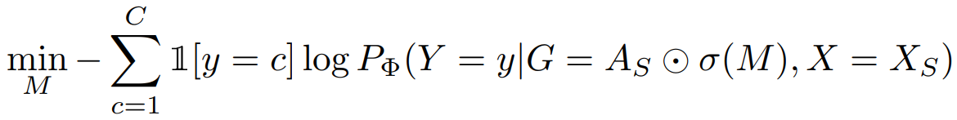
Optimization Process
Notes:
Given the exponentially large number of possible subgraphs, we can not directly optimize the given equation.
A “relaxed”-adjacency matrix (whose values are real numbers in the range 0 to 1) is introduced where each element of this fractional adjacency matrix is smaller than the corresponding element of the original adjacency matrix. Gradient descent can be performed on this adjacency matrix.

Slide 13
Including Node Features in the Explanation
Similar to the previous approach, another feature mask is learned (either one for entire GNN or one per node of the GNN) and is used as a feature selector.
Just like before, a “relaxed” mask M_{T} is trained to select features as M_{T} * X_{S}.
One tricky case is where one feature is important but its value is set close to 0. In the case, the value will be masked even though it should not be.
The workaround is to use Monte Carlo (MC) estimates of marginals of the missing features. This gives a way to assign importance scores to each feature dimension and a form of reparameterization trick is used to perform end-to-end learning.

Slide 14
Multi-Instance Explanations
Reference node
Related alignment
①
②
③
④
A set of nodes (having the label say y)
Compute importance
Given a set of nodes (having the label say y), the task is to obtain a global explanation of the predictions.

Slide 15
Multi-Instance Explanations
For the given class, a prototypical reference node is chosen by computing the mean of embeddings of all the nodes in the class and then selecting the node which is closest to the mean.
Reference node
Related alignment
①
②
③
④
A set of nodes (having the label say y)
Compute importance

Slide 16
Multi-Instance Explanations
Reference node
Related alignment
①
②
③
④
A set of nodes (having the label say y)
Compute importance
Now, compute the important computational graph corresponding to this node and align the computational subgraphs of all the other nodes (in the given class) to reference.

Slide 17
Let A* be the adjacency matrix and X* be the feature matrix for the explanation corresponding to the reference node. Let A_{v} and X_{v} be the adjacency matrix and feature matrix of the to-be-aligned computational graph.
A related alignment matrix P is optimized to align the nodes and features in the two graphs i.e. we minimize |P^{T}A_{v}P - A*| + |P^{T}X_{v} - X*|
Multi-Instance Explanations
Reference node
Related alignment
①
②
③
④
A set of nodes (having the label say y)
Compute importance
Notes:
Choosing concise explanations helps in efficient graph matching.
For GNNs that compute attention over the entire graph, edges with low attention weight can be pruned to increase efficiency.

Slide 18
Experiment
Datasets
Node classification: BA-Shapes, BA-Community, Tree-Cycles, Tree-Grid
Graph classification: MUTAG, Reddit-Binary
Baselines
GRAD - Compute the gradient of the model loss with respect to the adjacency matrix and the node features to be classified and fix the edges with the highest absolute gradient.
GAT - Graph Attention Network

Slide 19
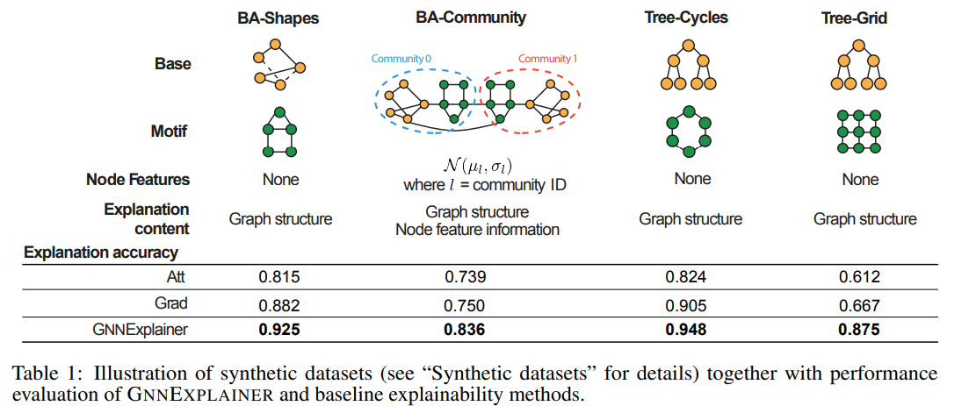
Experiment

Slide 20
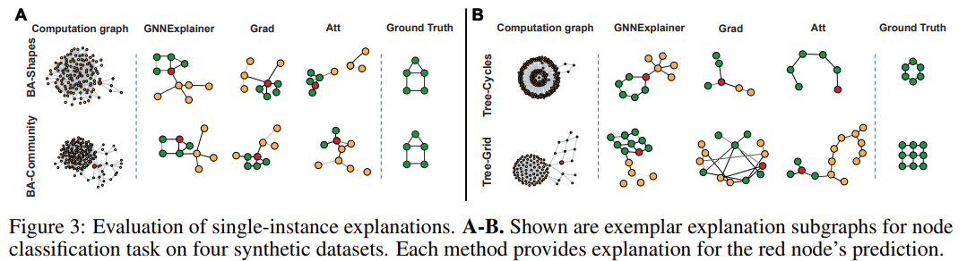
Experiment

Slide 21
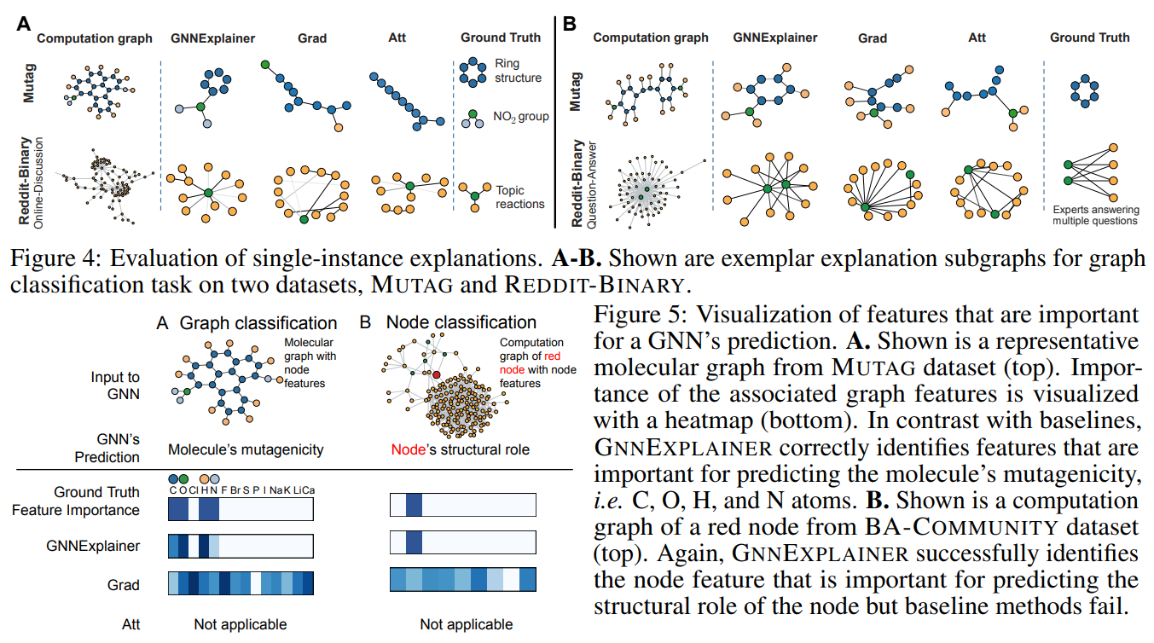
Experiment

Slide 22
Drawbacks
The proposed model seems to outperform the baselines both qualitatively and quantitatively. But the results should be taken with a grain of salt as only 2 baselines are considered.
The experiment does not specify which GNN they are using and compare the performance by using different black-boxes.
Why not use loss function instead of conditional entropy?
No explanation for features whose values are zero
No explanation for overall feature importance.

Slide 23

Questions
Suggestions

