Slide 1
TLPGNN: A Lightweight Two-Level Parallelism Paradigm for Graph Neural Network Computation on GPU
Qiang Fu Yuede Ji Howie Huang
George Washington University
University of North Texas

Slide 2
Outline
Backgrounds
TLPGNN
Future works

Slide 3

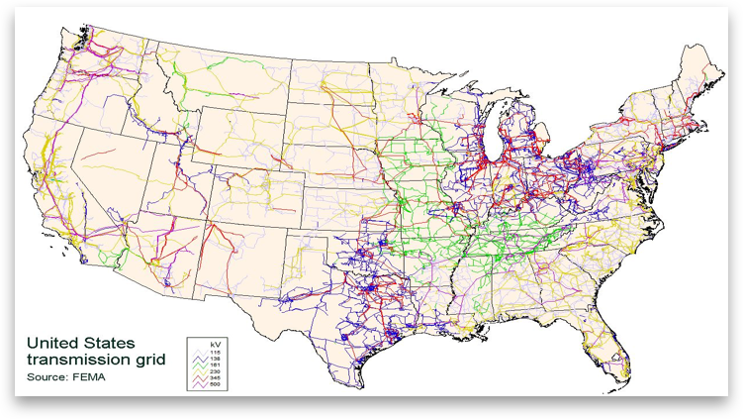
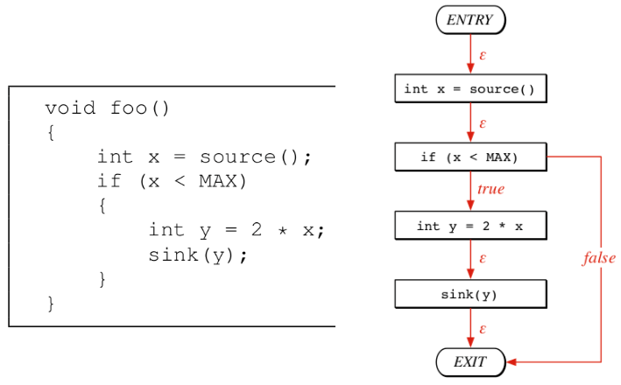
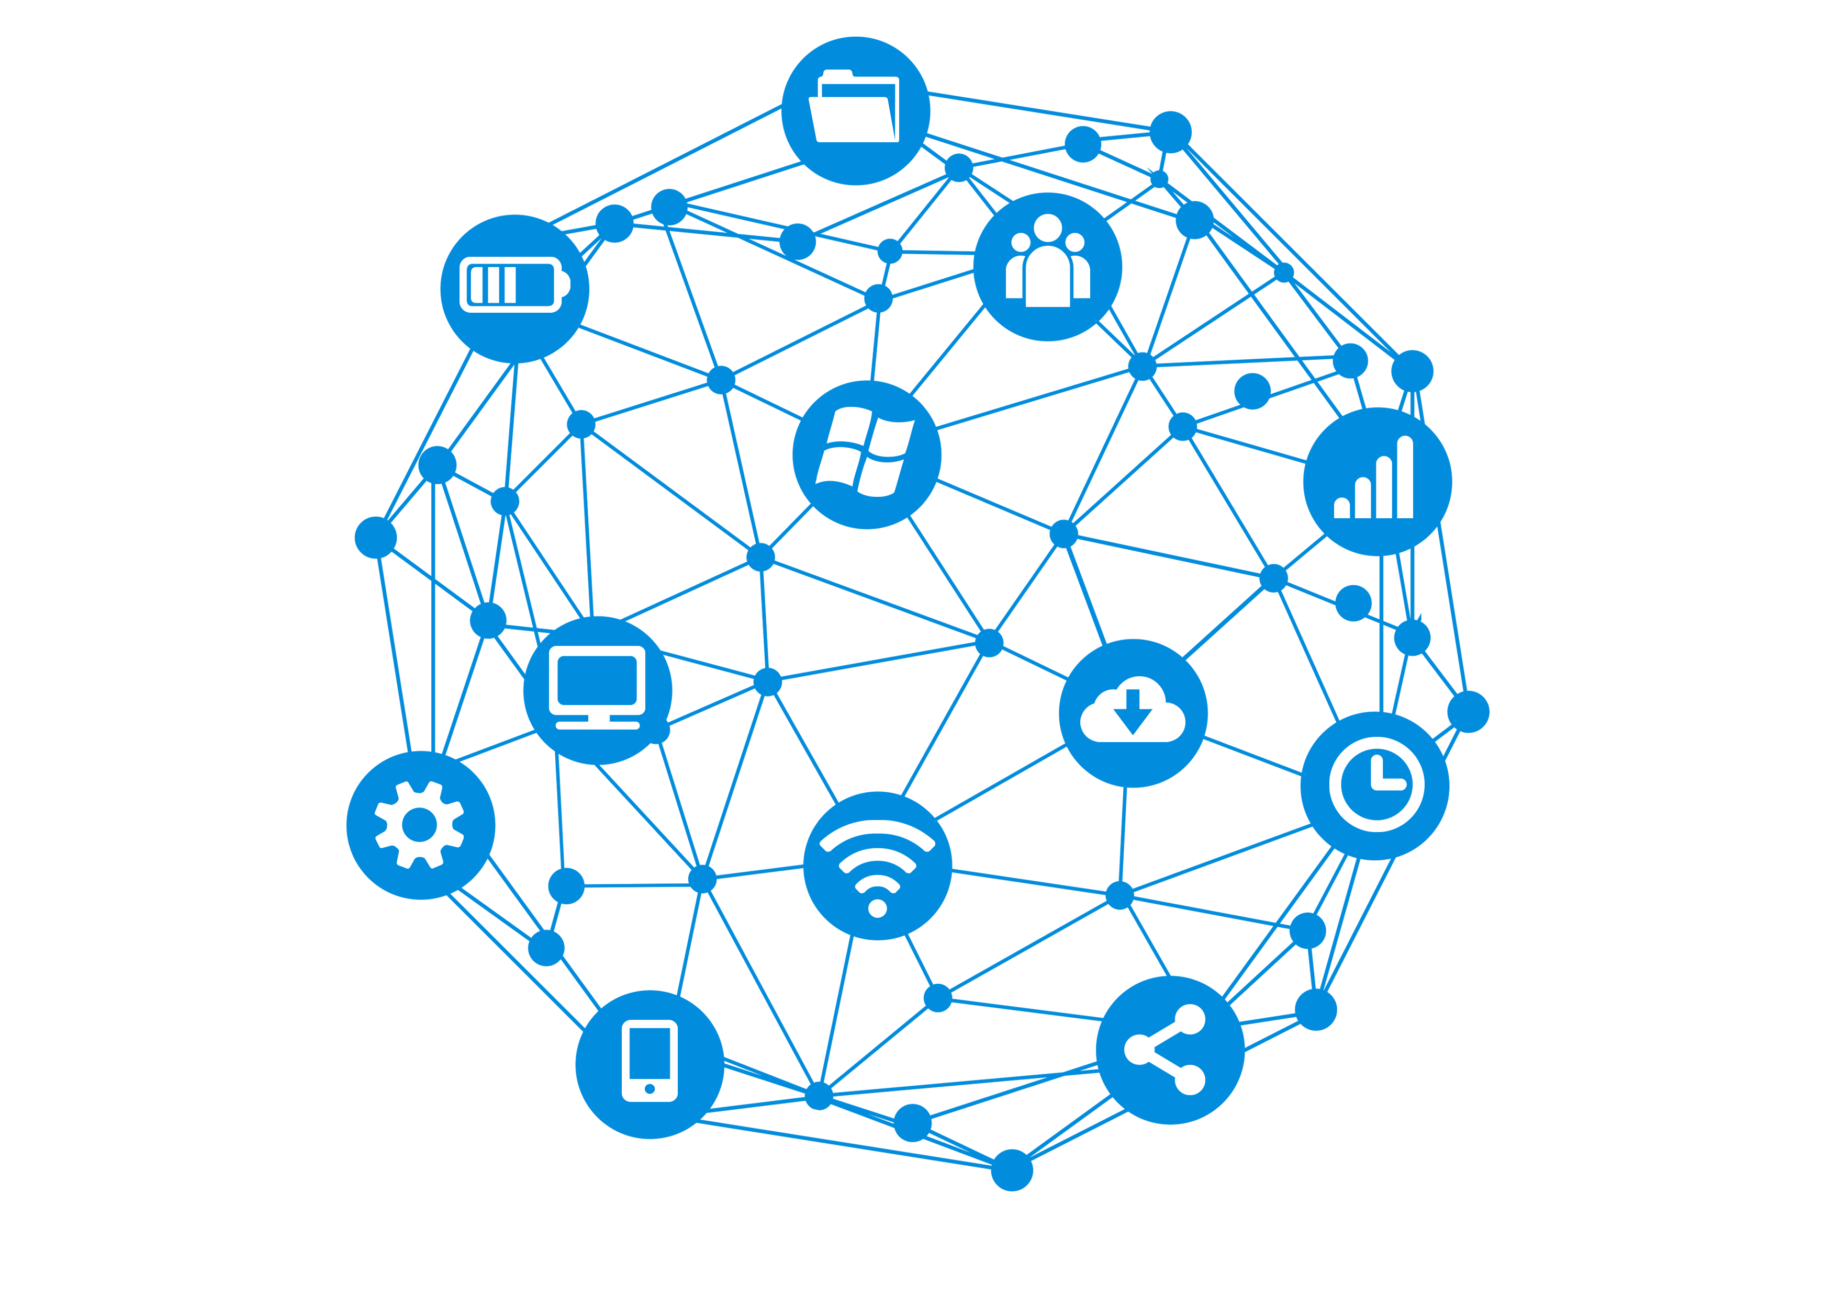
Graph is Everywhere
Notes:
Graph is made up of vertex and edge. It is a natural representation for many real-world applications.
For example, in the social network, every person is a vertex, the connection between two persons is an edge.
In code analysis, taking every statement as a vertex, the control flows between them as an edge, you can get a control flow graph.
Graphs can also be found in many other applications, such as map and internet communication networks as shown in the slides.

Slide 4

Graph Neural Networks (GNNs)
GNNs take as input graph and initial embedding.
Go through a series of convolution layers.
Output new embeddings incorporating graph structure information.
Successful application in social network mining, recommender system, molecule analysis etc.
Layer
1
…
Layer
n
Input graph
with embeddings
Output
new embeddings
GNN layers
Notes:
In recent years, graph neural networks are getting more and more popular.
The basic idea of them is to apply deep learning method on graph data structures.
First, we have input graph and initial embeddings associated with vertices or edges. Then the input data will go through a series of graph convolutional layers, similar with traditional deep neural networks. At last, GNN will output new embeddings incorporating graph structure information.
The output of Graph neural networks can be used in many applications, such as social network mining, recommender system, and molecule analysis.

Slide 5

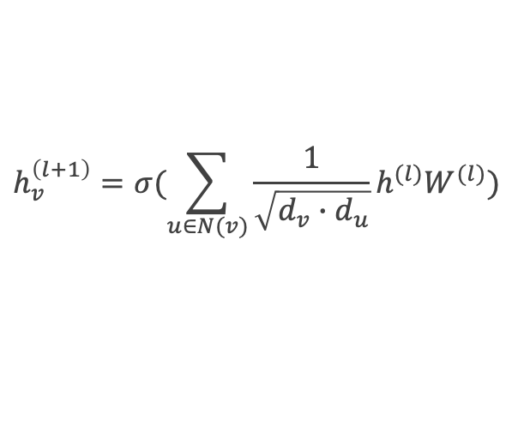
Computation in Each Layer of GNNs
Each vertex computes a new embedding by aggregating features (messages) from its neighbors.
Inputs: graph data (csr, csc etc.); feature matrix (each row for each vertex).
Example: Graph Convolution Network (GCN)
$$=φ( )$$
$$h_{v}^{\left(l+1\right)}=σ(\sum_{u∈N(v)}{\frac{1}{\sqrt{d_{v}∙d_{u}}}h^{(l)}W^{(l)}})$$
Notes:
The computation in each layer of GNNs follows a message passing paradigm.
That is, each vertex gathers the feature vectors of all its neighbors and the associated edges, applies the operations such as matrix multiplication, and combines the results with its own features to produce a new feature vector for the next layer.
Here we use Graph Convolution Network (GCN) as an example, which performs the weighted-sum aggregation on all neighbors’ features.
The formular shows the computation happened in each layer of GCN.

Slide 6
Cuda: Programming GPU
Thread hierarchy
Cuda thread
Thread block
Grid (kernel)
Each cuda thread is independent from others in the programming model.
Cuda allows you to define different control flow path in different cuda thread.

Slide 7

Warp: Gap between Model and Execution
Warp:
Every adjacent 32 cuda threads are grouped into a warp and assigned to a SIMD core.
The cuda threads in the same warp always execute the same instruction over different data.
…
…
…
…
…
SIMD core
SIMD core
SIMD core
SIMD core

Slide 8


Branch Divergence
Instructions
0
1
2
3
30
31
0
1
2
3
30
31
0
1
2
3
30
31
0
1
2
3
30
31
…
…
…
…
if ( … )
{
// then-clause
}
else
{
// else-clause
}
…
…
…
…
…
…
…
…
…
Coherent Execution
Divergent Execution

Slide 9
Global Memory Access
warp
Global memory requests are executed per warp
32 cuda threads in a warp provide memory address (in byte).
Hardware locates the line addresses in which those memory addresses fall
Then the hardware issues one or more transactions to the global memory to retrieve the data.
Coalesced memory access
All memory address fall into only a few lines
Best: one line. Worst: 32 lines
…
Memory address
…
Memory Controller
Line address
…
Global Memory (DRAM)

Slide 10
Coalesced vs Uncoalesced Access
Coalesced Access
Warp needs 32 bytes
32 bytes move across bus on a miss
Bus utilization: 100%
Uncoalesced Access
Warp needs 32 bytes
4 * 32 bytes move across bus on 4 misses
Bus utilization: 25%
Addresses requested from a warp
…
0
32
64
96
128
Memory addresses
Coalesced Access
Addresses requested from a warp
…
0
32
64
96
128
Memory addresses
Uncoalesced Access

Slide 11
Overview of TLPGNN
Profiling the existing GNN programs
Nvidia nsight compute
Performance metrics
Understanding the bottleneck
Atomic operations
Memory access
Kernel launch
Propose our new solutions for better performance
Two-level parallelism
Kernel fusion
…
Profiling GNN Programs on GPU
Understanding the bottleneck
New solutions

Slide 12
Atomic Operations
Atomic operations
Existing works use atomic operation for better workload balance.
Introducing extra overhead for memory access.
Observations
Using atomic operations increase the memory atomic store traffics
Making each warp spends more cycle waiting for data from memory.
Lower the performance.
Metrics | Push | Edge | GnnA. | Pull
Runtime (ms) | 3.3 | 2.8 | 10.4 | 1.8
Mem atomic traffics (GB) | 1.3 | 1.3 | 2.9 | 0.0
Stall for long scoreboard (cycle) | 36.7 | 80.1 | 45.1 | 26.5
SM utilization | 14.3% | 17.4% | 23.5% | 41.1%

Slide 13
Coalesced Memory Access
Implementations with coalesced memory access load small numbers of sector per request.
Then decrease the cycles waiting for data from memory.
Better for performance.
Metrics | One Thread | Half Warp (16)
Runtime (ms) | 434.9 | 15.9
Sector per request | 9.2 | 2.1
Long scoreboard (cycle) | 251.8 | 75.2

Slide 14
Kernel launches
Using less kernels can avoid kernel launch overhead and reduce DRAM usage.
Using less kernels means using registers to save intermediate data.
Avoid unnecessary memory load and store
Better for performance.
Metrics | DGL | Three Kernel | One Kernel
GPU kernel launch | 18 | 3 | 1
Runtime (ms) | 122 | 74.6 | 16.1
Launch overhead (ms) | 20 | 3.69 | 0.5
DRAM usage (GB) | 10 | 2.8 | 1.5
Memory traffics (GB) | 35.9 | 19.5 | 4.8
Stall for long scoreboard (cycle) | 241.4 | 241.1 | 18.0
SM utilization | 13.8% | 6.7% | 51.7%

Slide 15






Two-level Parallelism
First level of Parallelism
Mapping each vertex to one warp for process
Benefits
No atomic operations
No branch divergence
…
…
$$v0$$
$$Warp_{0}$$
…
…
$$v1$$
$$Warp_{1}$$
…
…
…
$$vn$$
$$Warp_{n}$$

Slide 16

Two-level Parallelism
Second level of Parallelism
In each warp, one thread process one dimension of the feature vector.
Benefits
No atomic operations
Coalesced memory access
$$v$$

Slide 17
Optimizations
Dynamic workload assignment
Dynamically assign the workload of each vertex to warp to avoid the workload imbalance.
Kernel Fusion
Using single kernel to avoid intermediate data and the unnecessary data load and store to global memory.

Slide 18
Performance Improvement
Average 5.6x, 7.7x and 3.3x speedup over DGL, GNNAdvisor, and FeatGraph.

Slide 19
Future Works
TLPGNN applies all the optimizations manually by writing Cuda codes.
Future works
Design a programming interface for GNN definition.
Build a compiler to automatically generate high-performance code for GNN computations.

Slide 20
Thank You

