Slide 2
Note
Course project
Deadline extension?
Homework
HW3 will be out next week
Same two weeks due
Nov. 13th midnight
Midterm
Class on Nov. 14th is cancelled (SC Week)
The content will be covered later.

Slide 3
Outline
Dynamic Programming
Definition
Applications
Fibonacci Numbers
0/1 Knapsack Problem
Longest Common Subsequence
All-Pairs Shortest Path

Slide 4
Dynamic Programming
Dynamic Programming (DP) is an optimization technique.
Simplify a complicated problem by breaking it down into simpler sub-problems in a recursive manner.
Two Key Attributes
Optimal substructure: the solution to a given optimization problem can be obtained by the combination of optimal solutions to its sub-problems.
Usually described by means of recursion.
Overlapping sub-problems: the space of sub-problems must be small, that is, any recursive algorithm solving the problem should solve the same sub-problems over and over, rather than generating new sub-problems.
Non-overlapping sub-problems → Divide and Conquer.

Slide 5
Optimal Substructure (The Principle of Optimality)
Definition: A problem is said to satisfy the Principle of Optimality if the sub-solutions of an optimal solution to a problem are themselves optimal solutions to their subproblems. Examples:
The shortest path problem satisfies the Principle of Optimality.
This is because if a,x1,x2,...,xn, b is a shortest path from node a to node b in a graph, then the portion of xi to xj on that path is a shortest path from xi to xj.
Proof by contradiction
The longest path problem, on the other hand, does not satisfy the Principle of Optimality.
Proof by a special case
Take for example the undirected graph G of nodes a, b, c, d, and e, and edges (a,b) (b,c) (c,d) (d,e) and (e,a). That is, G is a ring. The longest (acyclic) path from a to d to a,b,c,d. The sub-path from b to c on that path is simply the edge b,c. But that is not the longest path from b to c. Rather, b,a,e,d,c is the longest path. Thus, the subpath on a longest path is not necessarily a longest path.
Notes:
For the optimal substructure, it is also called the principle of optimality.

Slide 6
Steps of Dynamic Programming
Dynamic programming design involves 4 major steps:
Develop a mathematical notation that can express any solution and subsolution for the problem.
Prove that the Principle of Optimality (Optimal Substructure) holds and the sub-problems are overlapping.
Develop a recurrence relation that relates a solution to its subsolutions, using the math notation of step 1. Indicate what the initial values are for that recurrence relation, and which term signifies the final solution.
Write an algorithm to compute the recurrence relation.
Comments
Steps 1 and 2 do not have to be in that order. Do what makes sense in each problem.
Step 3 is the heart of the design process. In high level algorithmic design situations, one can stop at step 3. In this course, however, we will carry out step 4 as well.
Without the Principle of Optimality, it won't be possible to derive a sensible recurrence relation in step 3.
When the Principle of Optimality holds, the 4 steps of DP are guaranteed to yield an optimal solution. No proof of optimality is needed.

Slide 7
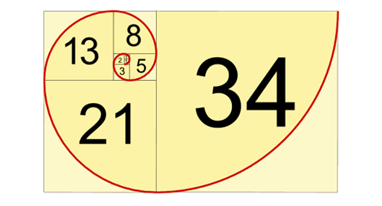
Application I: Fibonacci Numbers
Picture source: https://www.goodreads.com/topic/show/20901917-by-the-numbers

Slide 8
Fibonacci numbers
Recurrence relation
Overlapping subproblems, F(5)
Consider this function calculating Fibonacci numbers:
double F( int n ) {
return ( n <= 1 ) ? 1.0 : F(n - 1) + F(n - 2);
}
The runtime is similar to the actual definition of Fibonacci numbers:
An upper bound solution T(n) = 2 * T(n-1) + 1
O(2^{n})
Notes:
geometric sequence

Slide 9
Real Performance
To demonstrate, consider:
#include <iostream>
#include <ctime>
using namespace std;
int main() {
for ( int i = 33; i < 100; ++i ) {
cout << "F(" << i << ") = "
<< F(i) << '\t' << time(0) << endl;
}
return 0;
}
double F( int n ) {
return ( n <= 1 ) ? 1.0 : F(n - 1) + F(n - 2);
}

Slide 10
Fibonacci numbers
The output:
F(33) = 5702887 1206474355
F(34) = 9227465 1206474355 F(33), F(34), and F(35) in 1 s
F(35) = 14930352 1206474355
F(36) = 24157817 1206474356
F(37) = 39088169 1206474358
F(38) = 63245986 1206474360
F(39) = 102334155 1206474363
F(40) = 165580141 1206474368
F(41) = 267914296 1206474376
F(42) = 433494437 1206474389
F(43) = 701408733 1206474411
F(44) = 1134903170 1206474469 ~1 min to calculate F(44)

Slide 11
Fibonacci numbers
Problem:
To calculate F(44), it is necessary to calculate F(43) and F(42)
However, to calculate F(43), it is also necessary to calculate F(42)
It gets worse, for example
F(40) is called 5 times
F(30) is called 620 times
F(20) is called 75 025 times
F(10) is called 9 227 465 times
F(0) is called 433 494 437 times
Opportunity: we don’t have to recalculate F(10) almost ten million times…

Slide 12
Fibonacci numbers
Here is a possible solution:
To avoid calculating values multiple times, store intermediate calculations in a table
When storing intermediate results, this process is called memoization
We save (memoize) computed answers for possible later reuse, rather than re-computing the answer multiple times

Slide 13
Fibonacci numbers
double * array = new double[ARRAY_SIZE];
/*initialization*/
array[0] = 1.0;
array[1] = 1.0;
// use 0.0 to indicate we have not yet calculated a value
for ( int i = 2; i < ARRAY_SIZE; ++i ) {
array[i] = 0.0;
}
double F( int n ) {
if ( array[n] == 0.0 ) {
array[n] = F( n – 1 ) + F( n – 2 );
}
return array[n];
}

Slide 14
Top-Down and Bottom-Up Algorithms
This also allows for another approach:
Our implementation is top-down
From the very top, we break the problem into sub-problems
All divide-and-conquer algorithms we have seen are top-down
An alternative approach is bottom-up approach
Solve smaller problems and use these to build a solution for the problem
Notes:
algorithm design strategy

Slide 15
Top-Down and Bottom-Up Algorithms
Here is a bottom-up approach to calculating Fibonacci numbers:
double F( int n ) {
if ( n <= 1 ) {
return 1.0;
}
double a = 1.0, b = 1.0;
for ( int i = 2; i <= n; ++i ) {
a += b;
b = a - b;
}
return a;
}

Slide 16
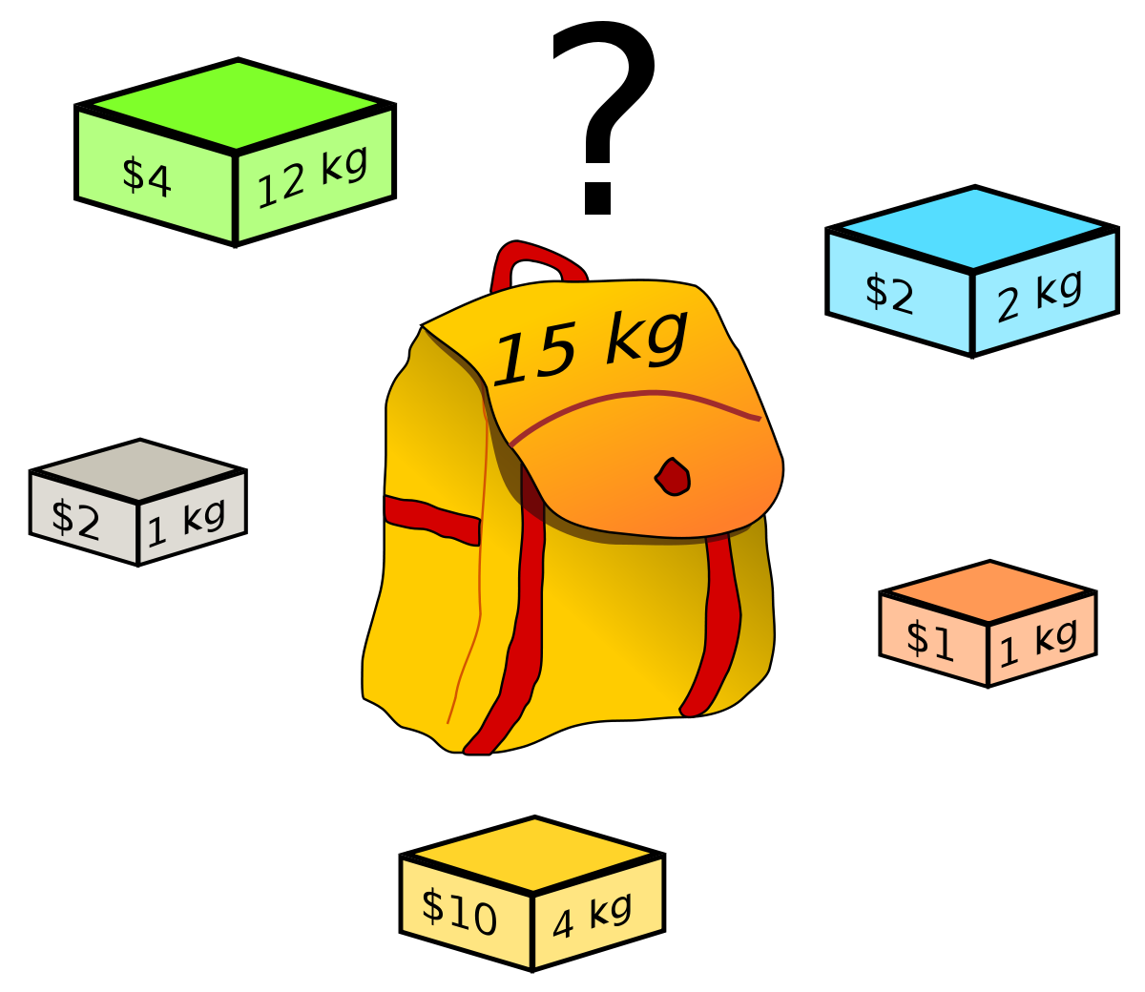
Application II: 0/1 Knapsack Problem
Picture source: Wikipedia, https://en.wikipedia.org/

Slide 17

0/1 Knapsack Problem
Problem Description:
Given a set of items, each with a weight and a value, determine the number of each item to include in a collection so that the total weight is less than or equal to a given limit and the total value is as large as possible.
Formal Definition:
The constraint c is an integer value
There are n items we could include:
The i-th item has weight w_{i}
Its value is v_{i}
Solution:
f(i, c): the optimal value for the first i items under constraint c
Recurrence relation
$$0 i<0$$
$$f\left(i,c\right)=$$
$$f\left(i−1, c\right) { w}_{i}>c$$
$$\max\left(f\left(i−1, c\right), f\left(i−1, c −w_{i}\right)+v_{i}\right) { w}_{i}≤c$$

Slide 18
Implementation I (Recursion)
// Driver program to test knapSack function
int main()
{
int val[] = { 10, 20, 30 };
int wt[] = { 1, 1, 1 };
int c = 2;
int n = 3;
printf("%d", knapSack(c, wt, val, n–1));
return 0;
}
int max(int a, int b) { return (a > b) ? a : b; }
int knapSack(int c, int wt[], int val[], int i)
{
// Base Case
if (i < 0 || c == 0)
return 0;
// If weight of the i-th item is more than c
if (wt[i] > c)
return knapSack(c, wt, val, i - 1);
// Return the maximum of two cases:
// (1) i-th item included (2) not included
else
return max(val[i] + knapSack(c - wt[i], wt, val, i - 1), knapSack(c, wt, val, i - 1));
}
Example of knapSack(n, c), i.e., K(3, 2)
Complexity Analysis:
Space Complexity: O(1)
Time Complexity: O(2^{n})

Slide 19
Implementation II (Memoization)
// Driver program to test knapSack function
int main()
{
int val[] = { 10, 20, 30 };
int wt[] = { 1, 1, 1 };
int c = 2;
int n = 3;
int **K; //initialized to -1
printf("%d", knapSack(c, wt, val, n–1, K));
return 0;
}
int max(int a, int b) { return (a > b) ? a : b; }
int knapSack(int c, int wt[], int val[], int i, int ** K)
{
// Base Case
if (i < 0 || c == 0)
return 0;
// Memoization
if (K[i][c] != -1)
return K[i][c];
// If weight of the i-th item is more than c
if (wt[i] > c)
K[i][c] = knapSack(c, wt, val, i - 1);
// Return the maximum of two cases:
// (1) i-th item included (2) not included
else
K[i][c] = max(val[i] + knapSack(c - wt[i], wt, val, i - 1), knapSack(c, wt, val, i - 1));
return K[i][c];
}
Example of knapSack(n, c), i.e., K(3, 2)
Complexity Analysis:
Space Complexity: O(n*c)
Time Complexity: O(n*c)

Slide 20
Implementation III (Bottom-up)
// Driver program to test knapSack function
int main()
{
int val[] = { 10, 20, 30 };
int wt[] = { 1, 1, 1 };
int c = 2;
int n = 3;
int **K; //initialized to -1
printf("%d", knapSack(c, wt, val, n–1, K));
return 0;
}
int max(int a, int b) { return (a > b) ? a : b; }
int knapSack(int c, int wt[], int val[], int n)
{
int K[n+1][c+1];
for(int i = 0; i <= n; ++i) {
for(int w = 0; w <= c; ++w) {
if (i == 0 or w == 0)
K[i][w] = 0;
else if (wt[i – 1] <= w)
K[i][w] = max(val[i-1] + K[i-1][w - wt[i-1]],
K[i-1][w]);
else
K[i][w] = K[i – 1][w];
}
}
return K[n][c];
}
Example of knapSack(n, c), i.e., K(3, 2)
Complexity Analysis:
Space Complexity: O(n*c)
Time Complexity: O(n*c)

Slide 21
Application III: Longest Common Subsequence

Slide 22
Problem
Problem Description:
Given two sequences, find the length of longest subsequence present in both of them. A subsequence is a sequence that appears in the same relative order, but not necessarily contiguous. Example, “ABCDEFG” → {“ABC”, “ADG”, “EG”, …}
Input: two sequences, X, Y
Output: the length of the longest subsequence.
Example:
X = ”ABCDGH”, Y = “AEDFHR”
The longest subsequence is “ADH”, length is 3

Slide 23
Using Dynamic Programming
Optimal Substructure
Let the input sequences be X[0…m-1] and Y[0…n-1] of lengths m and n respectively. And let L(X[0…m-1], Y[0…n-1]) be the length of LCS of the two sequences X and Y.
If last characters of both sequences match (or X[m-1] == Y[n-1]) then L(X[0..m-1], Y[0..n-1]) = 1 + L(X[0..m-2], Y[0..n-2])
If last characters of both sequences do not match (or X[m-1] != Y[n-1]) then L(X[0..m-1], Y[0..n-1]) = MAX ( L(X[0..m-2], Y[0..n-1]), L(X[0..m-1], Y[0..n-2]) )
Overlapping Sub-problems
Example, L(X[0…m-1], Y[0…n-1])

Slide 24

Longest Common Subsequence
Solution:
L(i, j): the length of the longest subsequence of X[0, … i] and Y[0, … j]
Three cases
Basic: either sequence is empty
Last characters match
Last characters do not match
Recurrence relation
$$0 i=0 or j=0$$
$$L\left(i,j\right)=$$
$$L\left(i−1,j−1\right)+1 i,j>0 and X\left[i\right]=Y[j]$$
$$max\left(L\left(i−1,j\right), L\left(i,j−1\right)\right) i,j>0 and X\left[i\right]!=Y[j]$$

Slide 25
Implementation I (recursion)
Procedure lcs( char *X, char *Y, int m, int n ) {
if (m == 0 || n == 0)
return 0;
if (X[m-1] == Y[n-1])
return 1 + lcs(X, Y, m-1, n-1);
else
return max(lcs(X, Y, m, n-1), lcs(X, Y, m-1, n));
}
Complexity Analysis:
Space Complexity: O(1)
Time Complexity: O(2^{n})

Slide 26
Implementation II (memoization)
Procedure lcs( char *X, char *Y, int m, int n, int **L) {
if (m == 0 || n == 0)
return 0;
if (L[m][n] != -1)
return L[m][n];
if (X[m-1] == Y[n-1])
L[m][n] = 1 + lcs(X, Y, m-1, n-1, L);
else
L[m][n] = max(lcs(X, Y, m, n-1, L), lcs(X, Y, m-1, n, L));
return L[m][n];
}
Complexity Analysis:
Space Complexity: O(n*m)
Time Complexity: O(n*m)

Slide 27
Implementation III (bottom-up)
Procedure lcs( char *X, char *Y, int m, int n) {
int L[m+1][n+1];
for (i=0; i<=m; i++) {
for (j=0; j<=n; j++) {
if (i == 0 || j == 0)
L[i][j] = 0;
else if (X[i-1] == Y[j-1])
L[i][j] = L[i-1][j-1] + 1;
else
L[i][j] = max(L[i-1][j], L[i][j-1]);
}
}
return L[m][n];
}
Complexity Analysis:
Space Complexity: O(n*m)
Time Complexity: O(n*m)

Slide 28
Application IV: All-Pairs Shortest Path

Slide 29
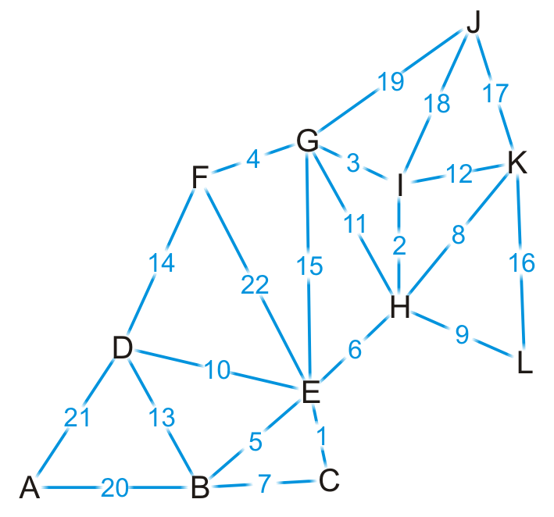
Problem
Input: A weighted graph, represented by its weight matrix w.
Problem: find the shortest distances between every pair of nodes.
Any algorithm that finds the shortest path between all pairs must consider, each pair of vertices; therefore, a lower bound on the execution would be

Slide 30
Using Dynamic Programming
Principle of Optimality
We already saw that any sub-path of a shortest path is a shortest path between its end nodes.
Recurrence relation:
Divide the paths from i to j where every intermediary node is of label ≤ k into two groups:
1. Those paths that do not go through node k
2. Those paths that do go through node k.
The shortest path in the first group is the shortest path from i to j where the label of every intermediary node is ≤ k-1.
Each path in group 2 consists of two portions: The first is from node i to node k, and the second is from node k to node j.
Recurrence relation
d[i][j] = min(d[i][k] + d[k][j], d[i][j])

Slide 31
The Floyd-Warshall Algorithm
Procedure apsp(w[0:n][0:n], n) {
double d[n][n];
Initialize d[i][j] = w[i][j] for i, j from 0 to n;
// Run Floyd-Warshall
for ( int k = 0; k < n; ++k ) {
for ( int i = 0; i < n; ++i ) {
for ( int j = 0; j < n; ++j ) {
d[i][j] = min(d[i][j], d[i][k] + d[k][j]);
}
}
}
}
Complexity Analysis:
Space Complexity: O(V²)
Time Complexity: O(V³)

Slide 32
Floyd-Warshall v.s. Dijkstra
Floyd-Warshall Algorithm
All-pairs shortest path
O(V³)
Dijkstra’s Algorithm
Single-source shortest path
O(E*logV)
Can be applied to all-pairs shortest path
O(VE*logV)
Worst case: O(V³logV)

Slide 33
DP vs. Greedy
Both techniques are optimization techniques, and both build solutions from a collection of choices of individual elements.
The greedy method computes its solution by making its choices in a serial forward fashion, never looking back or revising previous choices.
Dynamic programming computes its solution bottom up by synthesizing them from smaller subsolutions, and by trying many possibilities and choices before it arrives at the optimal set of choices.
There is no a priori litmus test by which one can tell if the Greedy method will lead to an optimal solution.
By contrast, there is a litmus test for Dynamic Programming, called The Principle of Optimality

Slide 34
DP vs. Divide and Conquer
Both techniques split their input into parts, find subsolutions to the parts, and synthesize larger solutions from small ones.
Divide and Conquer splits its input at prespecified deterministic points (e.g., the middle for binary search)
Dynamic Programming splits its input at every possible split points rather than at a prespecified points. After trying all split points, it determines which split point is optimal.

Slide 35
Summary
Dynamic Programming
Definition
Applications
Fibonacci Numbers
0/1 Knapsack Problem
Longest Common Subsequence
All-Pairs Shortest Path

