Slide 1

A Multiprocess Mechanism of Evading Behavior-Based Bot Detection Approaches
Yuede Ji, Qiang Li, Yukun He and Dong Guo
Jilin University
5/6/2014

Slide 2
OUTLINE
Introduction
Specific Features of Multiprocess Bot
Evasion Mechanisms
Critical Challenges
Experiments
Extended Architectures
Discussion
Conclusion

Slide 3
OUTLINE
Introduction
Specific Features of Multiprocess Bot
Evasion Mechanisms
Critical Challenges
Experimens
Extended Architectures
Discussion
Conclusion

Slide 4



1.1 What is botnet and bot?
Botnet is a network composed by a large scale of infected hosts under the control of botmaster through Command and Control (C&C) channel.
Bot is the infected host.
Bot
Bot
Bot
Botmaster
C&C Infrastructure
Infected Hosts

Slide 5
1.1 What is botnet and bot?
3 basic elements:
Bot, C&C channel, botmaster
Various C&C channels
Centralized: IRC, HTTP
Decentralized: Peer-to-Peer (P2P), Online Social Network (OSN)
A major threat to Internet security
DDoS, spam, identity theft, phishing

Slide 6
1.2 Existing Detection Approaches
Network-based
Analyze network traffic to filter out the bot host
Host-based
a) Signature-based
extracts the feature information of the suspicious program to match with a knowledge database
b) Behavior-based
Monitors the abnormal behaviors on host to determine whether the host is infected

Slide 7
1.3 The Problem
Most behavior-based approaches are based on single process or related family processes.
If a bot is separated into two or more processes, these approaches will be less effective.

Slide 8
OUTLINE
Introduction
Specific Features of Multiprocess Bot
Evasion Mechanisms
Critical Challenges
Experiments
Extended Architectures
Discussion
Conclusion

Slide 9
2.1 Specific Features of Multiprocess Bot
There are two specific differences between multiprocess and conventional bot:
Separating C&C connection from malicious behaviors
Assigning malicious behaviors to several processes

Slide 10
2.1 Separating C&C connection from malicious behaviors
1. The process communicating with C&C server has no other malicious behaviors, and the malicious processes do not communicate with
C&C server directly.
2. This feature is able to evade the detection
approaches correlating network behaviors with malicious behaviors.
3. However, it may not be able to evade approaches which only detect host malicious behaviors.

Slide 11
2.2 Assigning Malicious Behaviors to Several Processes
Each process only performs a small part of whole malicious behaviors.
This feature can effectively evade malicious behavior detection approaches
The number of malicious behaviors that each process performs becomes a critical challenge

Slide 12
2.2 Assigning Malicious Behaviors to Several Processes
Phase 1: Suppose we extract the system calls of known malicious behaviors to build the system call set fi of each behavior. We build the critical system call set C using the similar methods of building Common API in [15]. The system calls in the critical set are frequently called by these malicious behaviors.
Phase 2: We match every system call aij of each set fi with critical set C to generate num1 i , and after matching all we can get set Num1. It denotes the number of critical system calls of each behavior. We match every system call a i of critical set C with each set f i to generate num2 i , and then Num2. It denotes the number of behaviors that call a specific critical system call.
Phase 3: Based on set Num1 and Num2 we can get two assignment mechanisms: behavior level and system call level assignment mechanism. In behavior level assignment, we sort the behaviors in descending order in set Num1. The top behaviors represent the most frequent behaviors. We can separate the top behaviors with each other to average the critical behavior numbers of each process. In this way, we can decrease the malicious grain size of each process. We can assign the sorted set to the processes in S shape, and other assignment mechanisms like arithmetic, random walk, etc. can also be used. Set Num2 is about system call level assignment mechanism. We also sort the system calls in descending order. We assign top system calls to different processes or even a process only performing one critical system call. This assignment mechanism is more complicated than behavior level.

Slide 13
OUTLINE
Introduction
Specific Features of Multiprocess Bot
Evasion Mechanisms
Critical Challenges
Experiments
Extended Architectures
Discussion
Conclusion

Slide 14
3. Evasion Mechanisms
According to detection targets, we classify existing behavior-based detection approaches into 4 categories:
1. Detecting C&C connections
2. Detecting malicious behaviors
3. Detecting bot commands
4. Detecting bots (correlating C&C connection with malicious behaviors)

Slide 15
3.1 Evading C&C Detection

Slide 16
3.2 Evading Malicious Behaviors Detection

Slide 17
3.3 Evading Bot Commands Detection

Slide 18
3.4 Evading Bots Detection

Slide 19
OUTLINE
Introduction
Specific Features of Multiprocess Bot
Evasion Mechanisms
Critical Challenges
Experiments
Extended Architectures
Discussion
Conclusion

Slide 20
4. Critical Challenges
Although multiprocess bot is able to evade behavior-based bot detection approaches, it still has many critical challenges. We will present two of them: bootstrap mechanism, and process communication mechanism.
Conventional bot which has one process only needs to start itself, while multiprocess bot needs to start all the processes. Multiprocess bot may run in the hosts stealthily, while the bootstrap of all the processes is not easy to accomplish stealthily. If the bootstrap mechanism is not well designed, multiprocess bot may be detected at the startup stage.
IPC data may be easy to capture, while it may not be easy to identify the suspicious data from the variety benign IPC data. Covert channels are difficult to detect and changeable. Thus the process communication mechanisms make the detection more difficult.

Slide 21
OUTLINE
Introduction
Specific Features of Multiprocess Bot
Evasion Mechanisms
Critical Challenges
Experiments
Extended Architectures
Discussion
Conclusion

Slide 22
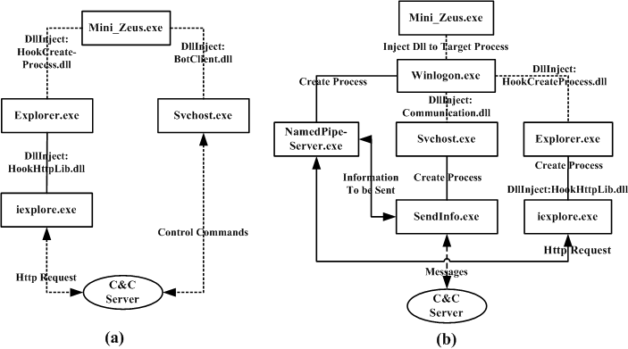
5.1 Prototype Architecture

Slide 23
5.2 Signature Analysis
File / URL | Detection ratio
Single_Mini_Zeus.exe 71e82907ae2a45fc51071910b7db39a62675b190f26e444b796eb81dbdfad77f | 28 / 47
SendInfo.exe 5d86d1fabefb094034e192039a5d75d5f982205b1149f5684bf3e74dc6e63224 | 6 / 33
NamedPipeServer.exe edb8897344e40b237c7d99ed6f5177f39c0b99f693a7b619e168c667058f0d55 | 2 / 47
Mini_Zeus.exe 0647dcd190af0e7519f2a4f003a6502e6186776be609c5494fe23cd6335fada5 | 13/47

Slide 24
5.3 Behavior Analysis

Slide 25
OUTLINE
Introduction
Specific Features of Multiprocess Bot
Evasion Mechanisms
Critical Challenges
Experiments
Extended Architectures
Discussion
Conclusion

Slide 26
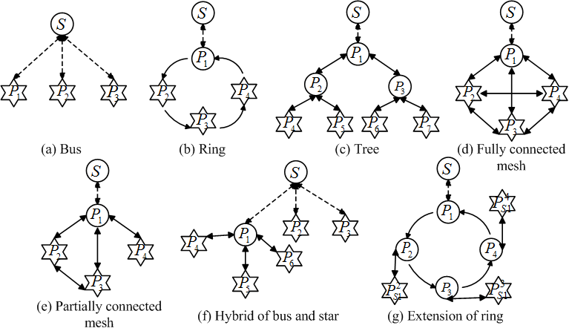
6 Extended Architectures of Multiprocess Bot
Six more architectures

Slide 27
6 Extended Architectures of Multiprocess Bot
Four extension rules

Slide 28
OUTLINE
Introduction
Specific Features of Multiprocess Bot
Evasion Mechanisms
Critical Challenges
Experiments
Extended Architectures
Discussion
Conclusion

Slide 29
7 Discussion

Slide 30
OUTLINE
Introduction
Specific Features of Multiprocess Bot
Evasion Mechanisms
Critical Challenges
Experiments
Extended Architectures
Discussion
Conclusion

Slide 31
8 Conclusion

Slide 32
Thanks!
Questions?

