Slide 1


Now You See Me, Now You Don’t!
Attentional Modulation in a L2/3 V1 Pyramidal Neuron Model
EITN School 2022 - NEURON Project Presentation
21/09/2022
Konstantinos-Evangelos Petousakis
EITN School 2022 tutor
PhD candidate

Slide 2
1. Introduction
EITN School 2022 - NEURON Project Presentation
21/09/2022

Slide 3

EITN School 2022 - NEURON Project Presentation
21/09/2022

Slide 4
…but more on that later.
EITN School 2022 - NEURON Project Presentation
21/09/2022

Slide 5
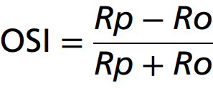
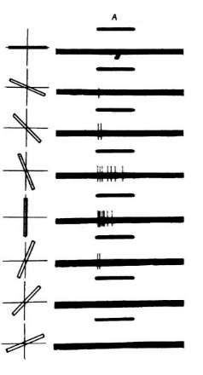
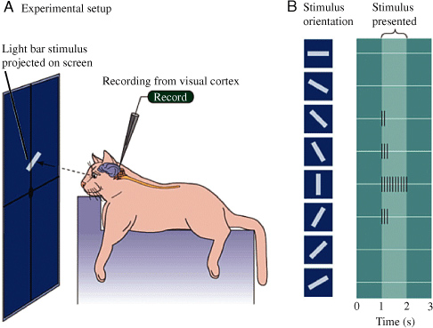
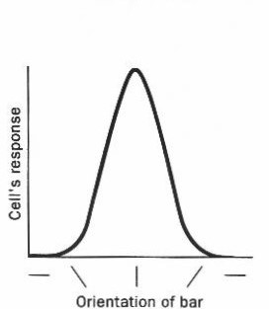
Introduction Orientation Selectivity
EITN School 2022 - NEURON Project Presentation
21/09/2022
Stimulus
Response
Hubel and Wiesel, 1962
Notes:
For now, let’s go through some basics of the visual system.
Through decades of research, we now know that light stimuli are registered by light-sensitive cells in the retina of the eye, which produce electrical signals. These signals are transmitted to the thalamus of the brain through the optic nerve, targeting a specific area known as the dorsolateral geniculate nucleus, or dLGN. The relay cells that make up this region then transmit new signals to the primary visual cortex, reaching the pyramidal neurons of layers 2 / 3 and 4.
In the 60s, Hubel and Wiesel experimented on anesthetized cats, presenting them with light bar-shaped stimuli on a dark display, while simultaneously recording the electrical responses of L2/3 pyramidal neurons. What they discovered is that these cells changed their firing rate in response to changes in the orientation of the stimulus [animation]. This phenomenon, whereby the response of a neuron depends on the orientation of a stimulus, is called orientation selectivity. By plotting the response frequency of the neuron as a function of stimulus orientation, we get the orientation tuning curve of the neuron. We can also use the maximum and minimum firing rates of the neuron to coarsely evaluate the extent to which a neuron shows orientation selectivity by computing the OSI value, which stands for Orientation Selectivity Index. This gives us a single number that we can easily use to understand whether a neuron exhibits tuning - that is to say, whether it is orientation selective.

Slide 6
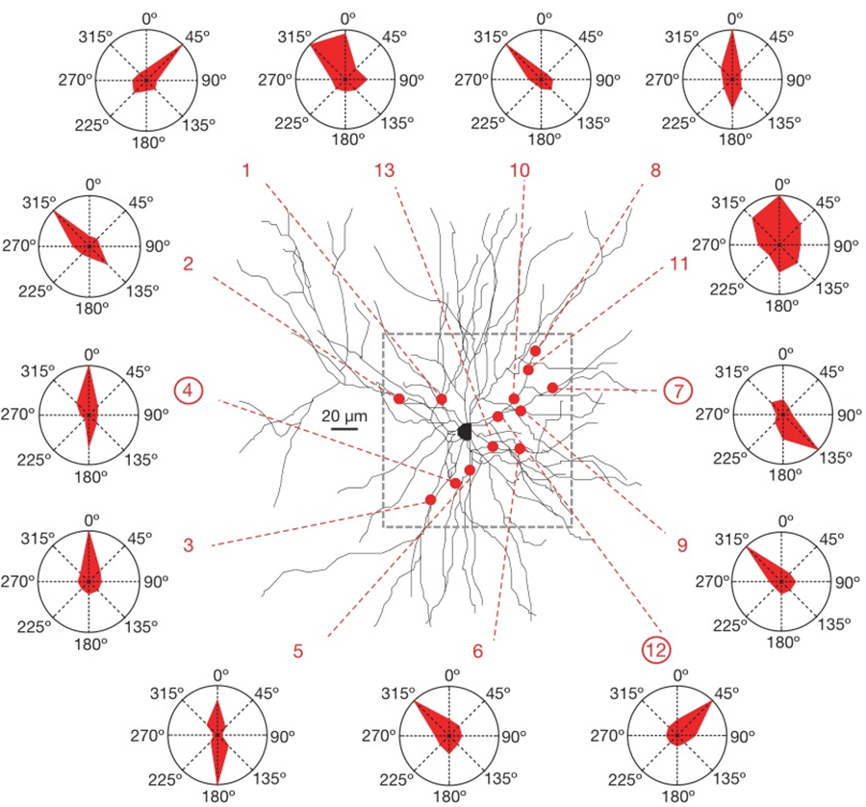
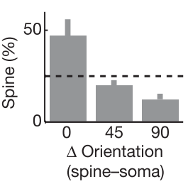
Introduction Synaptic Orientation Preference
EITN School 2022 - NEURON Project Presentation
21/09/2022
Same dendrite, different
synaptic orientation preference
Chen et al., 2013
Jia, Rochefort and Chen, 2010
Notes:
But how does orientation selectivity emerge ? Focusing on the synaptic level, we can observe that single synapses are more responsive for particular stimulus orientations compared to others. In addition, we have found that synapses featuring different orientation preferences can be located on the same dendritic branches [animation]! Overall, however, synaptic orientation preference distribution seems to exhibit a bias towards the orientation preference at the somatic level [animation]. So the neuron features a wide distribution of synaptic orientation preferences, and despite this variety, the output of the neuron shows a distinct preference for a narrow range of stimulus orientations, due to a biased distribution.

Slide 7
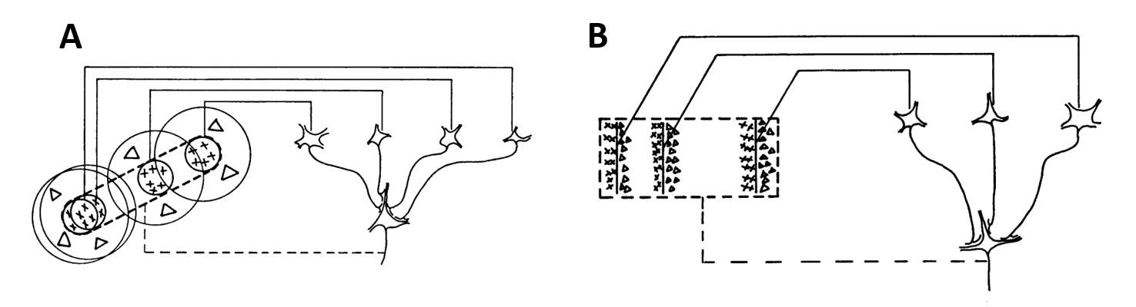
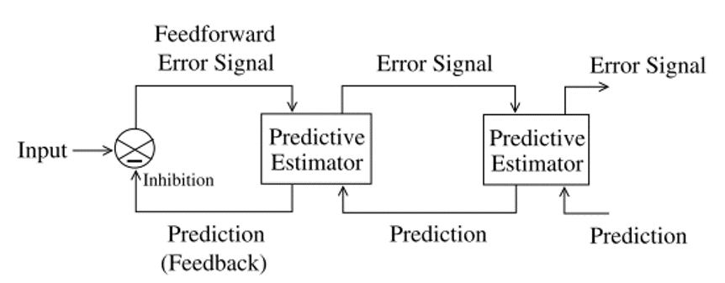
Introduction Hubel & Wiesel model / Predictive Coding model
EITN School 2022 - NEURON Project Presentation
21/09/2022
dLGN cells with collinear receptive fields
V1 simple cell
dLGN
V1
V2
V3
Receptive fields of V1 simple cells
Complex cell
Hubel and Wiesel, 1962
Rao and Ballard, 1999
Notes:
So, where do these inputs come from, and how do they interact?
After doing their experiments in the 60s, Hubel and Wiesel proposed the feedforward model of visual perception. This model claims that the behavior of visual cortex cells emerges as the result of their specific connectivity to other cells, lower in the visual hierarchy.
(As such, a V1 simple cell would recognize segments of a line simply because it was connected to dLGN cells whose receptive fields were collinear. In the same manner, the behavior of other visual cortex cells could be explained.)
Further research revealed that the H&W model could not adequately explain some features that were later discovered, such as contrast-invariance and cross-orientation suppression. To fill in the gap, Rao and Ballard proposed the predictive coding model, in which higher-order cortical areas send feedback signals to lower-order areas, priming them for particular stimuli [animation].
(If there is a disconnect between the prediction and the actual signal, an error signal is generated and propagates to the higher-order areas, prompting them to improve their predictions.)
Although this model explains some features of the visual cortex more accurately, it is still not a complete model. Contemporary models of visual processing feature greater degrees of complexity - but the existence of feedforward and feedback information streams remains.

Slide 8
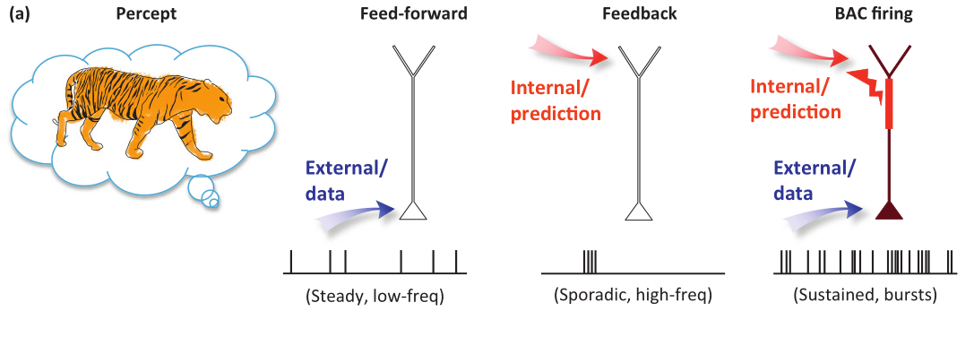
Introduction Feedforward vs Feedback inputs
EITN School 2022 - NEURON Project Presentation
21/09/2022
Larkum, 2013
Notes:
Let’s try to characterize these information streams a bit further, from the perspective of a post-synaptic primary visual cortex neuron. Let’s assume that a salient visual stimulus is presented. This visual information will reach the basal dendritic tree of the neuron, primarily, in a feedforward manner [animation]. In addition to this stimulus-driven input, the apical tree of the neuron, mostly, receives internally-generated signals from higher-order cortical areas [animation]. This is a feedback input stream. The neuron thus receives two different types of inputs, bearing different types of information.

Slide 9
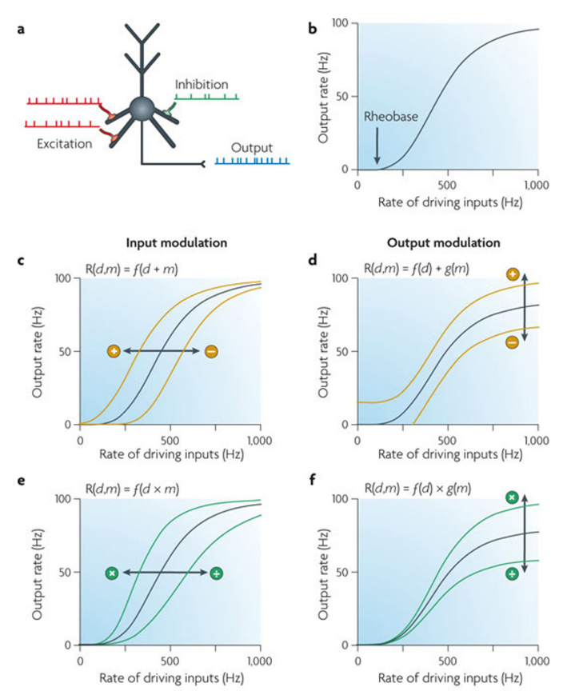
Introduction Attentional Signals and Modulation
EITN School 2022 - NEURON Project Presentation
21/09/2022
Attentional signals
dLGN
V1
V2
V3
Larkum, 2013
Rao and Ballard, 1999
Silver, 2010
Notes:
The feedback signals we have been referring to over the past couple of slides are labeled as “prediction”, but also heavily relate to attention. The role of these attentional signals is “to prioritize stimuli processing according to their physical salience or their relevance to current behavioral goals” (Sapountzis and Gregoriou, 2018). This means that they can alter the response of the neuron to feedforward input based on whether the stimulus information it bears is currently salient, or “being attended to” [animation].
The change in the response of the neuron is most easily examined by looking at its firing rate as a function of the input it receives. In the cases where attention is in effect, different kinds of changes to the output firing rate can be observed, depending on the specifics of the attentional signal.
For instance, if the attentional input is simply added to the feedforward input the cell normally receives, acting through a constant current, then the effect will be a shift of the response curve along the x-axis. If the attentional input is independent of the feedforward input, then the shift will occur along the y-axis. These kinds of modulations are either additive or subtractive in nature - they simply move the response curve along a specific direction. Modulation can also be multiplicative or divisive, changing the shape of the response curve - but this only occurs if the modulatory signal acts through gain control. In these cases, the modulatory signal alters the sensitivity - but not selectivity - of the neuronal response to changes in the input.
As a result, attentional inputs can change the response of the neuron to feedforward inputs - it’s I-O (input-output) curve. In the case of V1 orientation selective neurons, that would be the orientation tuning curve.

Slide 10

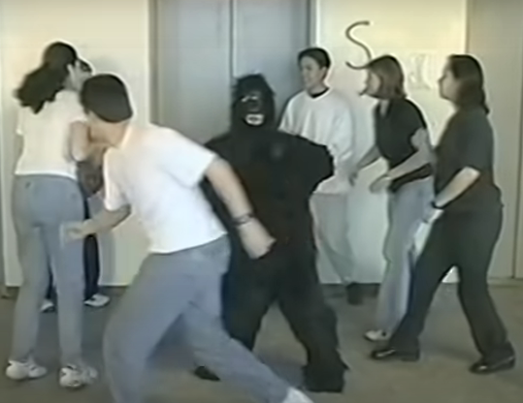
EITN School 2022 - NEURON Project Presentation
21/09/2022
Feedback - Attentional/Predictive Input
Feedforward - Visual Input
Notes:
So now, let’s recall what we’ve seen. We’ve seen that V1 neurons show orientation selectivity [animation] - their firing rates are a function of the orientation of the visual stimulus. This neuronal tuning phenomenon is due to the synaptic inputs themselves, which are also more responsive for particular stimulus orientations, but feature a wide range of preferences, even on the same dendritic branch [animation]. The output of the neuron is clearly a function of its input, and as such, all inputs need to be taken into account [animation]. Feedforward inputs bear external information about the visual stimulus, but they are not the only input. Feedback inputs bear internal information relating to prediction and attention, and are able to radically change the input-output curve of the neuron [animation].
A question then forms. Why do you sometimes not see that which is visible [animation], and other times see that which does not exist [animation]?
Given what we now know, it seems likely that the answer lies somewhere in the complicated interaction between the visible [animation-feedforward] and the invisible [animation-feedback].
So here is what I am proposing to you - would you like to try and find out?

Slide 11
2. Project Formulation
EITN School 2022 - NEURON Project Presentation
21/09/2022
Notes:
And so we reach the actual project. As you might expect, it is going to be in the NEURON simulation environment, but with a nice, cosy Python blanket. That makes things a lot nicer for everyone, believe me. Let’s get into some specifics.

Slide 12
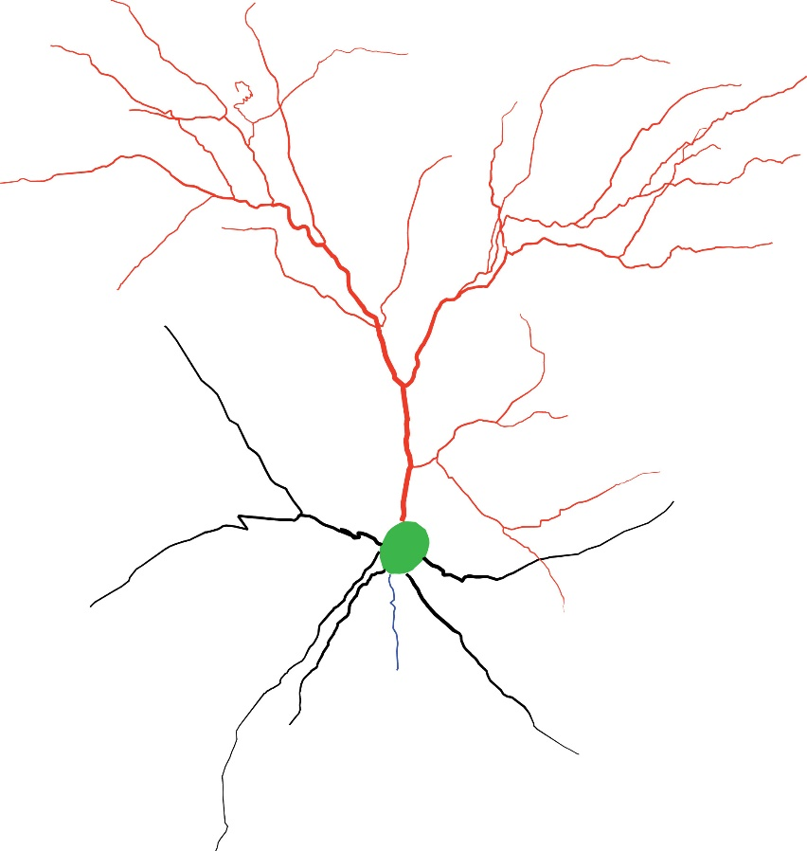
Setup Model morphology
EITN School 2022 - NEURON Project Presentation
21/09/2022
Apical Tree
43 dendritic sections
Soma
Axon
Basal Tree
7 dendritic sections
Notes:
You will not be starting from scratch - it would be way too time-consuming, and you’d be repeating a lot of what you’ll be doing in the NEURON tutorials tomorrow.
Instead, you will be given an already prepared model neuron. It is a morphologically accurate reconstruction of a mouse L2/3 V1 pyramidal neuron. It features 51 compartments, excluding the axon. 7 of these compartments correspond to basal dendritic sections, and 43 to apical dendritic sections, with the soma accounting for the last compartment.

Slide 13
Setup Model biophysics
EITN School 2022 - NEURON Project Presentation
21/09/2022
Apical Tree
43 dendritic sections
Hodgkin/Huxley voltage-gated Na⁺ channels
Hodgkin/Huxley voltage-gated K⁺ channels
Muscarinic voltage-gated K⁺ channels
A-Type voltage-gated K⁺ channels
T-Type Ca⁺⁺ channels
High voltage activated (HVA) Ca⁺⁺ channels
Calcium-dependent K⁺ channels
Active ATP Ca⁺⁺ pumps
…all configured properly!
Soma
Axon
Basal Tree
7 dendritic sections
Notes:
Now, this model will already be endowed with all the passive, active and voltage-gated mechanisms that it requires to properly function, all configured to fit the morphology of the neuron and pre-existing experimental data. So you won’t have to worry about that. But there’s something missing, something we’ve mentioned again and again in this presentation - the input.

Slide 14
Goal Synaptic Allocation
EITN School 2022 - NEURON Project Presentation
21/09/2022
Stimulus-Driven
Excitatory Synapses
???????
Inhibitory Synapses
Background-Driven (“noise”)
Notes:
As such, your first task is going to be to allocate the synaptic input the neuron receives [animation]. You will have to figure out some basic things: how many synapses does the neuron receive? Where are they located? What kinds of synapses? How many are excitatory, how many are inhibitory? What kinds of mechanisms do they utilize? How are they activated? Do they have any special properties [animation]?
After you have the information you need, all you have to do is properly add synapses to the existing model. You should have your first synapses up-and-running by the end of the first day working on the project, and all of the input should be allocated by the end of the third day.

Slide 15
Goal Attentional Modulation
EITN School 2022 - NEURON Project Presentation
21/09/2022
Notes:
While you are gathering information about the input, you need to be considering your implementation of feedback inputs - attentional inputs, to be precise [animation]. These are going to be your main target for experimentation, so you should put a great deal of thought into them. How many of them are there? Where are they located? What kinds of synapses? How many are excitatory, how many are inhibitory? What kinds of mechanisms do they utilize? How are they activated? Do they have any special properties?
After you’ve done so, you should be near the end of the fourth day.
Your next objective should be to generate a rough orientation tuning curve [animation]. Given the limited time you will have at your disposal, you will have to limit your sample sizes to some extent. Nevertheless, generating a tuning curve will let you know whether your model actually functions as a L2/3 V1 neuron should. The Orientation Selectivity Index will also come in handy. This should take a day at worst.
Finally, your ultimate goal is to investigate how attentional signals impact the output of the model. You can approach this question however you see fit, with all the time you have left at your disposal. Does your implementation of attention match the modulation types we already know of? What kind of change was produced? How realistic or feasible do you think this model of attention would be?
The question you seek to answer is this - can dendrite-bound attentional signals modulate the activity of orientation selective neurons?

Slide 16
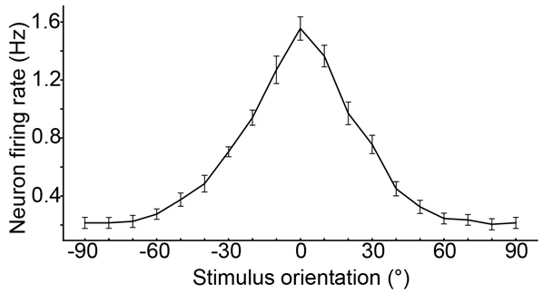
Goals Overview
EITN School 2022 - NEURON Project Presentation
21/09/2022
Project Milestones:
Allocate a single synapse and ensure correct function
Allocate multiple synapses according to a set plan
Ensure that stimulus-driven synapses feature orientation selectivity
Implement a subset of synapses as attentional (feedback) inputs
Allocate all synapses (feedforward & feedback)
Show that the neuron exhibits orientation tuning (tuning curve/OSI)
Investigate the effect of attention on neuronal output
Demonstrate the effect (or lack thereof) of attention
???
Present your results!
Rp = 1.6 Hz
Ro = 0.25 Hz
OSI = 0.74
Notes:
Let’s go over the project quickly one more time. You’ll start with a model of a L2/3 V1 pyramidal neuron already set-up with everything except synaptic input. Your first task will be to allocate this missing input, according to known information. While doing so, you should consider how to incorporate feedback, attentional inputs, and how these inputs will function. Then, to evaluate the function of the neuron, you should generate an orientation tuning curve of the neuron - but keep in mind that you don’t have the time to generate large sample sizes. The Orientation Selectivity Index will be a helpful tool for evaluating how well-tuned your model is. Finally, use your model to answer the question: “Can dendrite-bound attentional signals modulate the activity of orientation selective neurons?”
To expand on the question a bit, you could investigate, for instance, what happens when under “control” conditions versus what happens when attention is highly activated, mostly inactive, or in some way impaired. There are a myriad ways you can approach this question, and only your creativity is the limit.

Slide 17
Materials Useful Papers and Other Resources
EITN School 2022 - NEURON Project Presentation
21/09/2022
Useful Papers:
Silver, R. A. (2010). Neuronal arithmetic. Nature Reviews Neuroscience, 11(7), 474-489.
Goetz, L., Roth, A., & Häusser, M. (2021). Active dendrites enable strong but sparse inputs to determine orientation selectivity. Proceedings of the National Academy of Sciences, 118(30), e2017339118.
Park, J., Papoutsi, A., Ash, R. T., Marin, M. A., Poirazi, P., & Smirnakis, S. M. (2019). Contribution of apical and basal dendrites to orientation encoding in mouse V1 L2/3 pyramidal neurons. Nature Communications, 10(1), 1-11.
Other Resources:
The NEURON tutorials by András Ecker (tomorrow!)
https://neuron.yale.edu/neuron/static/py_doc/index.html [NEURON/Python documentation]
https://docs.python.org/3/reference/ [Python documentation]
Notes:
Just in case you thought you’d have to spend at least a couple of days finding papers, let me save you the search and just give you the 3 most important ones right off the bat.
Most of the practical knowledge and reference material you’ll need to work with NEURON will be provided tomorrow by Andras - but remember that documentation is always useful as well.

Slide 18
Good Luck!
Don’t forget to have fun!*
*Doing science and learning. All other kinds of fun subject to personal and institutional discretion. Contact your supervisor or other parental figure for more information. This is not legal advice.
;-)
EITN School 2022 - NEURON Project Presentation
21/09/2022

