Slide 1
Project 2 – ETF Allocator
by Kepler62f

Slide 2
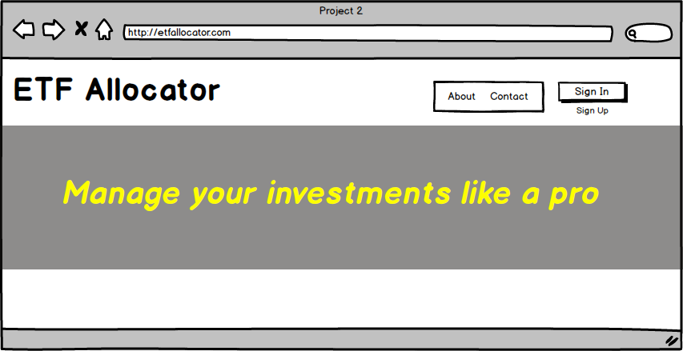
Wireframe

Slide 3
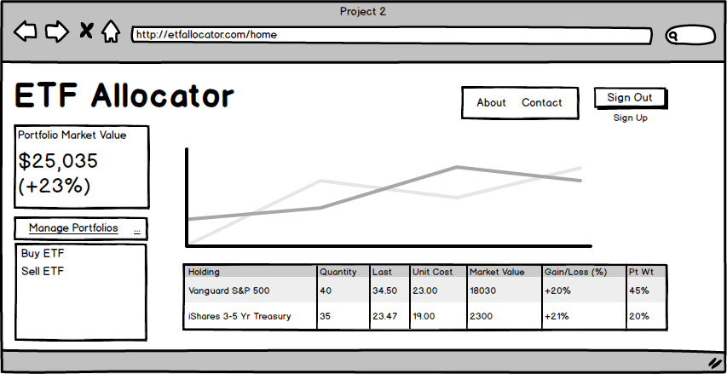
Wireframe

Slide 4
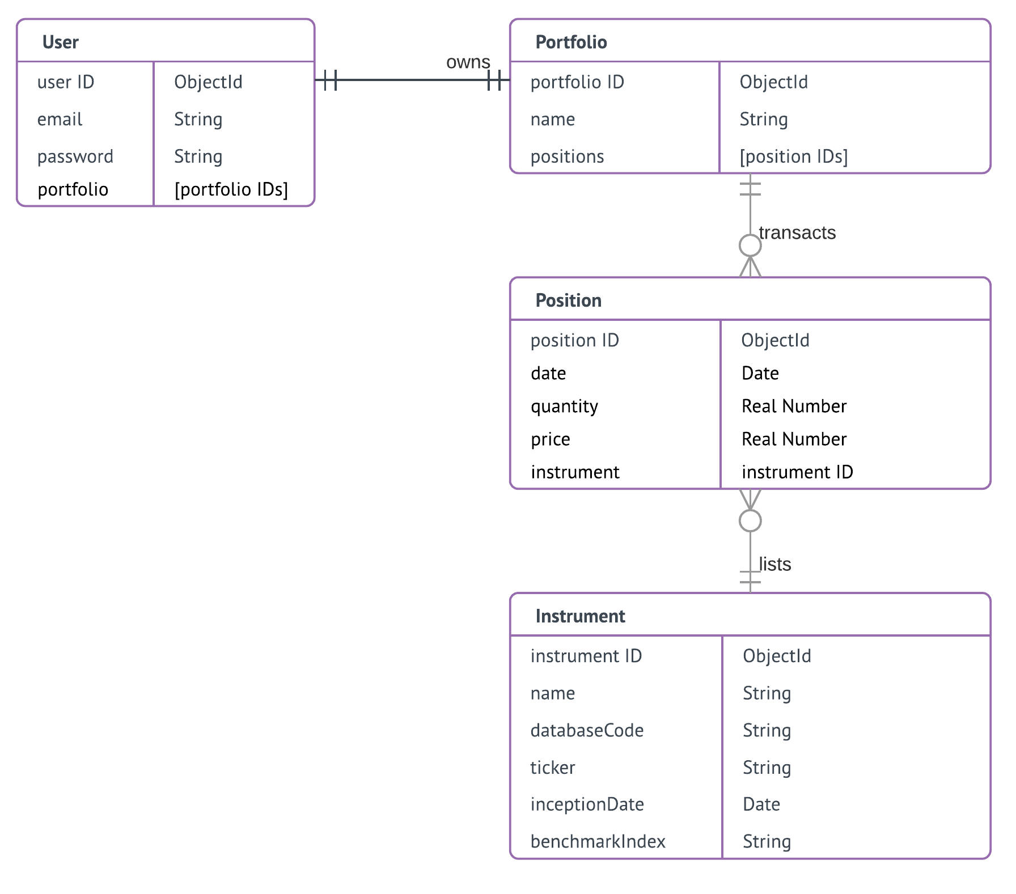

Slide 5
System Sequence – New User
View
Router
Controller
Model
/
users/signUp
req
signUp ()
User
New()
save()
home/
res
users/error
Portfolio
New()
save()
Notes:
Unified Modeling Language

Slide 6
System Sequence – Sign In & Buy (Part 1)
View
Router
Controller
Model
/
users/signIn
req
pp.authenticate ()
User
findOne()
validPassword()
/home
Success redirect
users/error
Failure redirect
Notes:
Unified Modeling Language

Slide 7
System Sequence – Sign In & Buy (Part 2)
View
Router
Controller
Model
/home
post
User
addPosition()
Portfolio
findOne()
Position
New()
res
save()
Instrument
res
eodMarketPricing()
Quandl API
Notes:
Unified Modeling Language

Slide 8
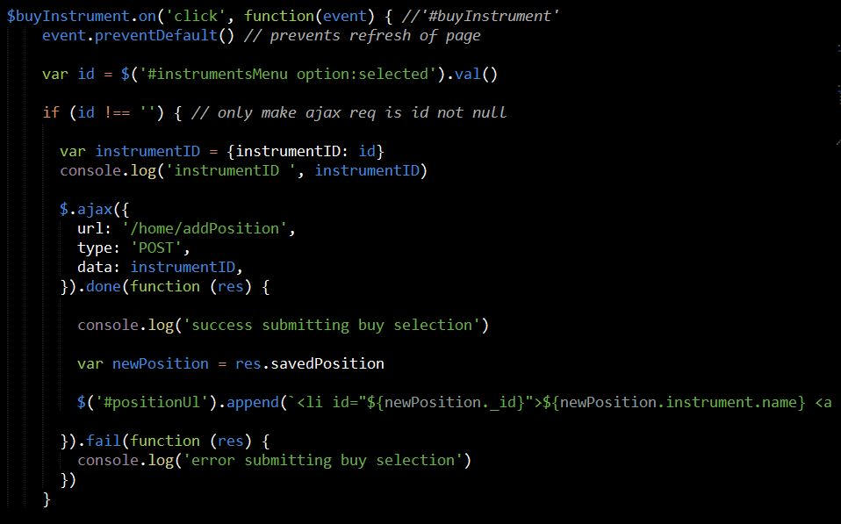
Code Snippet – ajax call

Slide 9
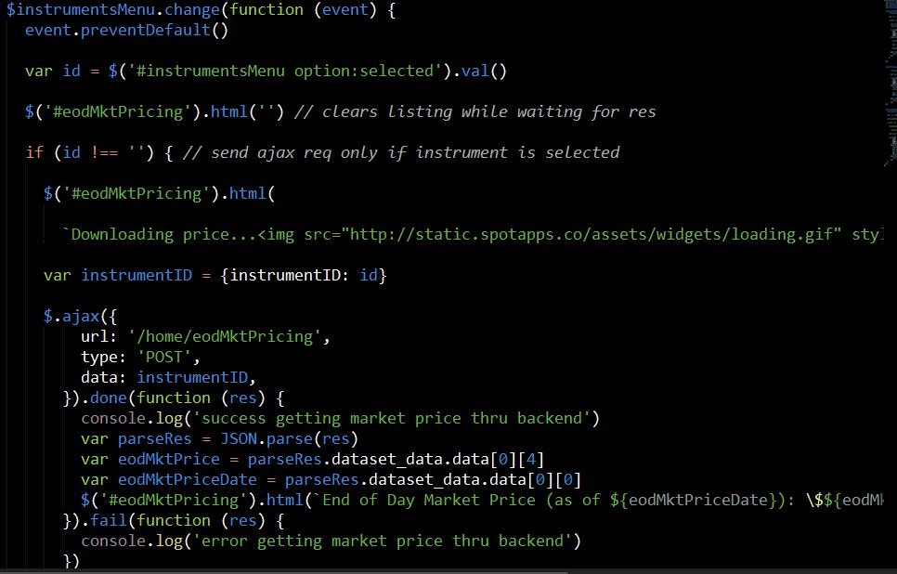
Code Snippet – handling async event

Slide 10
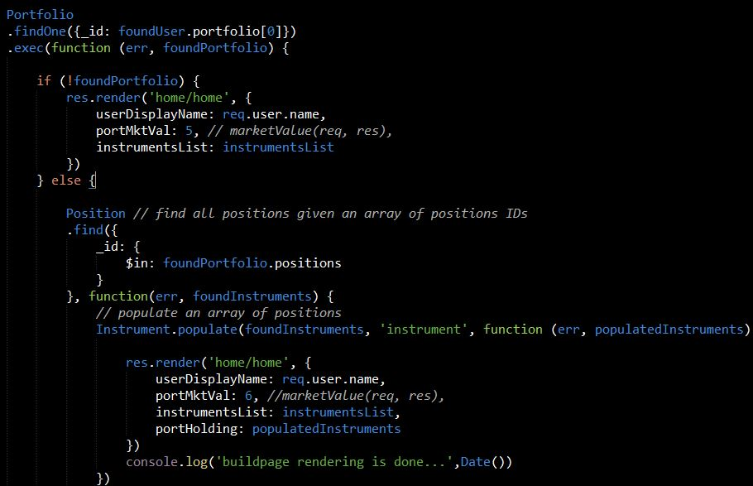
Code Snippet – populate multiple

