Slide 1

Notes:
Imagine you are building an app to convert kilometers to Miles but don’t remember the exact formula but you have knowledge of two pieces.

Slide 2
Approach To solve the Machine Learning problem
Notes:
Imagine you are building an app to convert kilometers to Miles but don’t remember the exact formula but you have knowledge of two pieces.

Slide 3
Approach To solve the Machine Learning Problem
DATA COLLECTION
DATA PREPARATION
CHOOSING A MODEL
TRAIN MODEL
EVALUATION
PARAMETER TUNING
PREDICTION
Notes:
Imagine you are building an app to convert kilometers to Miles but don’t remember the exact formula but you have knowledge of two pieces.

Slide 4



Collection of Data
This step is very important because the quality and quantity of data that you gather will directly determine how good your predictive model can be.

Slide 5
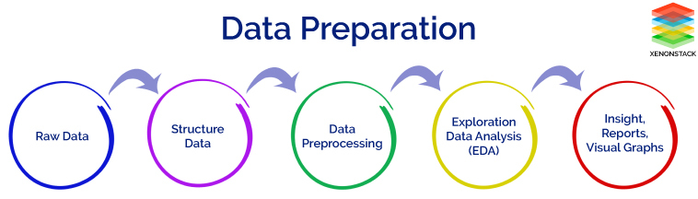
Data Preparation
Data preparation, where we load our data into a suitable place and prepare it for use in our machine learning training.
This is also a good time to do any pertinent visualizations of your data, to help you see if there are any relevant relationships between different variables you can take advantage of, as well as show you if there are any data imbalances.
We’ll also need to split the data in two parts. The first part, used in training our model, will be the majority of the dataset. The second part will be used for evaluating our trained model’s performance. We don’t want to use the same data that the model was trained on for evaluation, since it could then just memorize the “questions”, just as you wouldn’t use the same questions from your math homework on the exam.

Slide 6

Choosing a model
The next step in our workflow is choosing a model. There are many models that researchers and data scientists have created over the years. Some are very well suited for image data, others for sequences (like text, or music), some for numerical data, others for text-based data.

Slide 7

Train Model
Now we move onto what is often considered the bulk of machine learning — the training. In this step, we will use our data to incrementally improve our model’s ability to predict the correct results.
In some ways, this is similar to someone first learning to drive. At first, they don’t know how any of the pedals, knobs, and switches work, or when any of them should be used. However, after lots of practice and correcting their mistakes, a licensed driver emerges.

Slide 8
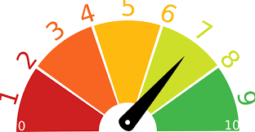
Evaluation
Once training is complete, it’s time to see if the model is any good, using Evaluation. This is where that dataset that we set aside earlier comes into play. Evaluation allows us to test our model against data that has never been used for training. This metric allows us to see how the model might perform against data that it has not yet seen. This is meant to be representative of how the model might perform in the real world.

Slide 9
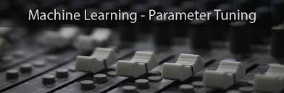
Parameter Tuning
Once you’ve done evaluation, it’s possible that you want to see if you can further improve your training in any way. We can do this by tuning our parameters. There were a few parameters we implicitly assumed when we did our training, and now is a good time to go back and test those assumptions and try other values.
One example is how many times we run through the training dataset during training. What I mean by that is we can “show” the model our full dataset multiple times, rather than just once. This can sometimes lead to higher accuracies.
Another parameter is “learning rate”. This defines how far we shift the line during each step, based on the information from the previous training step. These values all play a role in how accurate our model can become, and how long the training takes.

Slide 10
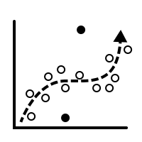

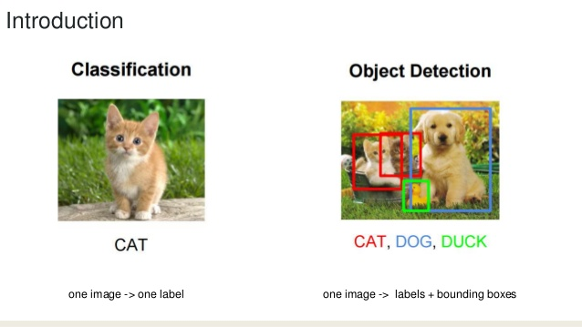
Prediction
Machine learning is using data to answer questions. So Prediction, or inference, is the step where we get to answer some questions. This is the point of all this work, where the value of machine learning is realized.

