Slide 1

Notes:
Imagine you are building an app to convert kilometers to Miles but don’t remember the exact formula but you have knowledge of two pieces.

Slide 2
Building The Intuition For Tensors in CNN

Slide 3
Fully connected Neural network
Notes:
http://scs.ryerson.ca/~aharley/vis/conv/

Slide 4
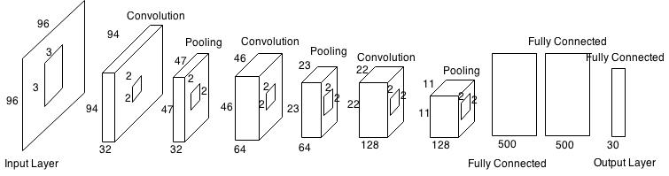
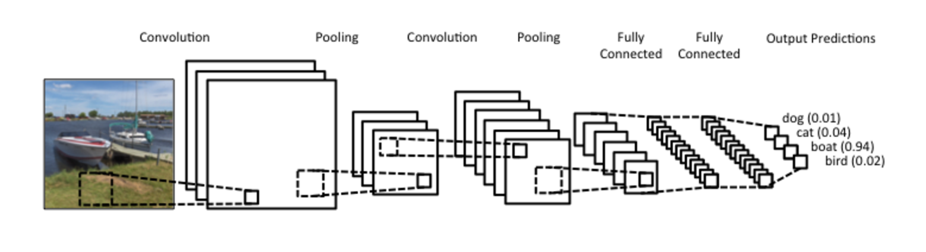
Typical CNN Architecture
Convolutional Neural Networks for Image classification
Notes:
http://setosa.io/ev/image-kernels/

Slide 5
Single channel single filter convolution
3x3
6x6
Notes:
http://setosa.io/ev/image-kernels/

Slide 6
Single channel single filter convolution
6x6
Notes:
http://setosa.io/ev/image-kernels/

Slide 7
Single channel single filter convolution
6x6
Notes:
http://setosa.io/ev/image-kernels/

Slide 8
Single channel single filter convolution
6x6
Notes:
http://setosa.io/ev/image-kernels/

Slide 9
Single channel single filter convolution
6x6
Notes:
http://setosa.io/ev/image-kernels/

Slide 10
Single channel single filter convolution
6x6
Notes:
http://setosa.io/ev/image-kernels/

Slide 11
Single channel single filter convolution
3x3
4x4
n-f+1
6x6
Notes:
http://setosa.io/ev/image-kernels/

Slide 12
Single channel Double filter convolution
3x3
4x4
6x6
4x4

Slide 13
3 channel Double filter convolution
Relu
b1
3x3
4x4x2
3x3x3
4x4
3x3
b2
3x3x3
6x6
Relu
4x4
6x6x3

Slide 14
Padding
3x3
4x4
6x6
Notes:
Two problems here –
Output size is reduced.
Corner pixels are only touched once. Information loss

Slide 15
Padding
3x3
6x6
8x8
N+2P-f+1

Slide 16
Strided convolution
3x3
3x3
7x7

Slide 17
Strided convolution
3x3
3x3
7x7
Stride =2
Notes:
Two problems here –
Output size is reduced.
Corner pixels are only touched once. Information loss

Slide 18
Strided convolution
3x3
3x3
(N+2P-f)/S+1
7x7
Stride =2
Notes:
Two problems here –
Output size is reduced.
Corner pixels are only touched once. Information loss

Slide 19
Example ConvNet
F=5
S =2
P=0
Nf=20
CONV2
CONV1
F=5
S =2
P=0
Nf=40
CONV3
Softmax
F=3
S =1
P=0
Nf=10
17x17x20
7x7x16
39x39x3
37x37x10
1960

Slide 20
Pooling Layer: Max pooling
1 | 3
2 | 9
1
2 | 1
1 | 1
9
6
2
1 | 3
5 | 6
2 | 3
1 | 2
3
Filter = 2
Stride = 2

Slide 21
Architecture
F=2
S =2
F=2
S =2
CONV2
CONV1
POOL1
POOL2
maxpool
maxpool
F=5
S =1
P=0
Nf=6
F=5
S =1
P=0
Nf=16
14x14x6
10x10x16
5x5x16
32x32x3
28x28x6
400
FC3
FC4
Softmax
120
84

Slide 22
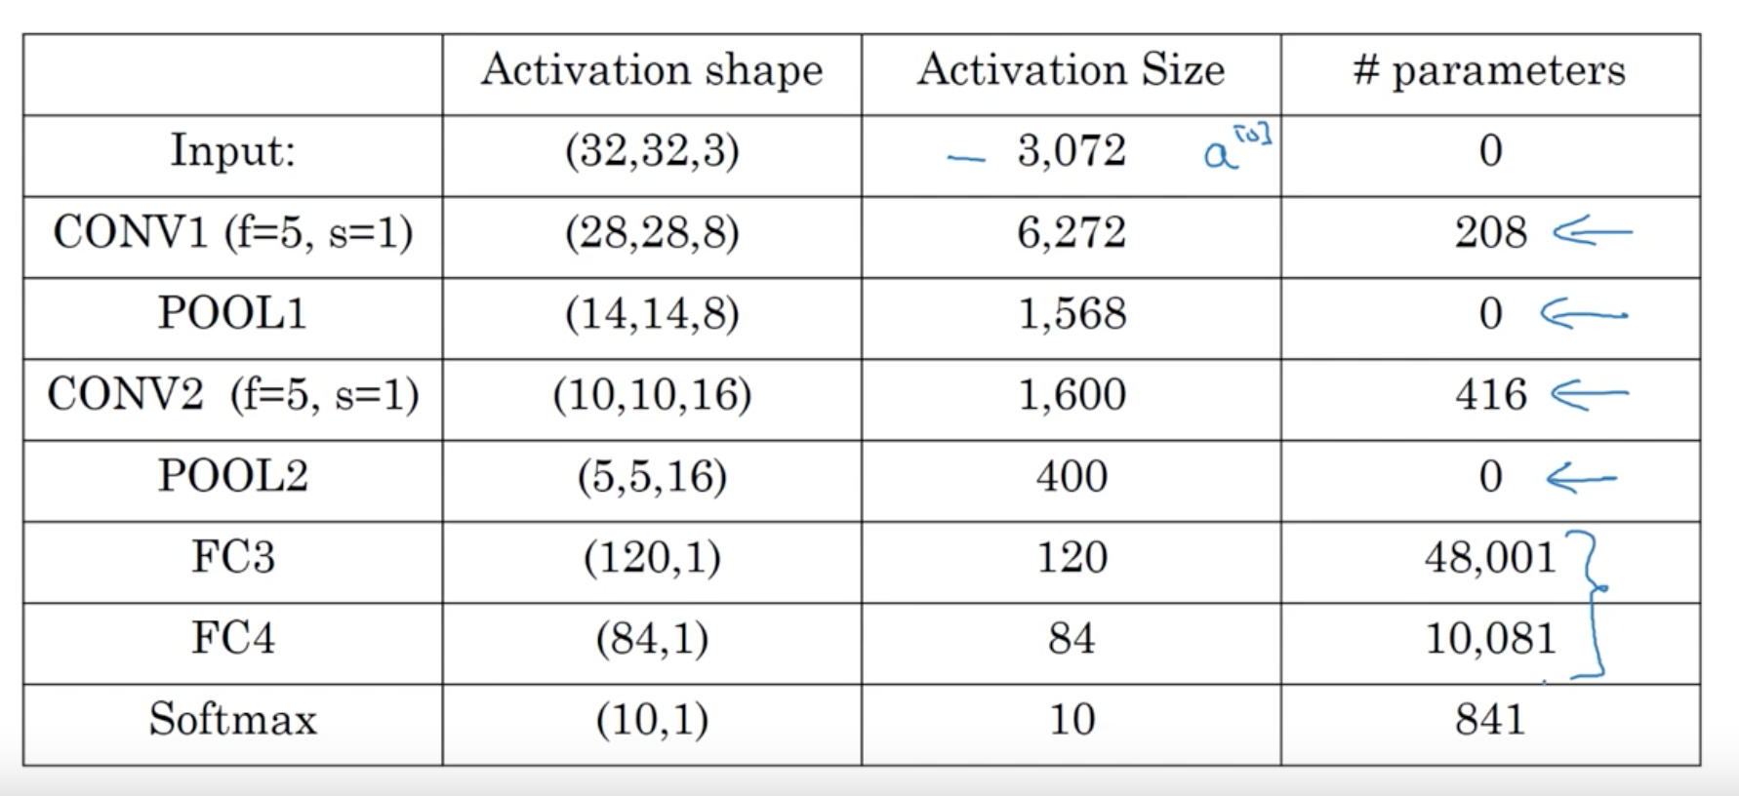
Parameters
Andrew Ng. deeplearning.ai
Notes:
Two problems here –
Output size is reduced.
Corner pixels are only touched once. Information loss

Slide 23
What we Just learnt
Convolution network has generally 3 types of layers – convolution, pooling and fully connected.
(CONV POOL) (CONV POOL) (FC) is a common pattern across CNN.
Convolution helps in reducing the parameter numbers and sharing of weights.
Notes:
Let us run a signal through the neural network

