Slide 1

Notes:
Imagine you are building an app to convert kilometers to Miles but don’t remember the exact formula but you have knowledge of two pieces.

Slide 2
Building The Intuition For Tensors in CNN
Notes:
Imagine you are building an app to convert kilometers to Miles but don’t remember the exact formula but you have knowledge of two pieces.

Slide 3
Fully connected Neural network
Notes:
http://scs.ryerson.ca/~aharley/vis/conv/

Slide 4
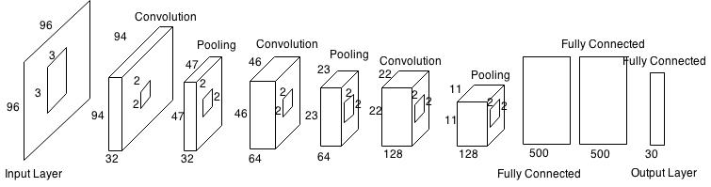
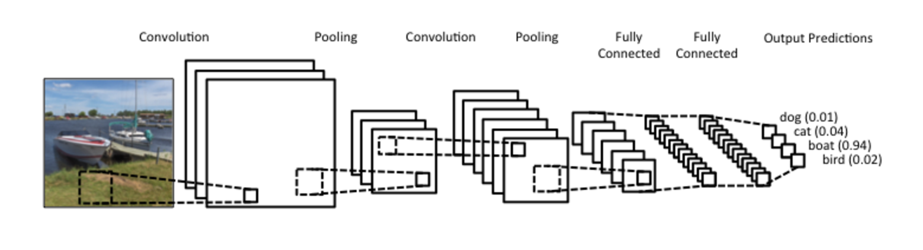
Typical CNN Architecture
Convolutional Neural Networks for Image classification
Notes:
http://setosa.io/ev/image-kernels/

Slide 5
Single channel single filter convolution
3x3
4x4
n-f+1
6x6
Notes:
http://setosa.io/ev/image-kernels/

Slide 6
Single channel Double filter convolution
3x3
4x4
6x6
4x4

Slide 7
3 channel Double filter convolution
3x3
4x4
3x3x3
3x3
3x3x3
6x6
4x4
6x6x3

Slide 8
Padding
3x3
6x6
8x8
N+2P-f+1

Slide 9
Strided convolution
3x3
3x3
7x7
Notes:
Two problems here –
Output size is reduced.
Corner pixels are only touched once. Information loss

Slide 10
Strided convolution
3x3
3x3
7x7
Stride =2
Notes:
Two problems here –
Output size is reduced.
Corner pixels are only touched once. Information loss

Slide 11
Strided convolution
3x3
3x3
(N+2P-f)/S+1
7x7
Stride =2
Notes:
Two problems here –
Output size is reduced.
Corner pixels are only touched once. Information loss

Slide 12
One Layer
RELU
3x3
3x3x3
4x4
3x3
4x4x2
3x3x3
6x6
RELU
4x4
6x6x3
Notes:
Two problems here –
Output size is reduced.
Corner pixels are only touched once. Information loss

Slide 13
Architecture
F=2
S =2
F=2
S =2
CONV2
CONV1
POOL1
POOL2
maxpool
maxpool
F=5
S =1
P=0
Nf=6
F=5
S =1
P=0
Nf=16
14x14x6
10x10x16
5x5x16
32x32x3
28x28x6
400
Softmax
120
84
Notes:
Two problems here –
Output size is reduced.
Corner pixels are only touched once. Information loss

Slide 14
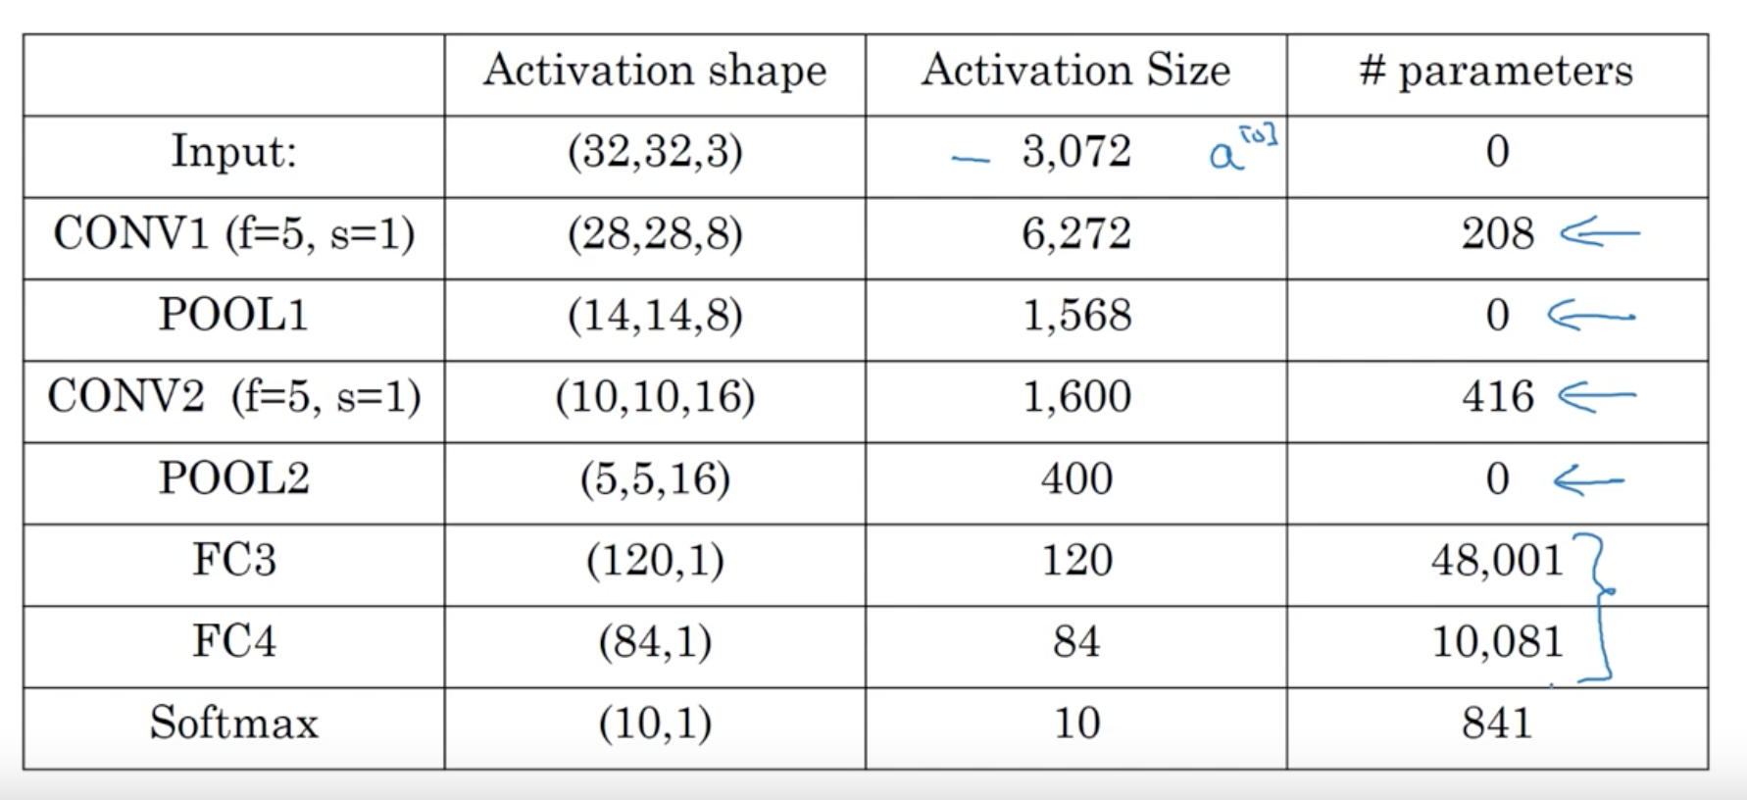
Parameters
Andrew Ng. deeplearning.ai
Notes:
Two problems here –
Output size is reduced.
Corner pixels are only touched once. Information loss

Slide 15
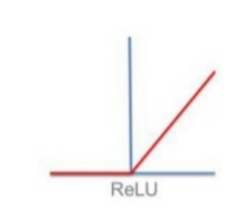
What we Just learnt
A neuron performs a combination of linear and non linear operation.
Non linear operations are called activation functions.
There are different type of activation functions – sigmoid, tanh, relu etc.
RelU layer
Notes:
Let us run a signal through the neural network

Slide 16
optimization tricks/ fine tuning
RelU layer
Notes:
Let us run a signal through the neural network

