Slide 1
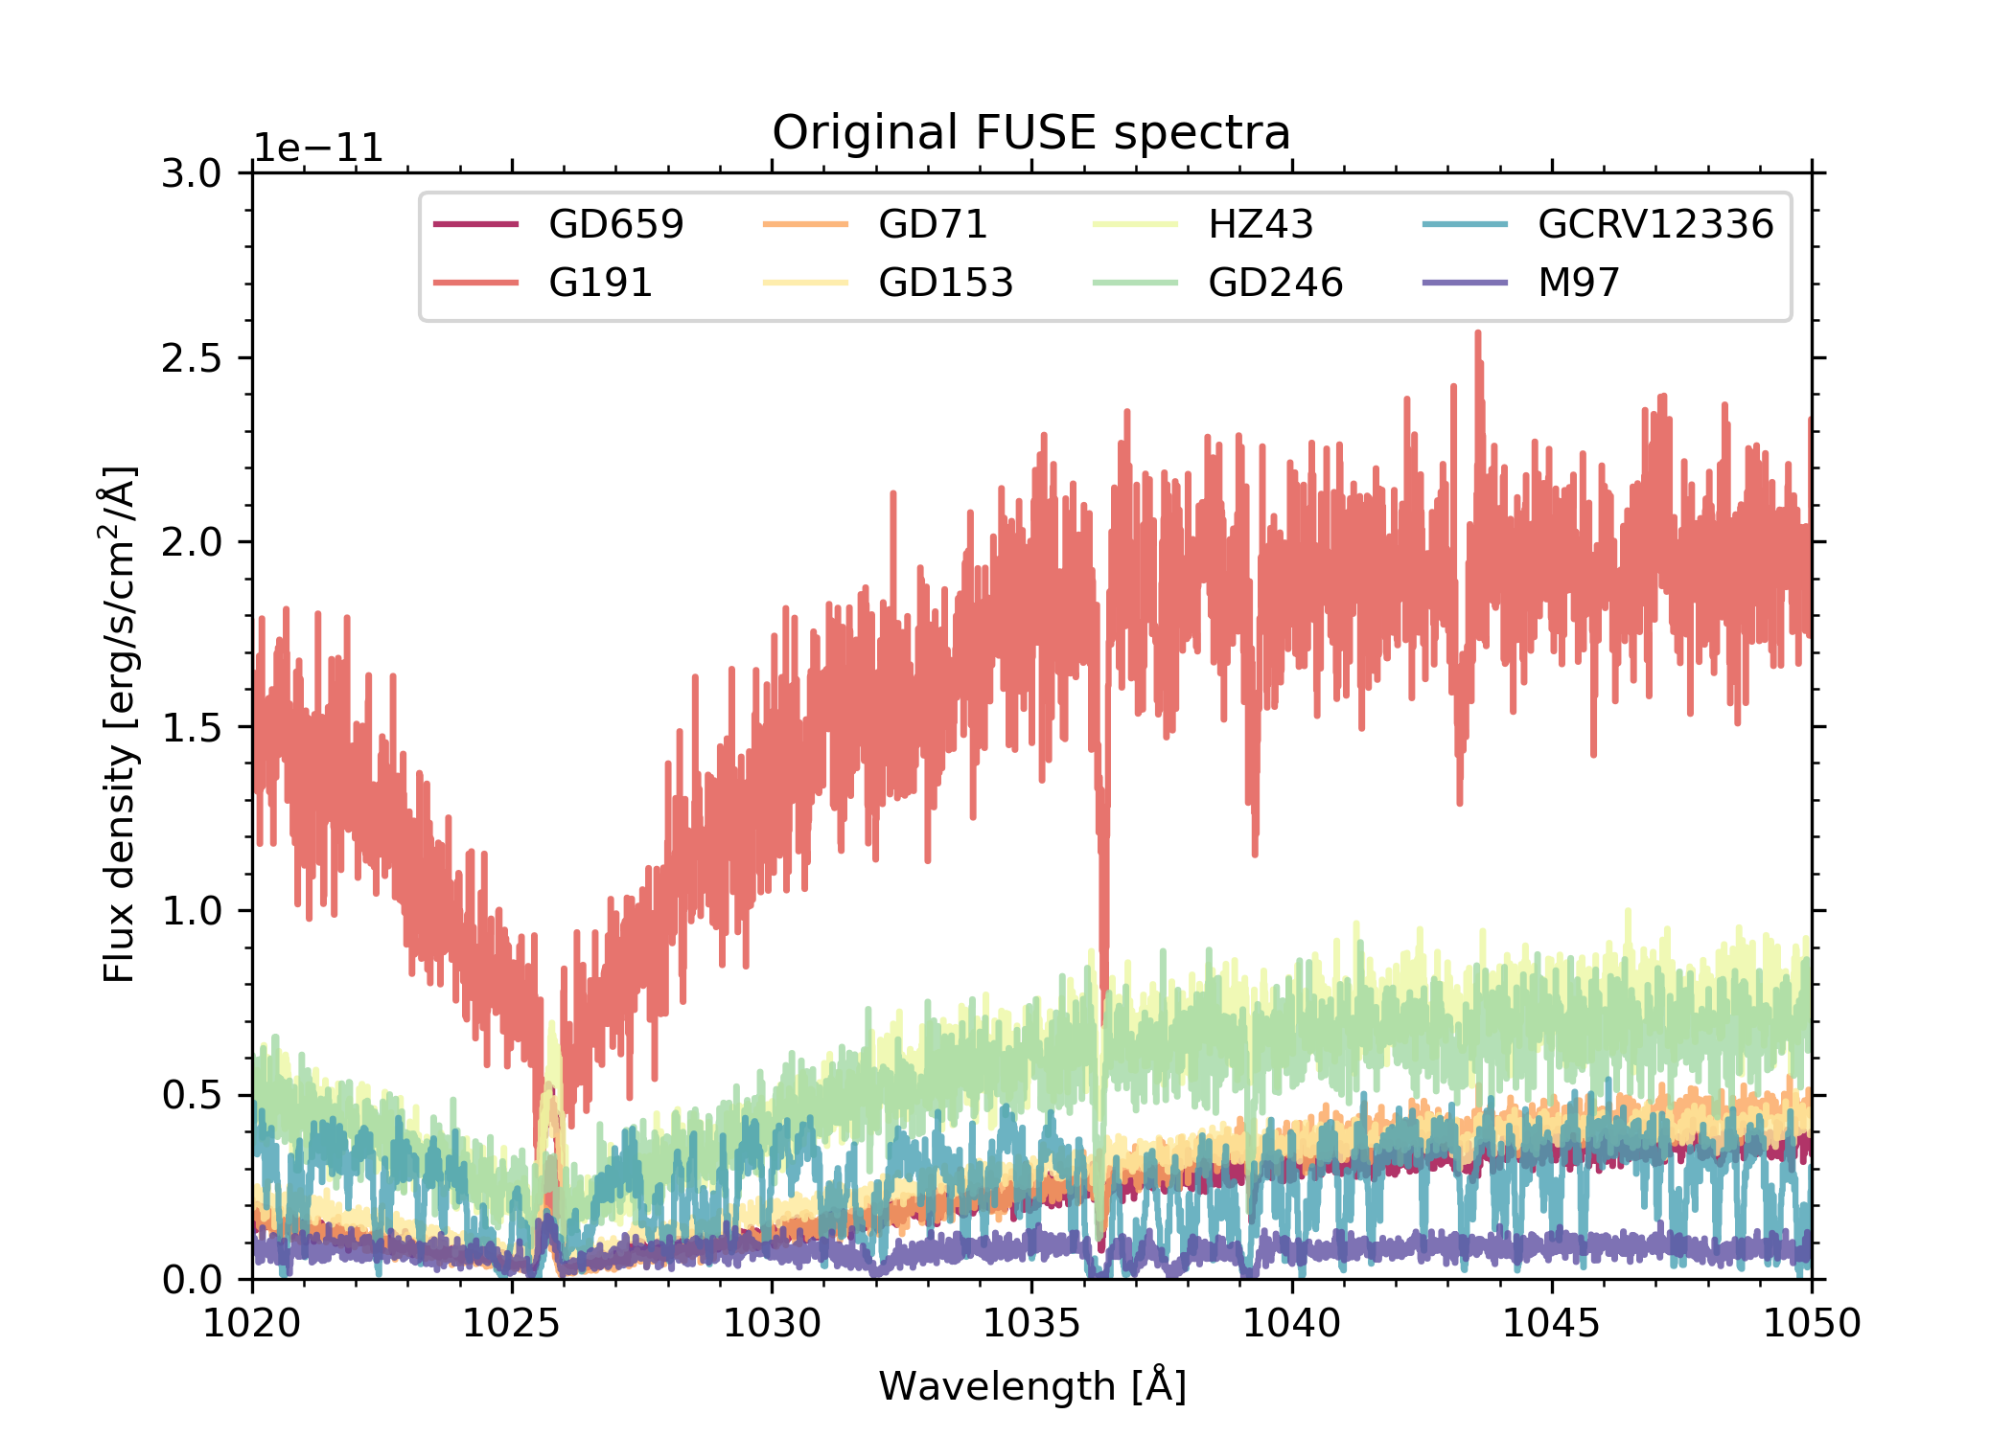
Flux spectra
Original FUSE spectra

Slide 2
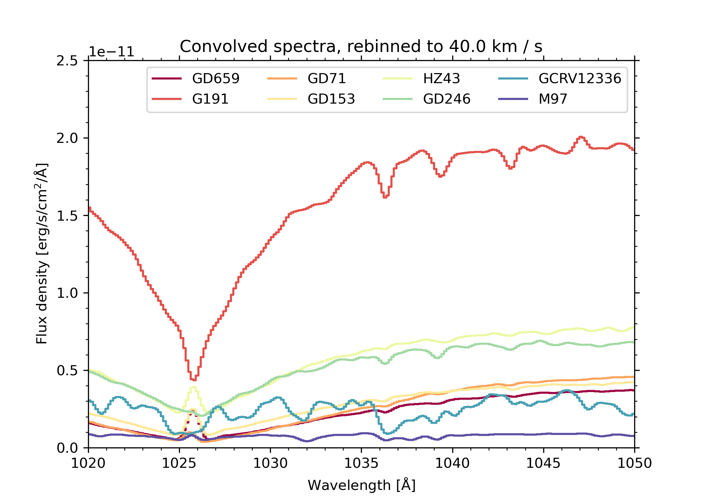
Flux spectra
Original FUSE spectra convolved to 200 km/s
Spectrally rebinned to 40 km/s

Slide 3
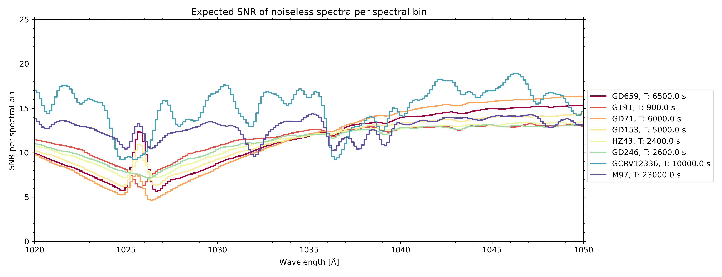
Counts spectra
Original FUSE spectra convolved to 200 km/s
Spectrally rebinned to 40 km/s
No random noise added
Converted to counts
Assumed exposure time: see legend
Assume effective area: 1.34 cm**2
No random noise added

Slide 4
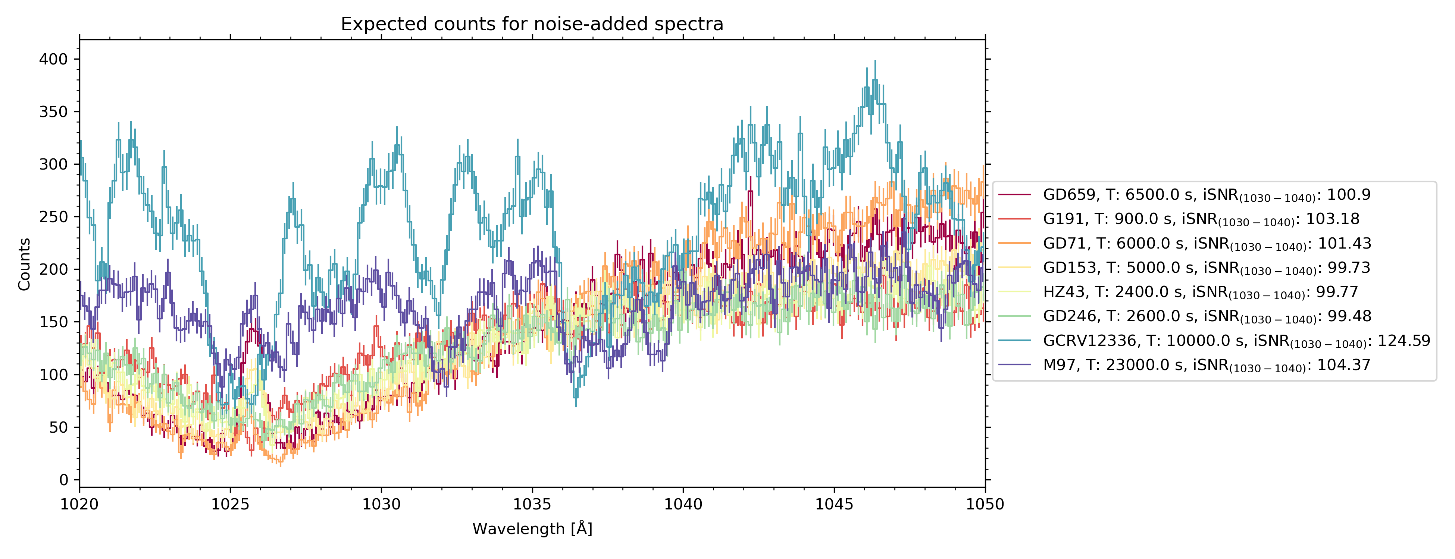
Counts spectra
Original FUSE spectra convolved to 200 km/s
Spectrally rebinned to 40 km/s
No random noise added
Converted to counts
Assumed exposure time: see legend
Assume effective area: 1.34 cm**2
Random noise added

Slide 5
SNR
Original FUSE spectra convolved to 200 km/s
Spectrally rebinned to 40 km/s
No random noise added
Converted to counts, then SNR per spectral bin
Assumed exposure time: see legend
Assume effective area: 1.34 cm**2
No random noise added

Slide 6
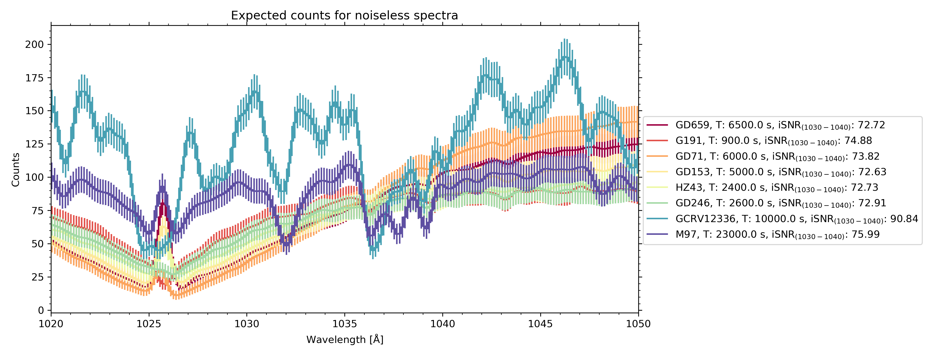
Counts spectra
Original FUSE spectra convolved to 200 km/s
Spectrally rebinned to 40 km/s
No random noise added
Converted to counts
Assumed exposure time: see legend
Assume effective area: 0.71 cm**2
No random noise added

Slide 7
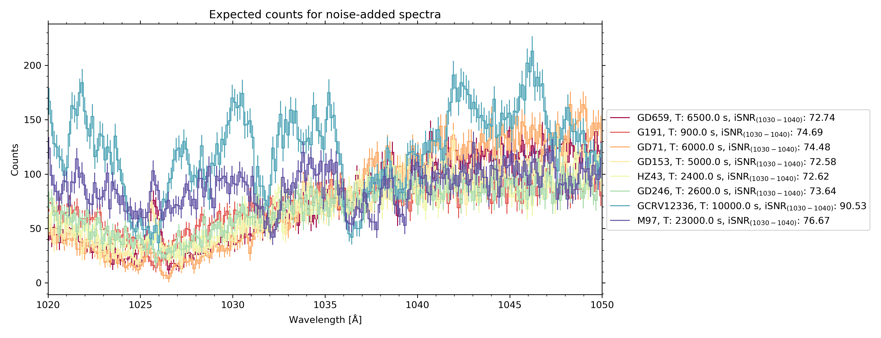
Counts spectra
Original FUSE spectra convolved to 200 km/s
Spectrally rebinned to 40 km/s
No random noise added
Converted to counts
Assumed exposure time: see legend
Assume effective area: 0.71 cm**2
Random noise added

Slide 8
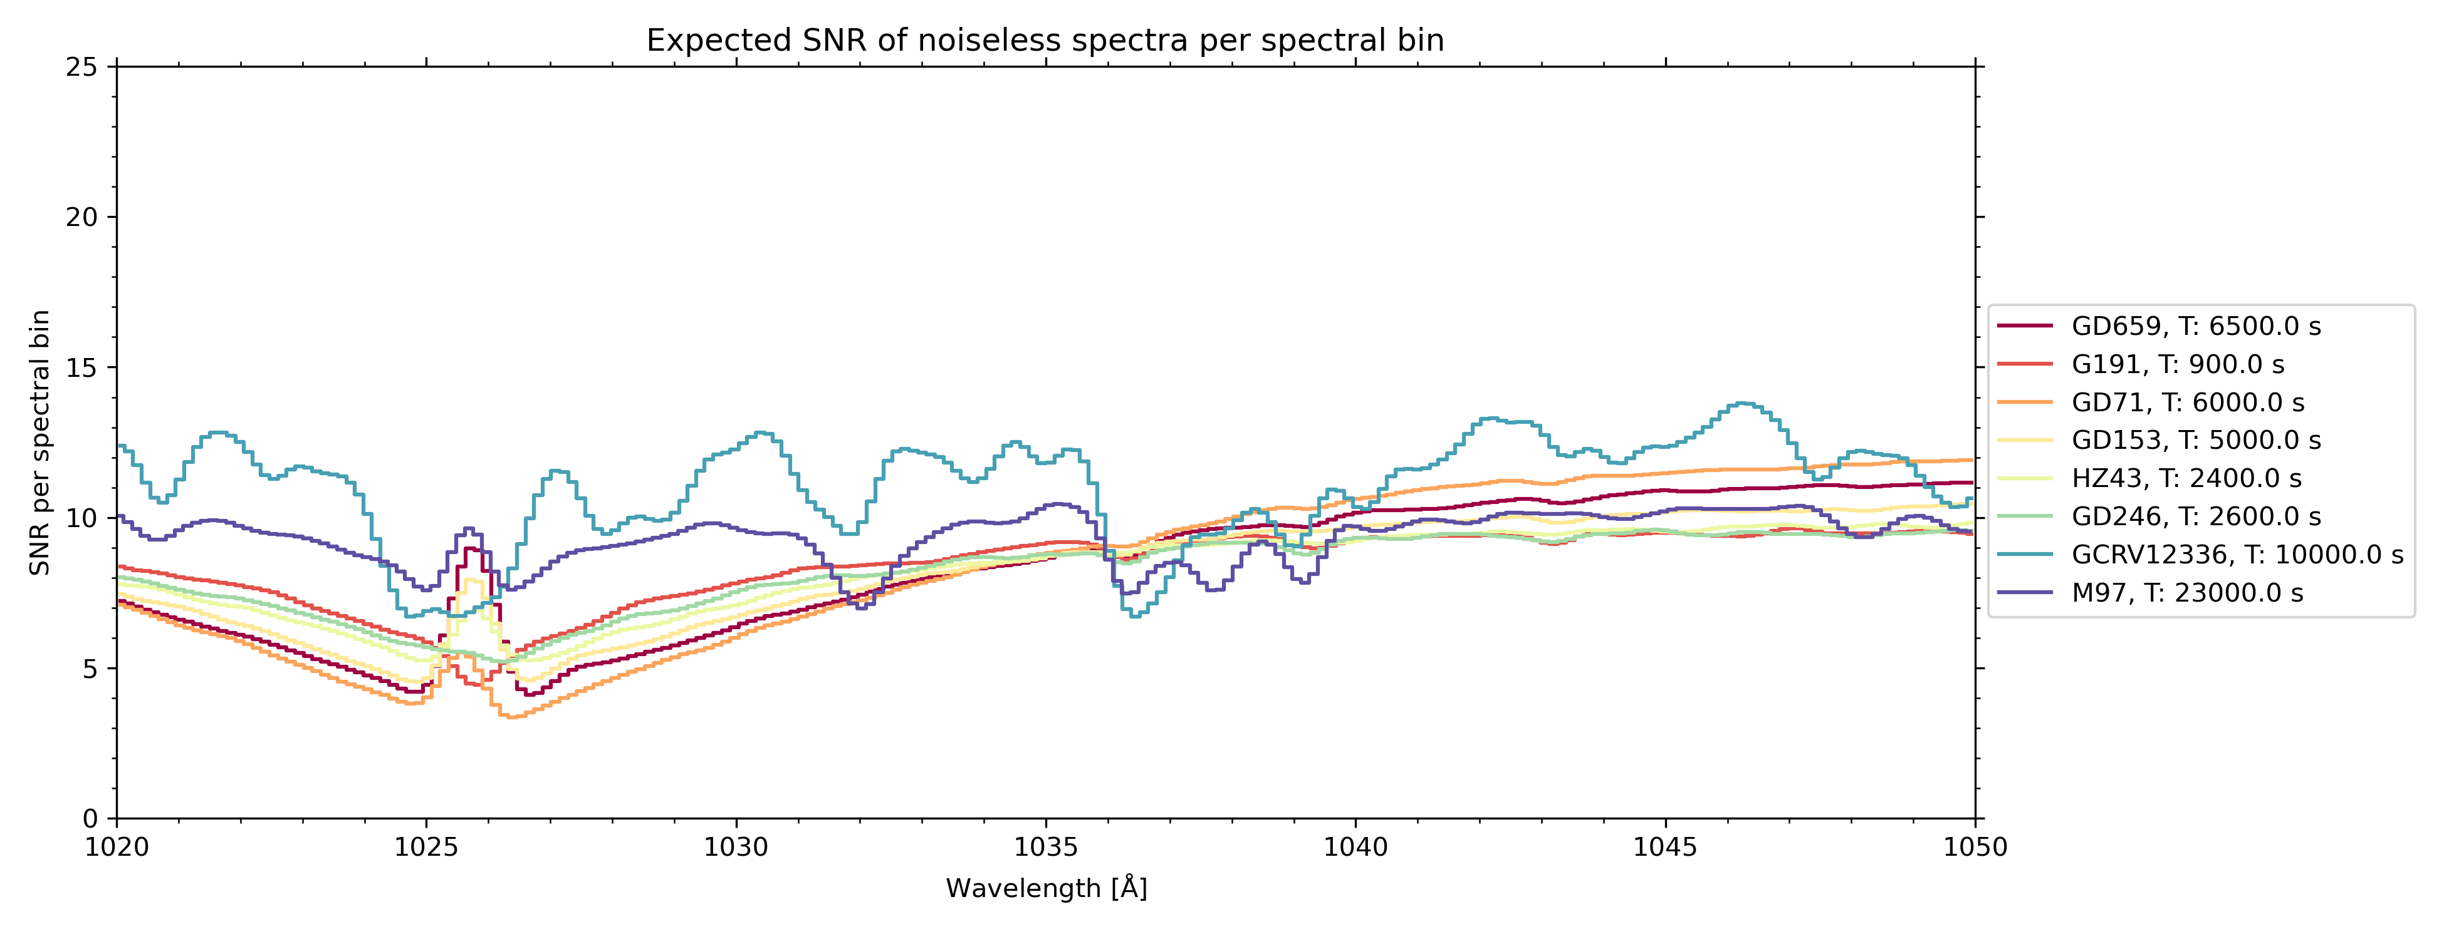
SNR
Original FUSE spectra convolved to 200 km/s
Spectrally rebinned to 40 km/s
No random noise added
Converted to counts, then SNR per spectral bin
Assumed exposure time: see legend
Assume effective area: 0.71 cm**2
No random noise added

Slide 9
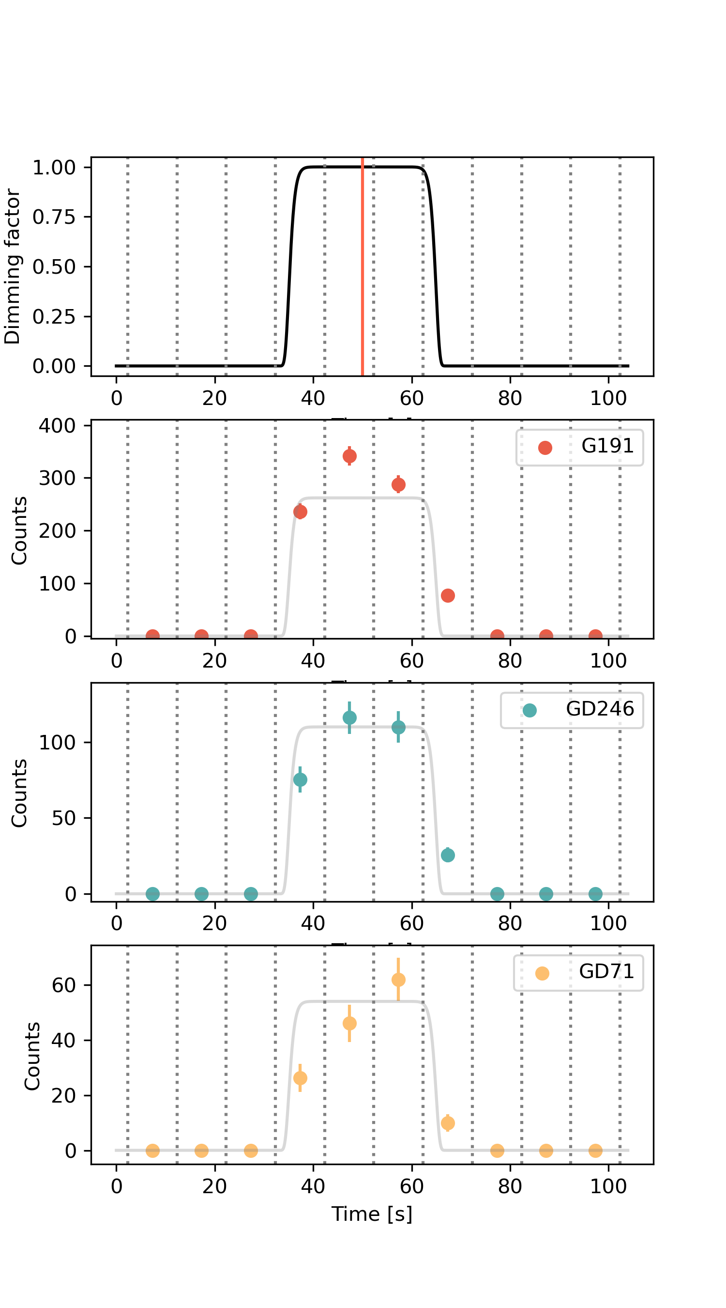
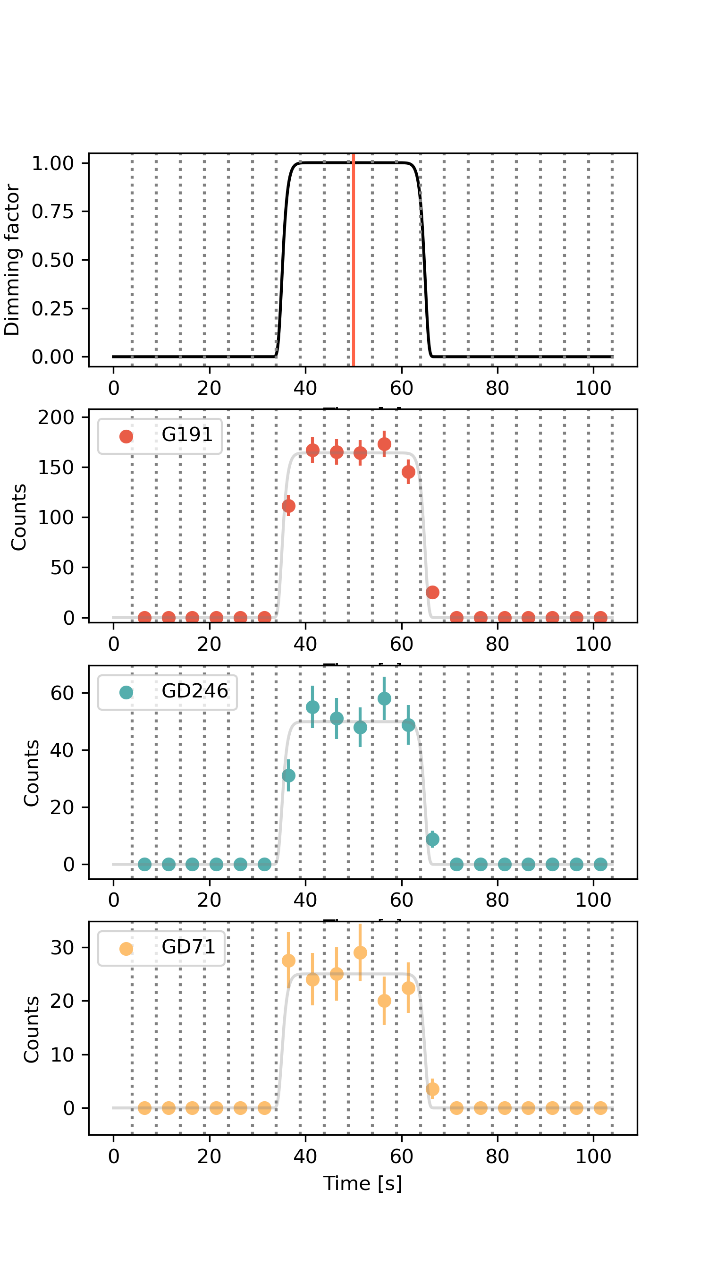
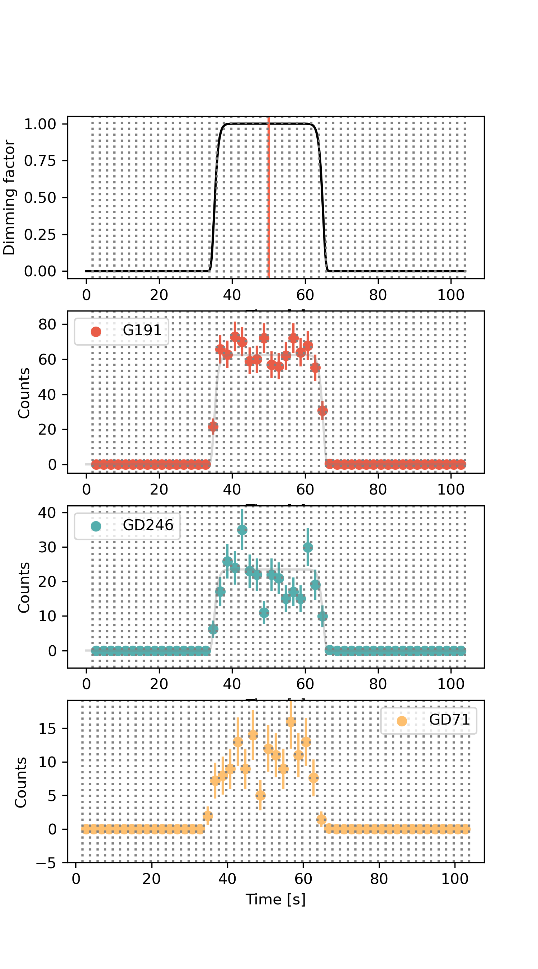
Light curves, Aeff=1.34cm**2
dt=5 s
dt=2 s
dt=10 s
Note: the gray line in each subplot is not a fit, but just the original (scaled) super gaussian to guide the eye.

Slide 10
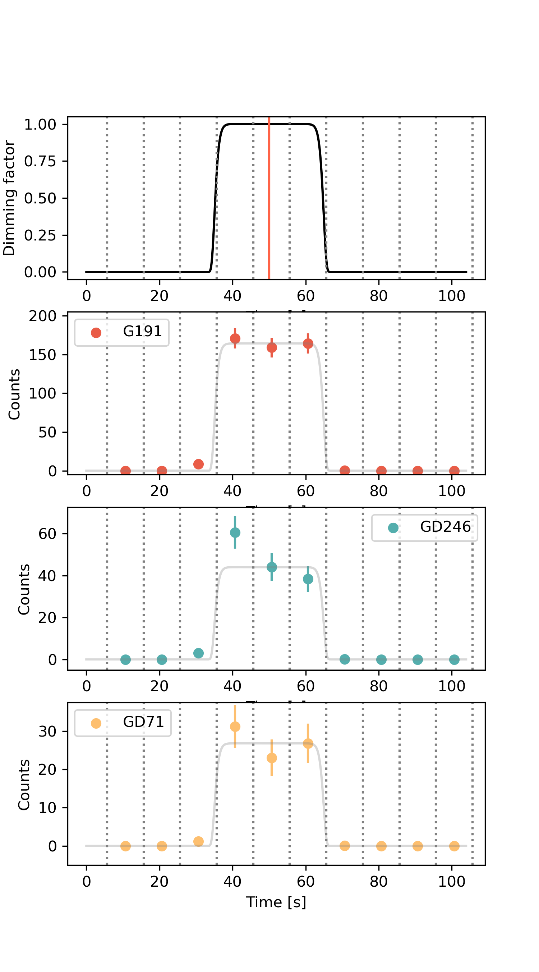
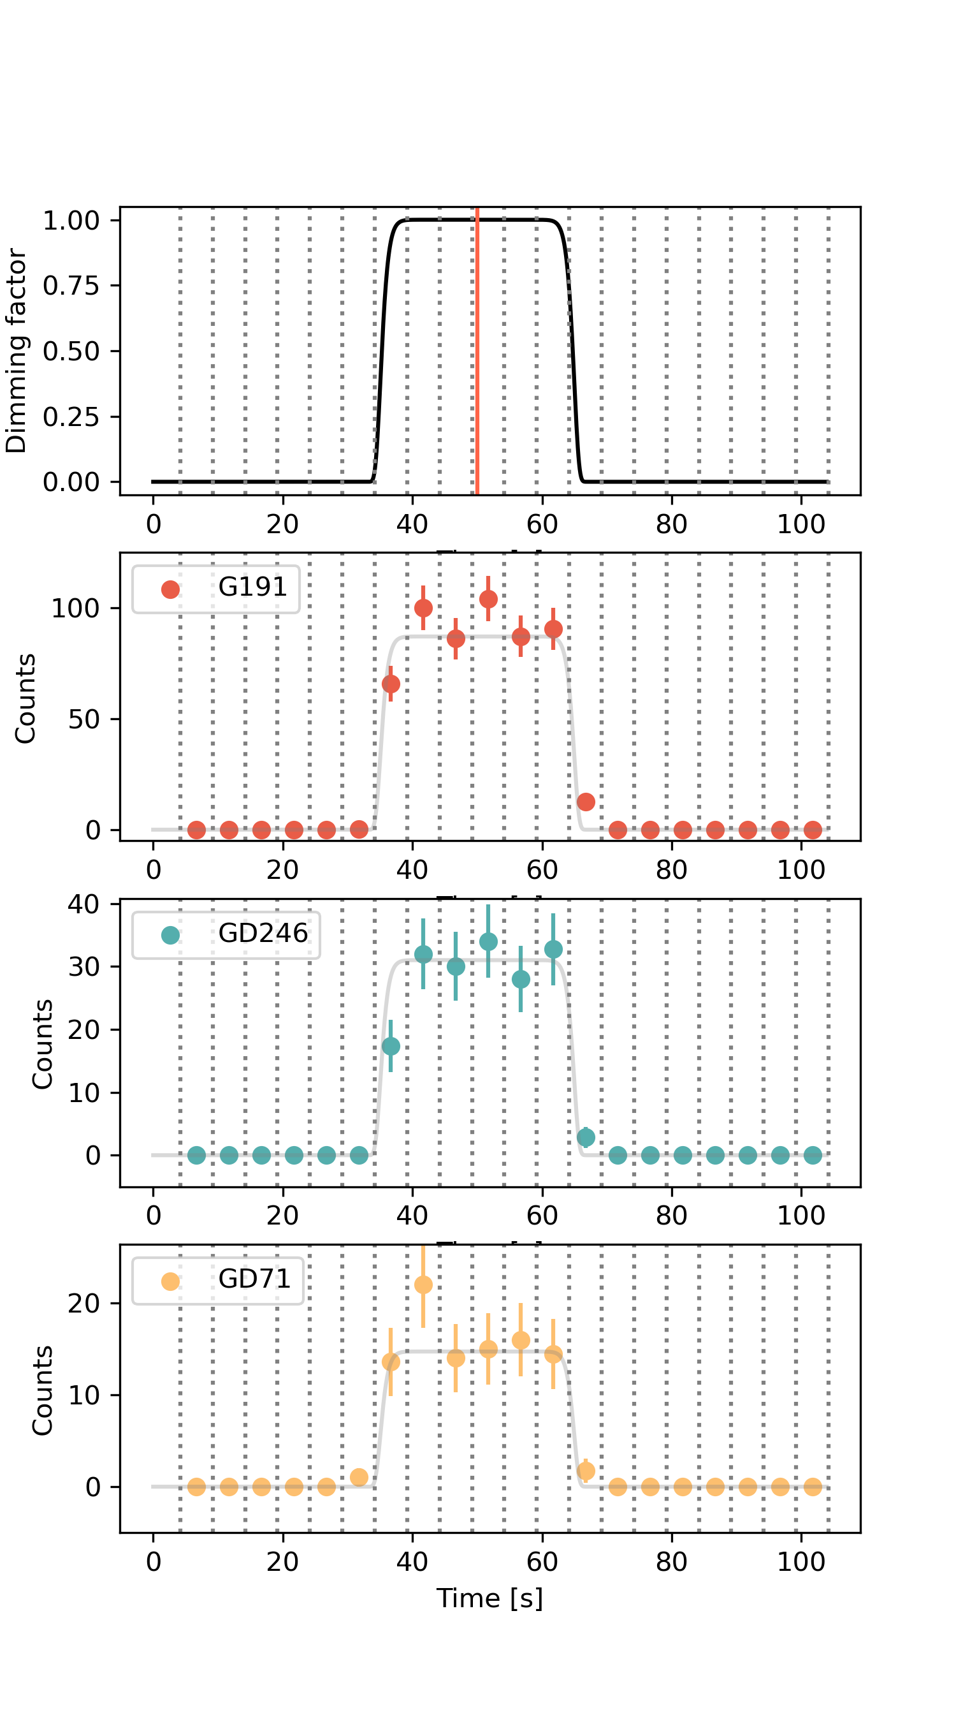
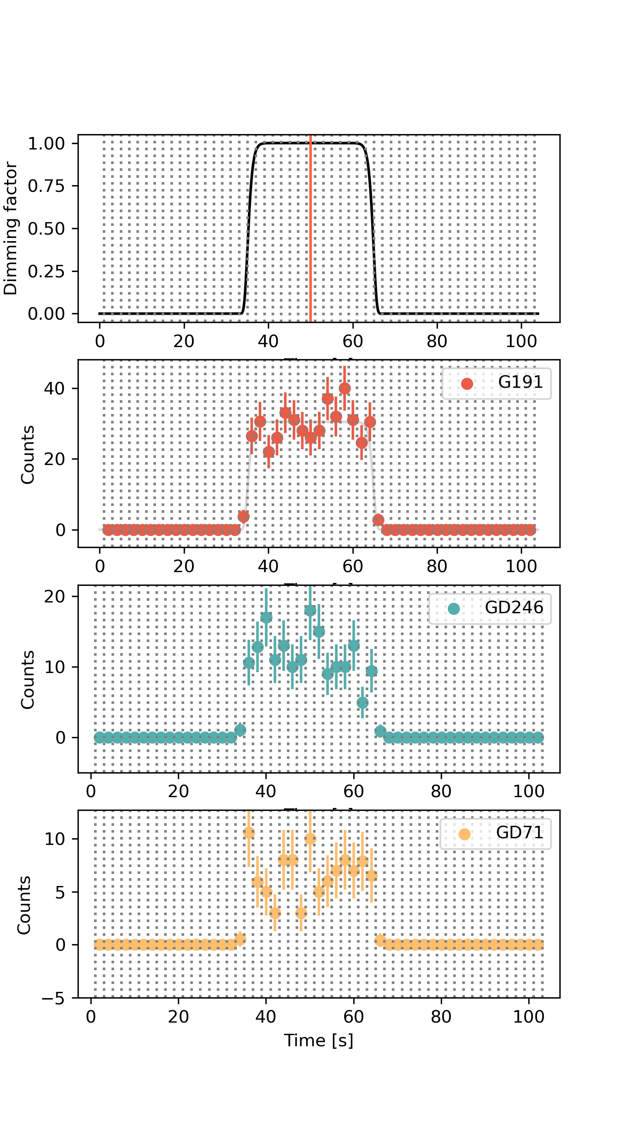
Light curves, Aeff=0.71 cm**2
dt=5 s
dt=2 s
dt=10 s
Note: the gray line in each subplot is not a fit, but just the original (scaled) super gaussian to guide the eye.

