Slide 1
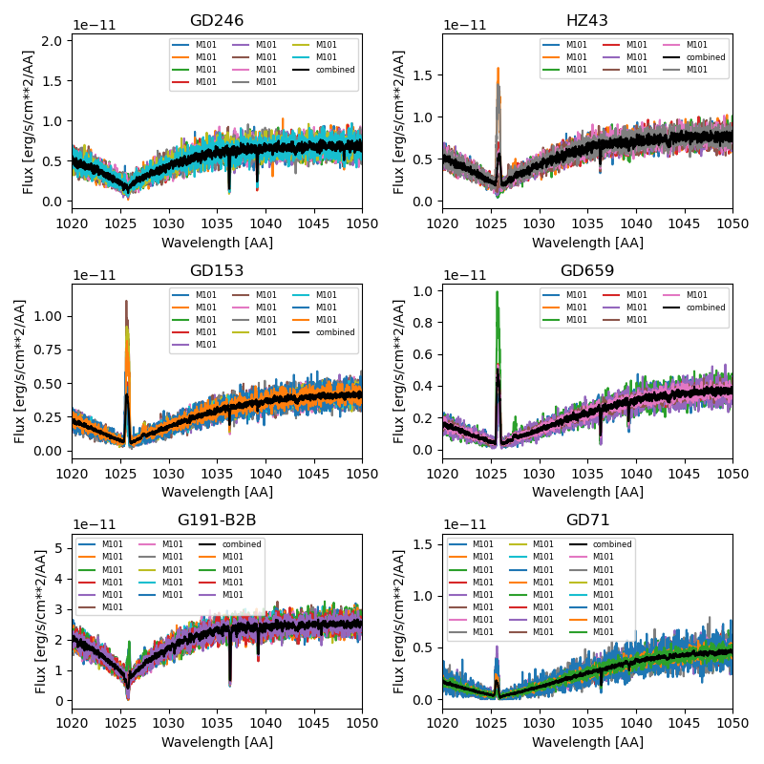
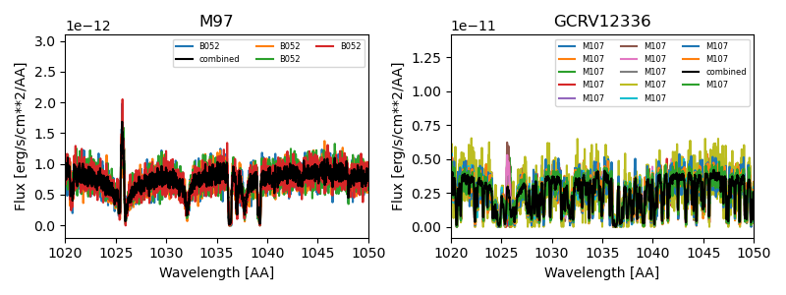
FUSE calibration spectra

Slide 2
Generating Aspera mock counts spectra
Gaussian smoothing (R=1500)
Spectral re-binning to
43 km/s (~intrinsic pixel size) or
146 km/s (~1 spectral resel)
Convert to counts
counts = flux density / (h*c/lambda) * Texp * dlam * Aeff
Assuming Aeff=0.75 cm**2

Slide 3
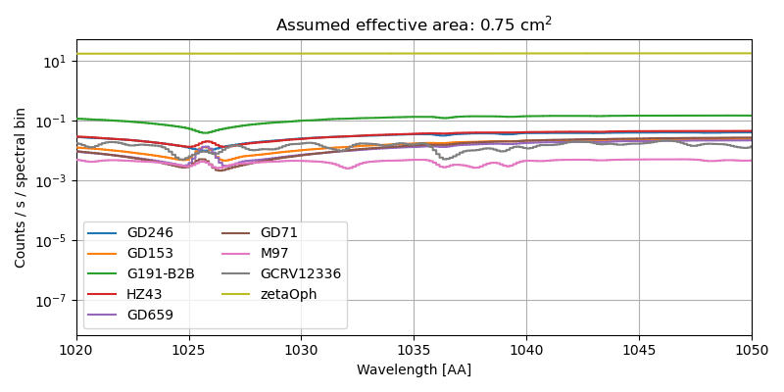
Expected count rates (rebinned to 43 km/s) - logscale

Slide 4
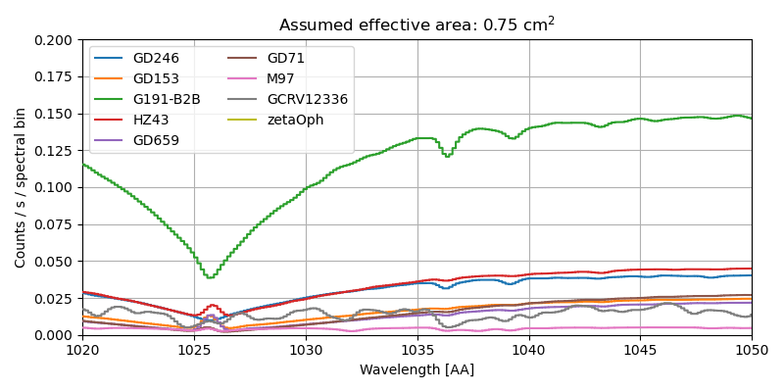
Expected count rates (rebinned to 43 km/s) – linear scale

Slide 5
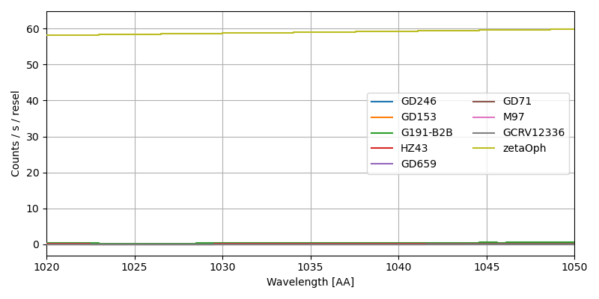
Count rates per resel (rebinned to 146 km/s)
Rebinned to 146 km/s (1 spectral resel)

Slide 6
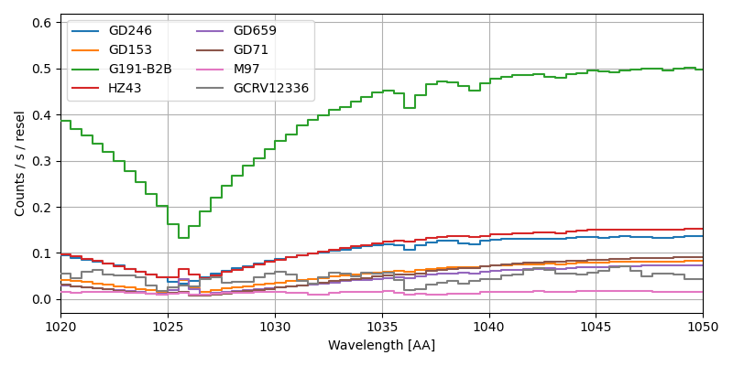
Count rates per resel (rebinned to 146 km/s)
Rebinned to 146 km/s (1 spectral resel)

Slide 7
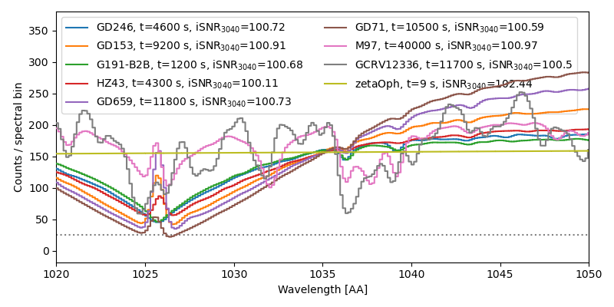
Count spectra
Goal: Integrated SNR (1030-1040 AA) > 100

Slide 8
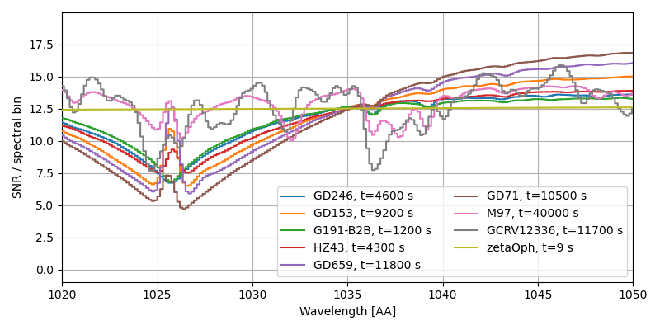
SNR spectra
Goal: SNR per bin > 5

Slide 9
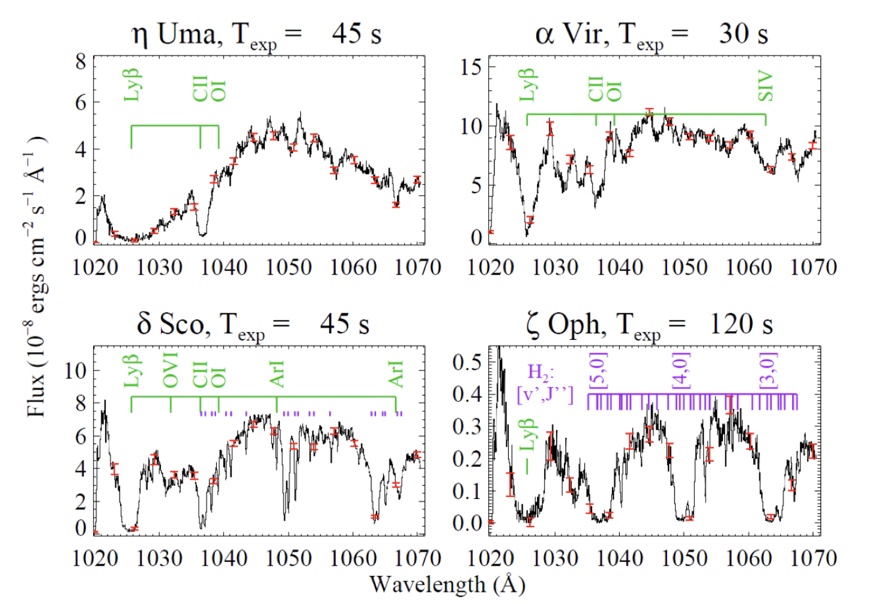
SLICE targets

