Slide 1
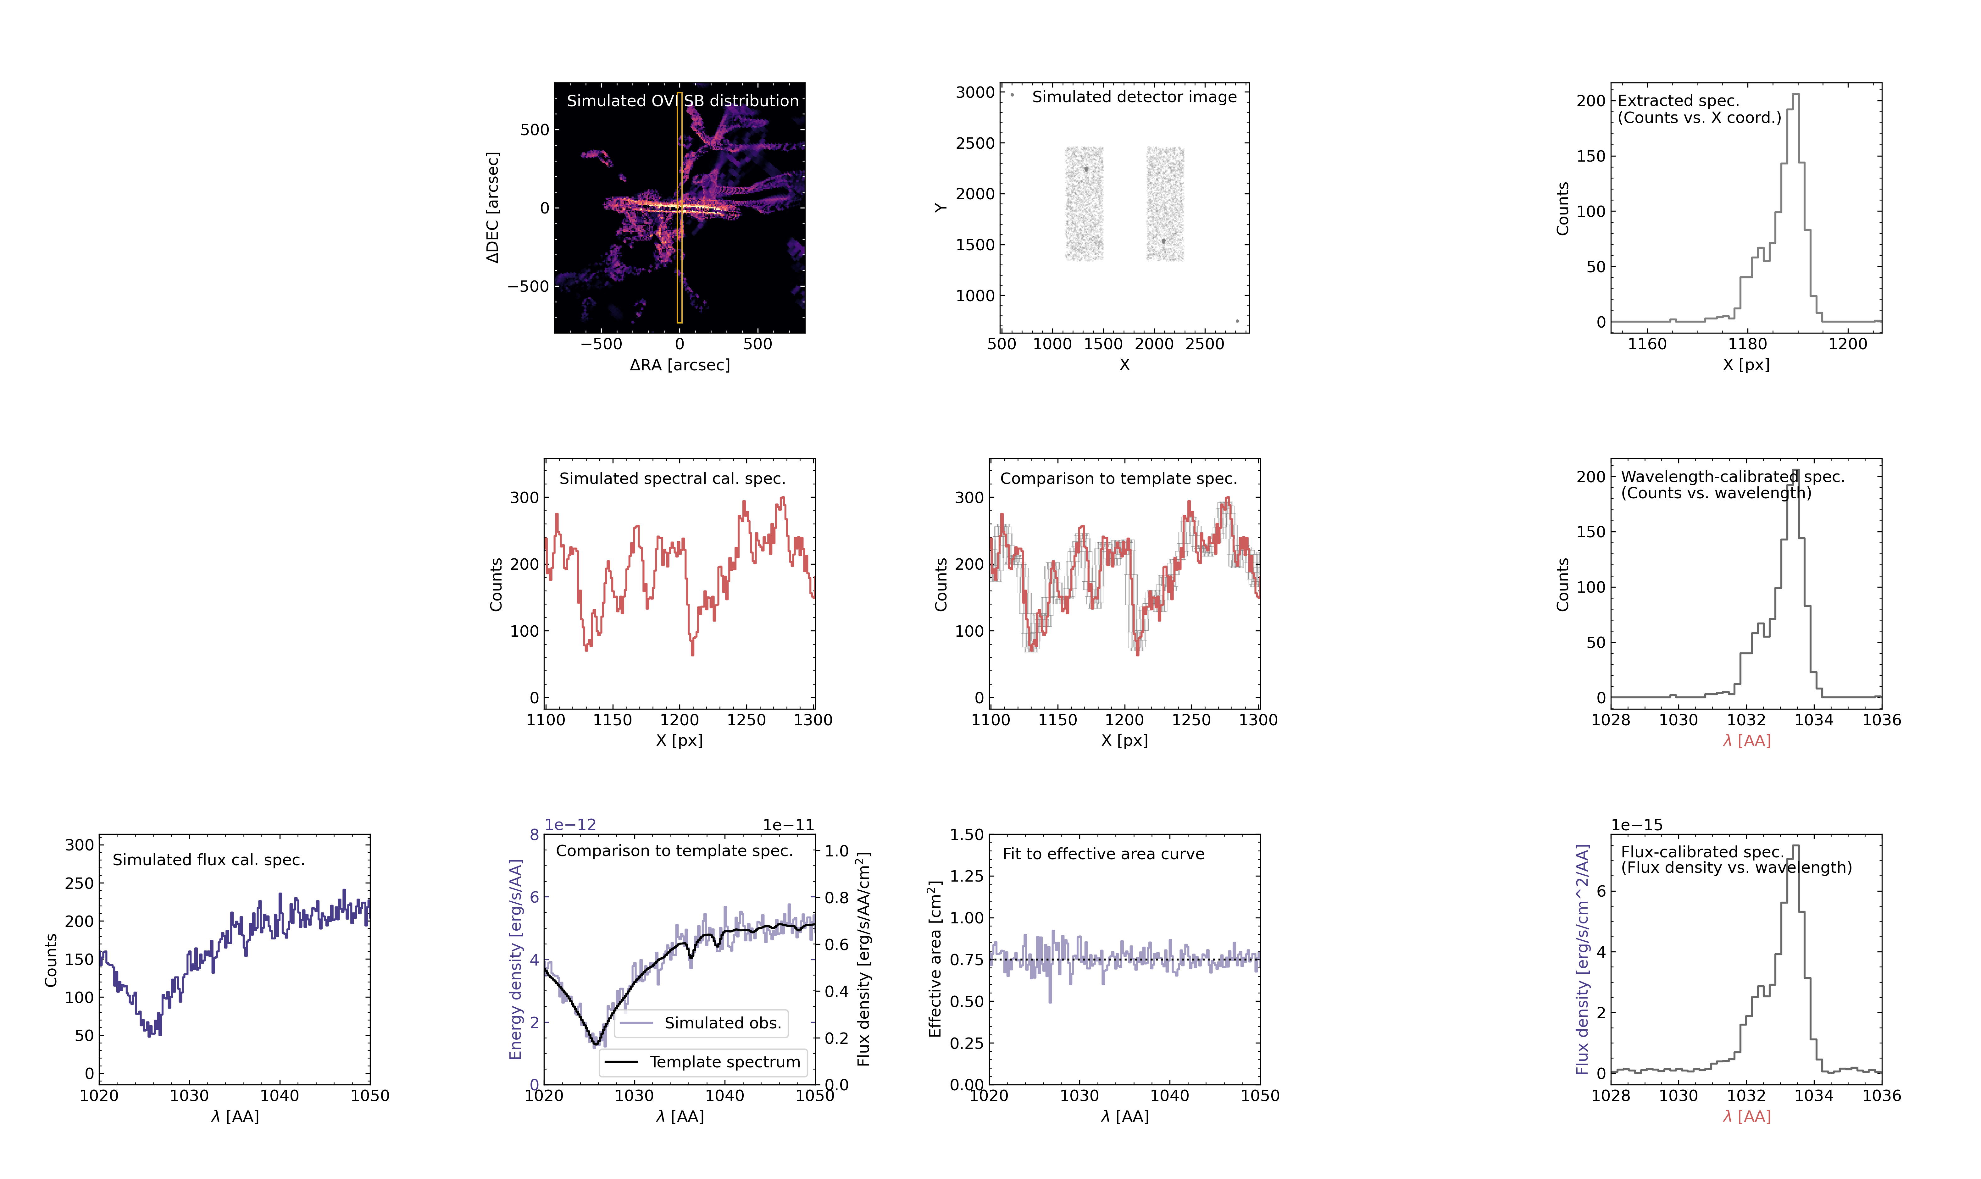
Wavelength solution:
Spectral plate scale
Wavelength zero-point
Effective area curve

