Slide 1
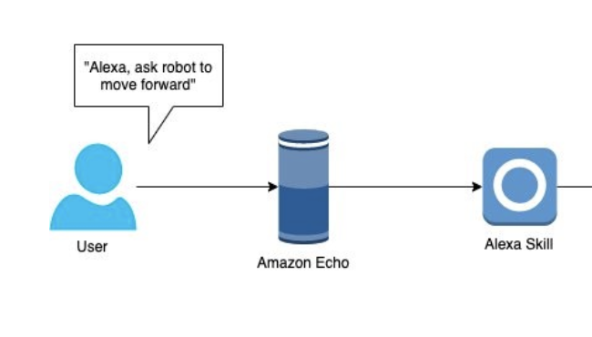
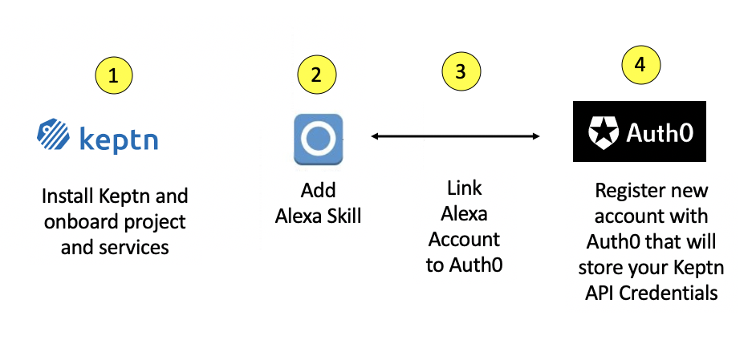



1
2
3
4
Alexa User
Alexa Device
Add Alexa Skill
Link Alexa Account to Auth0
Register new account with Auth0 that will store your Keptn API Credentials
Install Keptn and onboard project and services
https://github.com/keptn-sandbox/alexa-skill

Slide 2

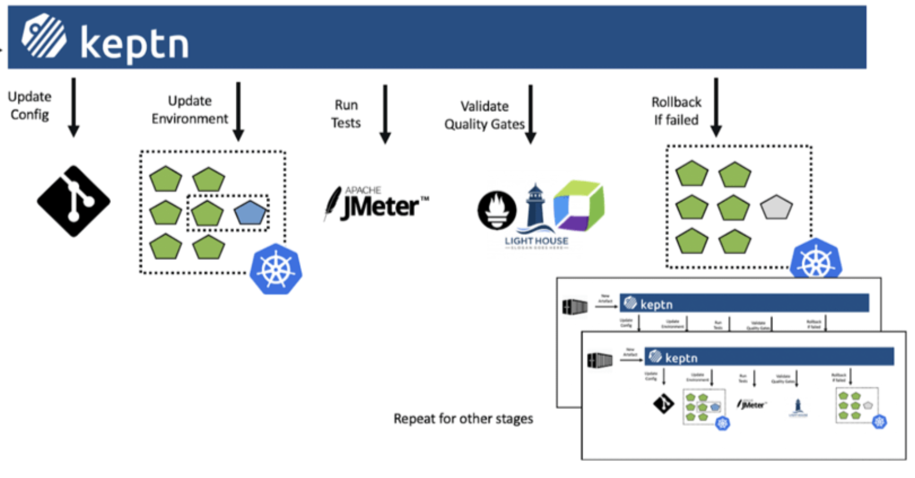
https://github.com/keptn-sandbox/alexa-skill
1
3
4
Invoke Skill
Skill sends Keptn event or calls Keptn API
Keptn returns data or processes Keptn event
Alexa User
Alexa Device
Keptn Alexa Skill
Keptn Seven, deploy carts version 1
2
Skill looks up your Keptn API Credentials

Slide 3
