Slide 1


control plane
.file
1
Keptn sends “triggered” event
Service sends ”started” event
Optionally fetch files from Keptn
Service sends “finished” event
2
3
4
service / integration

Slide 2


Progressive Delivery Workflow
Dev
Hardening
Production
Quality
Gate
Quality
Gate
Functional
tests
Performance tests
Remediation actions

Slide 3
Delivery
Release
Deploy
Test
Evaluate
Release
Operate
Declarative configuration

Slide 4

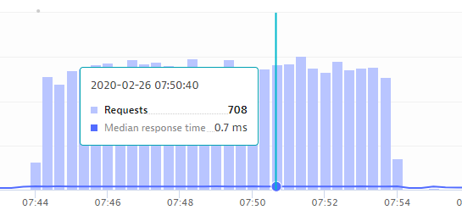

1
Trigger Evaluation
SLI
SLO
4
Get Result
87.5%
2
Evaluate Service-Level Objectives
Fetch Service-Level Indicators
3
87.5%

Slide 5


1
Trigger Evaluation
JMX
SLI
SLO
6
Get Result
87.5%
2
3
4
Deploy into
Test Environment
Trigger Test Execution
Fetch Test Results & Service Level Indicators
Evaluate Service-Level Objectives
5
Test environment
87.5%
1
2

