Slide 1



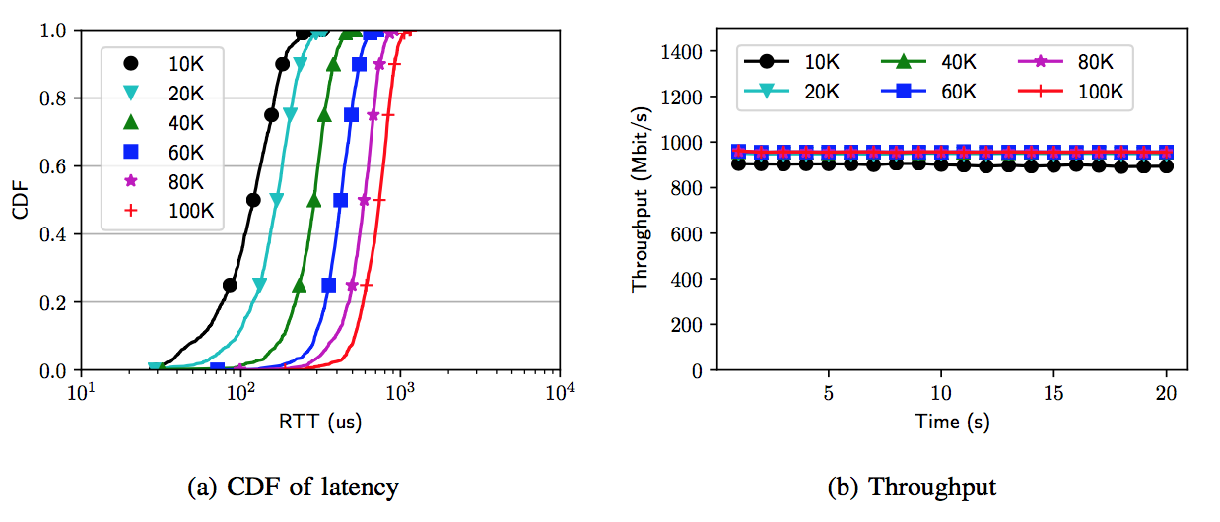
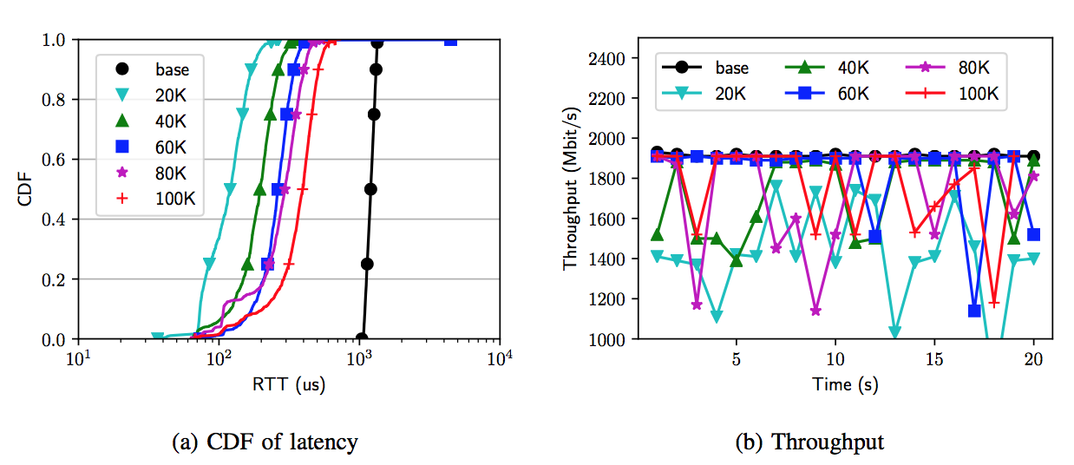
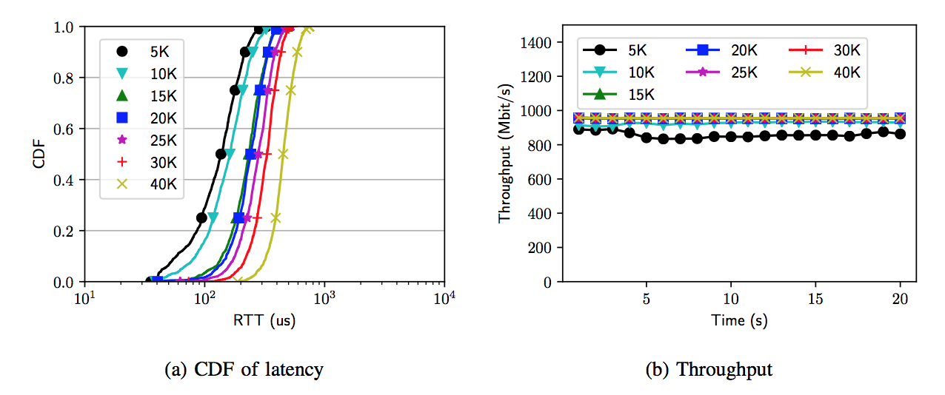
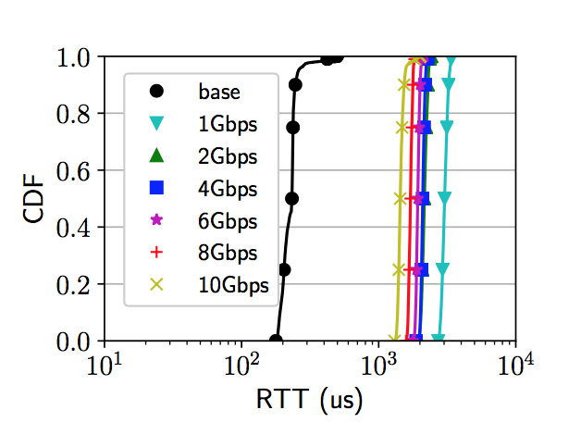
Improving Latency and Burst-tolerance for Software Rate Limiters
Keqiang He, Weite Qin, Qiwei Zhang, Wenfei Wu, Junjie Yang, Tian Pan, Chengchen Hu, Jiao Zhang, Aditya Akella and Ying Zhang
HP Labs
Introduction & Motivation
Design Requirements
Evaluation
Bandwidth allocation is a must in virtualized Datacenter networks
Software/Hardware Rate limiters are employed to enforce bandwidth allocation
Rate limiters increase end-to-end latency - bandwidth allocation, low latency, loss packet loss rate can not be achieved at same time.
 | High Tput | Low Latency | Generic
Raw HTB | Y | N | Y
HTB with DCTCP | N | Y | N
2Gbps HTB rate limiter with different ECN marking thresholds
Segment-level marking, instead of packet-level
Large control loop latency, can be affected by “in-network” latency
DEM performance
VM1
VM2
VM3
server
Key Ideas
RL1
RL2
RL3
DEM (Direct ECE Marking): directly set TCP ECE bit based on real time rate limiter queue length to reduce control loop latency and avoid segment-level marking. DEM relies on DCTCP and ECN
Spring: Window-based congestion control algorithm (e.g., TIMELY) based on real time rate limiter queue length. Enforcing congestion control decisions using RWND. Spring satisfies all design requirements.
Spring performance
Measurement of Linux HTB
Conclusion
Rate limiters are employed to enforce bandwidth allocation but raw rate limiters inflate network latency significantly
Design requirements: high throughput, low latency and generic.
DEM and Spring improve performance for software rate limiters. DEM relies on DCTCP/ECN support while Spring is a generic solution
Implementation
Implemented in Linux HTB and OVS
Tested in CloudLab
base: RTT without congestion

