Slide 1
Mapping Research Software Landscapes through Exploratory Studies of GitHub Data
Keven Quach
1st supervisor: Anna-Lena Lamprecht
2nd supervisor: Fernando Castor
Daily supervisor: Jonathan de Bruin

Slide 2
Table of Contents
Motivation
Background information
Research questions
Research method

Slide 3
Motivation Background information Research questions Research method

Slide 4
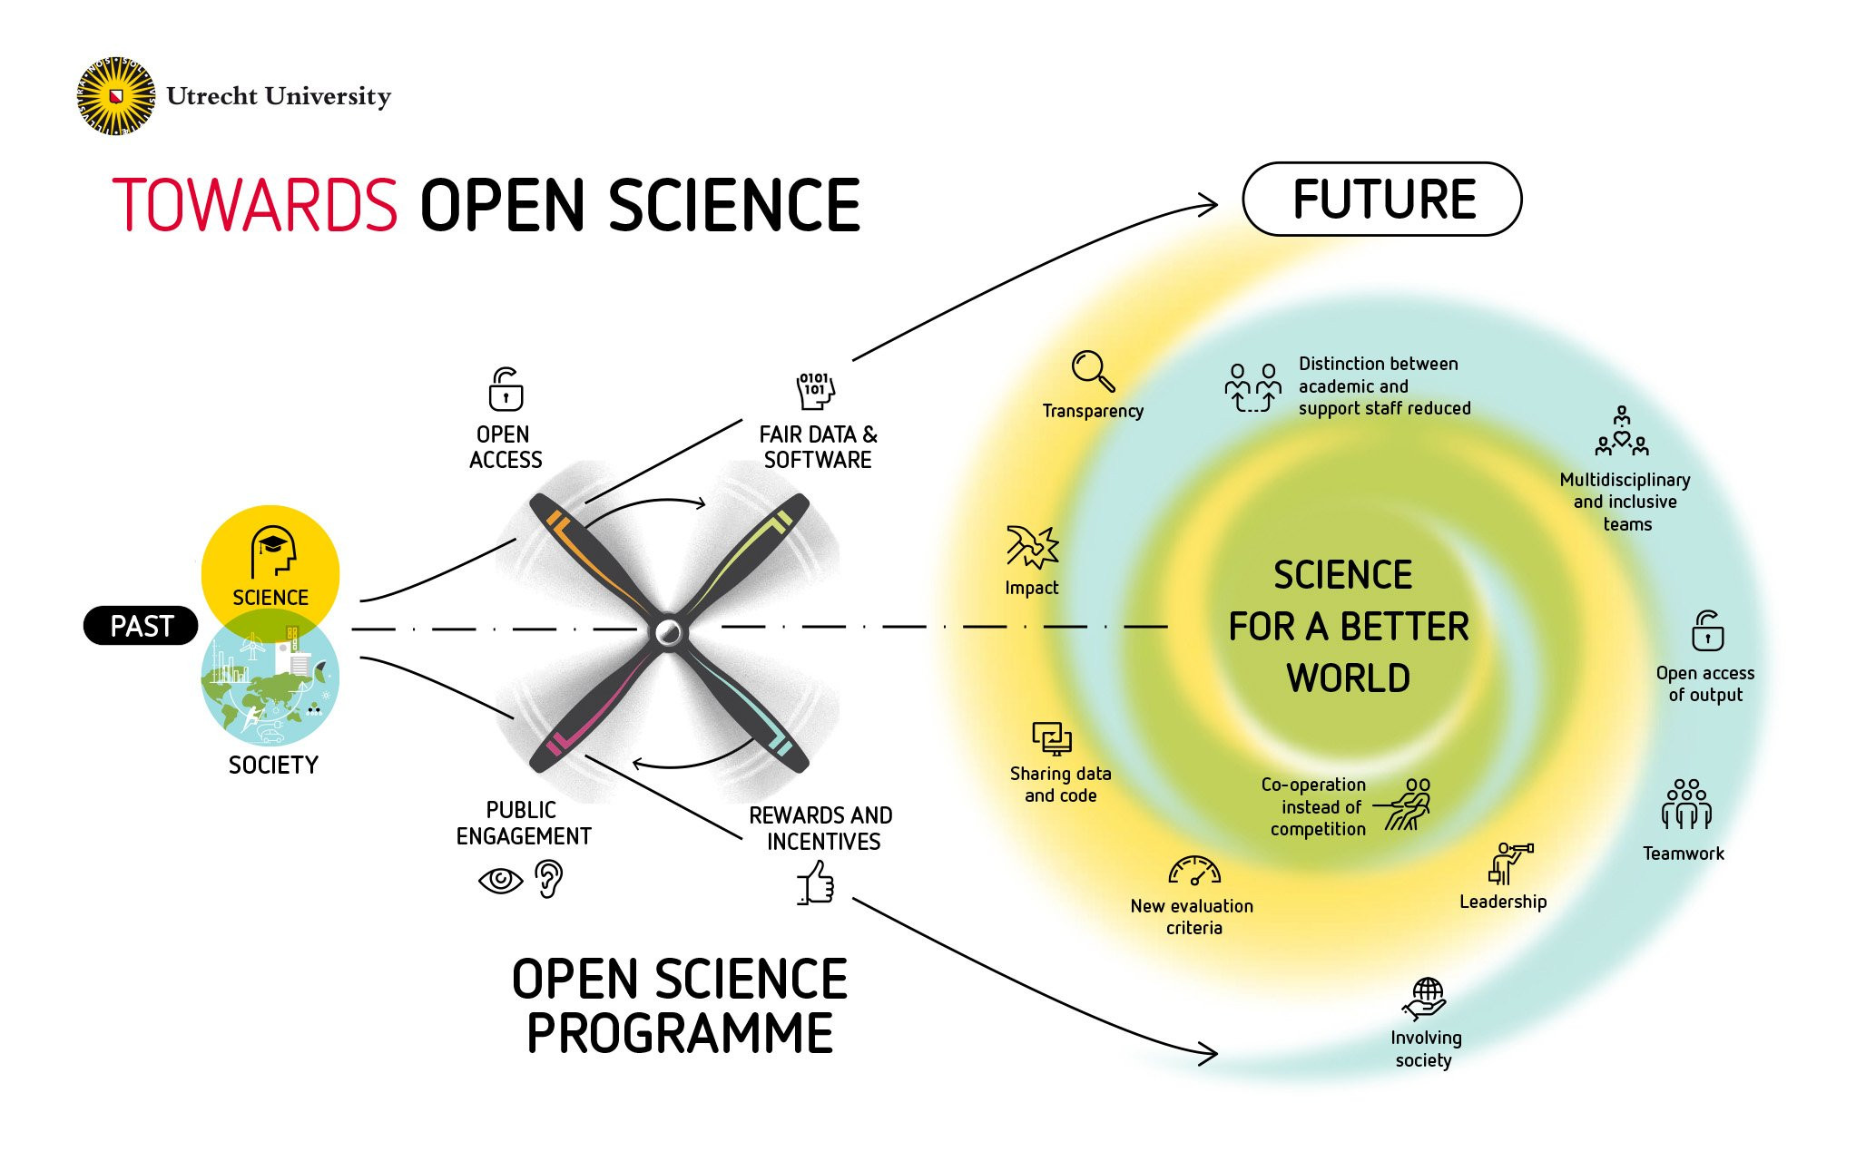
Why is this topic relevant? (1/3)
Transition to Open Science: research data and software should be open and FAIR (findable, accessible, interoperable, reusable).
What do we know about UU researchers’ code and software?
How open and FAIR is our researchers' code and software?
From https://www.uu.nl/sites/default/files/styles/original_image/ public/Utrecht-University-towards-open-science.jpg
Notes:
Not much is known, information is scattered across many platforms → see next slide

Slide 5


SWORDS@UU (2/3)
Scan and revieW of Open Research Data and Software at Utrecht University
Goal: Get insights about how UU researchers develop, manage, and publish software on GitHub
Collect users
Collect repositories
Collect variables
Filtering
Filtering
https://github.com/UtrechtUniversity/SWORDS-UU

Slide 6



Contribution of the thesis (3/3)
Provide labelled GitHub dataset
Extend SWORDS framework with FAIR-related variables
Develop method for reusable data analysis of an organization to infer recommendations
https://github.com/kequach/Thesis-Mapping-RS
Notes:
Labelling → Research domain + repo type
How open and FAIR is our researchers code and software? → How do we even measure this?
SWORDS only has basic descriptive statistics

Slide 7
Motivation Background information Research questions Research method

Slide 8

GitHub - a code hosting platform (1/3)
Most popular coding platform with many features
Provides REST API
Lots of GitHub analyses already performed
Notes:
Popular: For industry, academia, and private projects
Features: Issues, PRs, wikis, forking of repositories, machine-readable metadata
API: Allows large-scale data retrieval and analysis
Analysis: Proven method but only 1 on FAIRness and 0 on different research domains

Slide 9
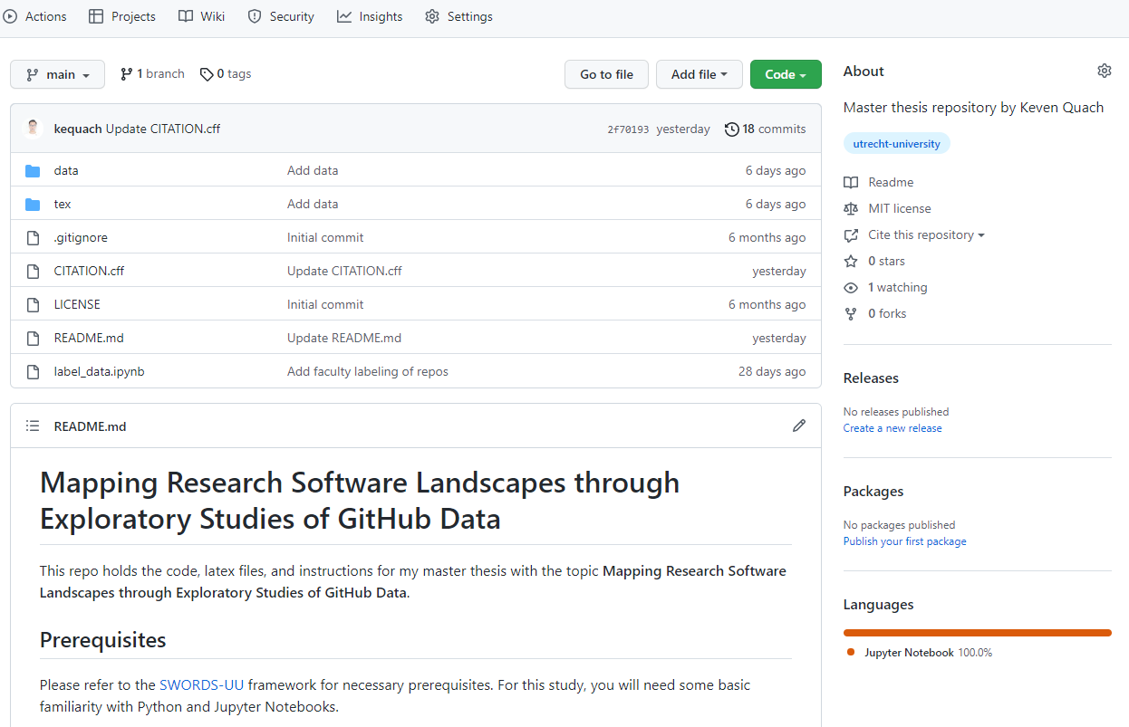

Slide 10
FAIR principles (2/3)
FAIR Guiding Principles for scientific data management and stewardship [1]
Published in 2016
Applicable to all research objects
Foundational principles accompanied by guiding principles
Facilitates reproducibility and reusability of research
[1] Wilkinson, M., Dumontier, M., Aalbersberg, I. et al. The FAIR Guiding Principles for scientific data management and stewardship.
Notes:
Most important publication for this thesis

Slide 11
FAIR principles (3/3)
FAIR Guiding Principles for scientific data management and stewardship [1]
Findable: “The first step in (re)using data is to find them. Metadata and data should be easy to find for both humans and computers. Machine-readable metadata are essential for automatic discovery of datasets and services, so this is an essential component of the FAIRification process.”
Accessible: “Once the user finds the required data, she/he/they need to know how they can be accessed, possibly including authentication and authorisation.”
Interoperable: “The data usually need to be integrated with other data. In addition, the data need to interoperate with applications or workflows for analysis, storage, and processing.”
Reusable: “The ultimate goal of FAIR is to optimise the reuse of data. To achieve this, metadata and data should be well-described so that they can be replicated and/or combined in different settings.” [2]
[1] Wilkinson, M., Dumontier, M., Aalbersberg, I. et al. The FAIR Guiding Principles for scientific data management and stewardship.
[2] https://www.go-fair.org/fair-principles/

Slide 12
Motivation Background information Research questions Research method

Slide 13
Research questions (1/2)
How can information about open source publications on GitHub be used to infer actionable recommendations for RSE practice to improve the research software landscape of an organization?
What is the current state of the art of FAIR principles?
How can FAIR principles be supplemented with additional variables?
How can the application of FAIR variables for research software be supported?
Are there different characteristics for different subpopulations in the data?
How well can we identify research software with available data?

Slide 14

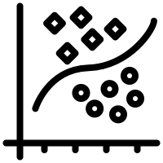
Answering Research questions (2/2)
1. Current SOTA
Literature review
2. Additional variables
3. Application of FAIR
Data analysis
4. Subpopulation characteristics
5. Identify Research software
Classification
RS vs. non-RS

Slide 15
Motivation Background information Research questions Research method

Slide 16
All phases in research method (1/5)
Collect users
Collect repositories
Collect variables
Exploratory data analysis and classification
Notes:
Phase 1 to 3 based on SWORDS – modified. Phase 4 new

Slide 17
Phase 1 – modified (2/5)
Gather GitHub users
Merge users
Enrich users with GitHub data
Filter irrelevant users
Label UU employees
628 users
176 users
Notes:
Filtering: Ex/Non-employees. Employed students included, non-employed excluded.

Slide 18
Phase 2 – modified (3/5)
Retrieve repositories of filtered users
Filter repositories automatically
Label repositories manually
2240 repositories
1521 repositories
823 repositories
Notes:
Filtering: Github.io repositories and forks

Slide 19
Phase 3 - modified (4/5)
Gather howfairis variables
Gather nested GitHub variables
Gather additional FAIR variables
Notes:
Howfairis variables: Repository open? License? Registry? Citation? Checklist?

Slide 20
Phase 4 – data analysis (5/5)
Subquestion 2
Subquestions 3, 4
Subquestion 5
Similarity analysis
Descriptive statistics
Mult. non-parametric ANOVAs
Classification: RS vs. non-RS
Howfairis variables
-and-
new FAIR variables
Min, max, mean, median, skewness, kurtosis
Follow-up:
Post-hoc analysis
Logistic regression,
Random forest
Jaccard similarity
FAIR variables score,
Heatmaps, Histograms
Feature importance
Notes:
Desc. Statistics and plots in addition for each faculty
Kruskal-Wallis tests → Dunn’s test

Slide 21
Thank you for listening! Questions?
Icons by Freepik from www.flaticon.com.
https://github.com/UtrechtUniversity/SWORDS-UU
https://github.com/kequach/Thesis-Mapping-RS
References:
[1] Wilkinson, M., Dumontier, M., Aalbersberg, I. et al. The FAIR Guiding Principles for scientific data management and stewardship.
[2] https://www.go-fair.org/fair-principles/

Slide 22
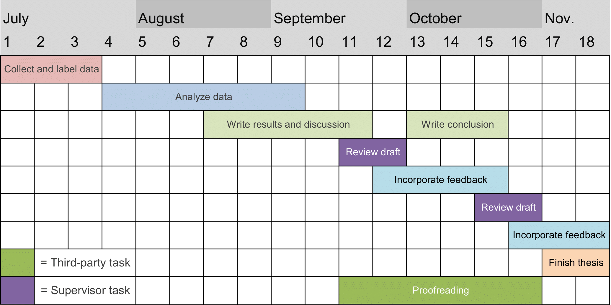
Schedule phase 2

Slide 23
Repository labels
RS
Rscript
RSWIP
Empty
Non-RS
Rdata
Workshop
Docs
Template
Student work
OtherRS
Irrelevant

Slide 24
FAIR variables
Variable | Description
Repository open? | Is the repository open?
License available? | Is there a license?
Registered in registry? | Is the repository registered in a registry?
Citation available? | Is there citation information?
Checklist available? | Is there a checklist?
Version control usage? | Does the repository use version control correctly?
Life span | Length in days between first and last commit
Repository active? | Was there a commit within the last 365 days?
Version identifiable? | Is there a scheme to uniquely identify software version?
Tests available? | Is there a tests folder?
Install instructions? | Are there installation instructions?
Example usage? | Are there usage examples?
Contribution guidelines? | Are there contribution guidelines?

Slide 25
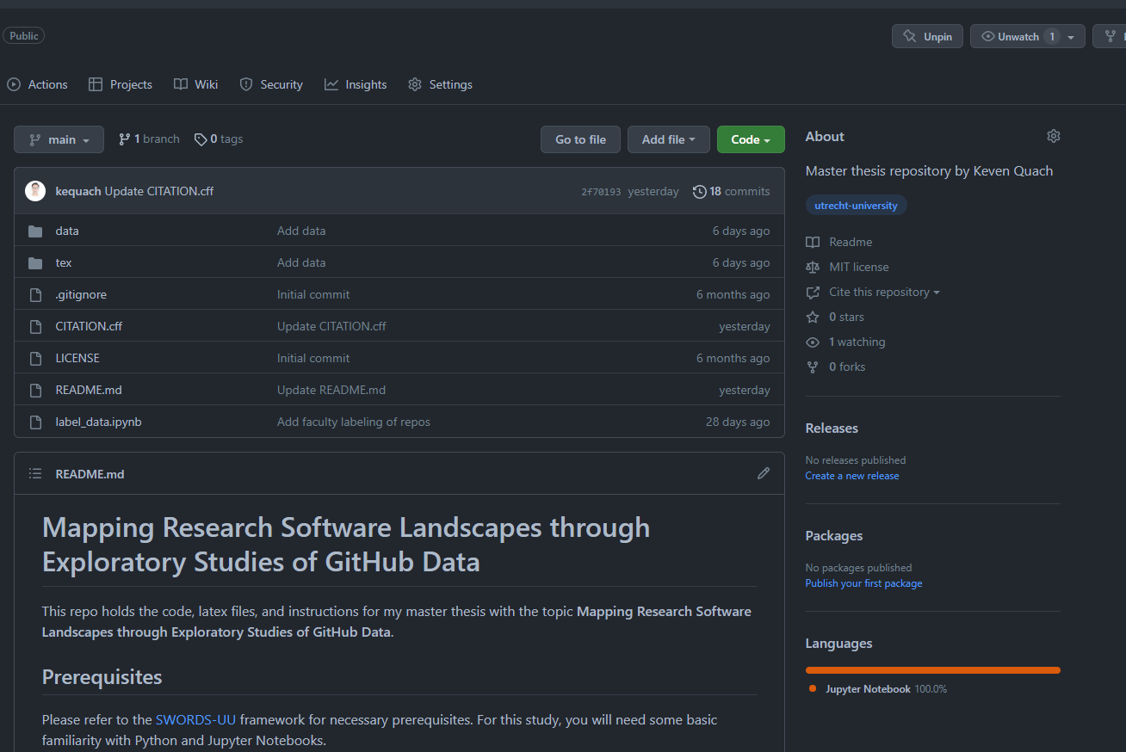
Notes:
Popular: For industry, academia, and private projects
Features: Issues, PRs, wikis, forking of repositories, machine-readable metadata
API: Allows large-scale data retrieval and analysis
Analysis: Proven method but only 1 on FAIRness and 0 on different research domains

Slide 26
History of FAIR principles (2/6)
FAIR Guiding Principles [1]
2016
Primarily discusses research data
Foundational principles accompanied by guiding principles
Applicable to all research objects
Facilitates reproducibility and reusability of research
[1] Wilkinson, M., Dumontier, M., Aalbersberg, I. et al. The FAIR Guiding Principles for scientific data management and stewardship.
Notes:
Most important points for this thesis
Good data management acts as a pre-condition for better knowledge discovery and innovation.

Slide 27
History of FAIR principles (3/6)
FAIR Guiding Principles [1]
Findable: “The first step in (re)using data is to find them. Metadata and data should be easy to find for both humans and computers. Machine-readable metadata are essential for automatic discovery of datasets and services, so this is an essential component of the FAIRification process.” [2]
2016
Primarily discusses research data
Foundational principles accompanied by guiding principles
Applicable to all research objects
Facilitates reproducibility and reusability of research
[1] Wilkinson, M., Dumontier, M., Aalbersberg, I. et al. The FAIR Guiding Principles for scientific data management and stewardship.
[2] https://www.go-fair.org/fair-principles/

Slide 28
History of FAIR principles (4/6)
FAIR Guiding Principles [1]
Accessible: “Once the user finds the required data, she/he/they need to know how they can be accessed, possibly including authentication and authorisation.”
Interoperable: “The data usually need to be integrated with other data. In addition, the data need to interoperate with applications or workflows for analysis, storage, and processing.”
Reusable: “The ultimate goal of FAIR is to optimise the reuse of data. To achieve this, metadata and data should be well-described so that they can be replicated and/or combined in different settings.” [2]
2016
Primarily discusses research data
Foundational principles accompanied by guiding principles
Applicable to all research objects
Facilitates reproducibility and reusability of research
[1] Wilkinson, M., Dumontier, M., Aalbersberg, I. et al. The FAIR Guiding Principles for scientific data management and stewardship.
[2] https://www.go-fair.org/fair-principles/

Slide 29
History of FAIR principles (5/6)
FAIR Guiding Principles [1]
Towards FAIR principles for RS [3]
2016
2020
Significant differences between data and software necessitate software-specific principles
Data can have privacy concerns, software often open-source
Data are hard facts, software is result of complex creative process
[1] Wilkinson, M., Dumontier, M., Aalbersberg, I. et al. The FAIR Guiding Principles for scientific data management and stewardship.
[3] Anna-Lena Lamprecht, et al. "Towards FAIR principles for research software". Data Sci. 3. (2020): 37-59.
Notes:
First position paper for FAIR RS.
Other relevant points like maintainability, OS community, software dependencies, etc..
Since then, reviewed by different stakeholders → incorporate community feedback

Slide 30
History of FAIR principles (6/6)
FAIR Guiding Principles [1]
Towards FAIR principles for RS [3]
FAIR4RS principles [4]
2016
2020
2022
FAIR4RS Working group founded in 2019
Incorporated all previous principles
[1] Wilkinson, M., Dumontier, M., Aalbersberg, I. et al. The FAIR Guiding Principles for scientific data management and stewardship.
[3] Anna-Lena Lamprecht, et al. "Towards FAIR principles for research software". Data Sci. 3. (2020): 37-59.
[4] Chue Hong, Neil P. et al. "FAIR Principles for Research Software (FAIR4RS Principles)." (2022).
Notes:
Assembled by different parties representing diff. stakeholders: RS users, developers, maintainers, policy creators, infrastructure managers, research funders

Slide 31
References
[1] Wilkinson, M., Dumontier, M., Aalbersberg, I. et al. The FAIR Guiding Principles for scientific data management and stewardship.
[2] https://www.go-fair.org/fair-principles/
[3] Anna-Lena Lamprecht, et al. "Towards FAIR principles for research software". Data Sci. 3. (2020): 37-59.
[4] Chue Hong, Neil P. et al. "FAIR Principles for Research Software (FAIR4RS Principles)." (2022).

