Slide 1
Thesis Defence: Mapping Research Software Landscapes through Exploratory Studies of GitHub Data
Keven Quach
1st supervisor: Anna-Lena Lamprecht
2nd supervisor: Fernando Castor
Daily supervisor: Jonathan de Bruin
27.10.2022

Slide 2
Table of Contents
Motivation
Background information
Research questions
Research method
Results
Discussion

Slide 3
Motivation Background information Research questions Research method Results Discussion

Slide 4
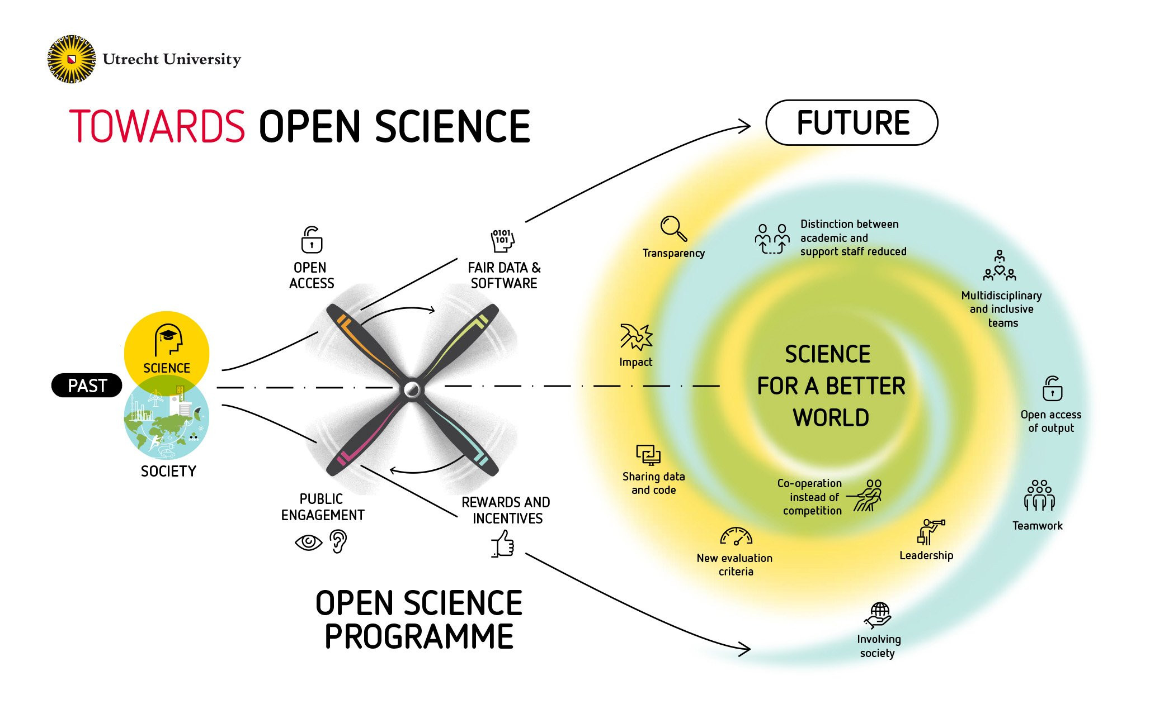
Why is this topic relevant? (1/3)
Transition to Open Science: research data and software should be open and FAIR (findable, accessible, interoperable, reusable).
(Research) software is widely used everywhere
What do we know about UU researchers’ code and software?
From https://www.uu.nl/sites/default/files/styles/original_image/ public/Utrecht-University-towards-open-science.jpg
Notes:
Hadoop, Spark, TensorFlow → relevant for everyone
How open and FAIR is our researchers' code and software?
Before thesis, not much was known

Slide 5


SWORDS@UU (2/3)
Scan and revieW of Open Research Data and Software at Utrecht University
Get insights about how UU researchers develop, manage, and publish software on GitHub
Collect users
Collect repositories
Collect variables
Filtering
Filtering
https://github.com/UtrechtUniversity/SWORDS-UU
Notes:
SWORDS only has basic descriptive statistics; No labelled repositories

Slide 6



Contribution of the thesis (3/3)
Provide labelled GitHub dataset
Extend SWORDS framework with FAIR-related variables
Provide method for reusable data analysis of an organization to infer recommendations
https://github.com/kequach/Thesis-Mapping-RS
Notes:
Labelling → repo type + Research domain
Extend → How open and FAIR is our researchers code and software? → How do we even measure this?

Slide 7
Motivation Background information Research questions Research method Results Discussion

Slide 8

GitHub - a code hosting platform (1/3)
Most popular platform with many features
Provides REST API
Lots of GitHub analyses already performed
Notes:
Features: Issues, PRs, wikis, forking of repositories, machine-readable metadata
API: Allows large-scale data retrieval and analysis
Analysis: Proven method but only 1 on FAIRness and 0 on different research domains

Slide 9
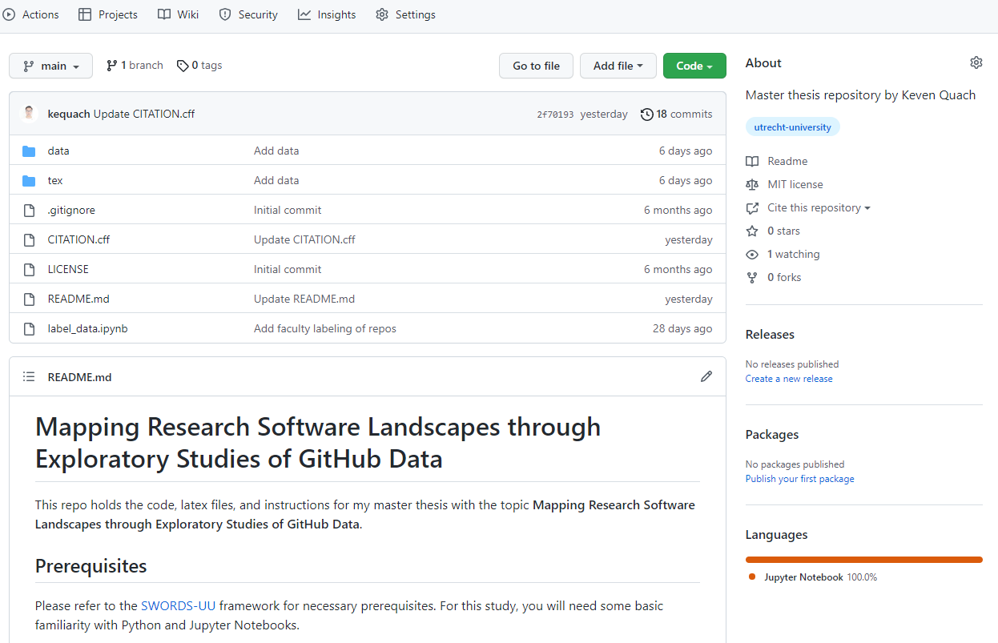
Notes:
Files → Citation → License → Readme → Languages

Slide 10
FAIR principles (2/3)
FAIR Guiding Principles for scientific data management and stewardship [1]
Published in 2016
Applicable to all research objects
Foundational principles accompanied by guiding principles
Facilitate reproducibility and reusability of research
[1] Wilkinson, M., Dumontier, M., Aalbersberg, I. et al. The FAIR Guiding Principles for scientific data management and stewardship.
Notes:
Elaborate

Slide 11
FAIR principles (3/3)
Findable: “The first step in (re)using data is to find them. Metadata and data should be easy to find for both humans and computers. Machine-readable metadata are essential for automatic discovery of datasets and services, so this is an essential component of the FAIRification process.”
Accessible: “Once the user finds the required data, she/he/they need to know how they can be accessed, possibly including authentication and authorisation.”
Interoperable: “The data usually need to be integrated with other data. In addition, the data need to interoperate with applications or workflows for analysis, storage, and processing.”
Reusable: “The ultimate goal of FAIR is to optimise the reuse of data. To achieve this, metadata and data should be well-described so that they can be replicated and/or combined in different settings.” [2]
[2] https://www.go-fair.org/fair-principles/
Notes:
High-level
Differences to software:
Accessibility → Runnability
Interoperable → Software much more complex (dependencies)

Slide 12
Motivation Background information Research questions Research method Results Discussion

Slide 13
Research questions (1/2)
How can information about open source publications on GitHub be used to infer actionable recommendations for RSE practice to improve the research software landscape of an organization?
What is the current state of the art of FAIR principles?
How can FAIR principles be supplemented with additional variables?
Are there different characteristics for different subpopulations in the data?
How can the application of FAIR variables for research software be supported?
How well can we identify research software with available data?
Notes:
Subpopulations = Different faculties

Slide 14


Answering Research questions (2/2)
1. Current SOTA
Literature review
2. Additional variables
3. Subpopulation characteristics
Data analysis
4. Application of FAIR
5. Identify Research software
Classification
RS vs. non-RS

Slide 15
Motivation Background information Research questions Research method Results Discussion

Slide 16
All phases (1/3)
= SWORDS
= Thesis addition
Collect users
Collect repositories
Collect variables
Exploratory data analysis
Phase 1
Phase 2
Phase 3
Phase 4
Gather GitHub users (628)
Merge users
Enrich users with GitHub data
Filter irrelevant users
Label UU employees (176)
Retrieve all repositories of filtered users (2240)
Filter repositories automatically (1521)
Label repositories manually (823)
Gather howfairis variables
Gather nested GitHub variables
Gather additional FAIR variables
Data preprocessing
See later slide (3/3)
Notes:
Phase 1 to 3 SWORDS – modified. Phase 4 new
P1: Filtering: Everyone not currently employed @UU. Employed students & Orgs included
P2: Filtering: Github.io repositories and forks
P3: Howfairis variables: Next slide | Languages, contributors, commits

Slide 17
FAIR variables (2/3)
Variable | Description
Repository open? | Is the repository open? Howfairis variable
Has license? | Is there a license? Howfairis variable
Is registered? | Is the repository registered in a registry? Howfairis
Has citation? | Is there citation information? Howfairis variable
Has checklist? | Is there a checklist? Howfairis variable
Correct vcs usage? | Does the repository use version control correctly?
Repository active? | Was there a commit within the last 365 days?
Has install instructions? | Are there installation instructions?
Has example usage? | Are there usage examples?
Has contrib. guidelines? | Are there contribution guidelines?
Has tests? | Is there a tests folder?
Version identifiable? | Is there a scheme to uniquely identify software version?
Notes:
All Booleans; not the only variables

Slide 18
Phase 4 – data analysis (3/3)
Subquestion 2
Subquestions 3, 4
Subquestion 5
Similarity analysis
Descriptive statistics
Mult. non-parametric ANOVAs
Classification: RS vs. non-RS
Howfairis variables
-and-
new FAIR variables
Min, max, mean, median, skewness, kurtosis
Follow-up:
Post-hoc analysis
Logistic regression,
Random forest, Chance
Jaccard similarity
FAIR variables score,
Heatmaps, Histograms
Feature importance
Notes:
Kruskal-Wallis tests → Dunn’s test
Heatmaps: numeric vars, FAIR variables, license, language, and topics

Slide 19
Motivation Background information Research questions Research method Results Discussion
Notes:
Only highlights

Slide 20
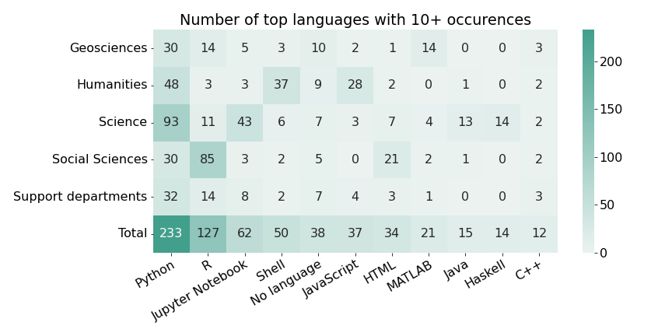
Language usage (1/4)
Notes:
First: Look at row labels
Removed veterinary medicine, and Law, Economics & Governance
Combined University library, Corporate offices and UtrechtUniversity to supp. Dept.
Python dominant, Social Science strong focus on R

Slide 21
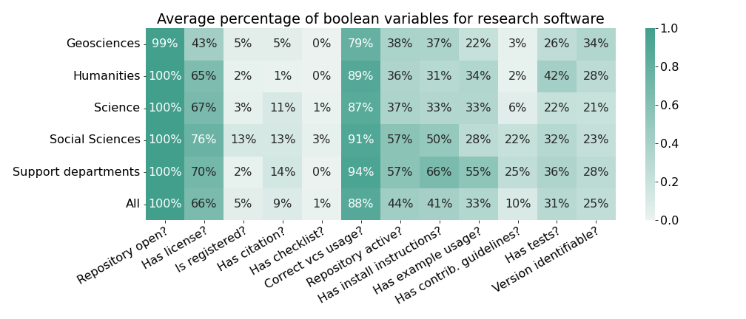
Average percentage FAIR variables (2/4)
Notes:
Social Sciences perform very well (highest license %; highest registered %)
Geo less than 50% of software licensed. Correct vcs usage quite low for Geo
Install instructions, example usage, contrib. guidelines → support dept performs well

Slide 22
Kruskal-Wallis test (3/4)
Variable | P-value | Significance
Stargazers | 1.247649e-08 | ***
Issues | 6.513571e-06 | ***
Forks | 1.301400e-09 | ***
Size (MB) | 3.112421e-04 | ***
Contributors | 3.651742e-05 | ***
Languages | 1.750939e-02 | *
Topics | 1.668033e-11 | ***
Life span (days) | 2.769494e-01
Significance codes for p-values: 0 '***' 0.001 '**' 0.01 '*' 0.05 '.' 0.1 ' ' 1
Notes:
Except life span, all metrics are significantly different

Slide 23
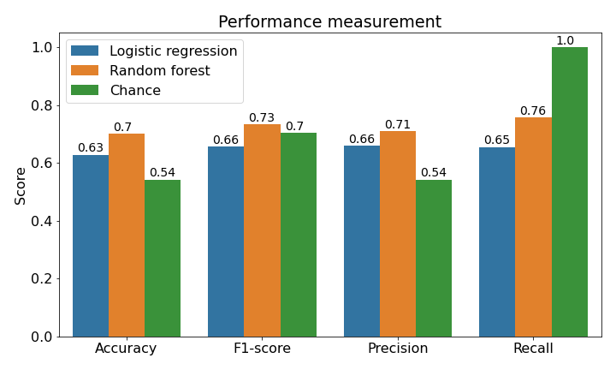
Classification evaluation (4/4)
Notes:
RF outperforms both log. Reg. and chance in every measurement except recall which is always 1.0 for the chance classifier

Slide 24
Motivation Background information Research questions Research method Results Discussion
Notes:
Recommendations & Future work

Slide 25

Recommendations (1/2)
Main RQ: How can information about open source publications on GitHub be used to infer actionable recommendations for RSE practice to improve the research software landscape of an organization?
Foster local programming communities (R/Python Café)
Two kinds of resource recommendations:
Fundamental training for software engineering & hands-on usage of relevant tools
Best FAIR practices document
Highlight FAIR & high impact research software
Create yearly FAIR reports of UU research software
Notes:
R: Prioritize support for popular languages → Café already exists and is highly popular
Training: Geo w/ high % of no license; low % of correct vcs usage; → Geo-focused
Document: Easily editable, changes over time; Training relatively established
Highlight RS: e.g. in newsletters | serve as reference
Yearly report: tracking progress of FAIRness at UU | incentivize researchers (report provides clear criteria for FAIRness) | more tangible than only principles

Slide 26
Future work (2/2)
Look at different subpopulations (job position)
Use classification model for yearly reports
Develop further variables for classification
Variable weighting
Extend analysis to other platforms
Improve variable retrieval logic
Notes:
Subpopulations: Faculty-based or position-based trainings/material
Variable logic: Has citation does not check readme

Slide 27
Thank you for listening! Questions?
Icons by Freepik from www.flaticon.com.
https://github.com/UtrechtUniversity/SWORDS-UU
https://github.com/kequach/Thesis-Mapping-RS
References:
[1] Wilkinson, M., Dumontier, M., Aalbersberg, I. et al. The FAIR Guiding Principles for scientific data management and stewardship.
[2] https://www.go-fair.org/fair-principles/
[3] Anna-Lena Lamprecht, et al. "Towards FAIR principles for research software". Data Sci. 3. (2020): 37-59.

Slide 28
Who is on GitHub?
Users collected via GitHub
GitHub query = “Utrecht University”
UU pages
PapersWithCode.com
PURE output
Results repositories
Results users
Results topic
Merge users
Manual
user labeling
Excluded: Students, non-employees
Note: Contributors of the found repositories were retrieved.

Slide 29
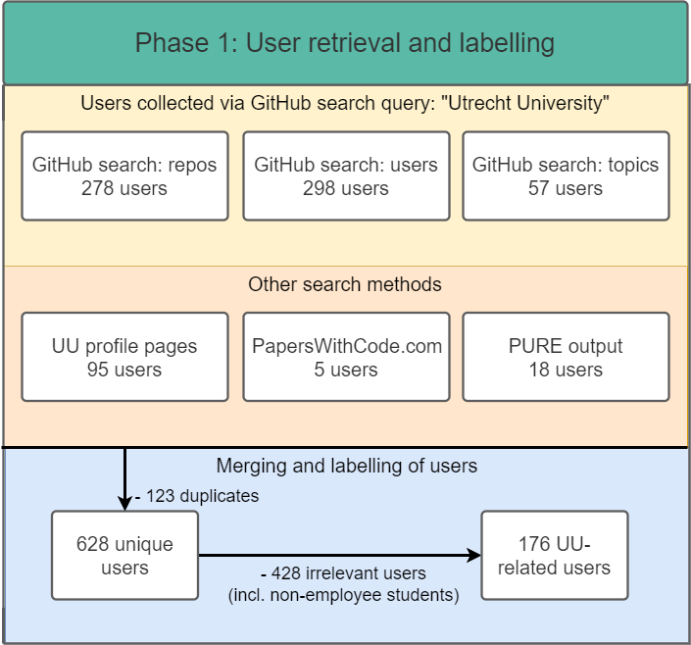

Slide 30
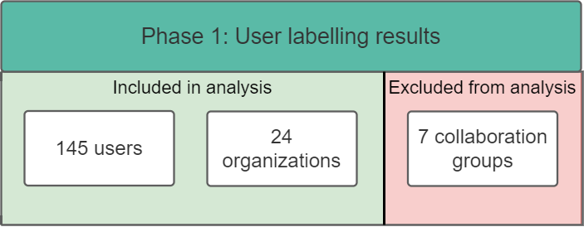

Slide 31
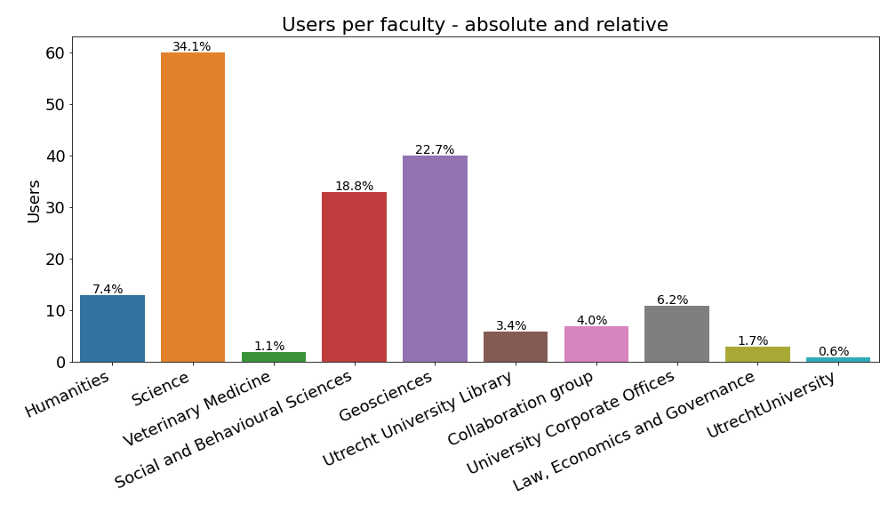
Users by faculty
Notes:
Low number for veterinary medicine, Law Economics & Governance. UtrechtUniversity is 1 account only

Slide 32
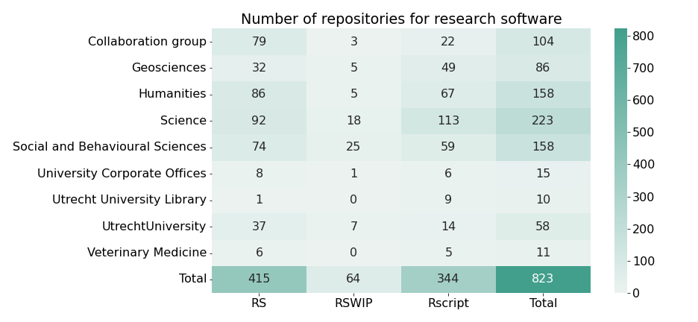
Repositories by faculty and repository type
Notes:
No Law, Economics & Governance faculty visible → no research software from this faculty

Slide 33
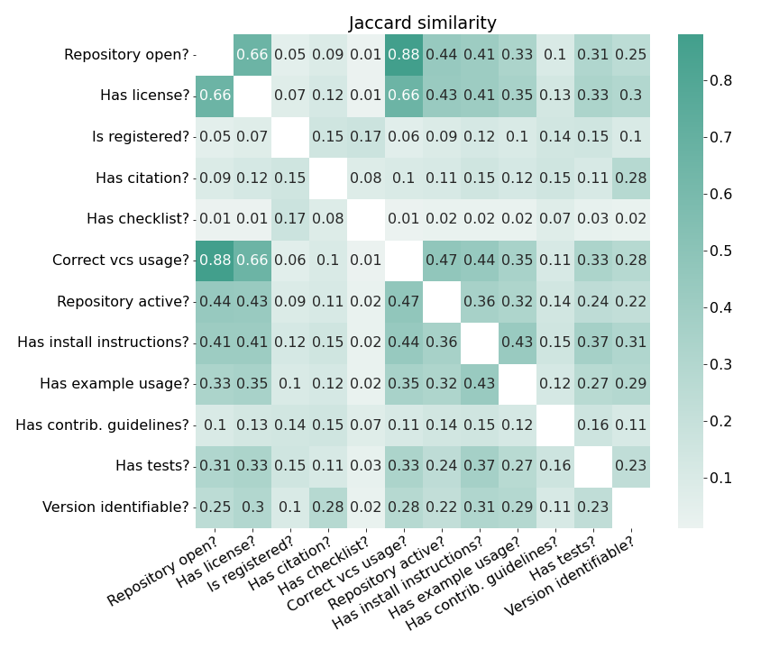

Slide 34
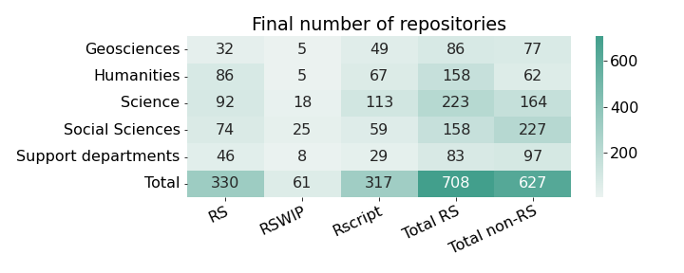
Faculties and repositories
Notes:
Removed veterinary medicine, and Law, Economics & Governance
Combined University library, Corporate offices and UtrechtUniversity to supp. Dept.

Slide 35
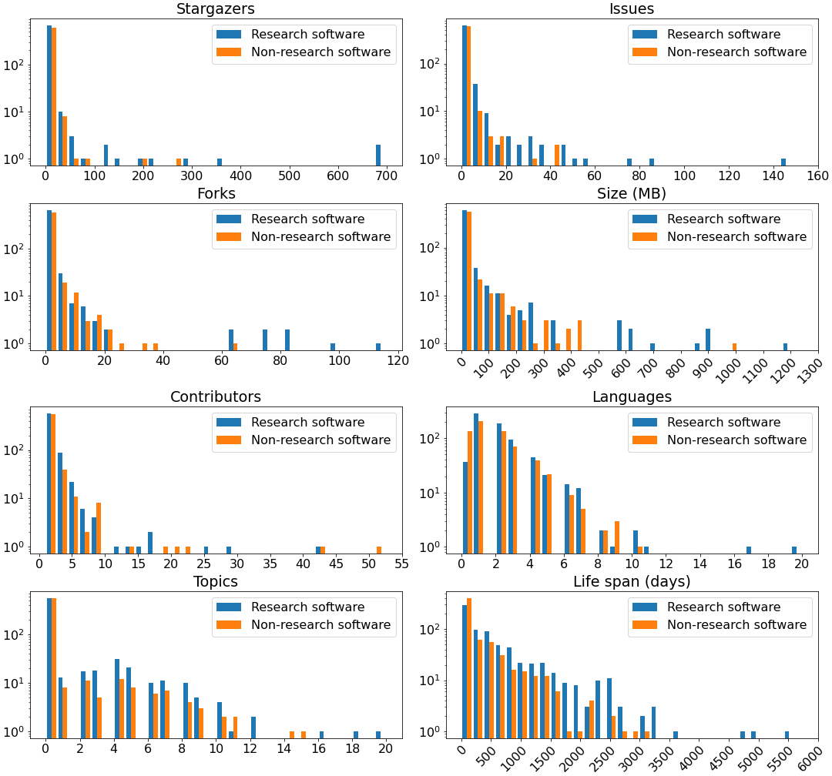
Numeric variables

Slide 36
Numeric variables

Slide 37
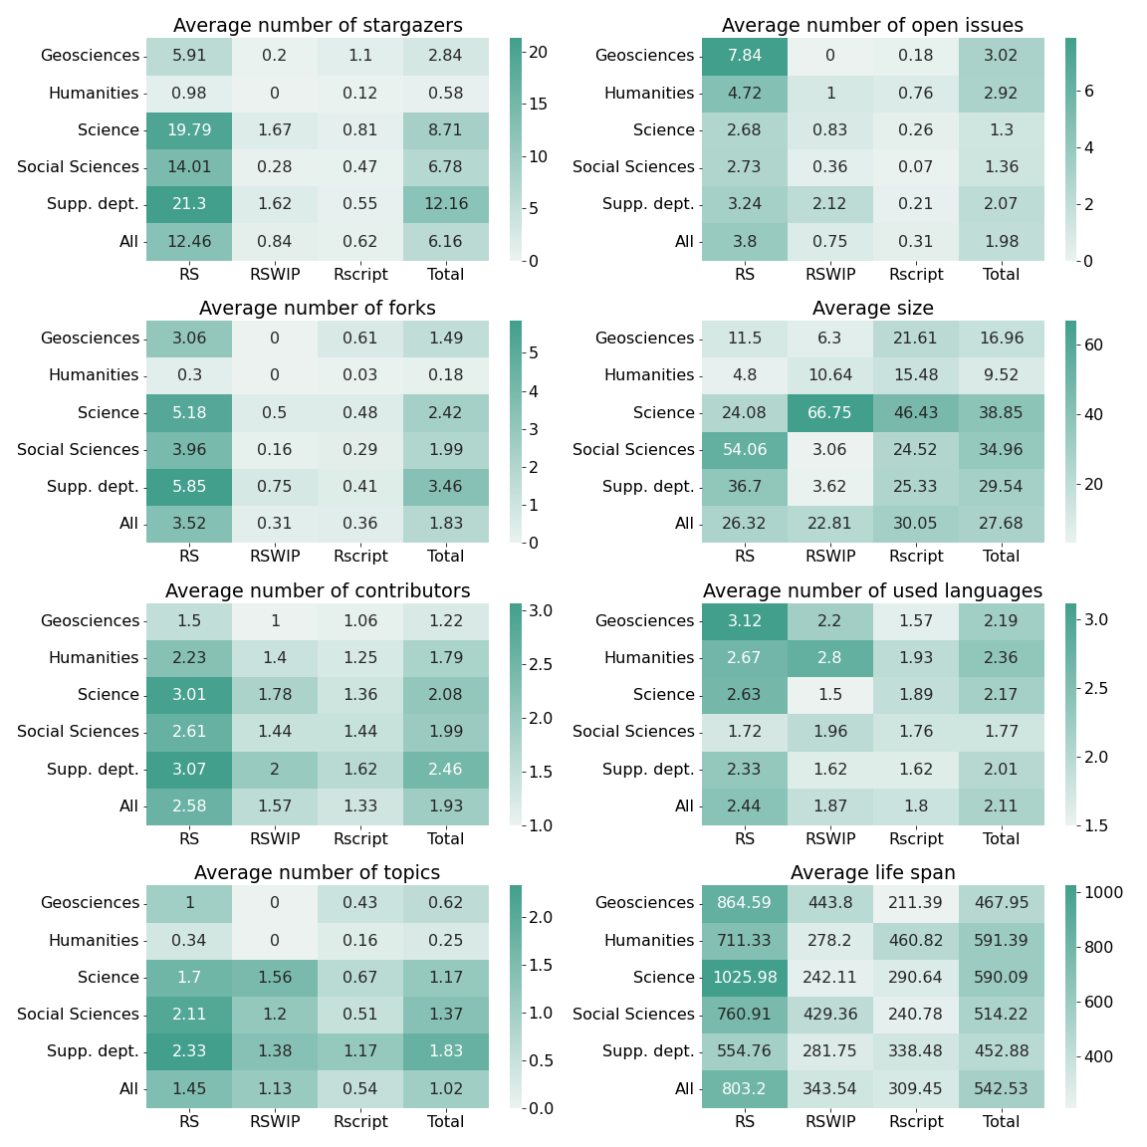
Numeric variables

Slide 38
Numeric variables

Slide 39
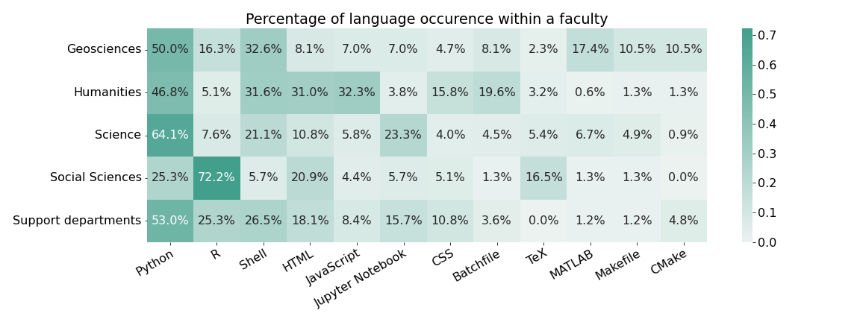
Language occurrence within faculty

Slide 40
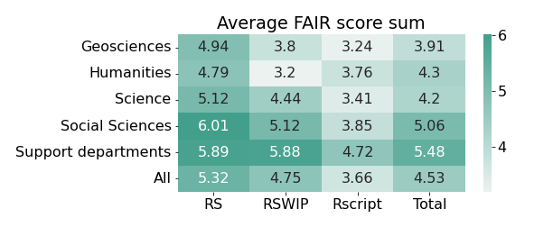
Average FAIR score sum
Notes:
Social Sciences and Supp. Dept. perform better than other faculties

Slide 41
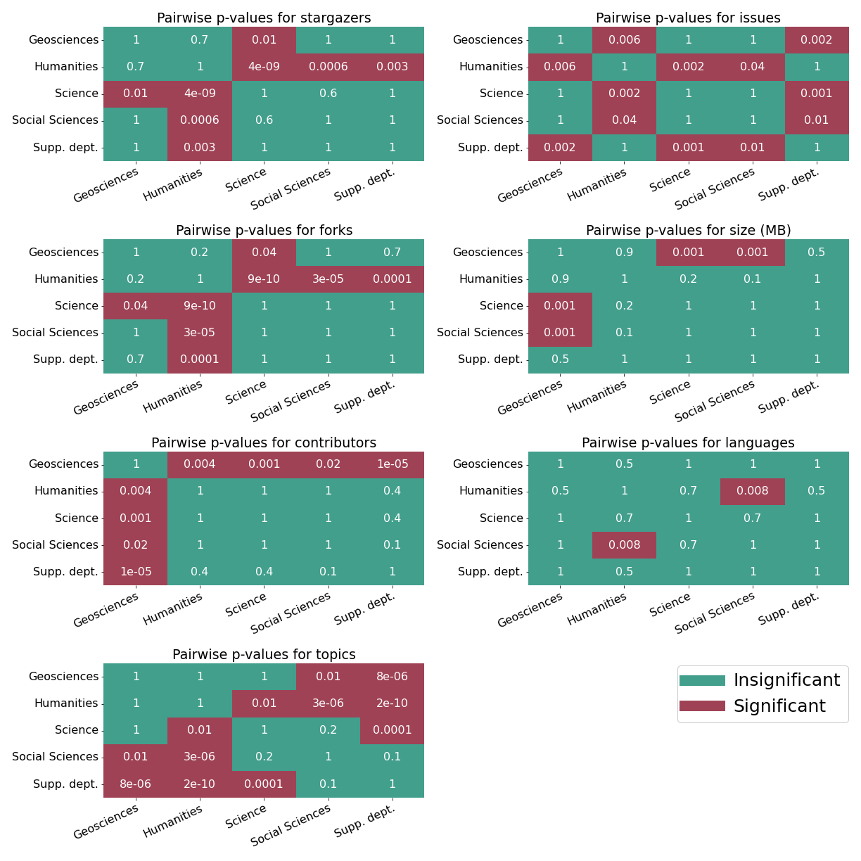
Dunn’s test

Slide 42
Dunn’s test

Slide 43
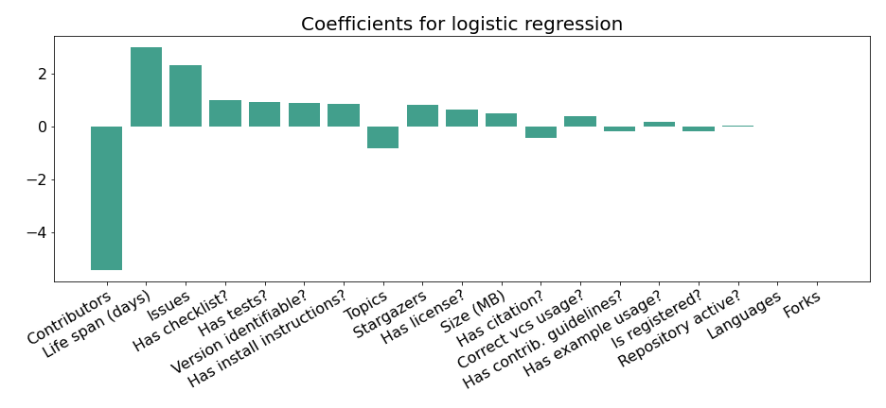
Feature importance (1/2)

Slide 44
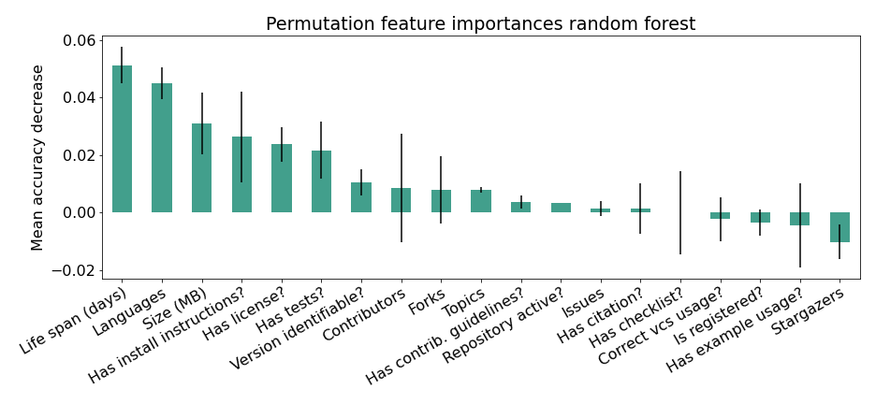
Feature importance (2/2)

Slide 45
FAIR principles
FAIR Guiding Principles [1]
Towards FAIR principles for RS [3]
2016
2020
Significant differences between data and software necessitate software-specific principles
Data can have privacy concerns, software often open-source
Data are hard facts, software is result of complex creative process
[1] Wilkinson, M., Dumontier, M., Aalbersberg, I. et al. The FAIR Guiding Principles for scientific data management and stewardship.
[3] Anna-Lena Lamprecht, et al. "Towards FAIR principles for research software". Data Sci. 3. (2020): 37-59.
Notes:
First position paper called Towards FAIR principles for RS.
Other relevant points like maintainability, OS community, software dependencies, etc..

Slide 46
Repository labels
RS
Rscript
RSWIP
Empty
Non-RS
Rdata
Workshop
Docs
Template
Student work
OtherRS
Irrelevant

Slide 47
History of FAIR principles (5/6)
FAIR Guiding Principles [1]
Towards FAIR principles for RS [3]
2016
2020
Significant differences between data and software necessitate software-specific principles
Data can have privacy concerns, software often open-source
Data are hard facts, software is result of complex creative process
[1] Wilkinson, M., Dumontier, M., Aalbersberg, I. et al. The FAIR Guiding Principles for scientific data management and stewardship.
[3] Anna-Lena Lamprecht, et al. "Towards FAIR principles for research software". Data Sci. 3. (2020): 37-59.
Notes:
First position paper for FAIR RS.
Other relevant points like maintainability, OS community, software dependencies, etc..
Since then, reviewed by different stakeholders → incorporate community feedback

Slide 48
History of FAIR principles (6/6)
FAIR Guiding Principles [1]
Towards FAIR principles for RS [3]
FAIR4RS principles [4]
2016
2020
2022
FAIR4RS Working group founded in 2019
Incorporated all previous principles
[1] Wilkinson, M., Dumontier, M., Aalbersberg, I. et al. The FAIR Guiding Principles for scientific data management and stewardship.
[3] Anna-Lena Lamprecht, et al. "Towards FAIR principles for research software". Data Sci. 3. (2020): 37-59.
[4] Chue Hong, Neil P. et al. "FAIR Principles for Research Software (FAIR4RS Principles)." (2022).
Notes:
Assembled by different parties representing diff. stakeholders: RS users, developers, maintainers, policy creators, infrastructure managers, research funders

Slide 49
FAIR variables (2/3)
Variable | Description | FAIR
Repository open? | Is the repository open? Howfairis variable | F
Has license? | Is there a license? Howfairis variable | R
Is registered? | Is the repository registered in a registry? Howfairis | FI
Has citation? | Is there citation information? Howfairis variable | R
Has checklist? | Is there a checklist? Howfairis variable | FAIR
Correct vcs usage? | Does the repository use version control correctly? | RS
Life span | Length in days between first and last commit | S
Repository active? | Was there a commit within the last 365 days? | F
Has install instructions? | Are there installation instructions? | R
Has example usage? | Are there usage examples? | R
Has contrib. guidelines? | Are there contribution guidelines? | A
Has tests? | Is there a tests folder? | R
Version identifiable? | Is there a scheme to uniquely identify software version? | F
Notes:
S = Sustainability

