Slide 1
GelPIA
A tool to quickly find guaranteed global upper bounds for functions

Slide 2
Interval Branch and Bound
Algorithm to find guaranteed global maxima
Exhaustively searches the domain
Branches by splitting domain into sub domains
Estimates the range of the function using interval arithmetic
Can discard domains if computed upper bound is below known lower bound for maximum
Essentially optimized binary search

Slide 3
Interval Arithmetic
Extends functions to operate on domains
If we have a function f:D->R, D a subset of R^{n}, and d a subset of D, we define
Ideally, we would like this interval to be as small as possible
We can define a similar version for a function evaluated in floating point math as
Where everything is computing in floating point arithmetic
We require
Again, we would like the interval to be as small as possible

Slide 4
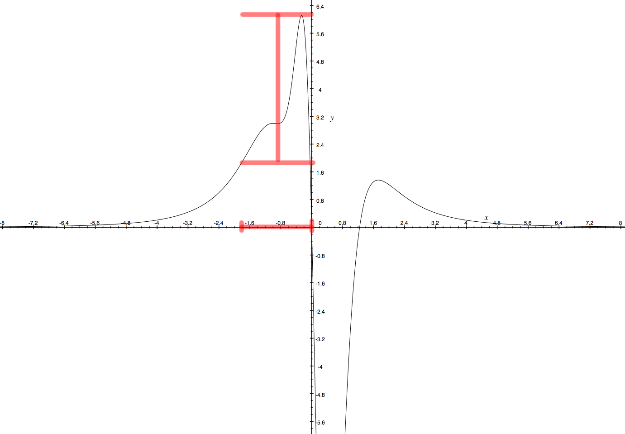

Slide 5
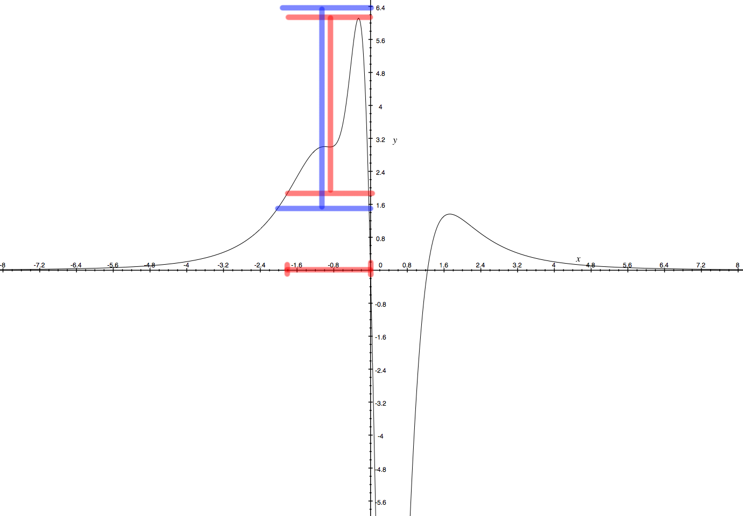

Slide 6
Problems with IBBA
If we subdivide along a dimension N times, and we have d dimensions, we have a worst case running time of N^{d}
We can leverage fast local search methods to help direct the global search
The global search can in turn be used to help steer local search methods away from regions known to not contain the maximum
A periodic reconciliation process can help keep communications overhead between the searches to a minimum

Slide 7
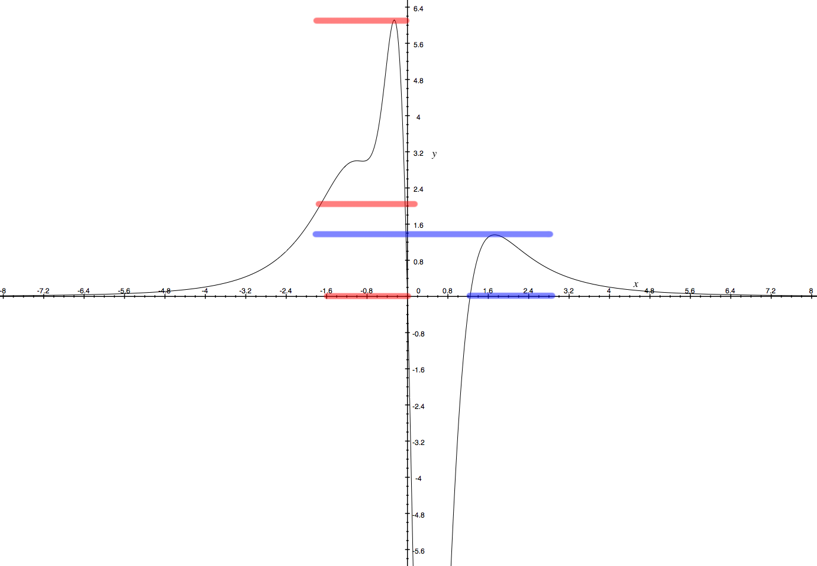

Slide 8
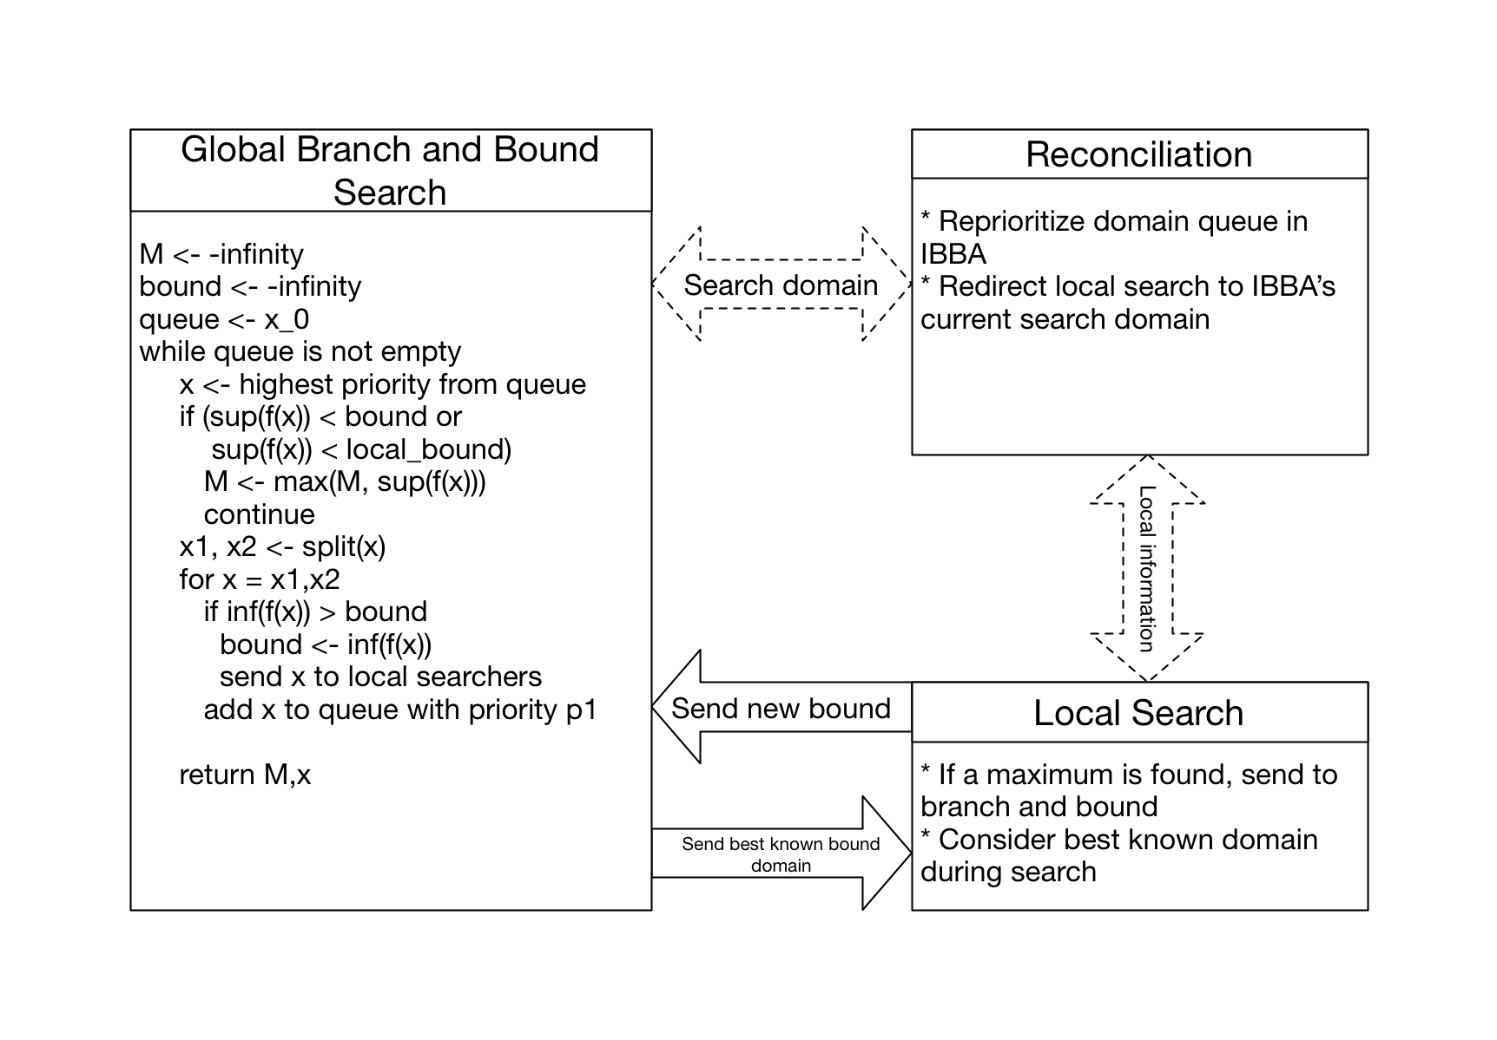
GELPIA Architecture

Slide 9
Soundness
Local methods find their maxima using FP interval arithmetic ensuring a guaranteed lower bound on their answers
The IBBA is guaranteed to find an upper-bound for the maximum
Since the local methods compute their results using FP interval arithmetic, we can be sure that new branch bounds are below the global maximum

