Slide 1
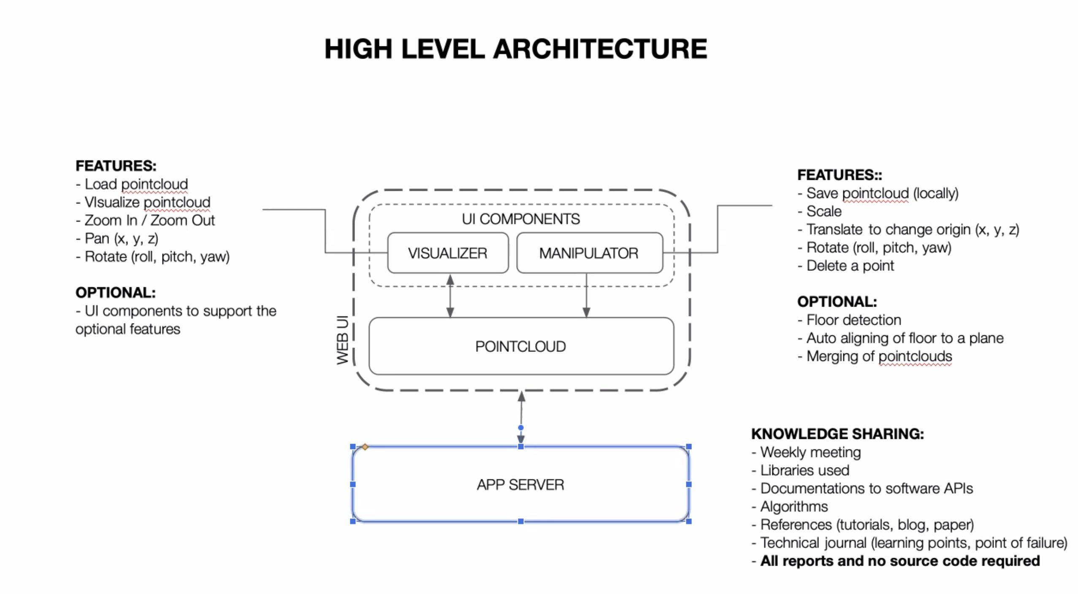
Demand

Slide 2
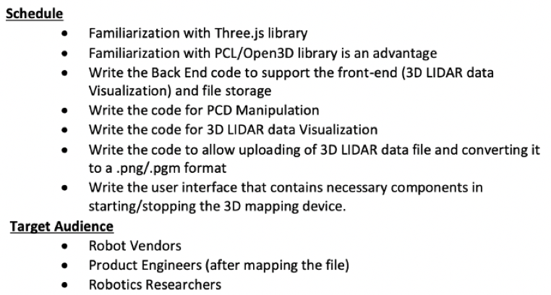
Demand

Slide 3
Demand

Slide 4
Demand

Slide 5
 | Zhengtao | Shaoxing | Weichu | Lidong
Duty | Web front | Web front | Back end | Back end
Jan 16 | System design | System design | System design | System design
Meeting record | More pcd file. Refine layout/ style | developmentpl
Jan 30
Metting record
Feb 13
Metting record
Feb 27
Metting record
Mar 13
Metting record
Mar 22 | Mid term report

Slide 6
System design
TBD:
auto align
Merge point cloud
Web front
Sever
AI algorithm
User
interaction
Dataflow
1.Floor detection
Displaying manipulation
Upload PCD to sever
Fetch PCD from sever
Save to local
snapshot
Dataflow
Database
Storage
Distance calculation

Slide 7
Questions
Point cloud data format; PCD for testing
The business scenario is Lidar imaging for sweeping robot? If yes, we should visualize the surrounding environment ?
Algorithm of Flatten and Stitch 3D Lidar Data.
Feedback
1.Development timeline
2.Include resource on how it is done
3. More pcd file. Refine layout/ style
Next week
1. timeline
2. front end UI demo
3. database,
4. backenddemo

Slide 8
Source
1.Code modified from
https://threejs.org/examples/#webgl_animation_keyframes

