Slide 1
Serializing Data with Google Protocol Buffers
PyOhio 2017| Paul Kerchen

Slide 2
Introduction

Slide 3
What are Protocol Buffers?
A mechanism for serializing structured data that is:
Extensible with versioning and backward compatibility
Language- and platform-neutral
An efficient alternative to text-based structured data (e.g. XML)
Well-tested: Used extensively within Google since 2001
Open Source and patent-free

Slide 4
Top 3 Benefits
Backward compatibility is easy to achieve
Efficient encoding
Automatically-generated parsing code

Slide 5
Protobuf vs. XML
More efficient: 3-10x smaller, 20-100x faster than XML
Simpler: data accessors automatically generated
Well-suited for devices with limited bandwidth/RAM/storage/CPU or large-scale applications
Not designed for large (> 1MB) data sets
Binary: not human-readable or human-editable; cannot easily interleave structure with text (e.g., HTML)

Slide 6
Proto2 vs. Proto3
Proto3 first stable release on July 2016
Recommended for new code
Language simplified for ease-of-use and to support a wider range of languages
Many other improvements and changes
Proto2 support to continue “for a long time”
Don’t use it, even though a lot of the docs still have examples in it!

Slide 7
Basic Workflow
Protobuf messages defined in plain text .proto files
.proto file compiled (using protoc) to generate data access classes
Supported languages: Python (2.x and 3.x), Java, C++, C#, Ruby, Go, Objective-C, JavaScript, PHP, and several more via third-party extensions
Pre-built protoc binaries available for OSX, Linux, Win32
Data access classes provide:
Simple accessors to read/write fields
Methods to serialize/parse structures to/from raw bytes

Slide 8

Basic Workflow
foo.proto

Slide 9

Basic Workflow
foo.proto
protoc

Slide 10

Basic Workflow
foo.proto
protoc
foo_pb2.py

Slide 11
Basic Workflow
import foo_pb2.py
foo.proto
protoc
foo_pb2.py
your_app.py

Slide 12
Supported Data Types
Numeric types: double, float, various 32- and 64-bit integers
string: UTF-8 or 7-bit ASCII; some Unicode support with Python
bool: uh, you know, a Boolean value
bytes: an arbitrary sequence of bytes
enum: a predefined list of values
any: like bytes + URL to resolve type

Slide 13
Different ints for Different Uses
Most have variable-length encoding
Choice of type depends on expected data values
For example, int32 is best for positive values; sint32 is better for negative values
Consider scaling float/double values to int types for more compact encoding

Slide 14
Other Notable Features
Messages can be nested
Messages can be used as fields in other messages
Associative maps (keys can be any integral or string type)
Messages can be encoded to, and decoded from, JSON
Message definitions can be imported from other .proto files

Slide 15
A Simple .proto File
message SensorData {
float temperature = 1;
uint32 humidity = 2; // Relative humidity
enum Units {
IMPERIAL = 0;
REBEL = 1;
}
Units units = 3;
}
Notes:
Things to point out:
Comments
Nesting
Field numbering

Slide 16
Generating Python Code
Code generated from .proto files via proto compiler (protoc)
Typical invocation for Python:
protoc –I path/to/.proto-dir --python_out=DST_DIR path/to/file.proto
Invoke protoc --help for full listing of options
Output: a module with a static descriptor of each message type, which is used with a metaclass to create the necessary Python data access class at runtime

Slide 17
Using the Compiled Code: Serializing
def serialize(t, h):
msg = simple_pb2.SensorData()
msg.temperature = t
msg.humidity = h
msg.units = simple_pb2.SensorData.REBEL
return msg.SerializeToString()

Slide 18
Using the Compiled Code: Deserialize
def deserialize(serialized_data):
msg = simple_pb2.SensorData()
msg.ParseFromString(serialized_data)
t = msg.temperature
h = msg.humidity
units = msg.units
if units == simple_pb2.SensorData.IMPERIAL:
t = (t - 32) * 5.0 / 9.0
return (t, h)

Slide 19
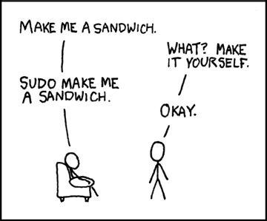
Command Line Interlude
https://xkcd.com/149/

Slide 20
Backward Compatibility
Numeric tags cannot change once deployed; rename field or use reserved keyword
Added fields are ignored by clients still using “old” format
Removed fields sent by “old” format clients are ignored by “new” clients
See https://developers.google.com/protocol-buffers/docs/proto3#updating for more details

Slide 21
Encoding Efficiency
For integers: varints and ZigZag encoding
Smaller values -> shorter encoding
Select data type based on expected value ranges
Using int32 or int64 for negative values is very inefficient—10 bytes each!
double & fixed64 always 8 bytes; float & fixed32 always 4 bytes
Frequently-used fields should have lower tags (magic numbers: 15, 2047)

Slide 22
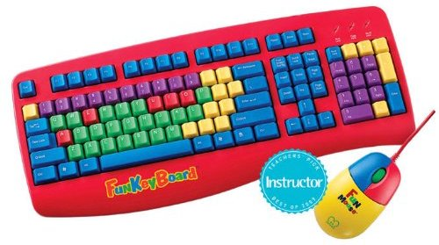
Command Line Interlude

Slide 23
Questions?
502 Bad Gateway
What You Learned
What I Said
Aww Yeah!
Packet Dropped
Clairvoyance
What I Meant

Slide 24
Links & Resources
Protobuf Github: github.com/google/protobuf
nanopb (embedded C generator): github.com/nanopb/nanopb
Presentation Materials: github.com/kerchen/PyOhioProtobuf
Contact Me: paul@whirlingchair.com

