Slide 1
One Digit
Seven Segment Display

Slide 2
Design Description:
This design is a driver circuit for one digit seven segments display.
It converts BCD number to the number which is proper for seven segments displays.

Slide 3
Design I/O:
in: 4 bit hex. input
sevenSeg: 8 bit output for seven segments display
SevenSegOneDig
in
4
8
sevenSeg

Slide 4
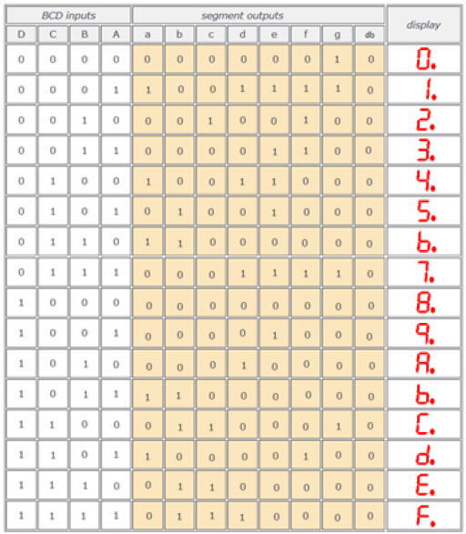
Design Behavior:
It is full combinational circuit. Its truth table is below. Take BCD inputs as in and segment outputs as sevenSeg

