Slide 1
Team Contacts Administration (TCA)
A Java Spring-based Web Application

Slide 2
Overview
TCA Application
manages the creation/deletion of teams and creation/update/deletion of contacts for the teams
is a web-based, Spring Boot Application which utilizes
Spring Boot Starter Web (Spring Web Mvc + Thymeleaf Templates)
Spring Boot Data JPA (Spring Data JPA Repositories + Hibernate ORM)
Spring Security (Authentication + URL-based Access Control)

Slide 3
Architecture
TCA Application
Web Frontend Layer
Thymeleaf Templates
Web Backend Layer
Contact Person Data Repository
Data Service Layer
Team Data Repository
Spring Web MVC Controller

Slide 4
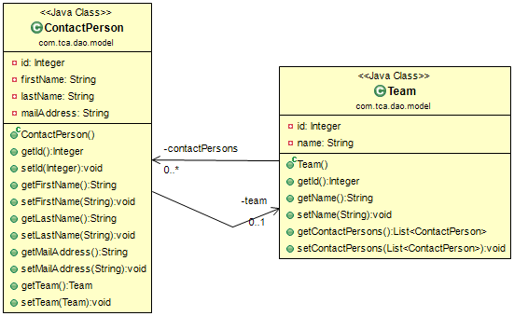
Architecture - Data Service Layer
TCA Spring Data Service
Data Model
ContactPerson Spring Data JPA Repository
Team Spring Data JPA Repository
Hibernate/JPA ORM
MySQL RDBMS

Slide 5
Architecture – Web Backend Layer
A Spring Web MVC controller is implemented, which provides the following request URL mappings:
/login
allows users to login to the application
/showcontacts
can be displayed by the authenticated users having USER or ADMIN role
shows all teams and the contacts of the selected team
accepts one request parameter that is optional
/createteam and /deleteteam
allows the user to create/delete teams and redirects to the /showcontacts URL

Slide 6
Architecture – Web Backend Layer
A Spring Web MVC controller is implemented, which provides the following request URL mappings: - continued
/showcontactdetails
allows authenticated users having ADMIN role to open a form for creating/updating/deleting contacts for the currently active (selected in /showcontacts URL) team
/editcontact
allows authenticated users having ADMIN role to create/update/delete contacts for the selected team
the type (create, update or delete) of the operation to be performed is determined according to the value of a specific request parameter
validation of the entered values in the corresponding form is performed on the server side via hibernate validation annotations on the data model classes

Slide 7
Architecture – Web Backend Layer
A Spring Web MVC controller is implemented, which provides the following request URL mappings: - continued
/logout
logs out the current user and redirects to the /login URL
/accessdenied
displays a warning page, when the requested page is not allowed to be dispayed by the current user
/
is mapped to the /login URL

Slide 8
Architecture – Web Frontend Layer
Implemented via utilizing Tyhmeleaf templates and integration of Tyhmeleaf templates with Spring framework
Four Tyhmeleaf templates are implemented:
accessdenied.html -> displayed when the currently authenticated user has no right to display the requested page
login.html -> displays the login page with warnings, when the login attempt is unsuccessful
showcontacts.html -> displays the teams and the contacts of the selected team, allows to create/delete teams
showcontactdetails.html -> allows to create/update/delete a contact person

