Slide 1

Junior Software Developer Application Case Study
Kerem Berk Güçlü

Slide 2
Some Setups
I created a spreadsheet from Google Sheets. Then i added a new sheet to this spreadsheet which has other url paths.
This is the how it works the system:
Loop to end of the urls in the attachment file
Take url_path and add to main_url -> new_path
Apply metrics to this new_path
Append row to the "MarkastokTable" sheet row by row.
Sort the datas according to Availability
Lastly send email these data as xml file to person

Slide 3
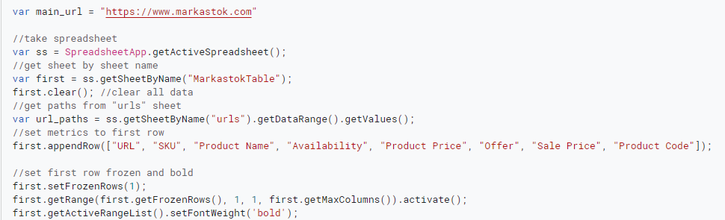


I have specified the functions of code in the comment line.
URL Fetch Service allows scripts to access other resources on the web by fetching URLs.
To parse the website i imported ‘Cheerio’ library.

Slide 4
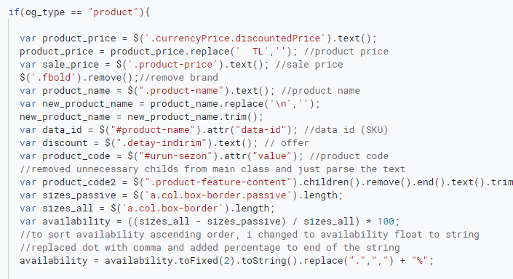
1. Scraping necessary metrics
I went through the sample product site and found the necessary parameters from the web source.

Slide 5
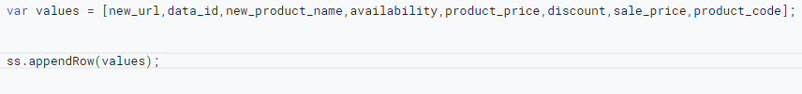
2. Writing this data to Google Sheets
I added the data to which the required parameters were applied to a list and added it to the table with the
appendRow() function.

Slide 6
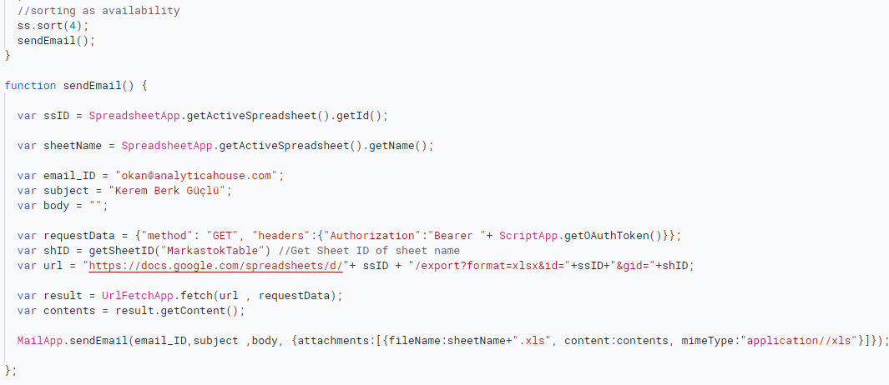
3. Sorting and Sending
I tried to sort data by availability but this not works properly i think.
When the data is in the table, it is sorted correctly, but when it is sent as an e-mail, it does not sort in the xml file.

Slide 7
4. Bonus
First i tried to parse product code from #urun-sezon bar, but i realize some items doesn’t have this bar.
I searched this code and found under the «product-feature-content» class. But there are more div’s in addition to
text. I specify the children and remove them and take the text then, to normalize all spacing i used trim() function.

Slide 8
Additional Questions
1. we can do this things using multiprocessing operations faster but i don’t know how to do it. it can be a system where similar works are done synchronously.
2. We can use triggers to automate this process.
Simple trigger can’t send email
Can’t access files other than the one they are bound to
Installable triggers can call services that require autorization
Offer several additional types of events including time-driven triggers
3. In computer programming, an application programming interface (API) is a set of subroutine definitions, protocols, and tools for building application software. To me, the API is the messenger that takes your order and tells the system what to do and in return gives back the response you asked for.

Slide 9
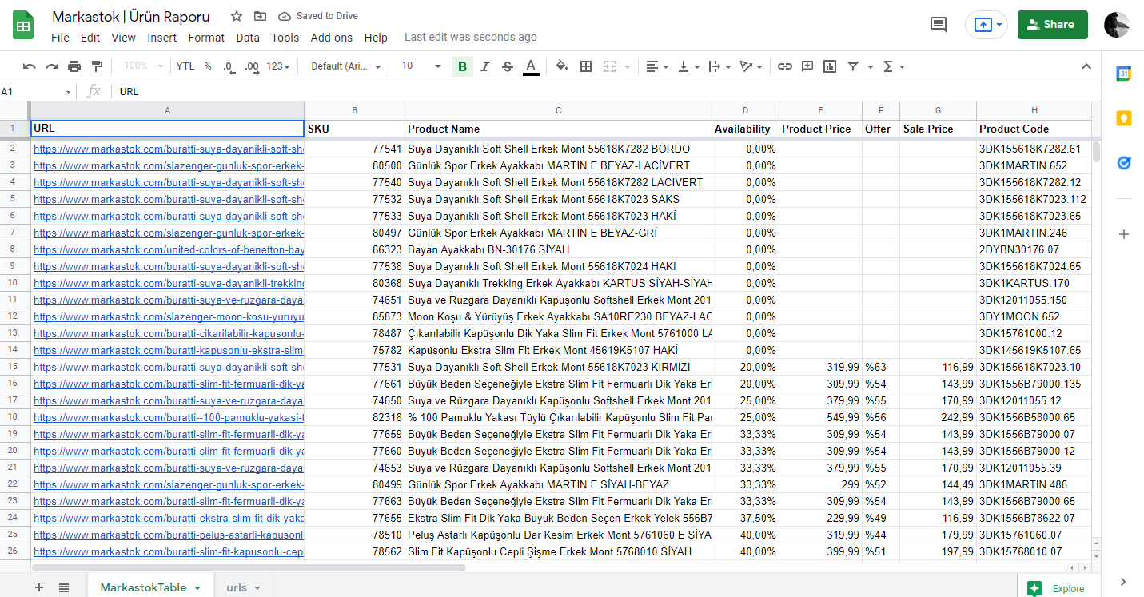
Example of Sheet Output

Slide 10
Contact
Phone: +90 (533) 630 06 72
Mail: kberkguclu@gmail.com
Github: https://github.com/keremperq
LinkedIn: https://www.linkedin.com/in/kberkguclu/

