Slide 1
EC48W Housing Prices Modelling Exploratory Data Analysis
Prepared by:
Esra Gül
Cihat Erbay
Ata Kerem Sütçüoğlu

Slide 2
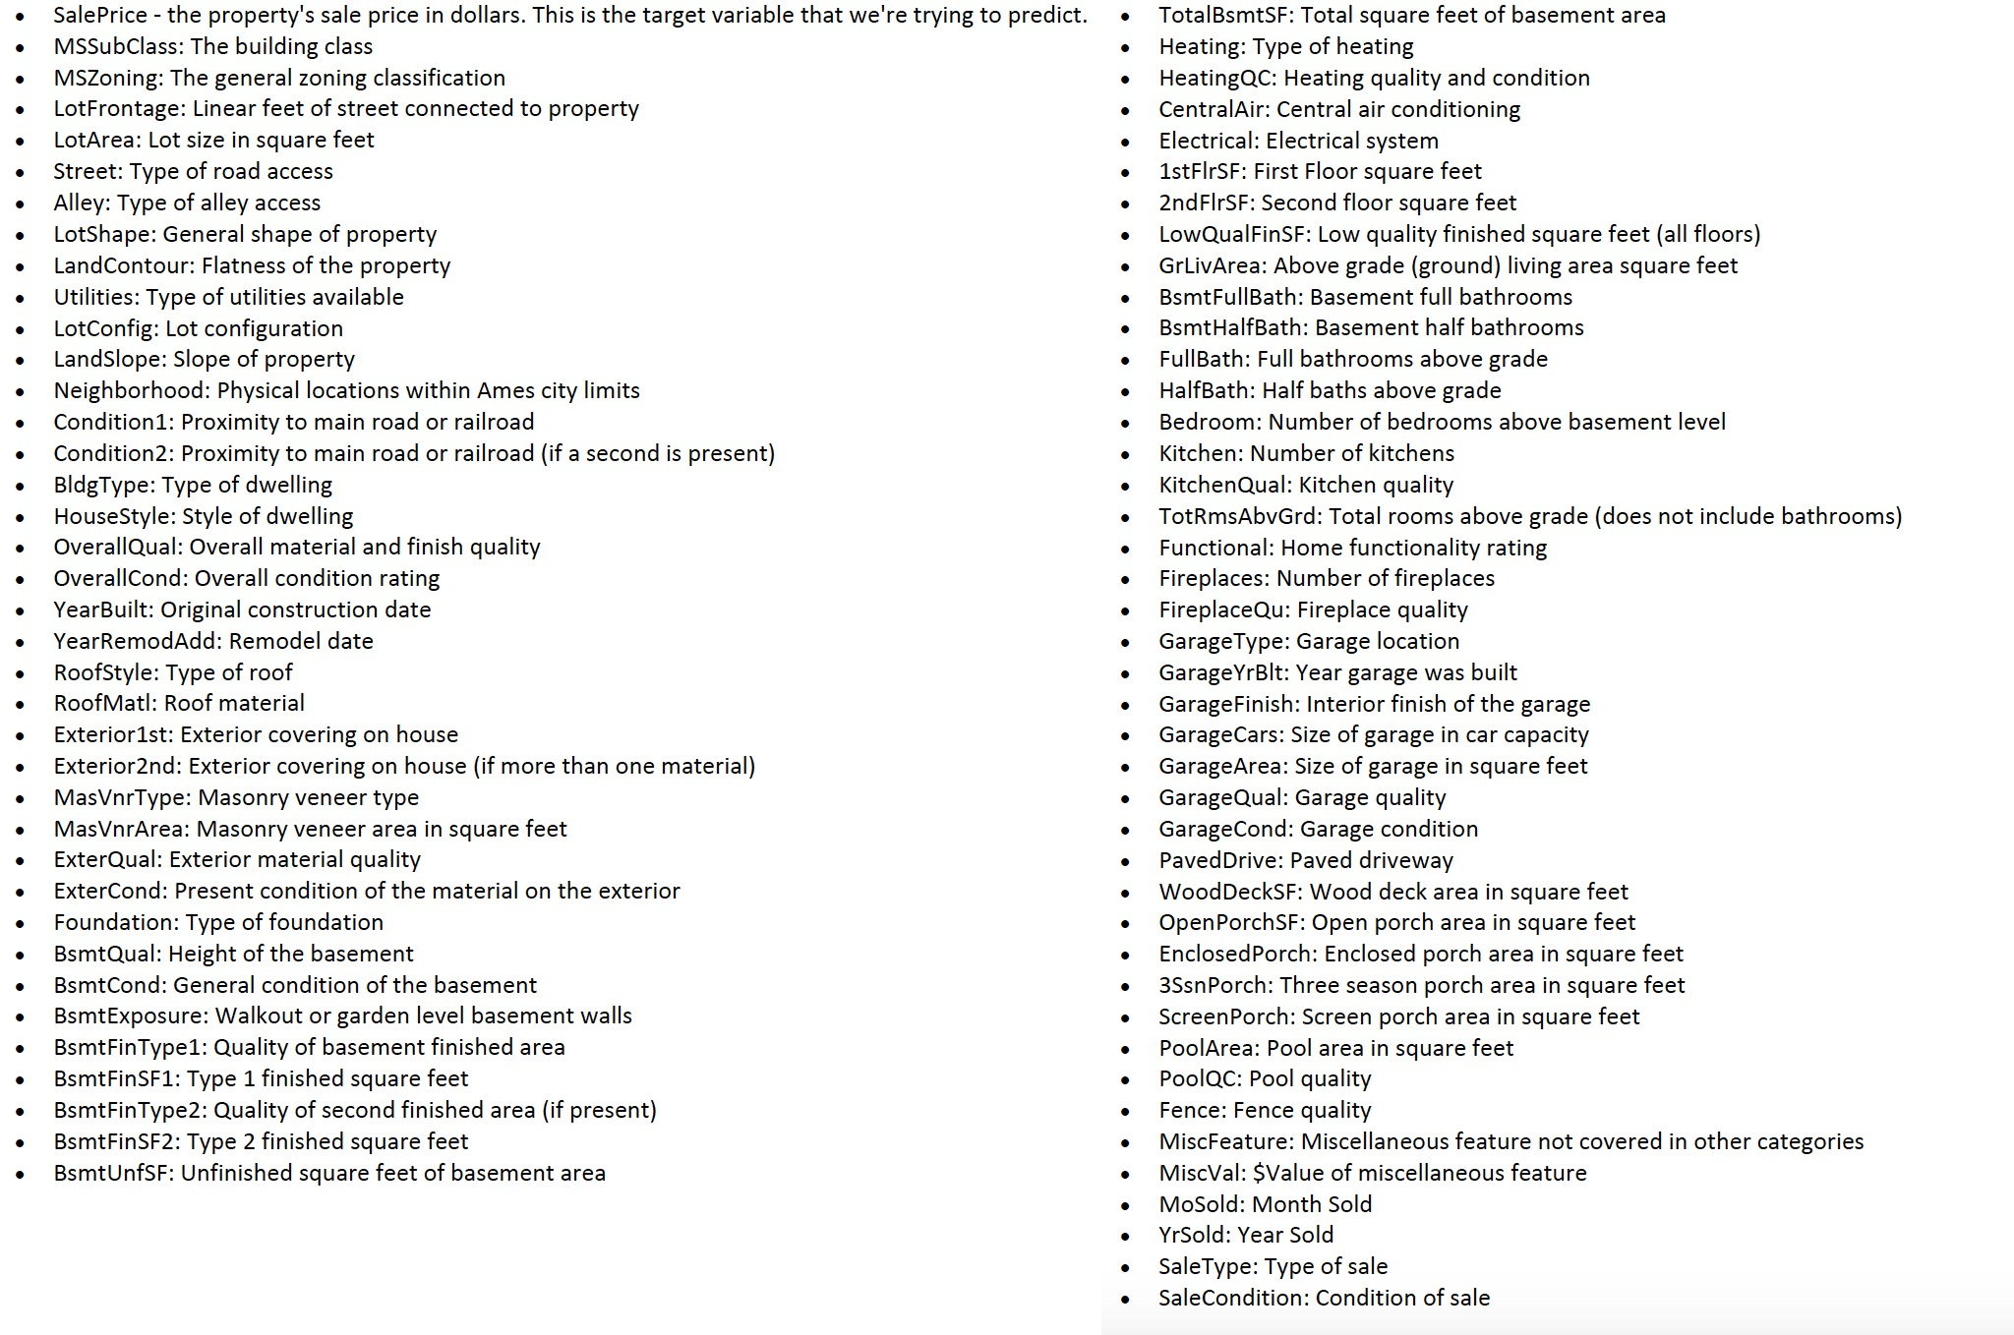
Feature list and their descriptions

Slide 3
Data types
There are 80 features that affect the variable we are going to predict
Among these, we have 43 categorical variables and 37 numerical variables
First, we looked at count, mean, standard deviation, median, an percentiles of numerical attributes, as they will help us to process missing values.
Now, we will see what features have missing values and how many missing values each of these features contain

Slide 4
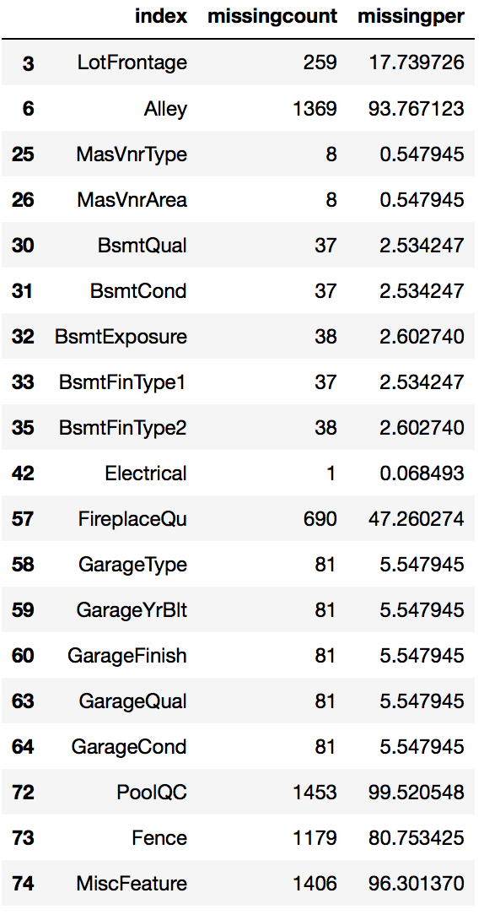
There are 19 features which has null values.
For features ‘Alley’, ’FireplaceQu’, ‘PoolQc’, ‘Fence’, ‘MiscFeature’ and ‘LotFrontage’ , missing percentage is very large. We decided to remove these features because they do not provide much information, and also we already have more than enough information to continue our prediction.
Finally we have: 75 features.

Slide 5
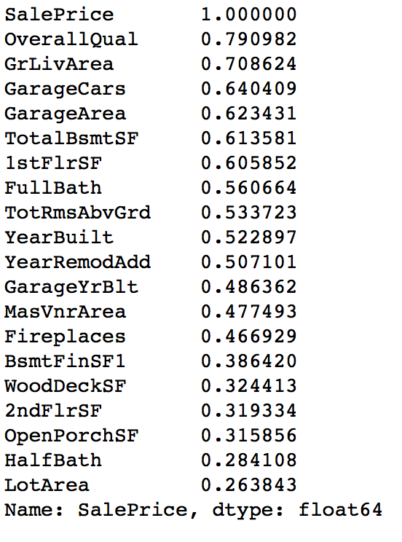
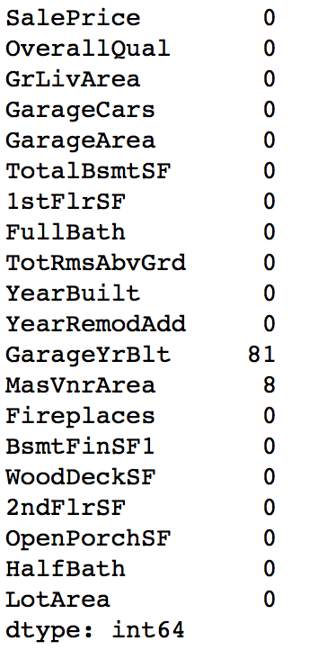
Now, to narrow our investigation we listed top 20 features that make huge contribution to target variables. The pairwise correlation of columns, excluding NA/null values can be seen from output in the right:
As the next step, we check whether any of these variables have null values or not:

Slide 6
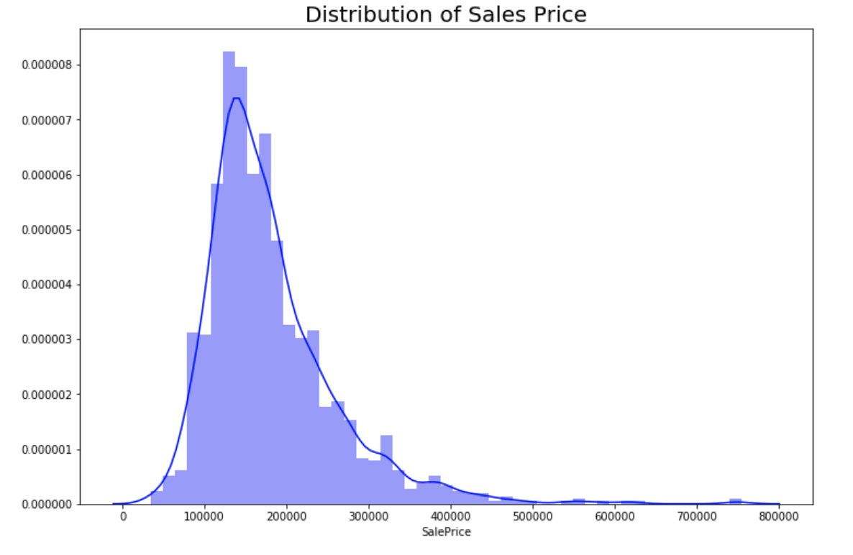
Therefore, we have two variables, ‘GarageYrBlt’ and ‘MasVnrArea’, that are in good correlation with target variable and have null values.
In order to handle missing values, we substituted them using the mode of the respective column.
As a next step, lets see how target variable values are:
As we can see, there is skewness which is about 1.88, moreover it is right skewed.
To remove skewness, we applied log transformation to values of the SalePrice.
After implementation, the value of skewness is about 0.12

Slide 7
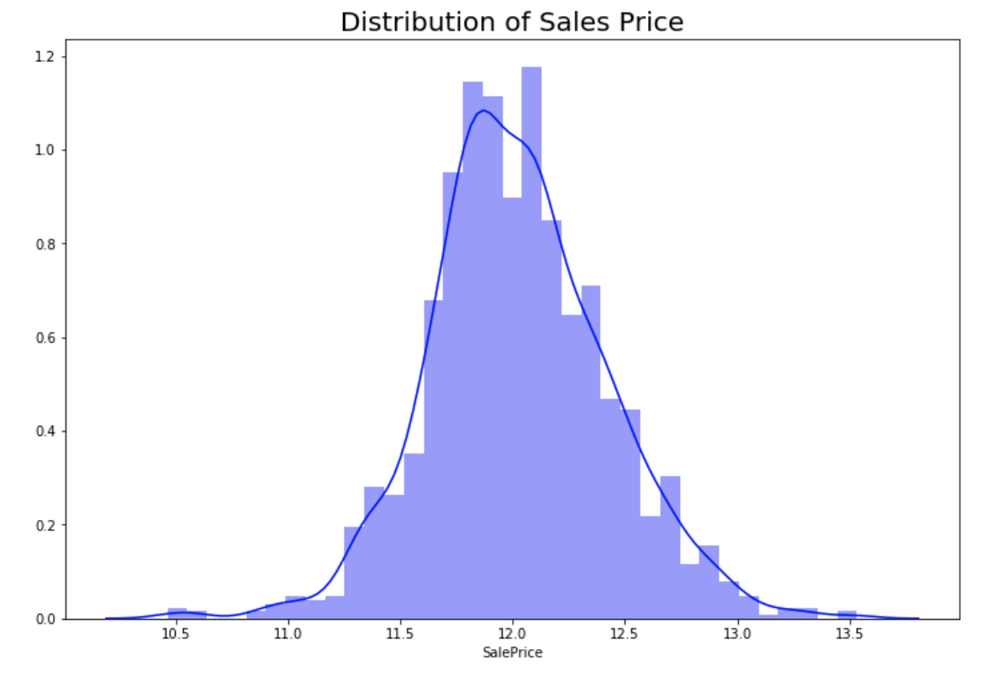
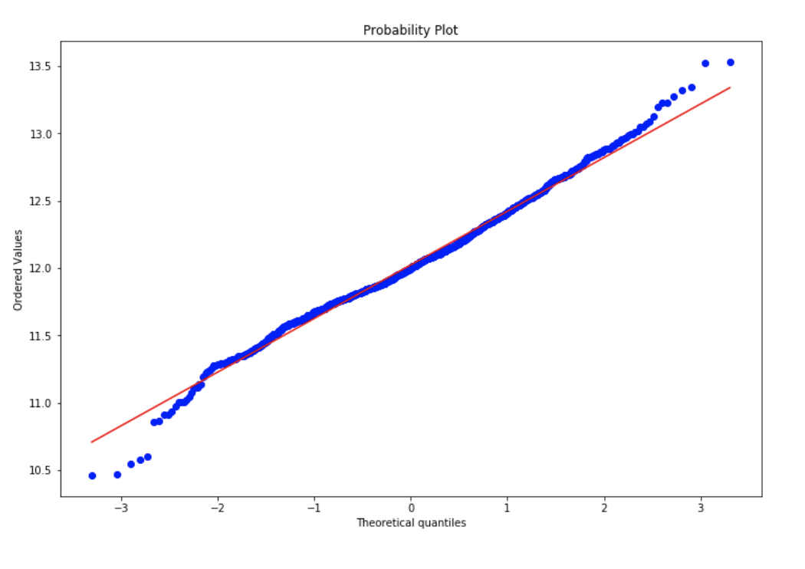
Also, we look at the normal probability plot of the variable to see whether our data items quite fit a normal distribution

Slide 8
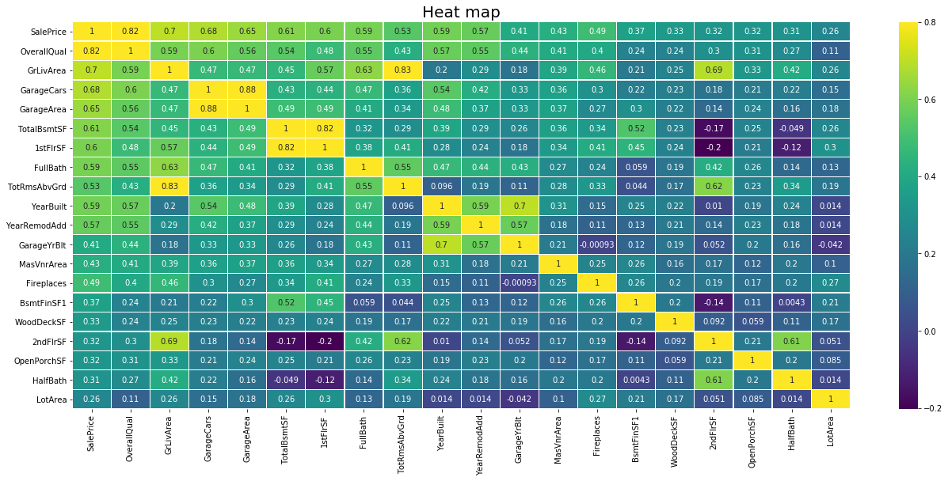
Look for the collinearity between variables through analyzing the heat map. Collinearity means having some relationship between the independent variables which may leads to so many problems when we interpret the results. So it is better to remove the variables that are highly correlated which is shown on the heat map as more yellowish.

Slide 9
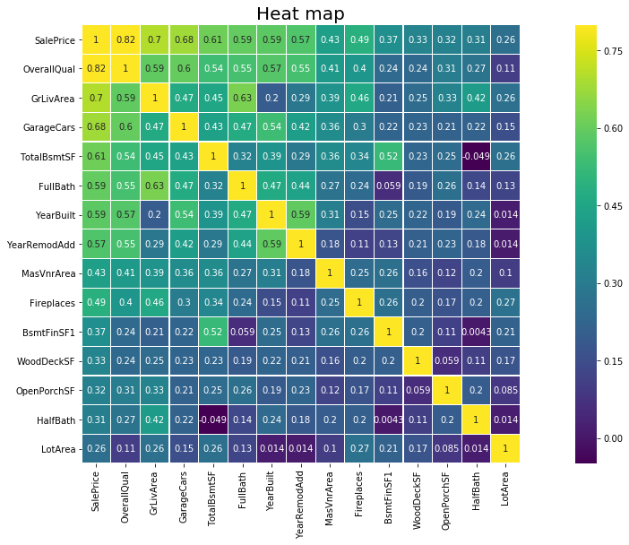
After dropping the variables that have collinearity which are "GarageArea", "TotRmsAbvGrd", "2ndFlrSF", "1stFlrSF", "GarageYrBlt“, then the resulting correlation matrix is the following.

Slide 10
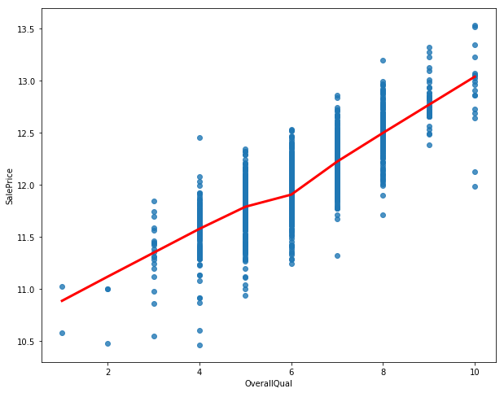
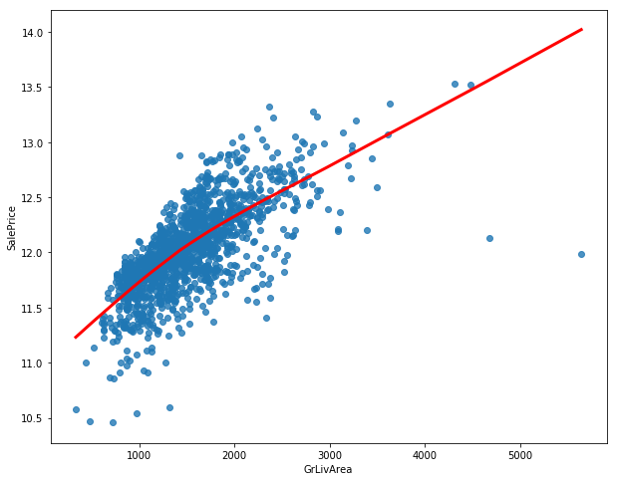
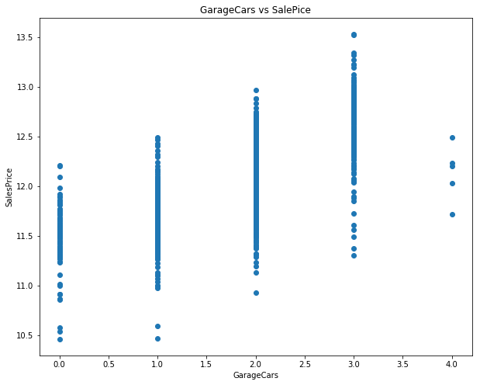
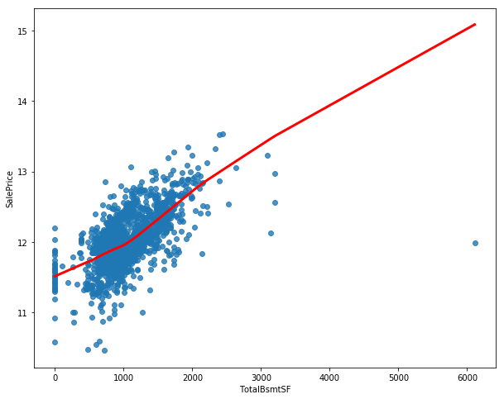
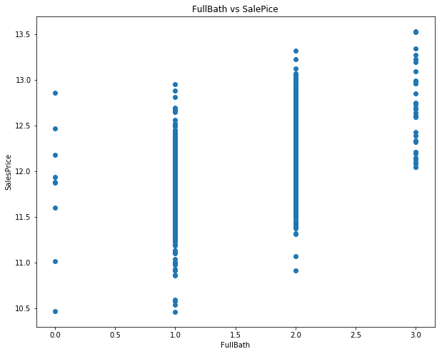
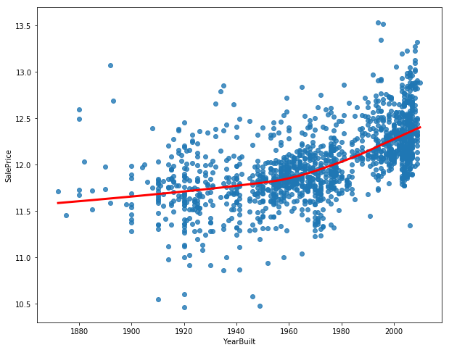
Overall Quality vs Sale Price
Ground Living Area vs Sale Price
Size of Garage vs Sale Price
Total Basement Area vs Sale Price
Full Bathrooms vs Sale Price
Year Built vs Sale Price

Slide 11
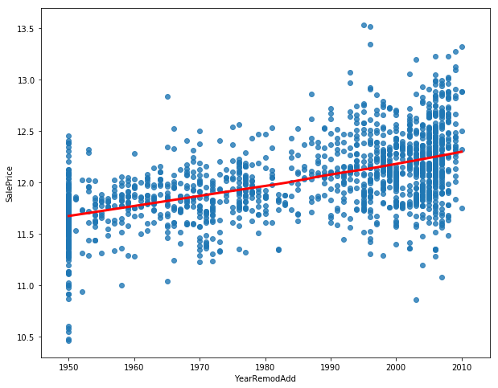
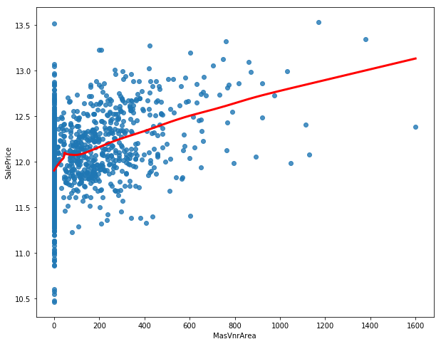
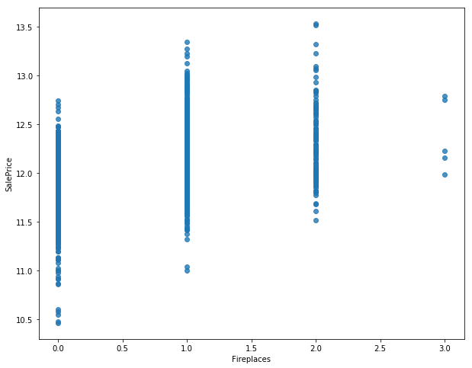
Remodel Date vs Sale Price
Masonry Veneer Area vs Sale Price
Number of Fireplaces vs Sale Price

