Slide 1
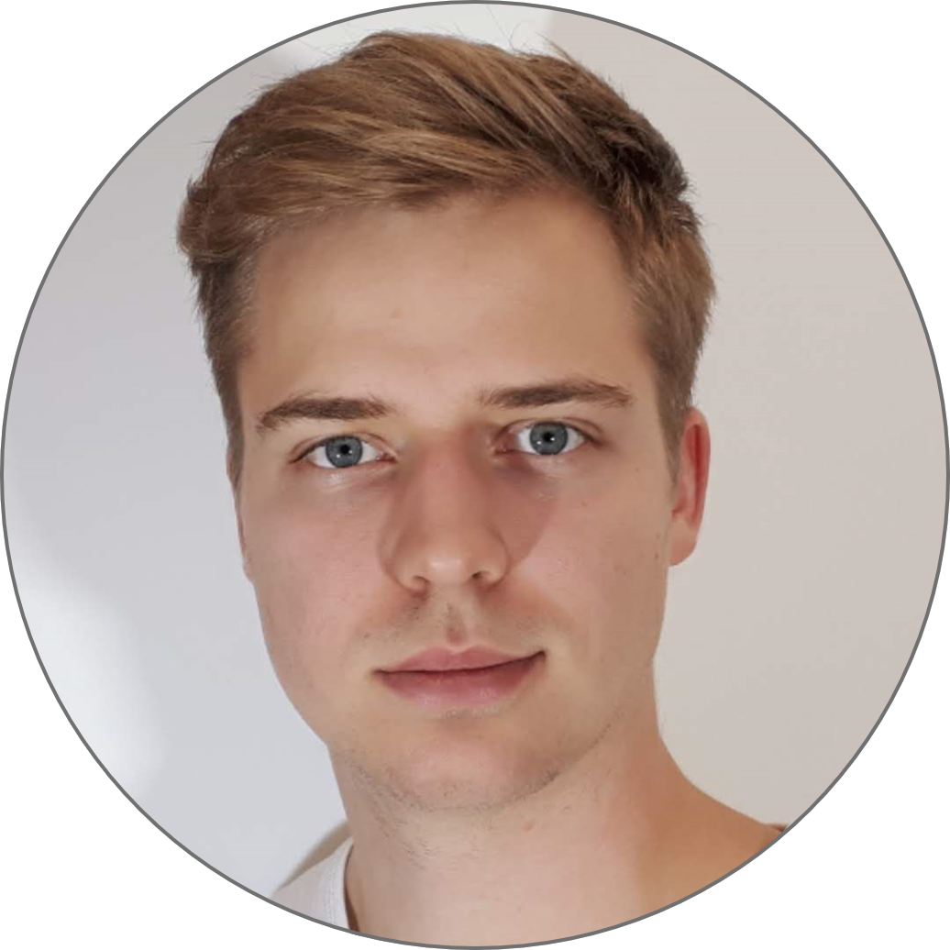












David Papp
Borbála Kovács
IT intern
Internship
Experience
Contact
Current Kitchen assist, Fratelli Pizza
As leader kitchen assistant I am responsible for keeping the orders on time. I calculate the time it takes to prepare the meals on incoming orders (can be 30-40/hour). 2018 – 2019 Sourcing intern, Rexel Hungary
As an IT intern I was responsible for operating the database of a company of 50 people. Among other things I updated the items in the webshop, I was in contact with suppliers daily. 2016 – 2017 Volunteer, Pivar Ignac Special School
I became a part of an 8th grade special class, I gave lectures in history and assisted the teacher and the students in everyday life.
45 91 82 3000
writeanemailtodavid@gmail.com
Matildelundsvej 44, 1/3, Viby J, Denmark 8260
davidapapp.com
education
Multimedia Design Business Academy Aarhus
Enginer IT Specialist Óbuda University
High School Diploma, 06/2018 Steiner’s Waldorf School of Fót
Personal Skills
Good problem solving skills
Self-sufficient
Focused work
Drivers license –
A, B categories
Spoken languages
Hungarian English – C1
Skills
Hobbies
Motorcycling Cooking Wood and ironworking

Slide 2
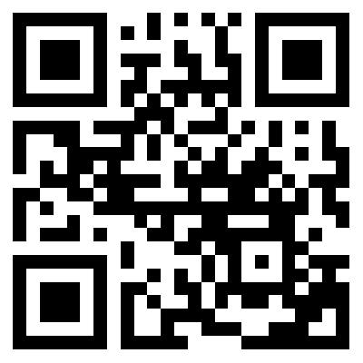
About me
I’m David, 22 years old from Hungary. I am a passionate student of Multimedia Design at Business Academy Aarhus. I moved to Denmark from Hungary in 2019 to join my interests in the IT and design areas.
I'm innovative and confident in my work. I consider creative problem solving and effective project management to be my greatest strengths. In my working process I operate efficiently with foreseeable and unexpected factors as well.
I enjoy the most when I successfully finish a product and can see result of my work.This is related to my hobby, which is making decorations and unique furnitures from wood and iron based on my own designs (link to my woodwork projects).
I regard myself joyful and free spirited, but when I’m working on a project I'm perfecting every detail until I find it satisfactory. I’m self sufficient, but prefer to work in a dynamic group environment.
davidapapp.com

