Slide 1

Software architecture for autonomous Robobot
J. Christian Andersen

Slide 2
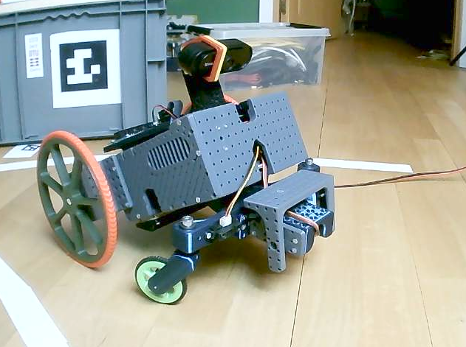
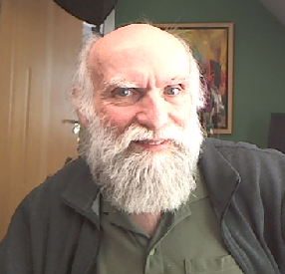
Robobot
Edge and distance code
J. Christian Andersen

Slide 3
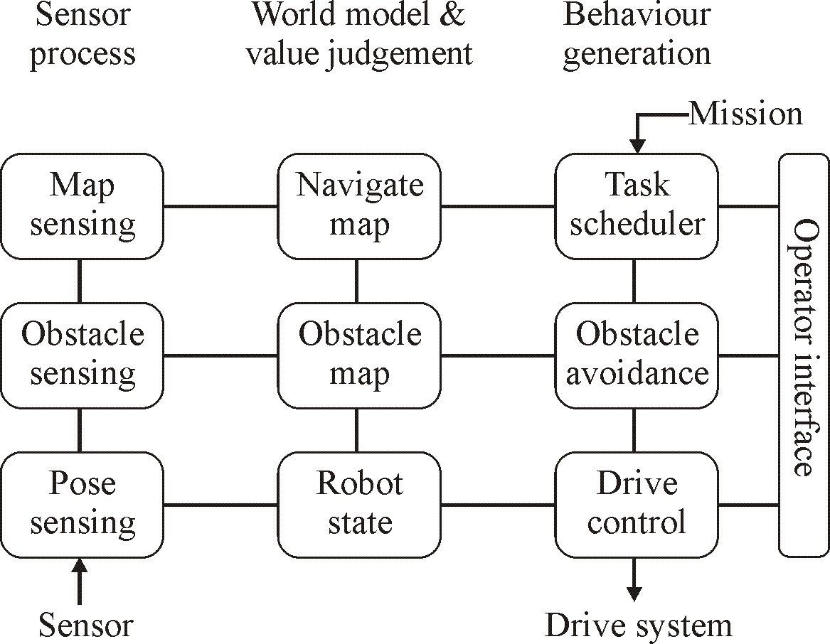
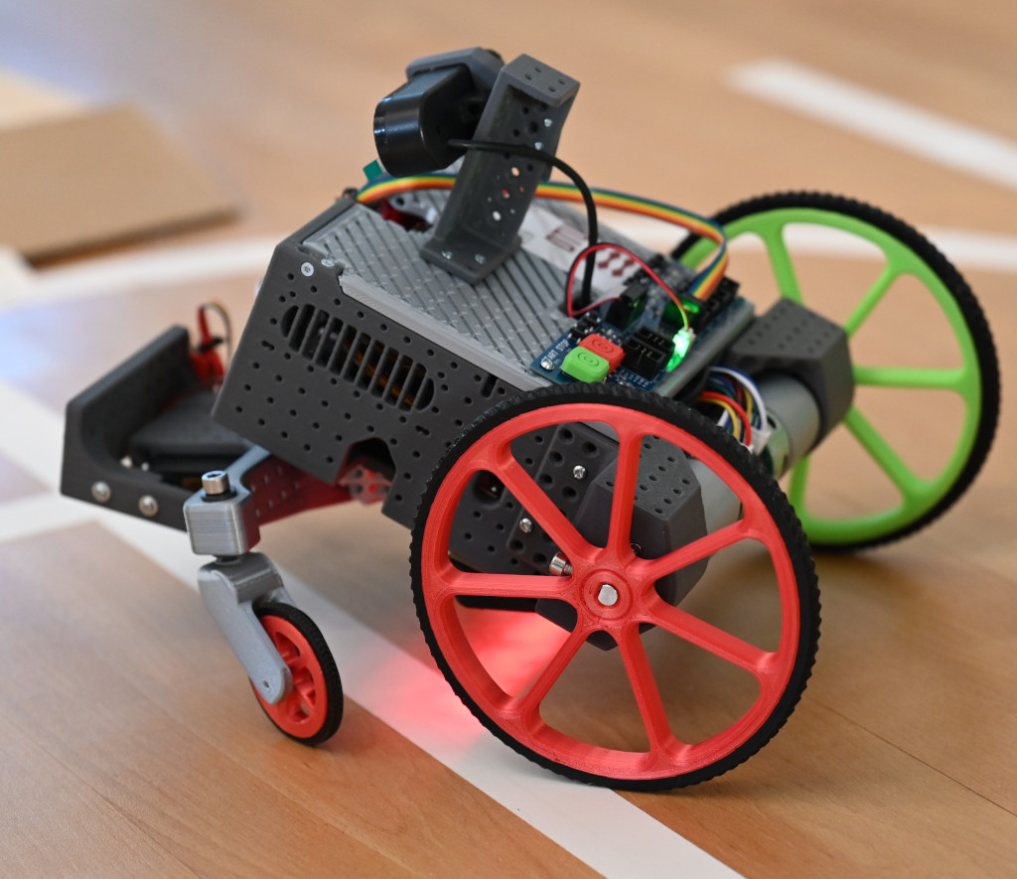
Robobot in blocks
Motor
Distance
Distance
Battery
12V
Servo
PWM
5V
Wifi
on
Raspberry PI
Mission app
Teensy board
(Regbot)
encoder
Camera
USB
PWM
5V
display
encoder
digital
pulse
analogue
Motor
Digital IO
IMU
Line sensor
start

Slide 4
Robobot software blocks
Camera
Raspberry PI (3 or 4)
USB
Teensy PCB (Regbot)
Wifi
display
Sensor
Interface
Publish/
Subscribe:
Encoder,
IMU,
IR-distance,
line-sensor
battery,
current
...
Python
(socket-base-py)
Base control
(raubase C++)
/dev/ttyACM0
USB
IP-display
(ip_disp)
Servo interface
Motor interface
Start button only
Digital IO
start

Slide 5
Robobot software blocks 2025
Pi
Camera
Raspberry PI (4 or 5)
Teensy PCB (Regbot)
Wifi
Camera
Streamer
(python)
LED band
Sensor
Interface
Publish/
Subscribe:
Encoder,
IMU,
IR-distance,
line-sensor
battery,
current
...
Mosquitto
(MQTT server)
display
Mission
app
MQTT-
Client
(python)
Teensy
interface
(C++)
/dev/ttyACM0
USB
MQTT
IP-display
(C++)
Servo interface
Start
Motor interface
Digital IO
stop
start

Slide 6
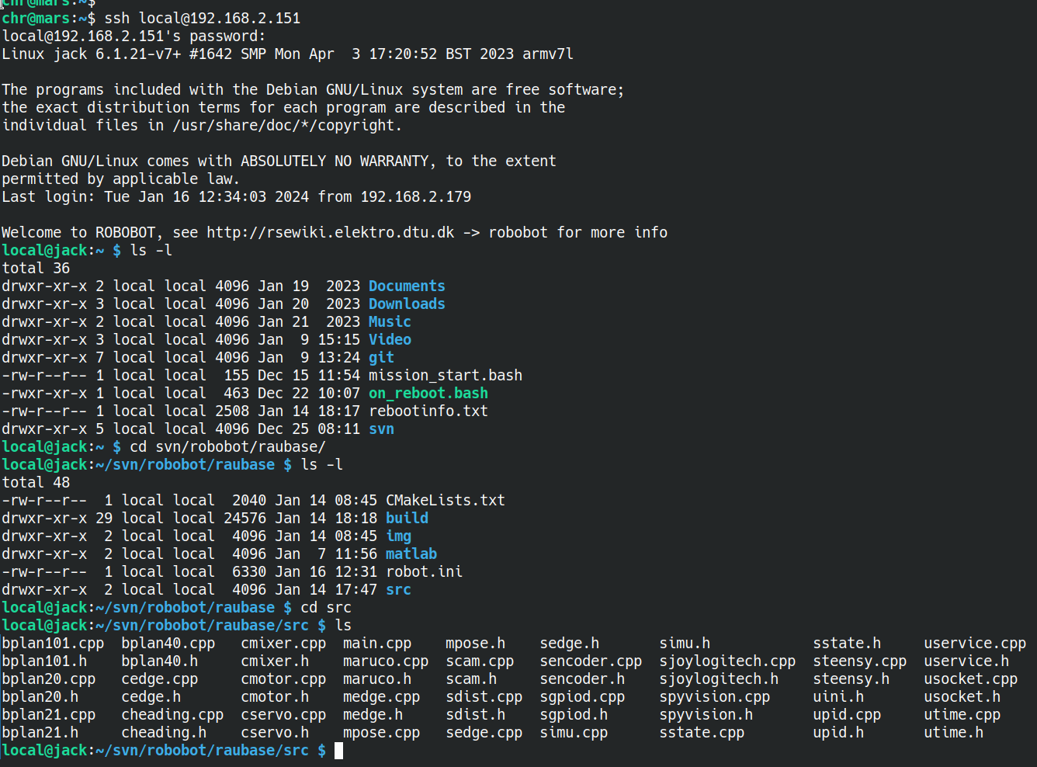
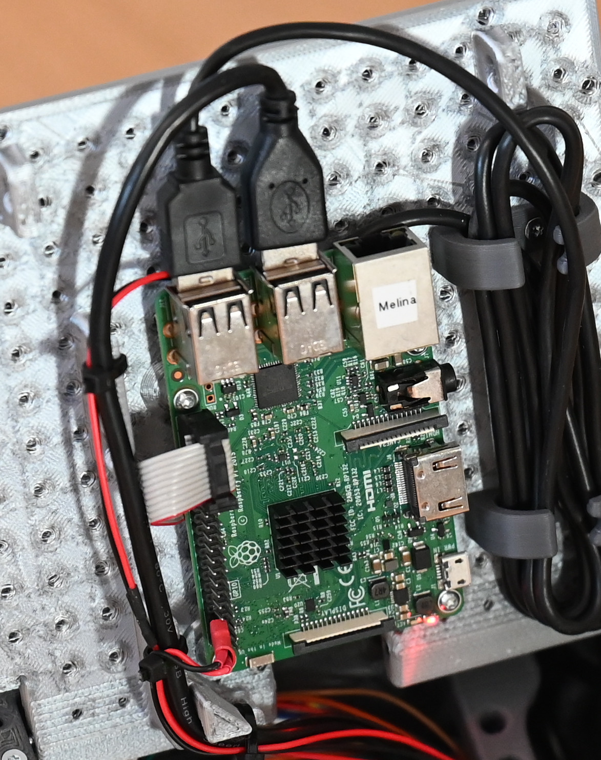
Software on Raspberry Pi
Camera
Raspberry PI (3 or 4)
USB
Wifi
Python3
(socket-base-py)
Base control
(raubase C++)
/dev/ttyACM0
IP-display
(ip_disp)
Start button only
Digital IO
start

Slide 7
Architecture description – NASREM
(text in boxes are just to exemplify)
hours
minutes
Sensory
processing
Modelling and
assessment
Behaviour
generation
Abstraction
Objectives
Update frequency
Situation
sensor
Situation
detect
Situation
behaviour
Drive
sensing
Drive
methods
Move type
control
Real time requirement
Planning horizon
Configuration
Operator interface (debug)
Pose
sensing
Robot
pose
Drive
control
seconds
milliseconds
sense
Drive system
ref: NASREM
The National Aeronautics and Space Administration (NASA) and the US National Institute of Standards and Technology (NIST) have developed a Standard Reference Model Telerobot Control System Architecture (NASREM). Albus, J. S. (1992), A reference model architecture for intelligent systems design.

Slide 8
Robobot level 1 (velocity and heading)
(version for the rsewiki)
Sensory
processing
Modelling
Plan and execute
Sensory
processing
Modelling and
assessment
Plan and
execute
Heading mode
Plan
Situation
sensor
Situation
detect
Situation
behaviour
Forward velocity
Rotation velocity
Forward velocity
Rotation velocity
Drive
sensing
Drive
methods
Drive type
control
Mixer
(cmixer)
Heading
(cheading)
Pose
sensing
Robot
pose
Drive
control
sense
Drive system
Encoder
(sencoder)
Pose
(mpose)
Velocity
(cmotor)
PID
(upid)
Logfiles
(for Matlab)
Parameters
(uservice)
Config.
(robot.ini)
Teensy i/f
(steensy)
USB
Hardware
(Teensy)
Most block text in brackets
corresponding to filenames
(eg. upid = upid.cpp and upid.h)
Sensor data
(text lines)
Motor voltage
(text lines)

Slide 9
Robobot level 2 (drive alternatives)
Behaviour plans
(version for the rsewiki)
Sensory
processing
Modelling
Behaviour generation
Selected
Drive type and
parameters
Sensory
processing
Modelling and
assessment
Plan and
execute
Situation
sensor
Situation
detect
Situation
behaviour
Distance
(sdist)
Distance
(mdist)
Wall drive
(cdist)
PID
(upid)
Drive
sensing
Drive
methods
Drive type
control
Pose
sensing
Robot
pose
Drive
control
Line sensor
(sedge)
Edge detect
(medge)
Edge drive
(cedge)
PID
(upid)
sense
Drive system
Parameters
(uservice)
Logfiles
(for Matlab)
Gyro/acc
(simu)
Tilt
(mimu)
Config.
(robot.ini)
Forward velocity
Rotation velocity
Heading mode
Teensy i/f
(steensy)
Pose
(mpose)
drive
control
Most block text in brackets
corresponding to filenames
(eg. upid = upid.cpp upid.h)
---- Dashed frame means
not provided.
Level 1

Slide 10
Robobot level 2 (drive alternatives)
Behaviour plans
(version for the rsewiki)
Sensory
processing
Modelling
Behaviour generation
Selected
Drive type and
parameters
Sensory
processing
Modelling and
assessment
Plan and
execute
Situation
sensor
Situation
detect
Situation
behaviour
Distance
(sdist)
Distance
(mdist)
Wall drive
(cdist)
PID
(upid)
Drive
sensing
Drive
methods
Drive type
control
Pose
sensing
Robot
pose
Drive
control
Line sensor
(sedge)
Edge detect
(medge)
Edge drive
(cedge)
PID
(upid)
sense
Drive system
Parameters
(uservice)
Logfiles
(for Matlab)
Gyro/acc
(simu)
Tilt
(mimu)
Config.
(robot.ini)
Forward velocity
Rotation velocity
Heading mode
Teensy i/f
(steensy)
Pose
(mpose)
drive
control
Most block text in brackets
corresponding to filenames
(eg. upid = upid.cpp upid.h)
---- Dashed frame means
not provided.
Level 1

Slide 11
Robobot level 3 (Vision)
Behaviour plans
(version for the rsewiki)
Sensory
processing
Modelling
Behaviour generation
Sensory
processing
Modelling and
assessment
Plan and
execute
Behaviour
sequence
(main)
Situation
sensor
Situation
detect
Situation
behaviour
Python
(socket-base-py)
Situation
detect
Drive
sensing
Drive
methods
Drive type
control
Behaviour
(bplanXX)
Pose
sensing
Robot
pose
Drive
control
Camera
(via USB)
Python i/f
(spyvision)
Golf ball
(m???)
sense
Drive system
Logfiles
(for Matlab)
Camera
(scam)
Aruco
(maruco)
Selected
Drive type and
parameters
Parameters
(uservice)
Config.
(robot.ini)
Most block text in brackets
corresponding to filenames
(eg. scam = scam.cpp scam.h)
---- Dashed frame means
not provided.
Drive
sensor
Drive
model
Drive
control
Level 1+2

Slide 12
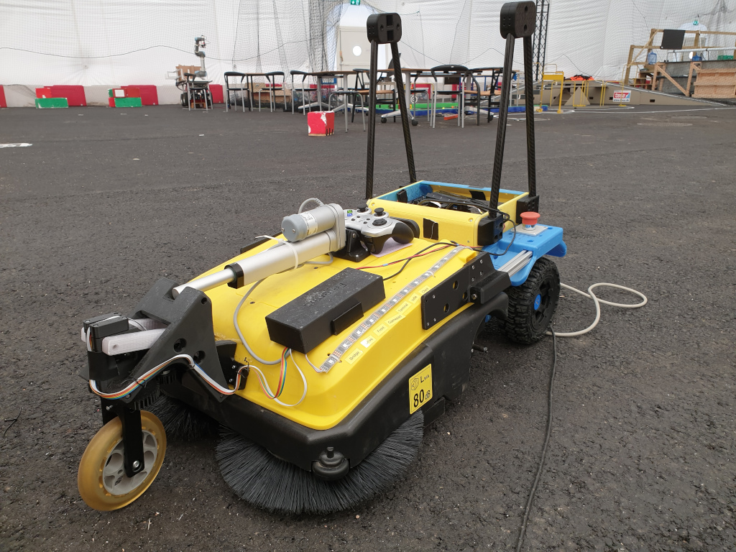
Architecture – higher levels?
Example
Situation detect
Snow, rain
Traffic situation
(Battery) power low
Road surface (soft, wet)
Localization lost
Someone in distress
Behavior rules (e.g. traffic)
Load status
Weed detect
opportunity
Task generate
deliver opportunity
pick up opportunity
cut weed
clean
assist/help
map
recharge option
Detect
Situation
Plan
Robot
Objective
Calendar
access
Calendar
assess
Objective
plan
go
Map
validity
Explore
plan
priority
e.g.
battery
Asset
sense
Asset
projection
Recharge
plan
Action
decision
Cable or net
Danger
detect
Area
limitations
Brush
use risc
Situation
items
Area
situation
Test setup
People
detect
People
movement
Friendly
behaviour
Mapping
localization
Map
route
Obstacle
sense
Local
map
Obstacle
avoid
NASREM
Pose
sense
Robot
state
Drive
control
sense
Action

Slide 13
NASREM software model
- for autonomous robot
Sensor processing
(prepare data)
World model
(in context)
Behavoiur
generation
Mission
objective
Abstraction
Situation
sensor
Situation
state
Behaviour
decision
Update frequency
Obstacle
sensor
Obstacle
map
Obstacle
avoidance
Configuration and monitoring
Pose
sensor
Robot
state
Drive
control
Sensor
Actuator
Function

Slide 14
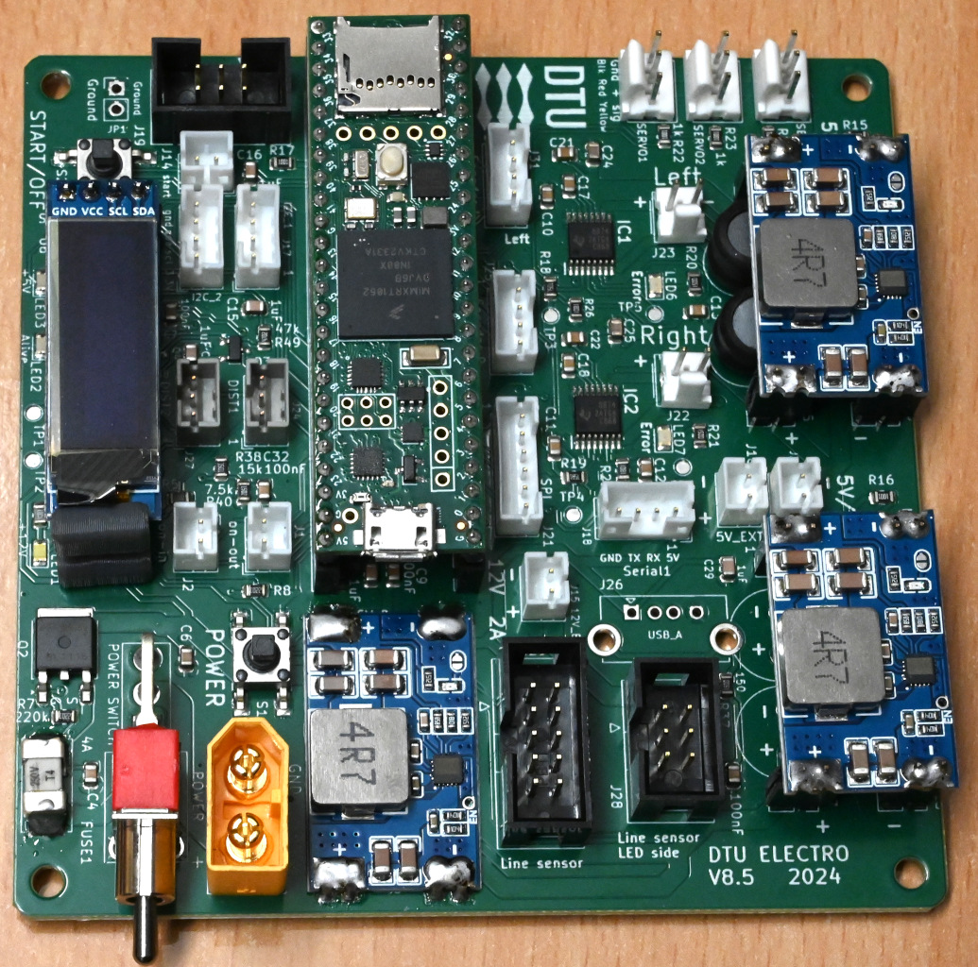
Teensy PCB
I2C
IMU
Servo 1-3
(5V 5A)
Start switch
Arduino
Start switch
Motor left
+ encoder
Motor right
+ encoder
Display
I2C-1
I2C
Motor left
+ encoder
Analogue IR sensor
Motor right
+ encoder
2
1
SPI
Power on switch
5V 5A (x2)
For Pi
Power on switch
LED band
display
11 – 24V
battery
Battery
(switched)
Analogue
Line sensor
LED
Line sensor

Slide 15
Teensy PCB LEDs
Teensy
User led
Teensy 5V
5V 5A Servo
Off if overloaded.
Note: power cycle to recover.
I2C
Teensy alive
Blink : alive
bright: logging
2
1
SPI
Battery power
Motor error
(red)
Motor error
(red)
5V 5A
Raspberry Pi
Teensy
uploading

Slide 16
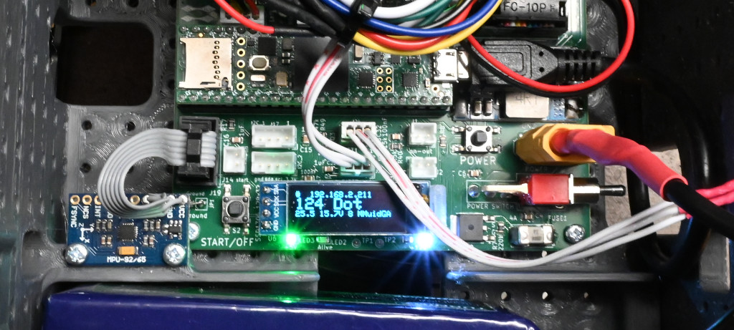
Teensy PCB
Power button
(power on while pressed)
Reset (upload)
button
Power button
May be external through this plug

Slide 17
Teensy PCB
Power ON
(after software off)
Start/off button
May be external through this plug
Power cut
Careful if Raspberry is on
Start/off
Press 5 sec to off
Power button
May be external through this plug

Slide 18
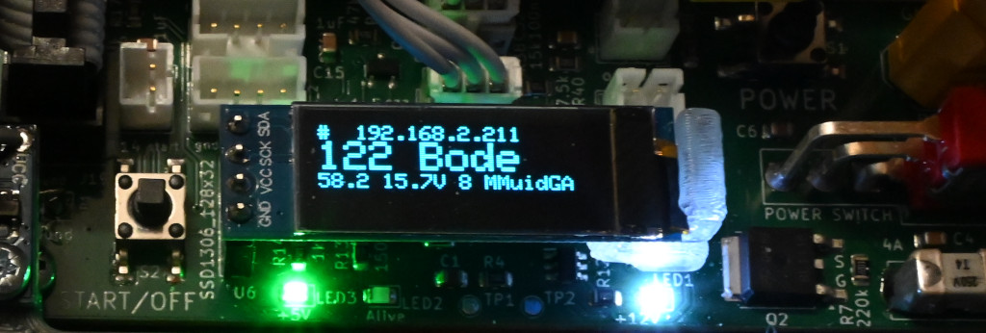
Teensy PCB display
User text – default is wifi IP
Module status
(capital is off/inactive)
MM/mm motor
U/u USB
I/i IMU found
D/d Distance
G/g Gamepad
A/a AS encoder
Robot name
Alive seconds
Hardware type
Battery voltage

Slide 19
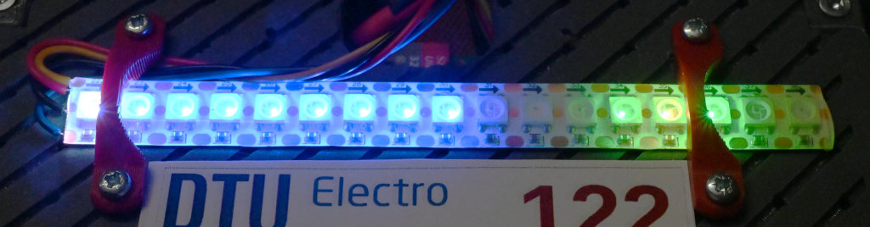
LED-band
LED 0
Teensy
Blink - alive
LED 14-16
User (mission)
14: teensy_interface alive
14-16: white is shutdown
16: mission dependent
LED 12-13
Distance
Sensor 1 and 2
Green is > 50cm
Yellow is > 13 cm
Red is < 13cm
LED 2-9
Line sensor
Blue – no line
Green - line
LED 13-14
Distance
Sensor 1 and 2
Green is > 50cm
Yellow is > 13 cm
Red is < 13cm
LED 1-8
Line sensor
Blue – no line
Green - line
LED 9-11
IMU gyro
X, Y, Z azis
Green is positive
LED 10-12
IMU gyro
X, Y, Z azis
Green is positive

Slide 20
LED-band
LED 14 (blinking)
teensy_interface is alive
LED 0
Teensy
Blink - alive

Slide 21
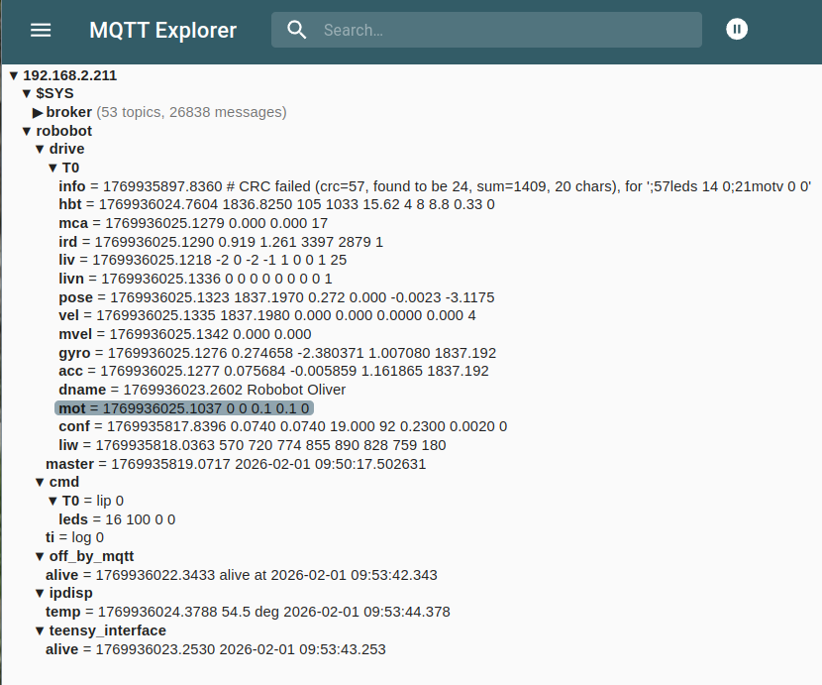
MQTT client
mission_start.bash
Raspberry Pi
ip_disp
(Start button)
mqtt-python
(mqtt-client.py)
Start
5 sec =
power off
Start:
on_reboot.bash
robobot/drive/T0/xxx
robobot/drive/master
MQTT server
(mosquitto)
Robobot/cmd/shutdown
robobot/cmd/ti
robobot/cmd/T0/xxx
off_by_mqtt
teensy_interface
Start:
on_reboot.bash
Start:
rename_host.bash
as root
log
Sudo shutdown
Robot.ini
“robobot/drive/T0/xxx”
“robobot/cmd/T0/xxx”
XT60
Power
teensy_firmware_8
(Teensy 4.1)
Wifi
(DTUdevice)
Teensy PCB 8.5

Slide 22
MQTT client
Python app
State machine
state == 0:
  Init
state == x:
  Part x
state == y:
  Part y
state == z:
...
Line
(sedge.py)
Camera
server
on robot
Camera
(scam.py)
Main loop
(mqtt-client.py)
Distance
(sir.py)
Pose
(srobot.py)
GPIO
(sgpio.py)
GPIO
6 x io
MQTT mm
(uservice.py)
Robot
(srobot.py)
log
(ulog.py)
stop
Mosquitto MQTT
server on robot
Logfile

Slide 23
Teensy Interface
Teensy_interface
Mosquitto
server
1883
MQTT
(umqtt)
Motor control
MQTT
(umqtt)
Mixer
(cmixer)
Joy
(ujoy)
Logitec
(ujoylogitech)
Gamepad
(Logitec)
Service
(uservice)
Main loop
(main)
Robot.ini
Motor
(cmotor)
PID
(upid)
Config
(uini)
Edge
(sedge)
Distance
(sdistforce)
Current
(scurrent)
Velocity
(svelocity)
Teensy[N]
(steensy)
Data
Servo
(cservo)
Robot
(srobot)
IMU
(simu)
Encoder
(sencoder)
USB
Teensy
Teensy
Logfiles

Slide 24
Teensy firmware
Sensors
Sensor
process
Behaviour
Support
IMU
MPU9250
Gyro/acc
(uimu2)
Main loop
RAM
logging
Interface
(usb)
USB
12 Mbit/s
IR distance
2Y0A2
Distance
(irdist)
Data
subscribe
Power ctrl
(robot)
Battery
2.2 Ah
Behaviour
state
Line sensor
8x analogue
Line sense
(ls)
Flash
EE-store
Display
(display)
O-led
128x32
Teensy 4.1
Encoder
(uencoder)
Motor ctrl
(motor)
Servo ctrl
(servo)
Led band
(ledband)
LEDs
x17
Encoder
Wheel
motor
Motor
driver
Servo
Actuator

Slide 25
Teensy interface – Odometry drive
Teensy 4.1
Teensy_
interface
MQTT
Python
MQTT-client
Voltage
to PWM
Velocity
control
Velocity
detect
Mixer
Behave
Sensor
interface
Data+
log
Sensor
data
Motor
Motor
Line sensor
Distance
IMU
Robot.ini
Settings

Slide 26
Teensy interface – Odometry drive
Teensy 4.1
Teensy_
interface
MQTT
Python
MQTT-client
Motor voltage
Voltage
to PWM
Velocity
control
Behave
Velocity
left+right
Velocity
detect
Mixer
Line control
Wheel
velocity
Turnrate,
velocity
Sensor
interface
Data
log
Sensor
data
Motor
Motor
Line sensor
Distance
IMU
Robot.ini
Settings

Slide 27
Teensy interface – Line control
Teensy 4.1
Teensy_
interface
MQTT
Python
MQTT-client
Motor voltage
Voltage
to PWM
Velocity
control
Behave
Velocity
left+right
Enable,
velocity, pos
Velocity
detect
Mixer
Line control
Wheel
velocity
Turnrate,
velocity
Line position
Normalize
Line detect
8 x reflectance
Motor
Motor
Line sensor

Slide 28
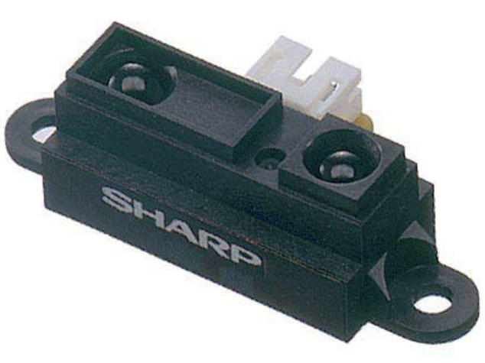
Distance sensor
Sharp 2x
2Y0A21Y
Teensy 4.1
A15, A16
AD interrupt
(uad)
IR-distance
(uirdist)
USB
(uusb)
Interface
(teensy_interface)
MQTT
IR Power
Pin 36
irRawAD[2]
Filter: Tc=10ms
Calib.: 13+50cm
Subscribe: sub ir N
On: iron 1
Analogue
Sample rate 28.3 ms
Raspberry Pi
Teensy PCB

Slide 29
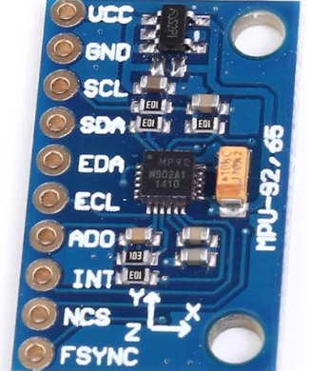
Inertial measurement unit
MPU 9250
Sensor
MPU9250
Teensy 4.1
I2C (18,19)
I2C/9250
(mpu9250)
IMU
(uimu2)
USB
(uusb)
Teensy if
(steensy)
IMU
(simu)
Filter: mean N
Sub: sub imu N
Log: yes
acc[3] (g)
gyro[3] (deg/s)
acc[3] (g)
gyro[2] (deg/s)
Teensy 4.1
(v8)
Raspberry Pi

Slide 30
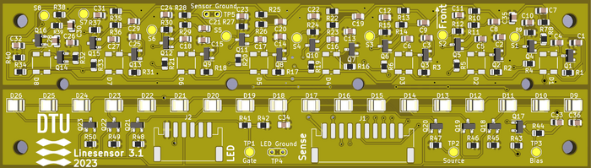
Line sensor
Sensor
VEMD5010
Filter
(~1kHz)
Teensy
A6 A7 A8 A9
A10 A11 A12 A13
AD interrupt
(uad)
Line sensor
(ulinesensor)
Edge sensor
(sedge)
Edge detect
(medge)
LED
C930KSKT
LED driver
BSS138
Teensy
Pin 33,34
adcLSDA[8]
USB
(uusb)
Teensy if
(steensy)
leftEdge (m)
rightEdge (m)
Teensy 4.1 (v8)
Raspberry Pi
Filter: mean over N
Sub: sub liv N or: sub livn N
Log: yes

Slide 31
Line sensor
Sensor
VEMD5010
Filter
(~1kHz)
Teensy
A6 A7 A8 A9
A10 A11 A12 A13
AD interrupt
(uad)
Line sensor
(ulinesensor)
MQTT
(mosquitto)
LED
C930KSKT
LED driver
BSS138
Teensy
Pin 33,34
adcLSDA[8]
USB
(uusb)
Interface
(teensy_interface)
Teensy_firmware_8
Raspberry Pi
Filter: mean over N (ms)
Subscribe (normalized):
sub livn N
Main function:
Translate, timestamp, log.
Can subscribe to most data (see robot.ini)

Slide 32
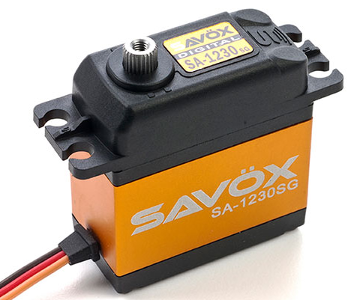
Servo interface
Teensy 4.1
Pin 8 9 10
Servo
(uservo)
USB
(uusb)
Teensy if
(steensy)
Servo ctrl.
(cservo)
Set: servo I P V
setServo(I,e,P,V)
SA1230sg
30Nm @ 5V
0.16s/60 deg
130 deg travel
Teensy 4.1
(v8)
Raspberry Pi

Slide 33
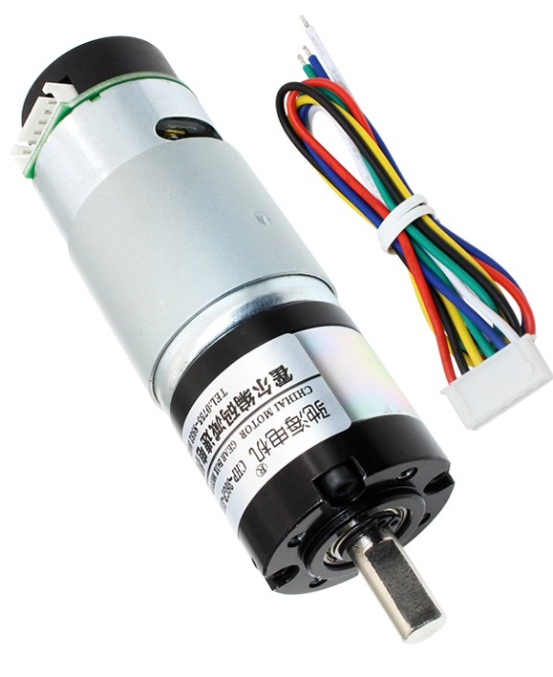
Motor interface
driver
DRV8874
6A 0.2Ohm
PWM
Pin 2 3 4 5
Motor ctrl
(umotor)
USB
(uusb)
Teensy if
(steensy)
Motor
(cmotor)
Encoder
Pin 28 28 30 31
Encoder
(uencoder)
Encoder
(sencoder)
Raspberry Pi
Current
A0 A1
AD interrupt
(uad)
Current
(ucurrent)
motv Vl Vr (volt)
2x
CHP-36GP-555-ABHLL
0.75 Nm @ 12V 2A
Gear 19:1
Filter: Tc (log-rate)
Teensy 4.1 (v8)

Slide 34
Power control
Battery
11-20V
XT60
Fuse 4A
(slow)
State
(ustate)
USB
(uusb)
Teensy if
(steensy)
Power reset
(on)
button/plug
IPD80P03P4L-07
P-MOSFET 80A
Teensy
Pin 35
Cmd: off
Cmd: off
Teensy 4.1
(v8)
Raspberry Pi

Slide 35
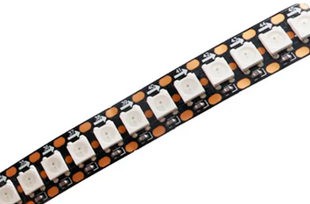
LED band interface
N
UART 1
Pin 1
LED ctrl
(uledband)
USB
(uusb)
Teensy if
(steensy)
Uses DMA
RGB band
1-wire interface
5V
Set: led N R G B
Set: led N R G B
Teensy 4.1
(v8)
Raspberry Pi

Slide 36
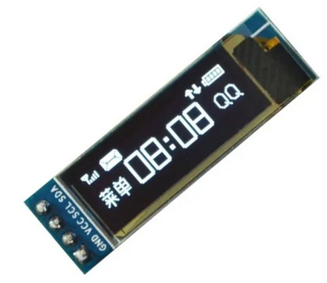
Display
SSD1306
(Ada fruit lib -
modified)
Display if
(udisplay)
USB
(uusb)
Teensy if
(steensy)
128 x 32 pixel
OLED
SSD1308
I2C 1
Pin 16,17
Set: disp text
Set: disp text
Teensy 4.1
(v8)
Raspberry Pi

