Slide 1
CS 436 Banking Cloud Project
Kerim Demir, Altuğ Yalım, Batu Onart, Egemen Kılıç

Slide 2

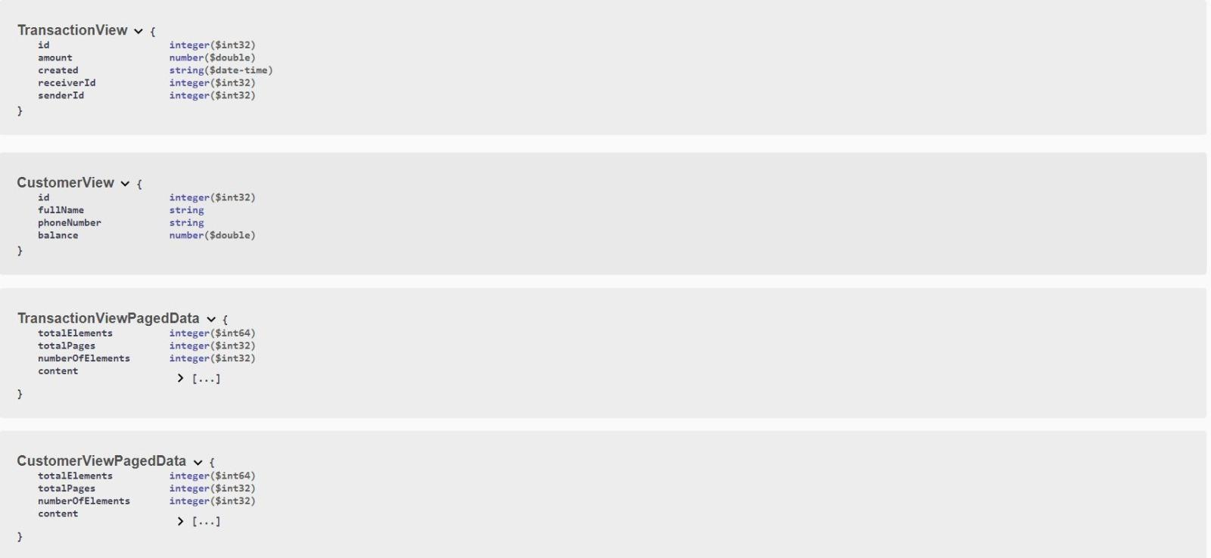

Application

Slide 3
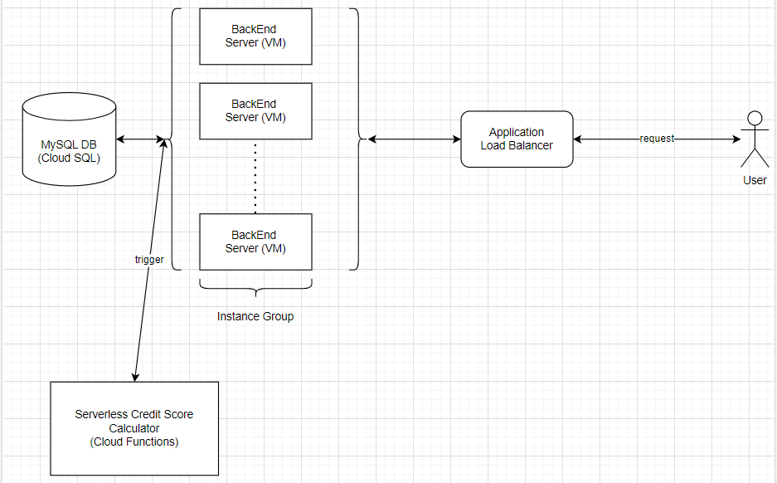
Architecture

Slide 4
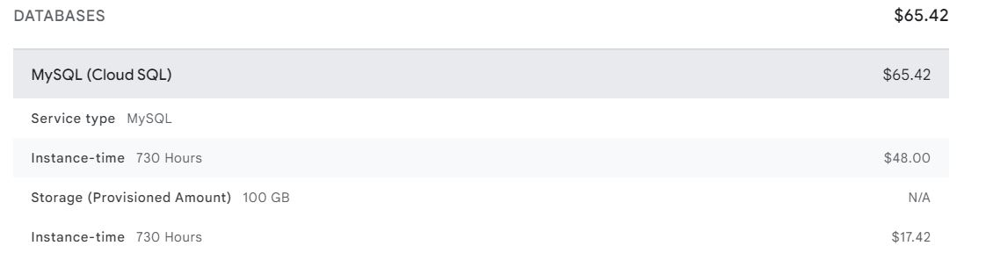
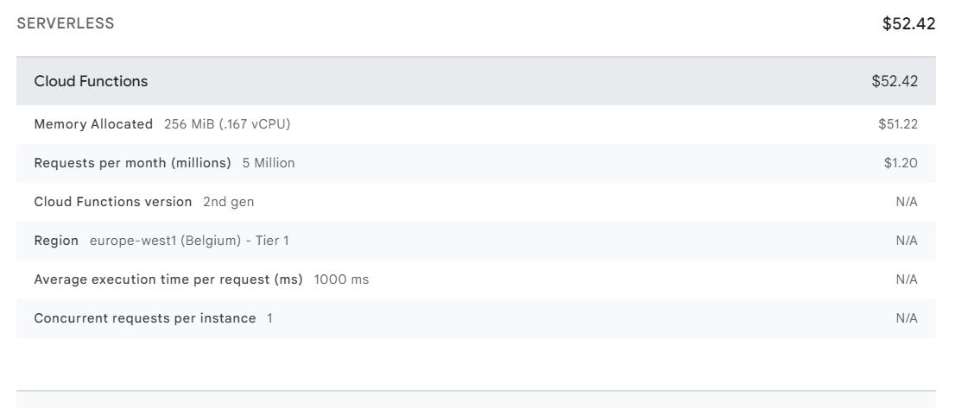
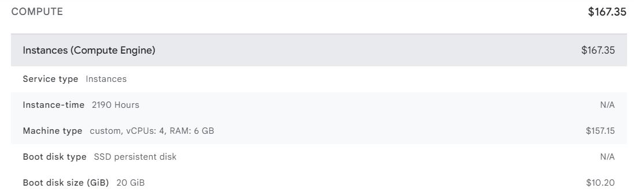

Billing
Our Total Projected Cost

