Slide 1
Impact of COVID-19 on football
Abdulkerim Ahmet Ünal
17030411027

Slide 2
INTRODUCTION
Covid-19 has affected almost every businesses in the World. Of course, football is one of them. Especially big clubs in European are affected by Covid-19.
In 5 big leagues, all of the broadcastings are affected because of empty stadiums.
Before Covid-19, the rate of the home wins was more than the rate of the home lossess but with Covid-19, it has changed.
Clubs earn money with matchday revenues. However, during Covid-09, many matches were delayed so it caused losing money.
Because of the fact that stadiums were empty during Covid-19, clubs lost a lot of revenues. For that reason, they increased the price of tickets and it has affected supporters financail situtation.
The COVID-19 pandemic at the beginning of 2020 hit the sports industry hard.

Slide 3
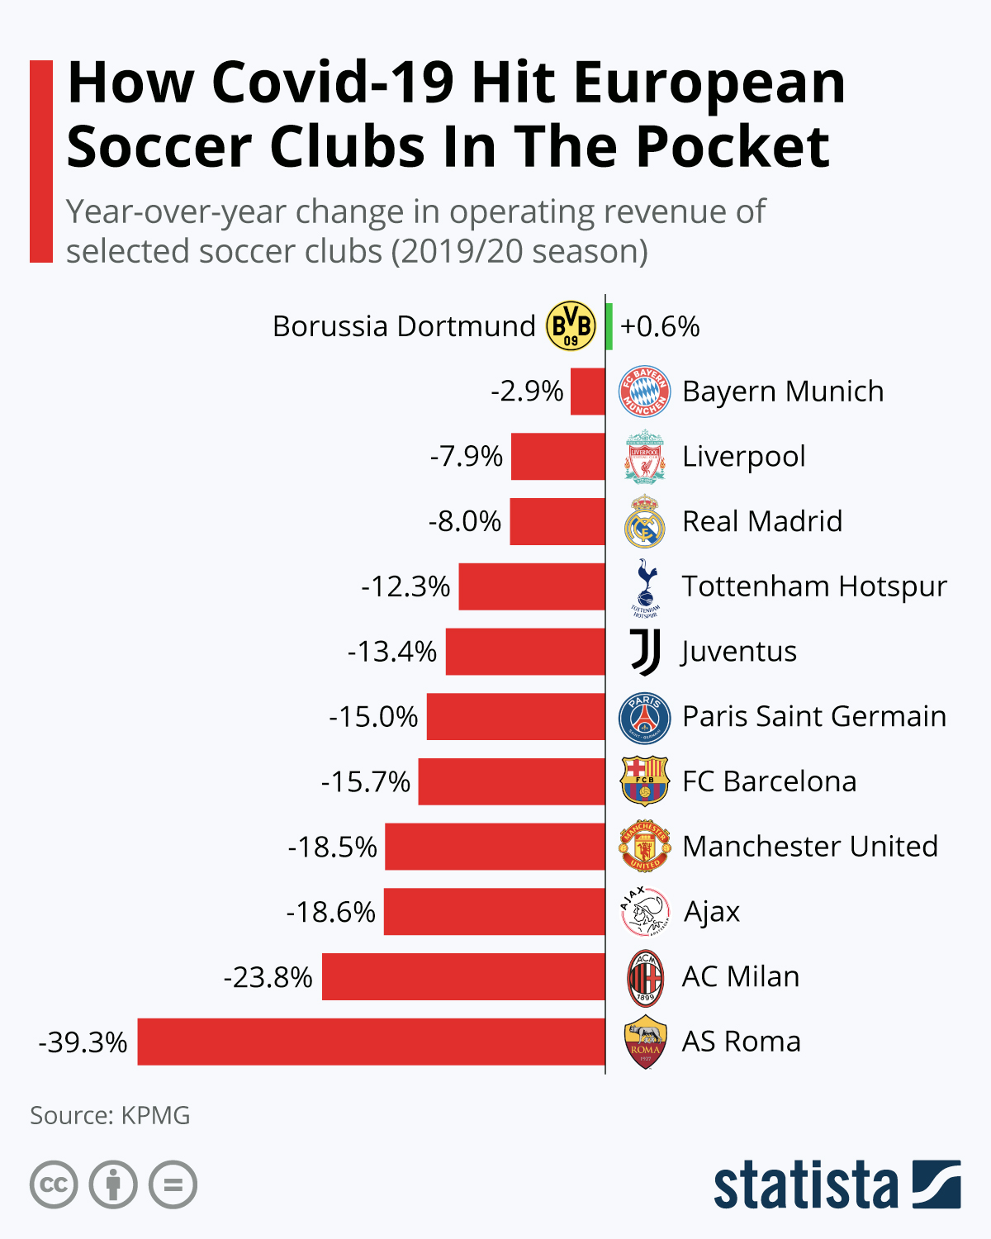
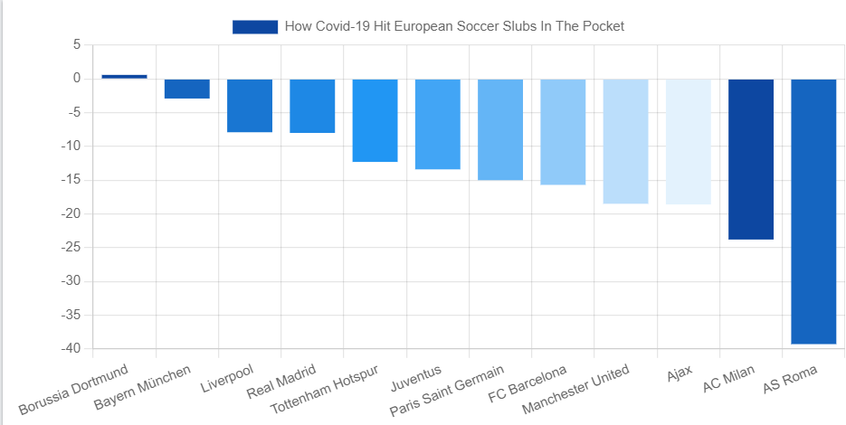
How Covid-19 Hit European Soccer Slubs In The Pocket
According to a study by market analyst KPMG, the biggest soccer clubs in Europe have lost €1 billion in revenue because of Covid-19. The reasons for the losses are seen as that clubs have to play their games in empty stadiums, which is depriving them of badly needed revenue. These reasons have carried with uncertainty regarding sponsorships and other payments.
Some of the biggest declines in operating revenue were seen in Italy's Serie A with AS Roma experiencing a year-over-year fall of 39.3 percent while AC Milan had a 23.8 percent contraction. Elsewhere, PSG and Barcelona experienced a fall of around 15 percent while Manchester United saw its operating revenue contract 18.5 percent.

Slide 4
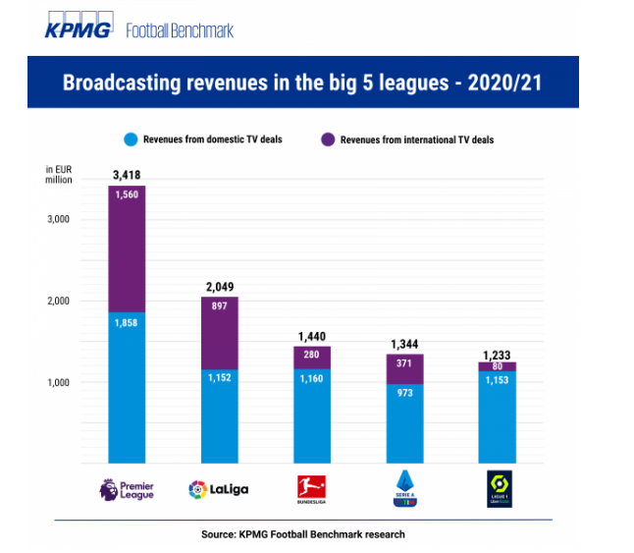
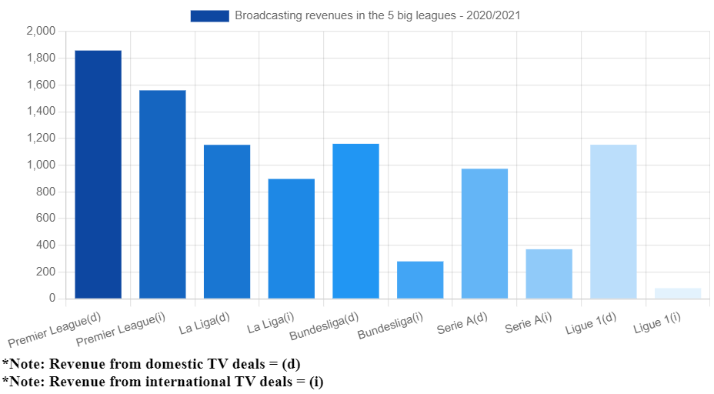
Pandemic not discouraging football club investors
While television rights revenue in the UK did not rise this year, the Bundesliga sold its local TV rights at a price 5 percent lower than the previous deal. Mediapro, the broadcasting partner of French Ligue 1, skipped the 172m euro payment in October. With the vision of increasing the league's overall broadcast revenues and global exposure, Italy plans to establish a new company to manage the broadcast and commercial rights of Serie A, thereby filling the gap with other major European leagues.

Slide 5
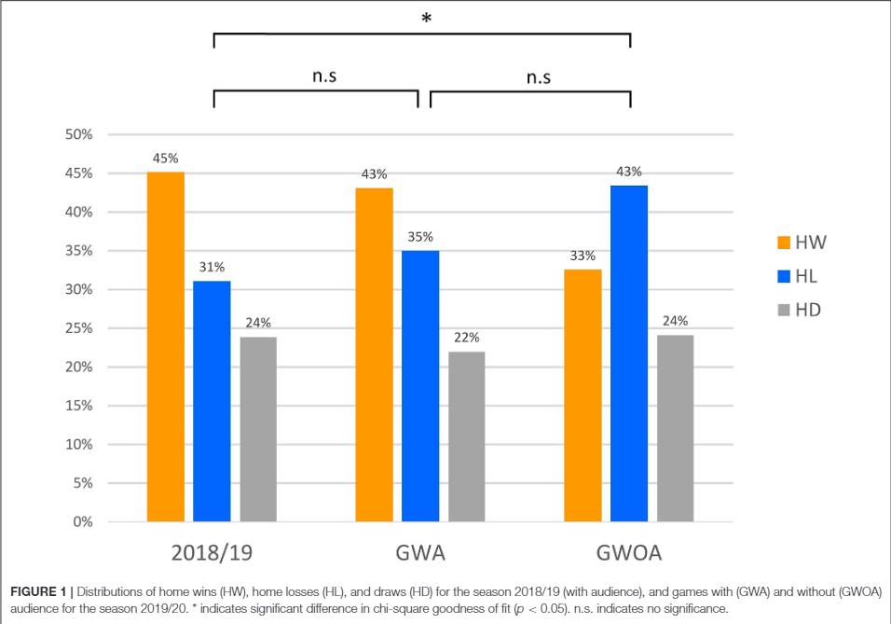
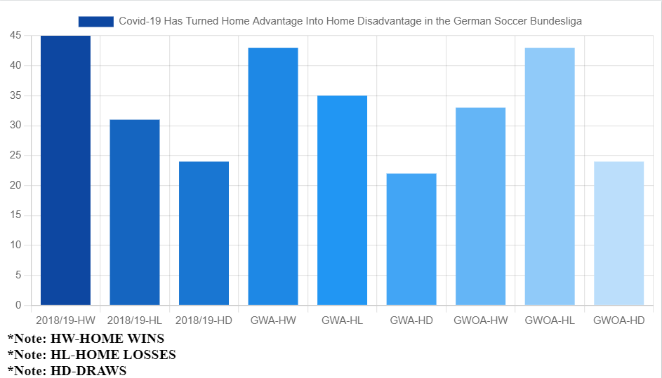
Covid-19 Has Turned Home Advantage Into Home Disadvantage in the German Soccer Bundesliga
The rate of the home wins was 45%, the rate of the home losses was 31%, the rate of the draws was 24% in 2018/19 before Covid-19.
During Covid-19, the rate of the home wins was 43%, the rate of the home losses was 35%, the rate of the draws was 22% in 2019/20 with audience. There are some declines in home wins but it is not that much.
Finally, after Covid-19 and without audience, it is clear that the rate of the home wins decreases and it becomes 33%, the rate of the home losses increases and it becomes 43%, the rate of the draws increases and it becomes 22% in 2018/19 during Covid-19.

Slide 6
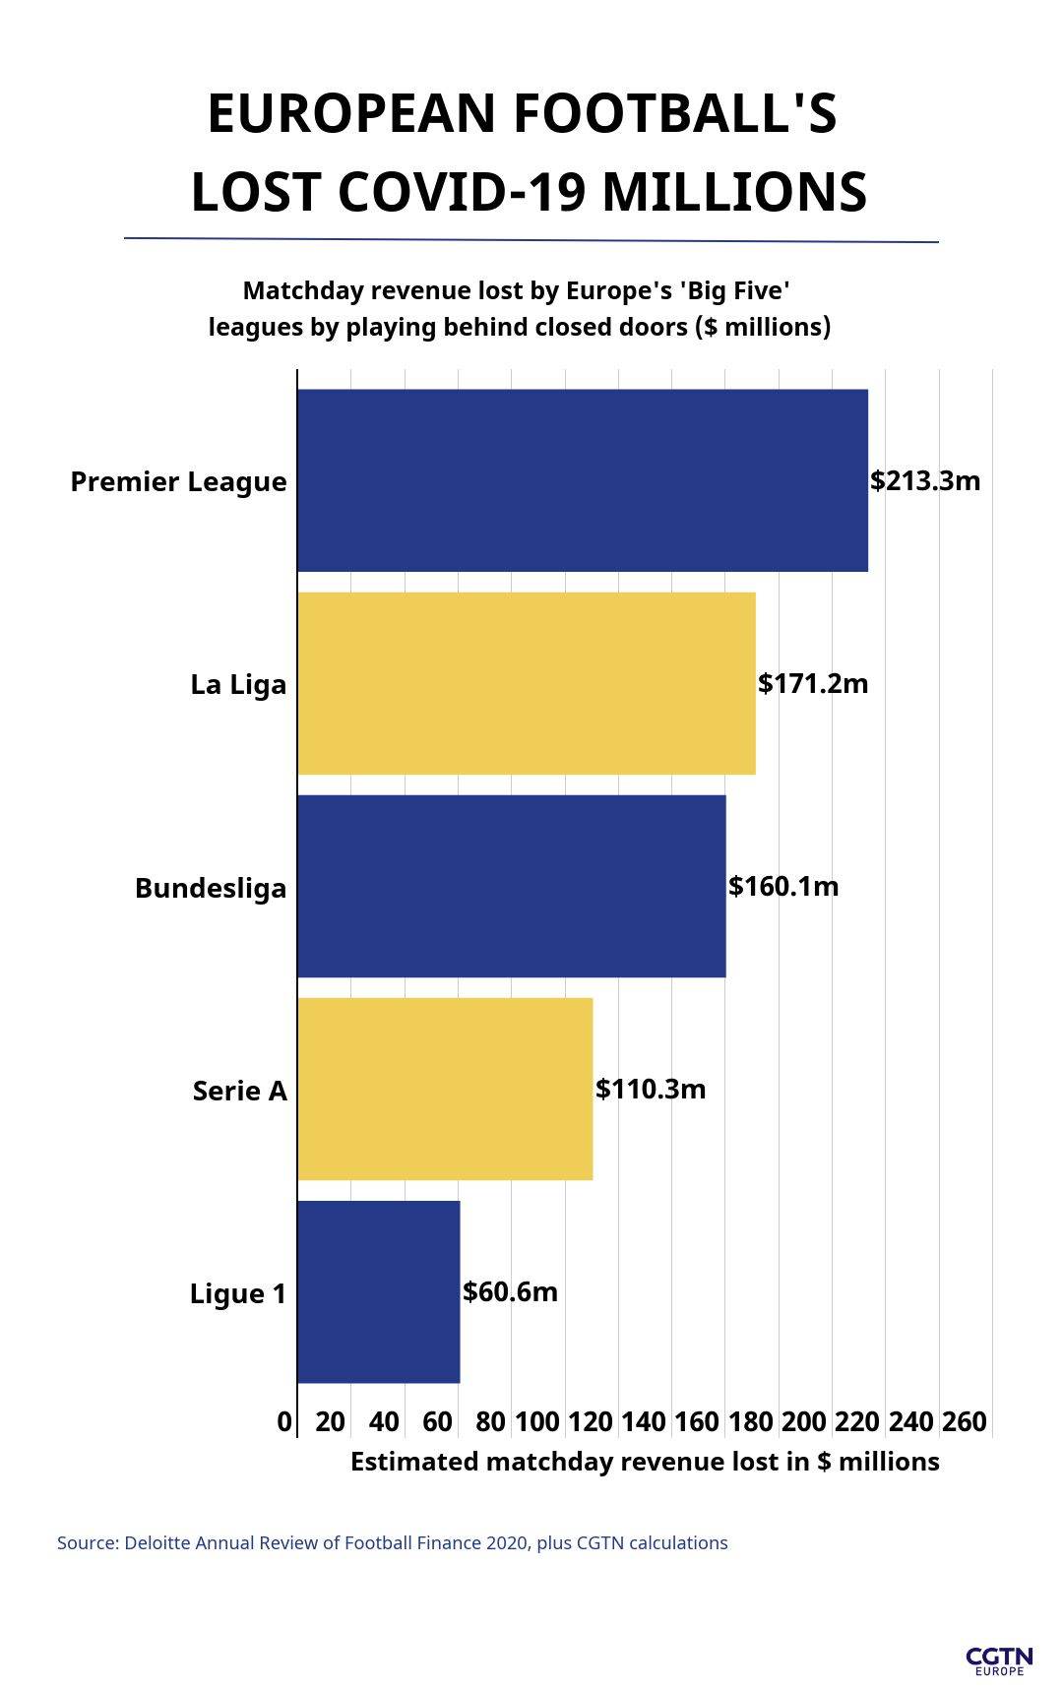
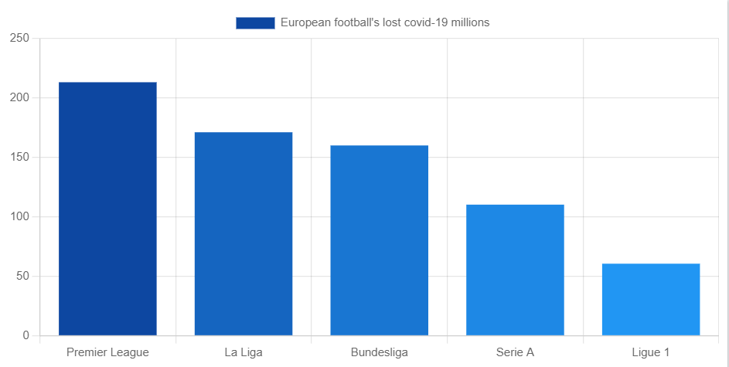
Europe's top football clubs face losing up to $718m in matchday revenue
According to Deloitte, Premier League clubs generated $881.9 million from matchday revenues in 2018/19, more than any other major European league.
With 110 games to be played behind closed doors until the delayed season is due to finish on 19 July, teams stand to lose $171.2 million in Spain.
In Germany, 18 clubs will still lose $160.1 million from expected matchday revenues for the 83 games to be played behind closed doors in completing the 2019/20 campaign by 27 June.
Clubs will lose $60.6 million of an expected $228.5 million in gate receipts and other expected matchday revenue in Ligue 1.

Slide 7
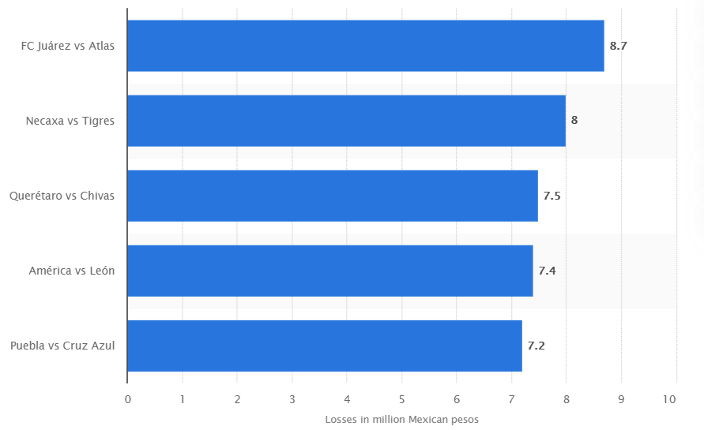
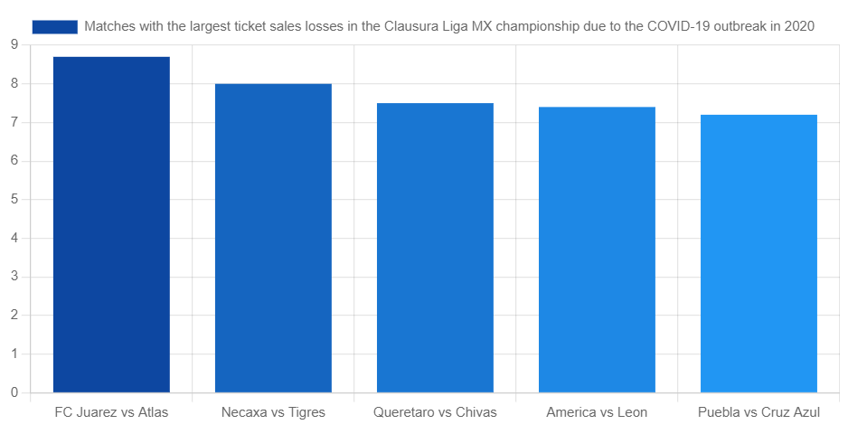
Soccer matches with the largest ticket sales losses in the 11th week of the Clausura Liga MX championship due to the COVID-19 outbreak in March 2020
The top tier Mexican soccer league (Liga MX) has been forced to suspend its second tournament of the 2019-20 season (Torneo Clausura) due to the COVID-19 outbreak. The executive board of the Liga MX decided to halt all activities by the end of week 10th of the tournament. It was estimated that the match between FC Juaréz and Club Atlas would represent the largest ticket sales losses among the matches that were supposed to take place during the 11th week of the tournament, at 8.7 million Mexican pesos.

Slide 8
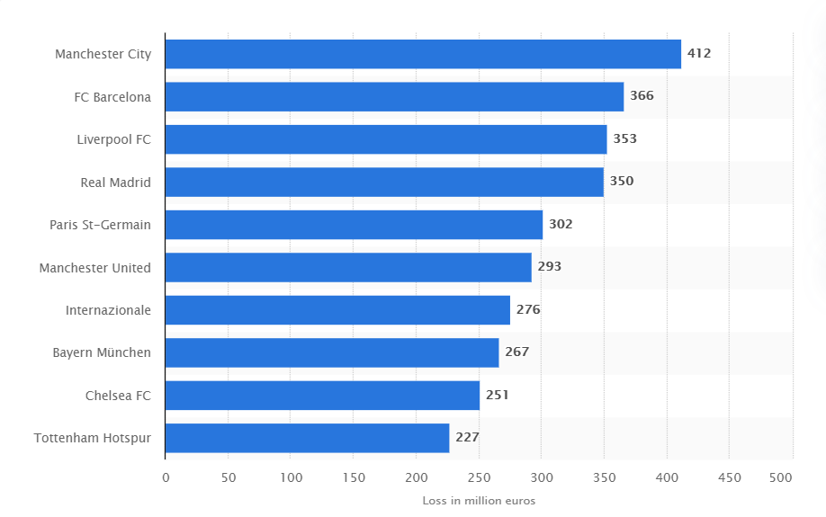
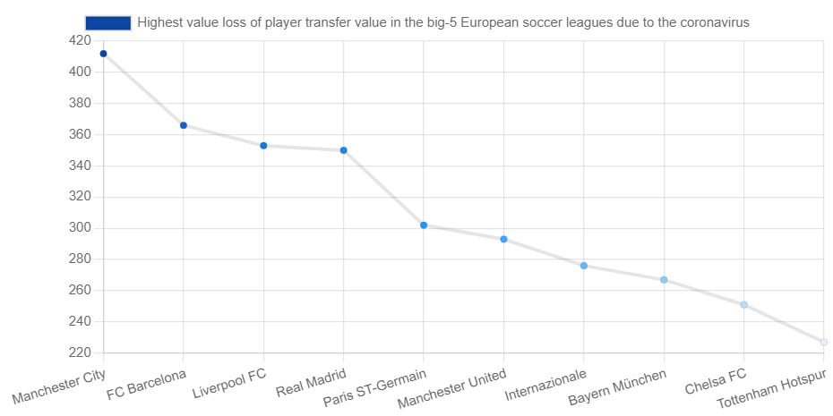
Highest value loss of player transfer value in the big-5 European soccer leagues due to the coronavirus
The COVID-19 pandemic at the beginning of 2020 hit the sports industry hard. Many professional leagues across the globe suspended their seasons, throwing the very lucrative European soccer market into doubt. With some players' contracts running out at the end of season and no decision yet on whether the soccer season will even be played to a conclusion, huge question marks remain about player transfers and contracts. In the event that no further matches are played this season and no contracts are extended until the end of June, the English Premier League side Manchester City stands to lose 412 million euros of its players' transfer value.

Slide 9
RESULT
Now is the time for global solidarity and support, especially with the most vulnerable in our societies, particularly in the emerging and developing world. Only together can we overcome the intertwined health and social and economic impacts of the pandemic and prevent its escalation into a football industry catastrophe, with the potential loss of already achieved development gains.

