Slide 1

IT 334 – DevOps Engineering on AWS Cloud
Project – Building a Highly Available, Scalable Web Application
Group 11: Kerim Šabić Ajla Korman
Date: 14.06.2024.
Teacher: Dženana Dževlan

Slide 2
Business scenario overview
Scenario overview:
Subject: University Web Application
Issue: Slow or not available application during the peak admission period
Reason: High number of inquiries (large traffic)
Opportunity: Provide a cost-effective, highly available, and scalable web application that handles large number of requests without a negative impact on user experience.
Notes:
You can also go more in depth about the design considerations and trade-offs that you made.

Slide 3
Business scenario overview
Solution Requirements:
Cost-effective: Proposed and designed solution should have low operational costs.
Functional: Proposed solution should meet functional requirements, such as the ability to view, add, delete, or modify the student records, without any perceivable delay.
Highly Available: Application should have limited downtime when the web servers are not working.
High performing: The routine operations (viewing, adding, deleting, or modifying records) should be performed without a perceivable delay under normal, variable, and peak loads.
Scalable: It should be able to scale up and down depending on the demand without affecting user experience.
Load balanced: The solution should correctly balance user traffic to avoid overloaded or underutilized resources.
Secure: Database is not directly accessible from public network.
The web application is accessible over the internet.
Database credentials are not hardcoded into the web application.
The web servers and database can be accessed only over the appropriate ports.
Notes:
You can also go more in depth about the design considerations and trade-offs that you made.

Slide 4
Solution overview
High – level description:
We created a solution that enables web application to be highly available and scalable for storing student records.
Our application has a relational database to store student information.
The database and web server are separate components of the solution.
Application has two servers in different AZs in order to be highly available.
Application is publicly accessible, but the database is not.
We configured appropriate network security settings for the web servers and database.
As well as configured access permissions between AWS services.
Notes:
Explain at a high level what you have built.
For example: “I built a web application for a company to host their blog.“
Talk about why you chose certain parts of the solutions and any tradeoffs that you made. Focus on how you designed the solutions and how you applied the AWS Well-Architected Framework as part of the process (AWS Well-Architected Framework: https://docs.aws.amazon.com/wellarchitected/latest/framework/welcome.html).
For example: “I configured load balancers and auto scaling to make the application highly available and reliable.”
Include the use cases that you are addressing. Think about who your users are and how they would want to interact with your solution to solve their problem.
For example: “Users can view, upload, edit, and delete blog posts. Administrators can approve blog posts.”
Talk about the use cases that you addressed as part of the minimum viable product (MVP) that you scoped and built.
Note:
An above-bar description is concise and includes the most important benefits. For example: “The solution allows customers to quickly upload, store, and search large catalogs of images and videos in Amazon S3.”
A below-bar description is too detailed or not specific. For example: “Our solution analyzes media files.”

Slide 5
Solution overview
Design considerations:
Application should be deployed in one region
It should have at least two availability zones
A budget of $100 per month
Use AWS VPC, security groups and secrets manager for security
Use AWS EC2 and VPC for high availability, performing and functioning
Use AWS RDS and EC2 Auto Scaling for scalability
Use AWS Cloud9 for database migration
Use AWS ELB for load balancing
Notes:
Explain at a high level what you have built.
For example: “I built a web application for a company to host their blog.“
Talk about why you chose certain parts of the solutions and any tradeoffs that you made. Focus on how you designed the solutions and how you applied the AWS Well-Architected Framework as part of the process (AWS Well-Architected Framework: https://docs.aws.amazon.com/wellarchitected/latest/framework/welcome.html).
For example: “I configured load balancers and auto scaling to make the application highly available and reliable.”
Include the use cases that you are addressing. Think about who your users are and how they would want to interact with your solution to solve their problem.
For example: “Users can view, upload, edit, and delete blog posts. Administrators can approve blog posts.”
Talk about the use cases that you addressed as part of the minimum viable product (MVP) that you scoped and built.
Note:
An above-bar description is concise and includes the most important benefits. For example: “The solution allows customers to quickly upload, store, and search large catalogs of images and videos in Amazon S3.”
A below-bar description is too detailed or not specific. For example: “Our solution analyzes media files.”

Slide 6
Solution overview
Use cases:
We implemented load balancing to effectively manage the anticipated spike in requests during peak admission periods, as specified in the requirements.
Our database is placed in the private subnet, ensuring it is not publicly accessible over the Internet.
We created security groups to allow only specific requests to our EC2 instances.
To guarantee high availability, our application instances are distributed across two different availability zones.
Additionally, we created an auto-scaling group based on AMI, which automatically launches a new instance if the current one fails, further ensuring high availability.
We had multi-tier architecture to separate layers of application, such as web servers and database.
Notes:
Explain at a high level what you have built.
For example: “I built a web application for a company to host their blog.“
Talk about why you chose certain parts of the solutions and any tradeoffs that you made. Focus on how you designed the solutions and how you applied the AWS Well-Architected Framework as part of the process (AWS Well-Architected Framework: https://docs.aws.amazon.com/wellarchitected/latest/framework/welcome.html).
For example: “I configured load balancers and auto scaling to make the application highly available and reliable.”
Include the use cases that you are addressing. Think about who your users are and how they would want to interact with your solution to solve their problem.
For example: “Users can view, upload, edit, and delete blog posts. Administrators can approve blog posts.”
Talk about the use cases that you addressed as part of the minimum viable product (MVP) that you scoped and built.
Note:
An above-bar description is concise and includes the most important benefits. For example: “The solution allows customers to quickly upload, store, and search large catalogs of images and videos in Amazon S3.”
A below-bar description is too detailed or not specific. For example: “Our solution analyzes media files.”

Slide 7
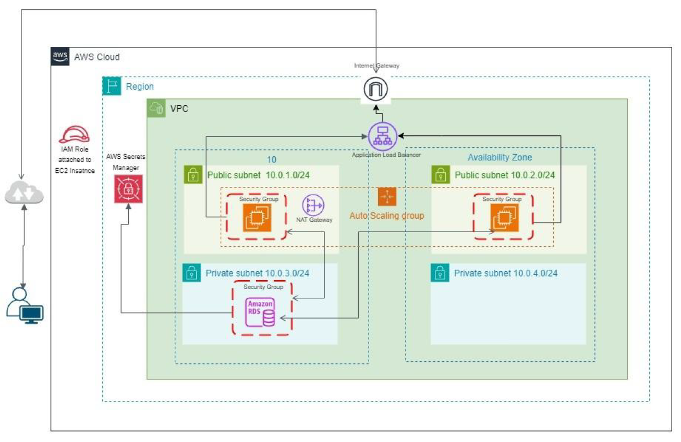
Architecture diagram of the proposed solution
Notes:
Note: Remove this slide from your final presentation.
This example architecture diagram shows a solution to configure a webhook to link Git with AWS. You can find this example in the Toolkits for PowerPoint at https://aws.amazon.com/architecture/icons.

Slide 8
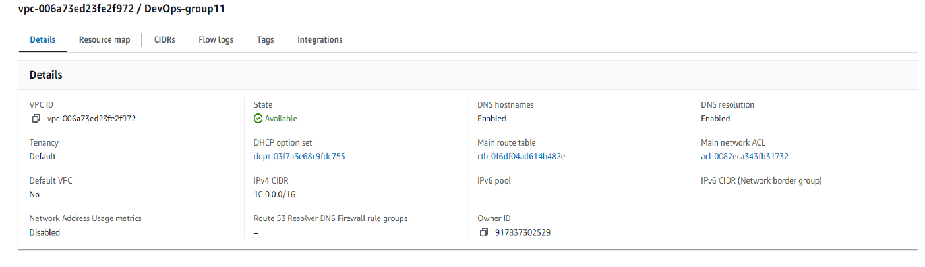
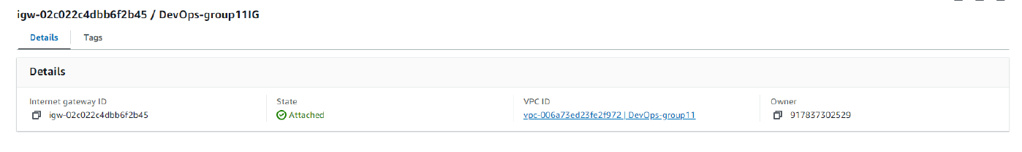
Demo
Notes:
For the demo, guide the audience through the two to three most important benefits of the solution and how it addresses the requirements.
Your demo materials can be screen captures, recordings, or to show AWS console.

Slide 9
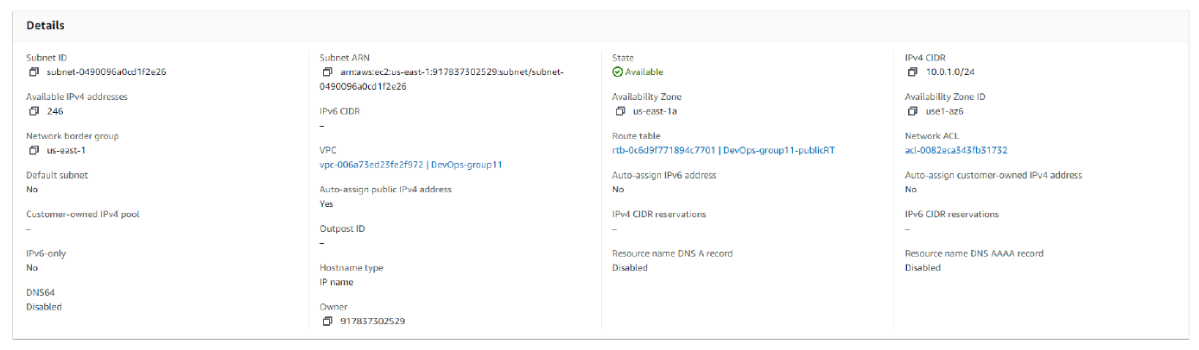
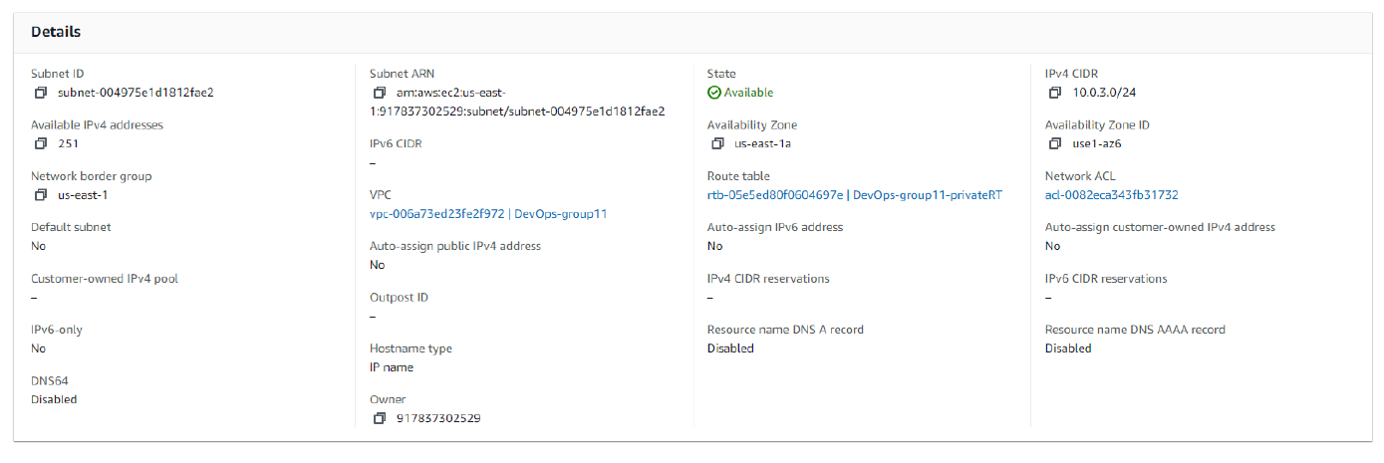
Demo
Notes:
For the demo, guide the audience through the two to three most important benefits of the solution and how it addresses the requirements.
Your demo materials can be screen captures, recordings, or to show AWS console.

Slide 10
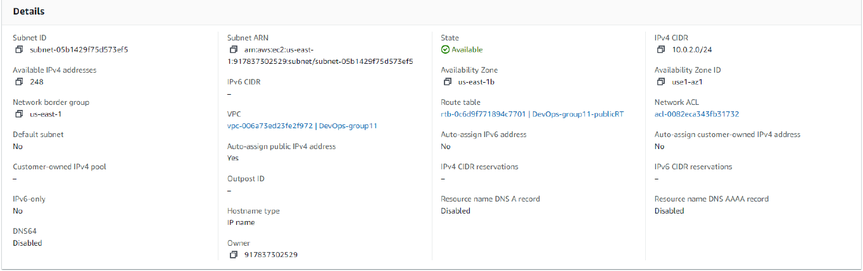
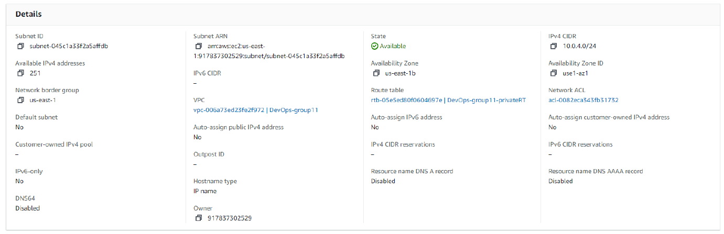
Demo
Notes:
For the demo, guide the audience through the two to three most important benefits of the solution and how it addresses the requirements.
Your demo materials can be screen captures, recordings, or to show AWS console.

Slide 11
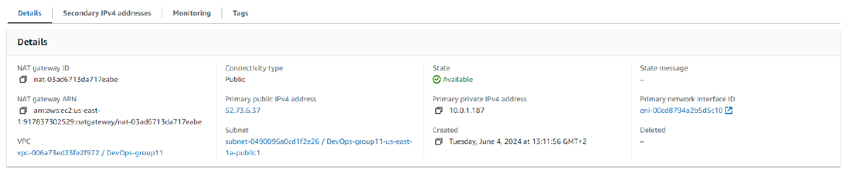
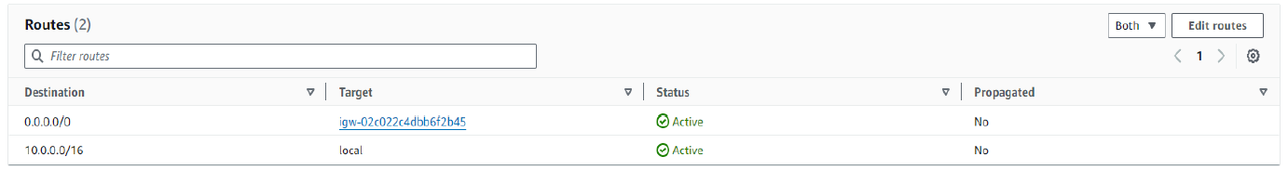
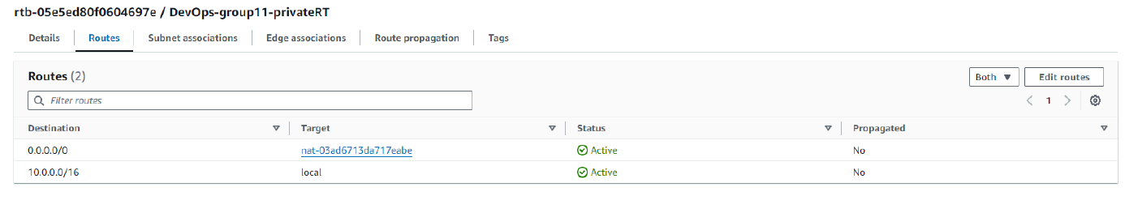
Demo
Notes:
For the demo, guide the audience through the two to three most important benefits of the solution and how it addresses the requirements.
Your demo materials can be screen captures, recordings, or to show AWS console.

Slide 12
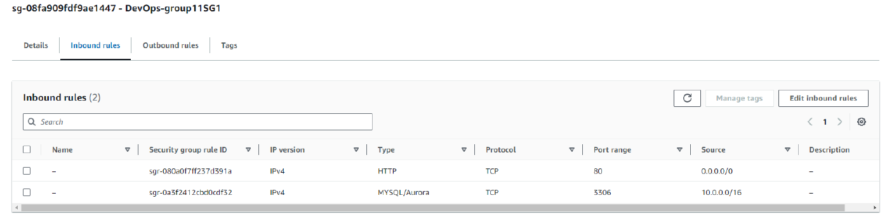
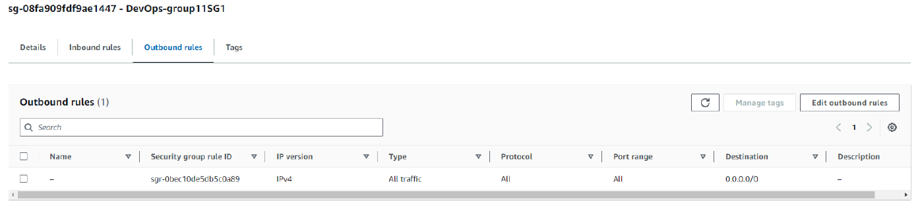
Demo
Notes:
For the demo, guide the audience through the two to three most important benefits of the solution and how it addresses the requirements.
Your demo materials can be screen captures, recordings, or to show AWS console.

Slide 13
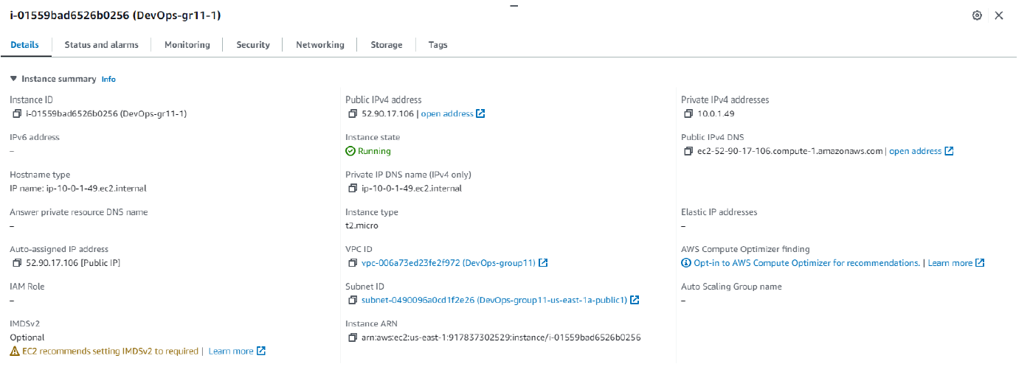
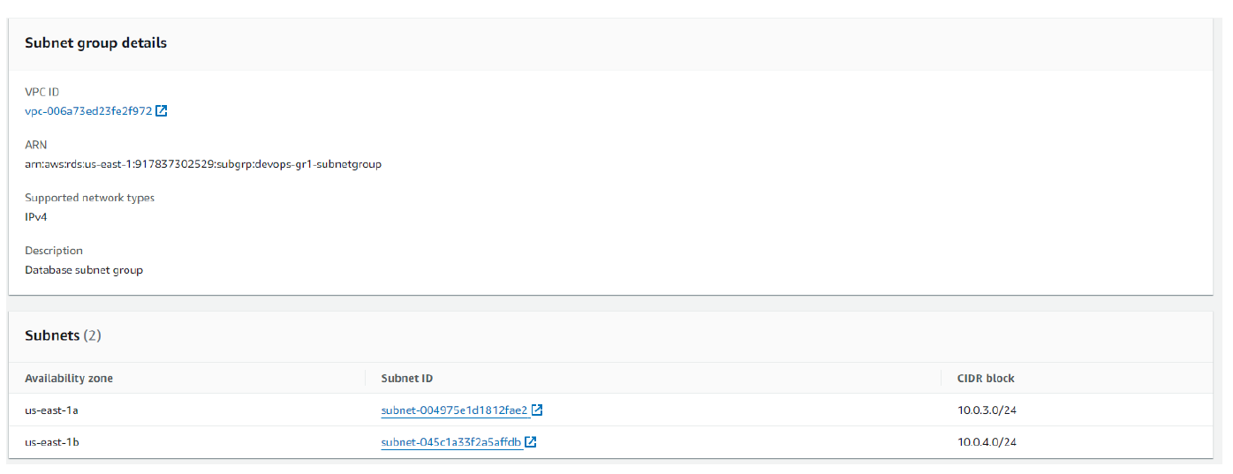
Demo
Notes:
For the demo, guide the audience through the two to three most important benefits of the solution and how it addresses the requirements.
Your demo materials can be screen captures, recordings, or to show AWS console.

Slide 14
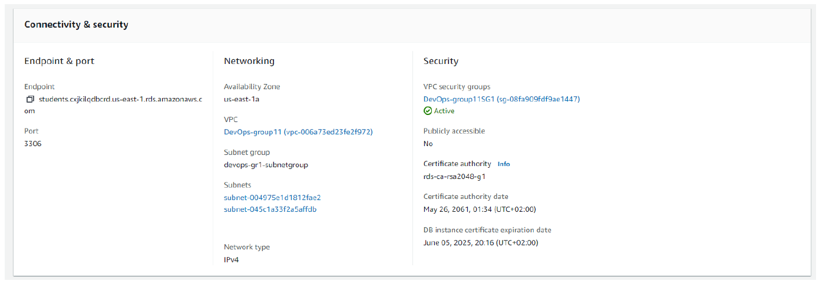
Demo
Notes:
For the demo, guide the audience through the two to three most important benefits of the solution and how it addresses the requirements.
Your demo materials can be screen captures, recordings, or to show AWS console.

Slide 15
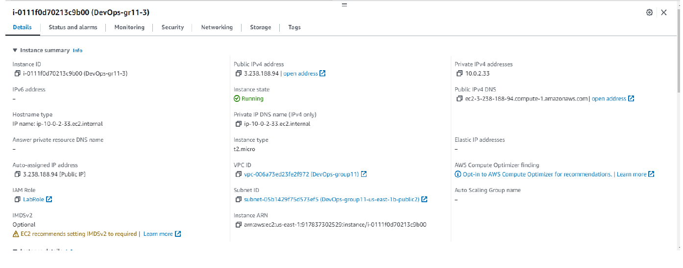
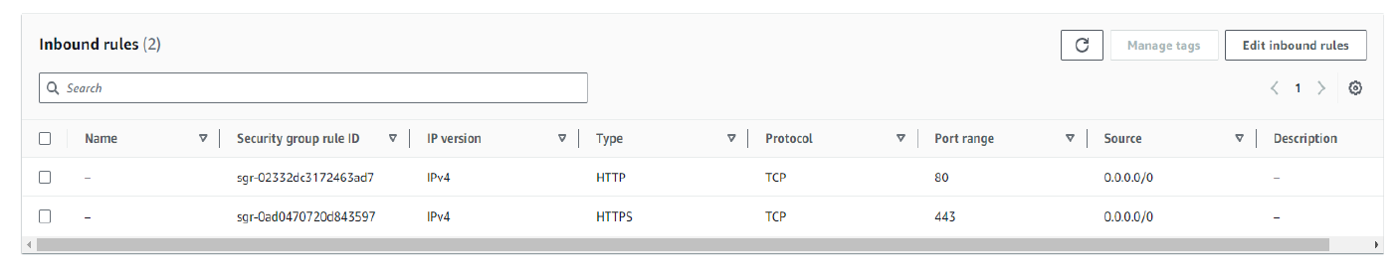
Demo
Notes:
For the demo, guide the audience through the two to three most important benefits of the solution and how it addresses the requirements.
Your demo materials can be screen captures, recordings, or to show AWS console.

Slide 16
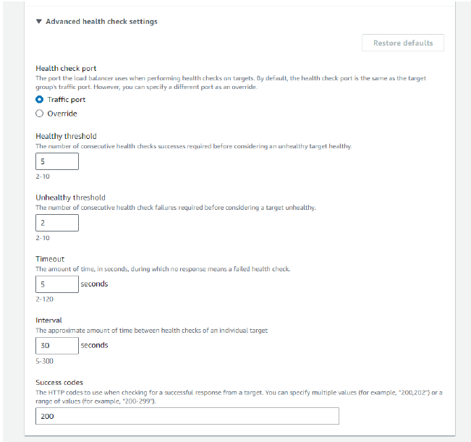
Demo
Notes:
For the demo, guide the audience through the two to three most important benefits of the solution and how it addresses the requirements.
Your demo materials can be screen captures, recordings, or to show AWS console.

Slide 17
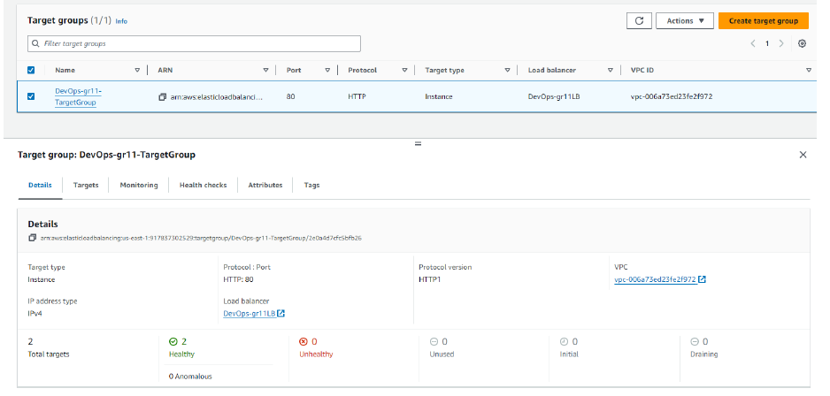
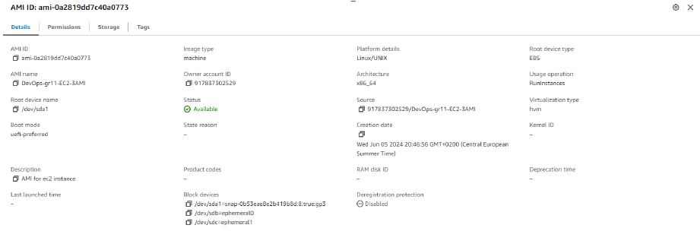
Demo
Notes:
For the demo, guide the audience through the two to three most important benefits of the solution and how it addresses the requirements.
Your demo materials can be screen captures, recordings, or to show AWS console.

Slide 18
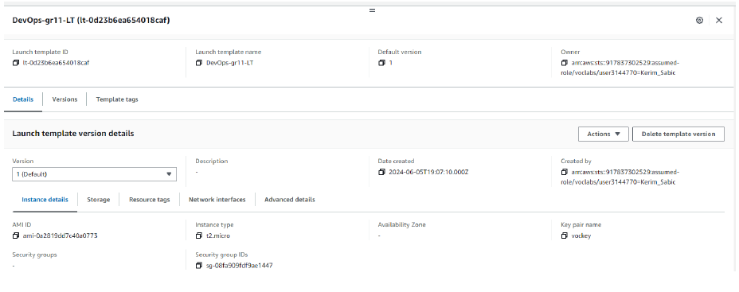
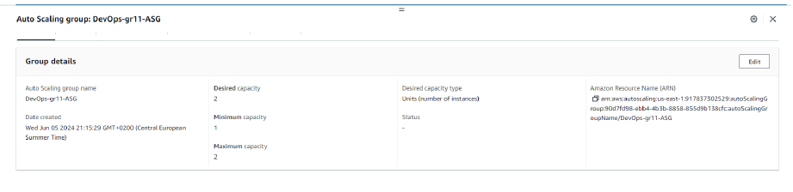
Demo
Notes:
For the demo, guide the audience through the two to three most important benefits of the solution and how it addresses the requirements.
Your demo materials can be screen captures, recordings, or to show AWS console.

Slide 19
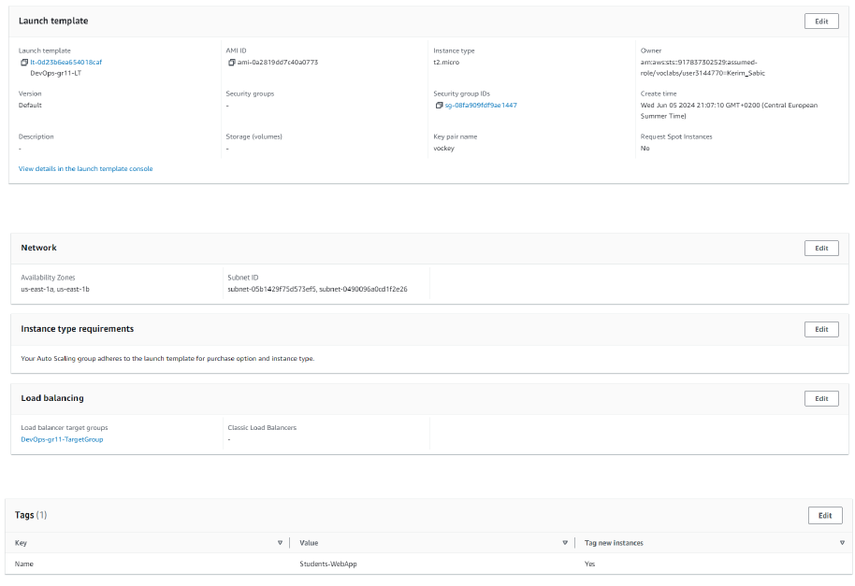
Demo
Notes:
For the demo, guide the audience through the two to three most important benefits of the solution and how it addresses the requirements.
Your demo materials can be screen captures, recordings, or to show AWS console.

Slide 20
Lessons learned
Challenges:
Our biggest problem was the connection with the database
We had trouble connecting to the database, because we did not realize at the start that the database name and password should be the same as the ones given in the script to us.
Additionally, when importing data into the RDB, it took us time to realize that “nodeapp” keyword should be replaced with the master name for database that we had given it during the creation.
Also, we struggled to figure where we should use database password from the script and where ours.
Understanding of the secrets manager at the first was also a problem.
Notes:
Explain at a high level what you have built.
For example: “I built a web application for a company to host their blog.“
Talk about why you chose certain parts of the solutions and any tradeoffs that you made. Focus on how you designed the solutions and how you applied the AWS Well-Architected Framework as part of the process (AWS Well-Architected Framework: https://docs.aws.amazon.com/wellarchitected/latest/framework/welcome.html).
For example: “I configured load balancers and auto scaling to make the application highly available and reliable.”
Include the use cases that you are addressing. Think about who your users are and how they would want to interact with your solution to solve their problem.
For example: “Users can view, upload, edit, and delete blog posts. Administrators can approve blog posts.”
Talk about the use cases that you addressed as part of the minimum viable product (MVP) that you scoped and built.
Note:
An above-bar description is concise and includes the most important benefits. For example: “The solution allows customers to quickly upload, store, and search large catalogs of images and videos in Amazon S3.”
A below-bar description is too detailed or not specific. For example: “Our solution analyzes media files.”

Slide 21
Lessons learned
Resources:
https://docs.aws.amazon.com/pricing-calculator/index.html
https://docs.aws.amazon.com/elasticloadbalancing/latest/application/application-load-balancers.html
https://docs.aws.amazon.com/cli/latest/reference/secretsmanager/create-secret.html
https://www.youtube.com/watch?v=aeLdPYGnn_Q
Plus labs on AWS Academy, on how to create certain parts of the infrastructure.
Notes:
Explain at a high level what you have built.
For example: “I built a web application for a company to host their blog.“
Talk about why you chose certain parts of the solutions and any tradeoffs that you made. Focus on how you designed the solutions and how you applied the AWS Well-Architected Framework as part of the process (AWS Well-Architected Framework: https://docs.aws.amazon.com/wellarchitected/latest/framework/welcome.html).
For example: “I configured load balancers and auto scaling to make the application highly available and reliable.”
Include the use cases that you are addressing. Think about who your users are and how they would want to interact with your solution to solve their problem.
For example: “Users can view, upload, edit, and delete blog posts. Administrators can approve blog posts.”
Talk about the use cases that you addressed as part of the minimum viable product (MVP) that you scoped and built.
Note:
An above-bar description is concise and includes the most important benefits. For example: “The solution allows customers to quickly upload, store, and search large catalogs of images and videos in Amazon S3.”
A below-bar description is too detailed or not specific. For example: “Our solution analyzes media files.”

Slide 22
Lessons learned
New skills:
We learned how to migrate database data to an actual relational database, and to create separate business logic layers between web servers and database.
Additionally, we gained practical experience by observing how auto-scaling works in real-time. We saw new instances being created as backups when existing instances were terminated, ensuring continuous availability and performing.
We learned how to use AWS Calculator as well.
It was beneficial for us to see how all of these AWS services work together in order to better understand their individual purposes.
Notes:
Explain at a high level what you have built.
For example: “I built a web application for a company to host their blog.“
Talk about why you chose certain parts of the solutions and any tradeoffs that you made. Focus on how you designed the solutions and how you applied the AWS Well-Architected Framework as part of the process (AWS Well-Architected Framework: https://docs.aws.amazon.com/wellarchitected/latest/framework/welcome.html).
For example: “I configured load balancers and auto scaling to make the application highly available and reliable.”
Include the use cases that you are addressing. Think about who your users are and how they would want to interact with your solution to solve their problem.
For example: “Users can view, upload, edit, and delete blog posts. Administrators can approve blog posts.”
Talk about the use cases that you addressed as part of the minimum viable product (MVP) that you scoped and built.
Note:
An above-bar description is concise and includes the most important benefits. For example: “The solution allows customers to quickly upload, store, and search large catalogs of images and videos in Amazon S3.”
A below-bar description is too detailed or not specific. For example: “Our solution analyzes media files.”

Slide 23
Lessons learned
Next step:
Exploring better approaches to resolving of the same problem, but with greater access to the AWS services.
Implementing monitoring and alarms for certain traffic spike loads to see how the infrastructure is behaving.
Also, implementing alarms for costs to try to create as cost-efficient solution as possible.
Expanding, web servers to other AZs, and regions as well.
Creating backup database server replicas.
Notes:
Explain at a high level what you have built.
For example: “I built a web application for a company to host their blog.“
Talk about why you chose certain parts of the solutions and any tradeoffs that you made. Focus on how you designed the solutions and how you applied the AWS Well-Architected Framework as part of the process (AWS Well-Architected Framework: https://docs.aws.amazon.com/wellarchitected/latest/framework/welcome.html).
For example: “I configured load balancers and auto scaling to make the application highly available and reliable.”
Include the use cases that you are addressing. Think about who your users are and how they would want to interact with your solution to solve their problem.
For example: “Users can view, upload, edit, and delete blog posts. Administrators can approve blog posts.”
Talk about the use cases that you addressed as part of the minimum viable product (MVP) that you scoped and built.
Note:
An above-bar description is concise and includes the most important benefits. For example: “The solution allows customers to quickly upload, store, and search large catalogs of images and videos in Amazon S3.”
A below-bar description is too detailed or not specific. For example: “Our solution analyzes media files.”

Slide 24

Questions?

Slide 25
THANK YOU!

