Slide 1
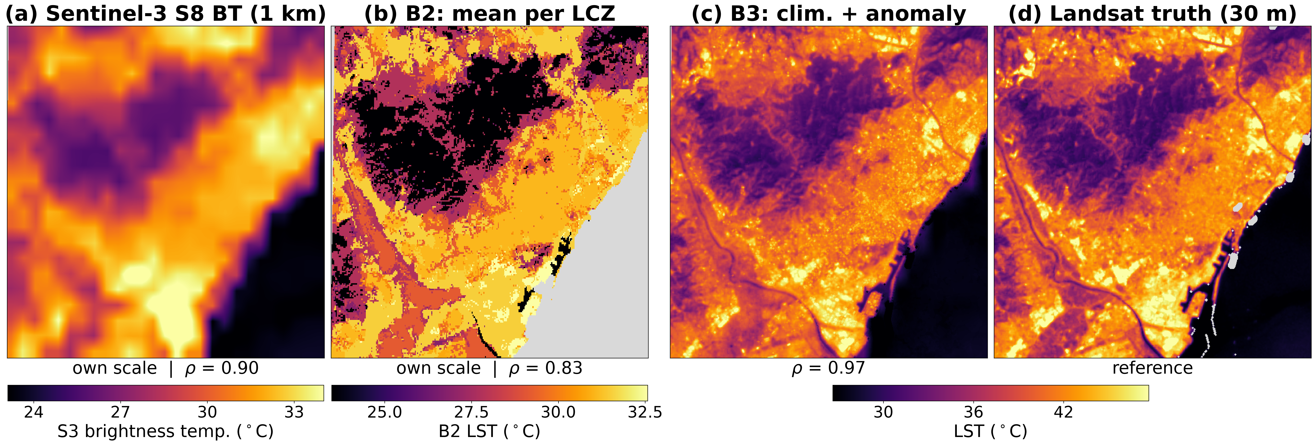
Towards a Spatio-Temporally Complete Urban Land Surface Temperature Record: A Multi-Sensor Benchmark and Rank-Based Baseline Evaluation for Thermal Downscaling over Barcelona
Kerin Cardona*, Jordi Cipriano, Gerard Mor
International Centre for Numerical Methods in Engineering (CIMNE), Building Energy and Environment Group, Lleida, Spain
*Corresponding author: kcardona@cimne.upc.edu
INTRODUCTION & AIM
METHOD
Urban heat-exposure mapping needs high-resolution land surface temperature (LST), yet no single sensor is complete in both space and time:
Landsat 8/9: 30 m grid (100 m native thermal), 16-day revisit, cloud-limited
Sentinel-3 SLSTR: daily, but 1 km
ECOSTRESS: 70 m, irregular revisit
Standardised, exposure-relevant benchmarks for urban thermal downscaling are lacking.
Aim: build a multi-sensor benchmark and set a verified baseline floor that any learned downscaling model must beat.
Benchmark over the Barcelona metropolitan core (464 km², ~21 × 22 km):
189 co-registered pairs, 2016–2024: Sentinel-3 SLSTR S8 brightness temperature (1 km, day pass ≈10 UTC) / Landsat LST (30 m)
Independent ECOSTRESS (70 m) reference, never used for fitting
Temporal split, no leakage: train 2016–2021 (80) · validation 2022 (34) · held-out test 2023–2024 (75)
Rank-based protocol: Spearman ρ, hottest-10 % IoU, hotspot F1, per-LCZ consistency (exposure depends on spatial ranking, not magnitude)
Baselines: B1 bilinear resample of S3 (no downscaling) · B2 mean LST per Local Climate Zone · B3 = Landsat train climatology + daily S3 anomaly
RESULTS & DISCUSSION
Held-out test, 75 pairs (2023–2024), mean ± s.d. over dates. B1 = S3 without downscaling (reference).
Baseline | Spearman ρ ↑ | IoU top-10 % ↑ | Hotspot F1 ↑ | RMSE (K) ↓ | Bias (K)
B1 S3 bilinear resample (no downscaling) | 0.73 ± 0.14 | 0.26 ± 0.13 | 0.00 ± 0.00 | 7.10 ± 3.73 | −6.42
B2 Mean LST per LCZ | 0.62 ± 0.20 | 0.04 ± 0.02 | 0.09 ± 0.10 | 10.22 ± 4.77 | −0.20
B3 Landsat climatology + S3 anomaly | 0.79 ± 0.21 | 0.37 ± 0.14 | 0.33 ± 0.17 | 3.98 ± 1.83 | +1.36
Chance level for top-10 % IoU ≈ 0.05. B2 does not locate hotspots; B1 ranks well but its top-of-atmosphere values miss every absolute hotspot (F1 = 0).
Held-out date 2024-08-03, per-scene ρ. (a) At 1 km S3 already ranks the scene but spans 11 K vs 21 K, with no 30 m detail. (b) B2 has the LCZ pattern but no daily signal (all-season mean, own scale). (c) B3 recovers the intra-urban detail. (d) Reference.
Cross-check: ECOSTRESS (70 m)
3 test dates with usable swath
Why not a learned model (yet)?
Gradient boosting on raw S3: ρ = 0.78, above the LCZ mean (B2, 0.62), close to B3 (0.79).
With S3 anomaly + climatology: ρ = 0.81 vs 0.79, not significant (B3 wins 41/75 dates, p = 0.71), with lower RMSE (3.01 vs 3.98 K) and higher F1 (0.43 vs 0.33).
Static covariates (NDVI, elevation, building density, LCZ) as a residual model on B3: test R² ≈ 0, ρ 0.79 → 0.80. ≈ 97 % of the residual variance is within-pixel, i.e. temporal.
B3 today: a climatology-anchored gap-filler, not a downscaler
OK seasonal ranking of exposure between districts (ρ = 0.79)
OK filling cloudy or non-overpass days
NO day-specific hotspot alerts (F1 = 0.33)
NO absolute daily temperature (RMSE 4.0 K)
Comparison | ρ | RMSE (K)
B3 vs ECOSTRESS | 0.79 ± 0.11 | 4.52 ± 1.23
ECOSTRESS vs Landsat | 0.91 ± 0.03 | —
n = 3: a consistency check, too small to rank methods.
CONCLUSIONS
FUTURE WORK/ REFERENCES/ACKNOWLEDGMENT
A high-resolution climatological prior is indispensable: learned models must beat it to add value.
The B3 residual is temporal: progress needs temporal information, not more static covariates.
Benchmark, protocol and baselines: a reproducible foundation for spatio-temporal deep learning.
Future work: evaluate spatio-temporal deep-learning models on this benchmark, against B3.
Data: Sentinel-3 SLSTR, Landsat 8/9 Collection 2, ECOSTRESS L2G LSTE; LCZ map: WUDAPT (Demuzere et al.).
Correction to the abstract: the Sentinel-3 overpass selection was fixed after submission (night → day pass); all results shown use the day pass.
Session S1 — AI in Remote Sensing
https://sciforum.net/event/ECRS2026

