Slide 1
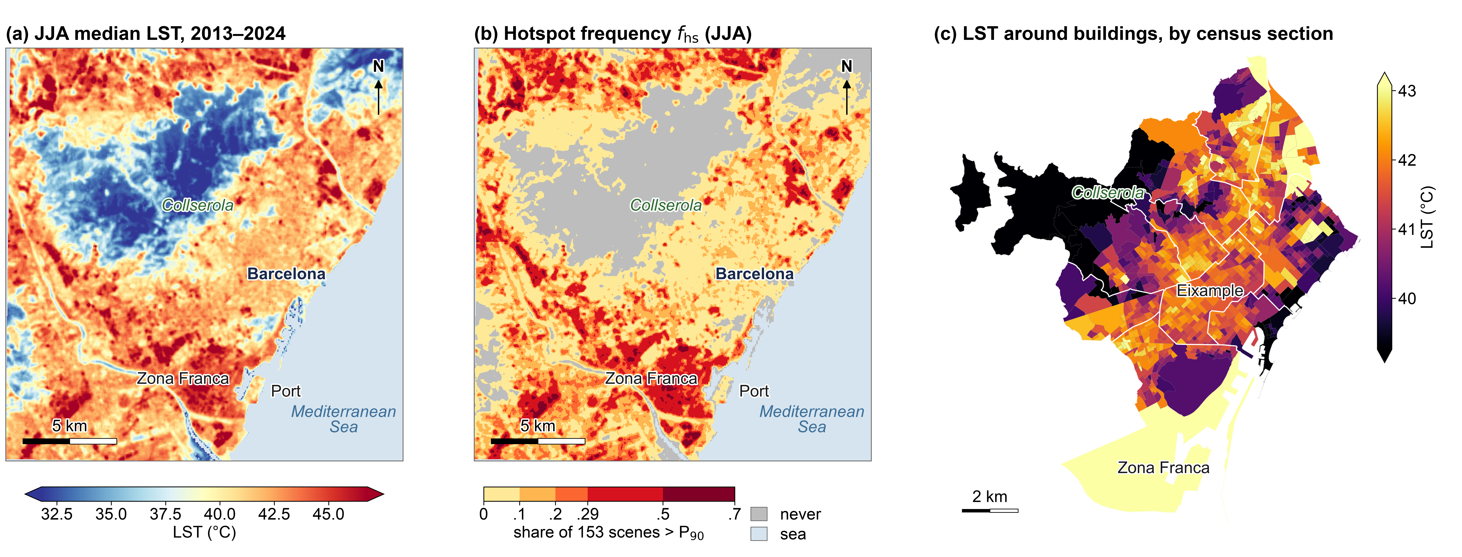
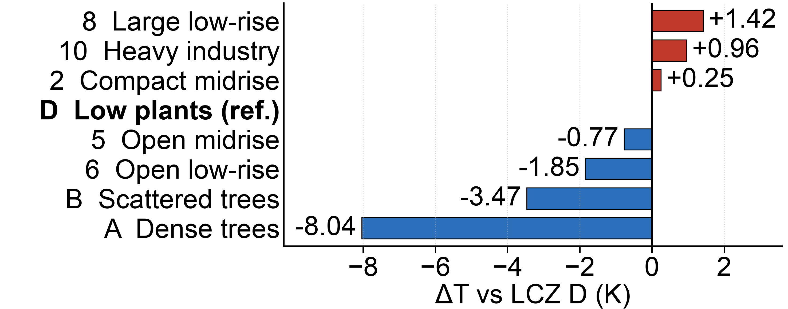
Twelve-Year Landsat-Derived Surface Urban Heat Island Intensity by Local Climate Zone in Barcelona (2013–2024)
Kerin Cardona*, Jordi Cipriano, Gerard Mor
International Centre for Numerical Methods in Engineering (CIMNE), Building Energy and Environment Group, Lleida, Spain
*Corresponding author: kcardona@cimne.upc.edu
INTRODUCTION & AIM
METHOD
Outdoor thermal exposure depends strongly on urban surface temperature, yet long-term, high-resolution land surface temperature (LST) climatologies remain scarce for Mediterranean cities:
Weather stations: point air temperature only
ERA5-Land: skin temperature at ~9 km, no intra-urban structure
Single satellite scenes: snapshots that depend on the weather of the day
Aim: a 12-year, 30 m LST climatology for Barcelona, read through Local Climate Zones (LCZ) and turned into hotspot, building and census-section exposure indicators for adaptation planning.
Barcelona metropolitan core: 464 km² window (~21 × 22 km), 13 municipalities.
378 cloud-filtered Landsat 8/9 Collection 2 Level-2 scenes, 2013–2024 (153 in summer), ~10:30 local; 30 m grid, ~100 m native thermal
Climatology: seasonal median, MAD and clear-sky count per pixel
SUHI by LCZ (Bechtel et al. 2019): class median minus LCZ D (low plants, 315.0 K)
Hotspot frequency: share of summer scenes above the 90th percentile of the JJA field (317.2 K)
Drivers: gradient boosting + SHAP, 13 covariates, 37,345 land cells, 2 km spatial-block cross-validation
Cross-checks: ERA5-Land (325 pairs); ECOSTRESS 70 m (7 scenes, |Δt| ≤ 2 h)
RESULTS & DISCUSSION
Summer (JJA) daytime, 12-year climatology. 106,203 buildings and 1,068 census sections linked to it.
(a) The Llobregat industrial corridor and dense cores exceed 45 °C; Collserola forest is the main cool feature. (b) 64 % of the window (78 % of land) is a hotspot at least once, 1.1 % (1.3 %) in over half of summer scenes. (c) Median LST in 30 m building buffers, 1,068 census sections of Barcelona city; port and logistics areas are the hottest.
Cross-checks of the 30 m field
SUHI by Local Climate Zone (JJA)
Exposure indicators
106,203 buildings, 13 municipalities: LST in 30 m and 100 m buffers (r = 0.989)
Only 10,333 distinct values: Landsat resolves ~100 m context, not single buildings
1,068 census sections: median 34.9–47.2 °C, but IQR only 41.1⁠–⁠42.1 °C; extremes set by land use (port vs seafront, parks)
Reference | n | Bias (K) | r
ERA5-Land, all | 325 | −4.32 | 0.92
ERA5-Land, JJA | 134 | −5.57 | 0.26
ECOSTRESS, pooled | 7 | +0.37 | 0.92
ECOSTRESS, per scene | 7 | −6.4…+4.3 | 0.43–0.96
Bias = reference − Landsat; n = matched Landsat scenes. ERA5 follows the seasons but not the city. ECOSTRESS places warm and cool areas in the same locations; n = 7 cannot establish absolute accuracy.
CONCLUSIONS
FUTURE WORK/ REFERENCES/ACKNOWLEDGMENT
A tree-canopy cool island (−8.0 K; still 8.4 K below LCZ 8 at equal elevation) dominates over a weak built heat island (≤ +1.4 K).
Vegetation (NDVI) is the leading driver (held-out R² = 0.84; ranked first in 5/5 splits): tree cover is the main modifiable cooling lever.
Reproducible 30 m baseline from open data for adaptation planning; ERA5-Land cannot replace it.
Future work: combine exposure with socio-economic vulnerability; year-split validation; night-time LST.
Data: Landsat 8/9 C2 L2, ECOSTRESS L2G v002, ERA5-Land, INSPIRE cadastre, Copernicus DEM / HRL / Urban Atlas; LCZ map: Demuzere et al. (2019).
Session S5 — Remote Sensing in Urban Areas
https://sciforum.net/event/ECRS2026

