Slide 1
A 12-Year, 30 m Thermal Baseline for the Barcelona Metropolitan Area
A 12-year, 30 m thermal baseline for urban climate adaptation
Kerin Cardona, Jordi Cipriano, Gerard Mor — CIMNE (International Centre for Numerical Methods in Engineering)
ECRS 2026 | Session S5 — Remote Sensing in Urban Areas | Oral, online

Slide 2
MOTIVATION
The Problem: No Baseline, No Way to Measure Change
• Outdoor thermal exposure depends strongly on urban surface temperature.
• The gap: long-term, high-resolution LST climatologies remain scarce for Mediterranean cities.
• Without a baseline: cannot measure change, cannot prioritize interventions, cannot tell which neighborhoods are persistently hotter.
• Barcelona: 3M+ people in its metropolitan area, a Mediterranean coastal city — until now, no systematic, satellite-based thermal baseline.
2

Slide 3
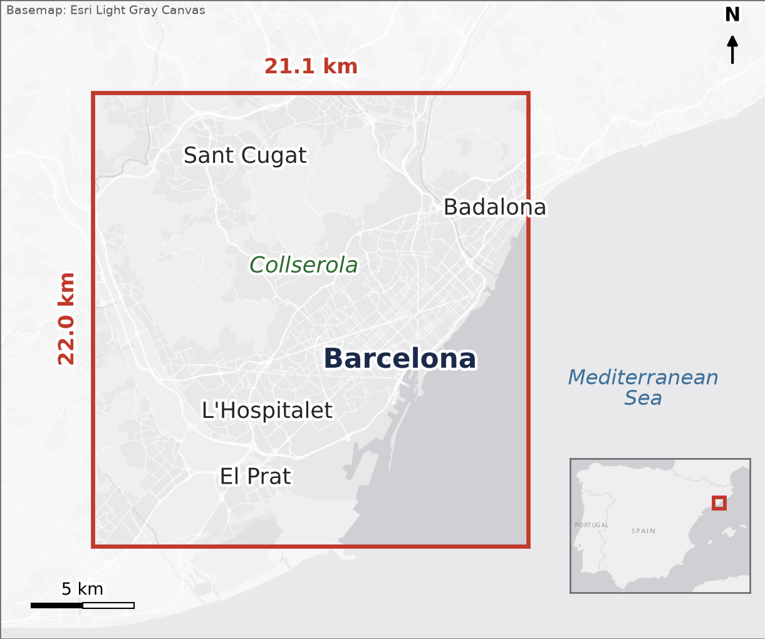
METHODS — DATA
Study Area and Data
• 464 km² over the Barcelona metropolitan core (21.1 × 22.0 km).
• 378 Landsat 8/9 scenes, Collection 2 Level-2, 2013–2024 (12 years).
• 30 m grid, cloud-filtered.
• Four seasonal medians (winter, spring, summer, fall) → one climatology.
3

Slide 4
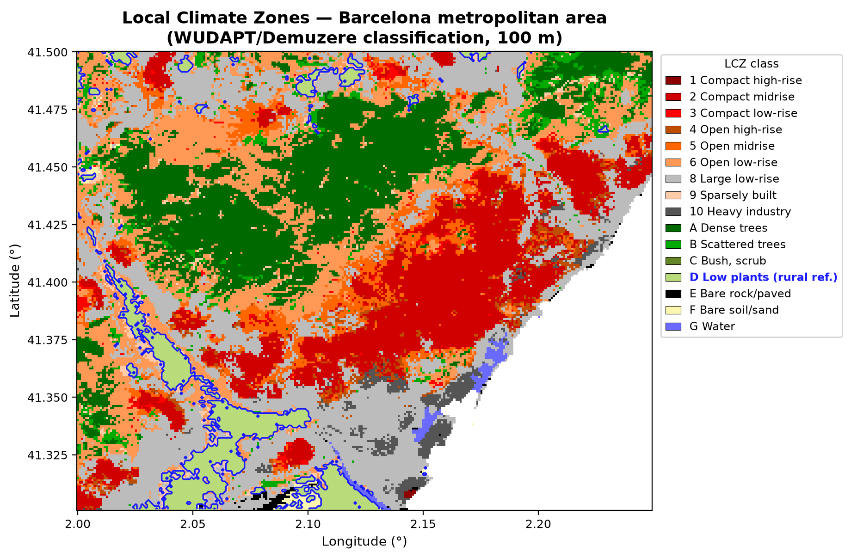
METHODS — CLASSIFICATION & VALIDATION
Local Climate Zones + Dual Consistency Checks
• Local Climate Zones (WUDAPT/Demuzere) — each zone has a distinct urban form: building height, density, vegetation cover.
• Reference: LCZ D (low plants) — the rural background.
• Two consistency checks, not one:
– ERA5-Land skin temperature, n=325 matched pairs — checks the seasonal cycle.
– ECOSTRESS, 70 m, n=7 near-coincident scene pairs (|Δt| ≤ 2h) — independent consistency assessment.
• Consistency — not validation. Seven scene pairs is not enough for full validation.
4

Slide 5
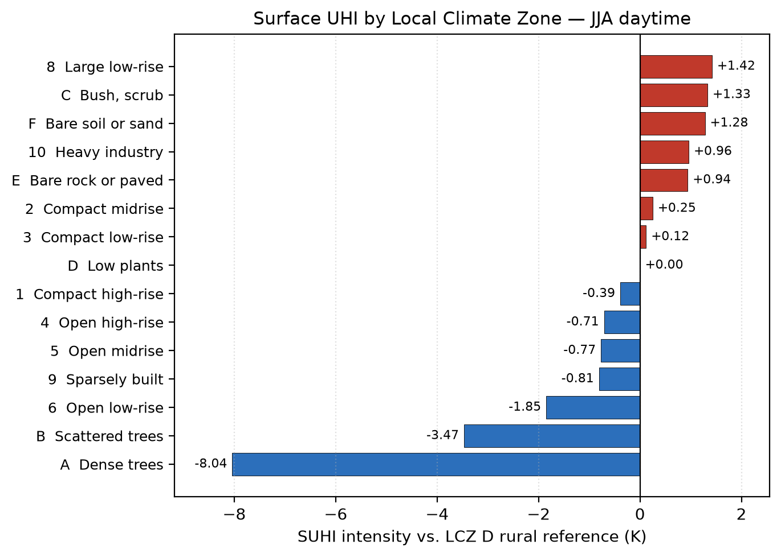
RESULTS
LCZ Thermal Hierarchy: The Tree-Canopy Cool Island
• Median JJA (summer) LST by Local Climate Zone, relative to LCZ D (rural reference):
– LCZ 8 — large low-rise: +1.4 K (hottest built class)
– LCZ 10 — heavy industry: +1.0 K
– LCZ A — dense trees: −8.0 K (tree-canopy cool island)
• A 9.4-Kelvin gap between large low-rise and dense trees — same city, same 12-year summer climatology.
• It is not that built areas are exceptionally hot — it is that trees are dramatically cooler.
5

Slide 6
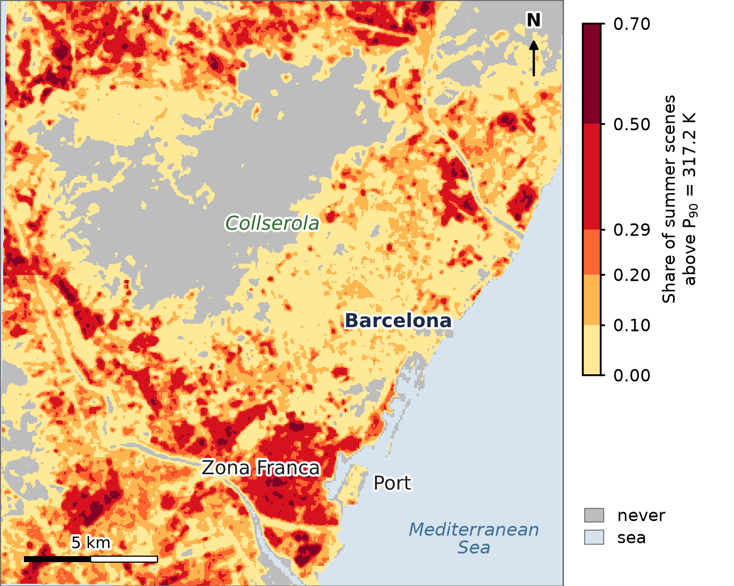
RESULTS
Hotspot Analysis: Where Heat Recurs
• Hotspot = pixel above the summer (JJA) P90 threshold.
• 78% of the land area (64% of the window, which includes sea) experiences at least one hotspot event in 12 years.
• 1.3% of the land area is persistently affected (hotspot frequency > 0.5) — the same pixels, year after year.
• These are the places where adaptation matters most: tree planting, cool roofs, urban redesign.
6

Slide 7
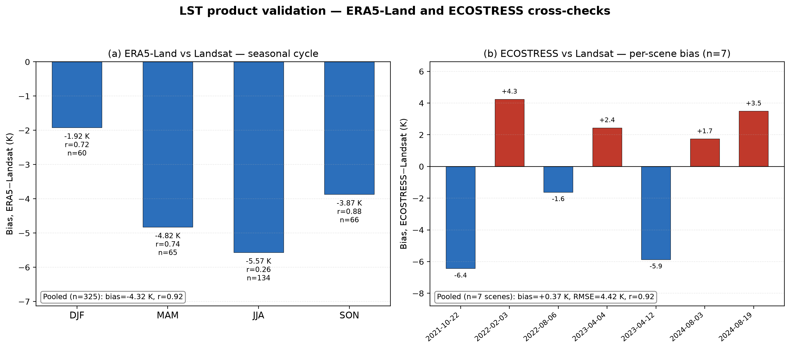
RESULTS — VALIDATION
Two Independent Consistency Checks
• ERA5-Land (left panel): pooled seasonal cycle r = 0.92 — good agreement at the seasonal scale.
– Within the summer season (JJA), r drops to 0.26 — ERA5 tracks the seasons but does not resolve intra-urban structure (0.1° grid).
• ECOSTRESS, 70 m (right panel): bias +0.37 K, RMSE 4.4 K, r = 0.92 — consistent with our 30 m field.
• ERA5 tells you what season it is. ECOSTRESS tells you your LST is about right. Only Landsat gives you the 30 m structure.
7

Slide 8
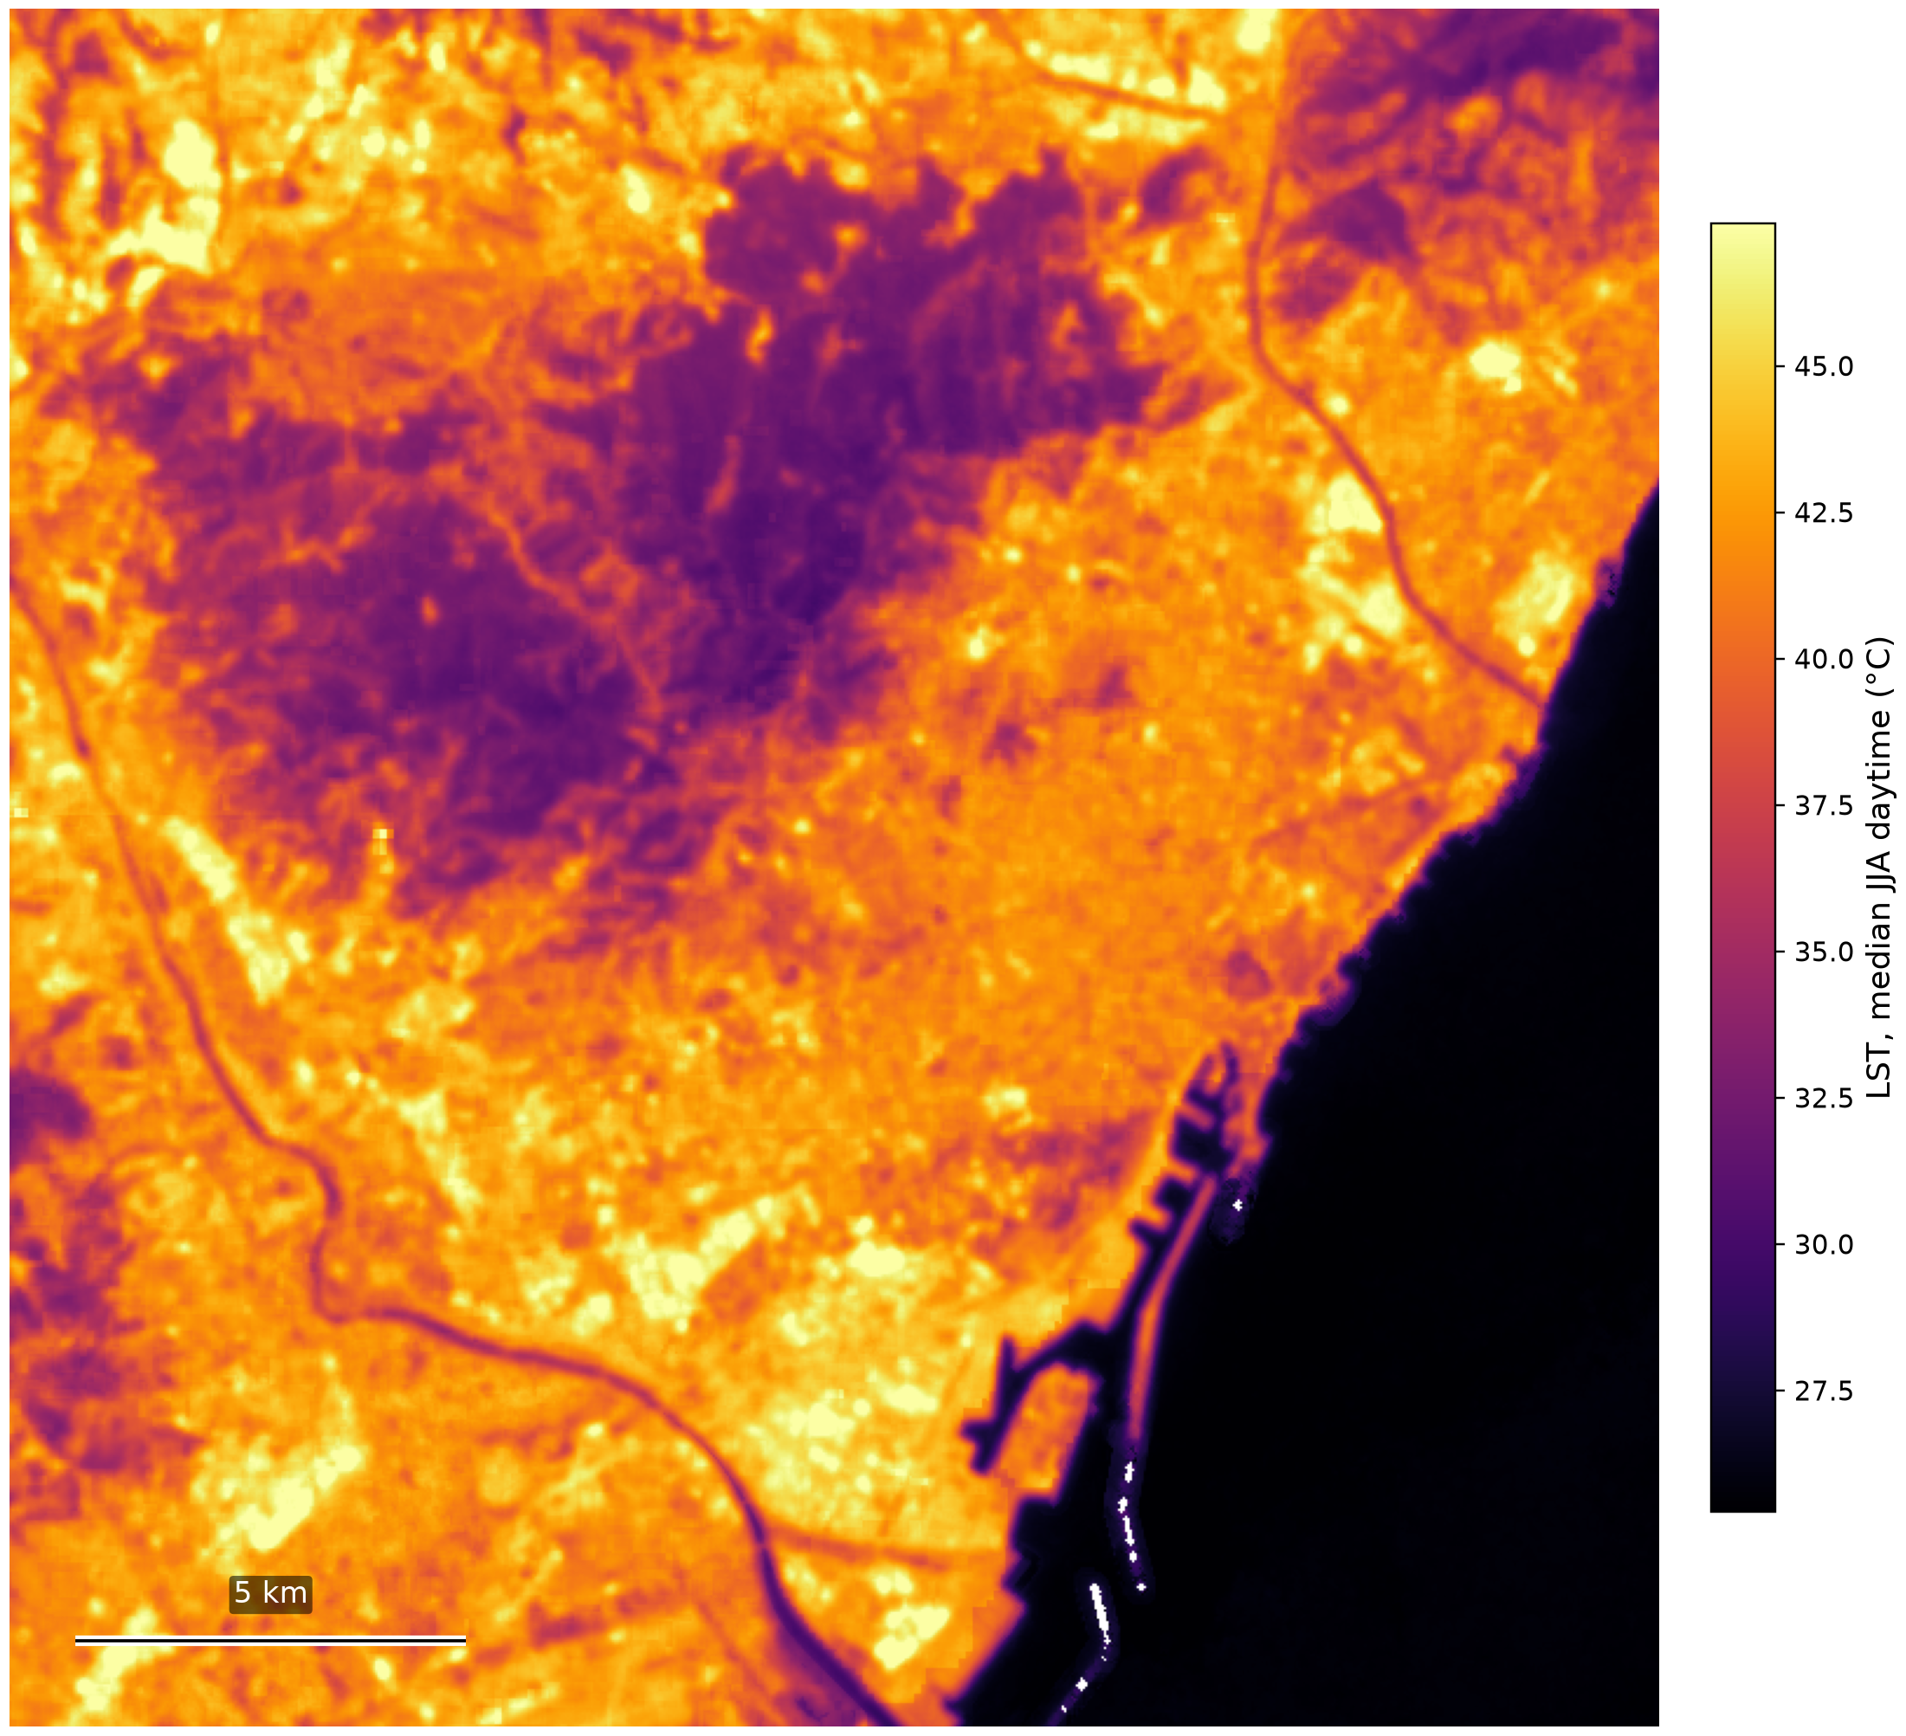
This is the baseline.
12 years. 30 meters.

Slide 9
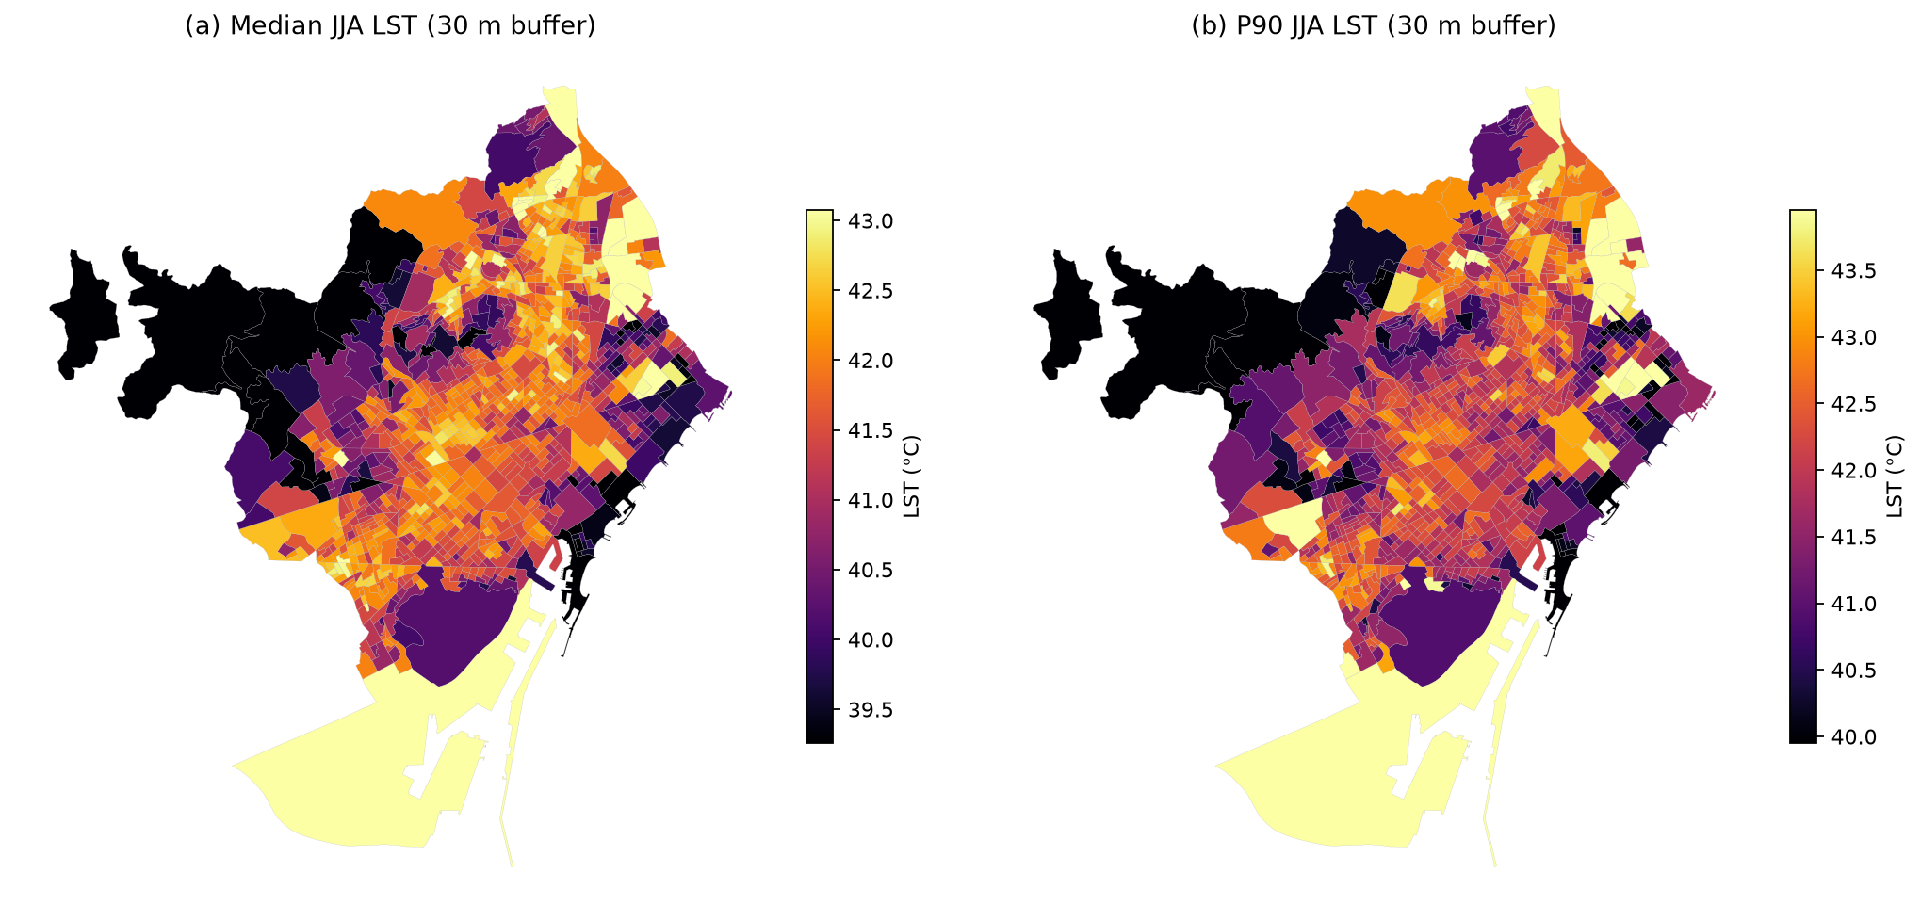
BRIDGE TO CONCLUSIONS
Building Exposure: From Map to Baseline
• The climatology is not just a map — it is an exposure baseline.
• 106,000+ buildings overlaid across 13 municipalities; each building gets the median summer LST within a 30 m buffer.
• At Landsat's effective thermal resolution (~100 m), these are exposure indicators, not per-building retrievals.
• They tell you which neighborhoods carry the highest thermal load on their building stock.
9

Slide 10
CONCLUSIONS
Three Findings — and One Takeaway
• 1. A 12-year, 30 m SUHI-by-LCZ climatology for a Mediterranean city — reproducible, built entirely from open data.
• 2. Dense tree cover is 8 K cooler than the rural reference (≈9.4 K below large low-rise) — vegetation is the dominant spatial cooling signal.
• 3. ECOSTRESS confirms our Landsat field is consistent; ERA5 cannot substitute for high-resolution urban LST.
TAKEAWAY
A reproducible, satellite-based thermal baseline for adaptation planning in Mediterranean coastal cities.
10

Slide 11
Thank You
Slides, posters and figure code:
github.com/kerin84/ecrs2026-barcelona-lst
kcardona@cimne.upc.edu
Happy to take your questions.

