Slide 1
Brown Bag – Bokeh
Interactive Visualization
December 5, 2018
Keri Wheatley

Slide 2


What is Bokeh?
Interactive visualization library
Open-source, supported financially by NumFOCUS and Anaconda
Uses modern web browsers
Handles large or streaming datasets
Codes in Python
Outputs JavaScript
Still undergoing big changes (0.13.0 → 1.0.0 major release in October 2018)
Documentation: https://bokeh.pydata.org/en/latest/

Slide 3
Comparing Popular Tools
Viz Tools | Pro | Con
Bokeh | Built-in server, interactive, Python-based, open-source | Still undergoing major changes, fewer online resources, some interactions hard to build
D3.js | Very flexible, large online community, open-source | Steep learning curve
Tableau | Fast prototyping, drag-and-drop, built-in server | Very expensive, unsecured server
Plotly/Dash (haven’t actually used it) | Python-based, similar to Bokeh, much newer but gaining a lot of popularity
Matplotlib | Fast, flexible, Python-based, open-source | Not interactive

Slide 4
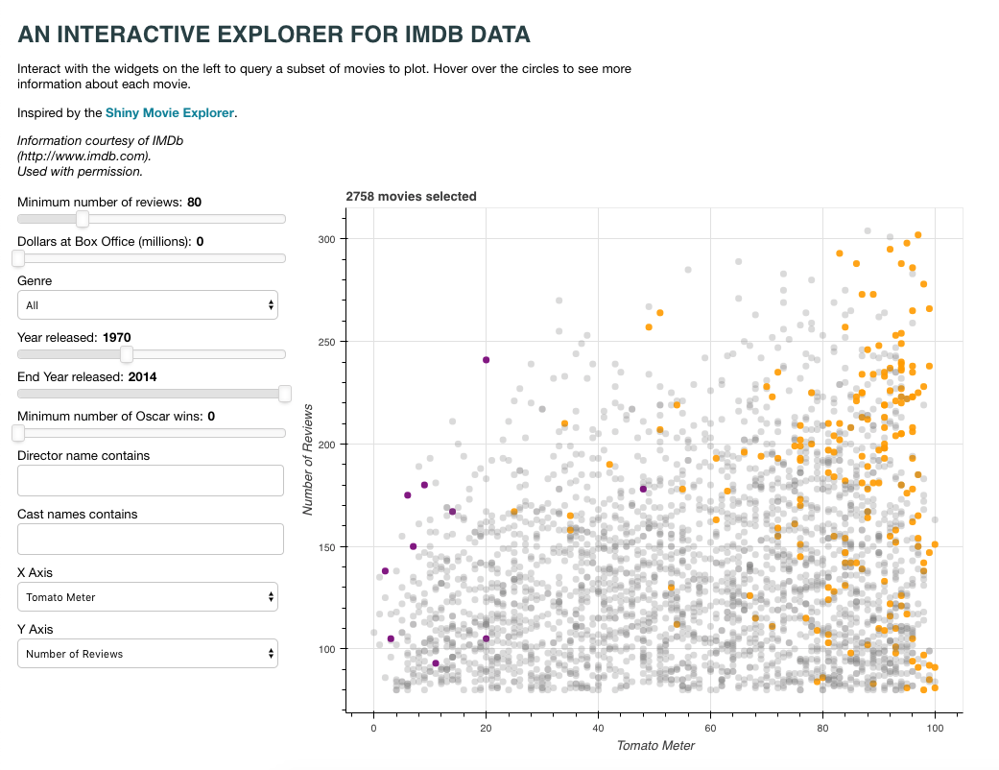
Bokeh Demo
https://demo.bokehplots.com/apps/movies

Slide 5
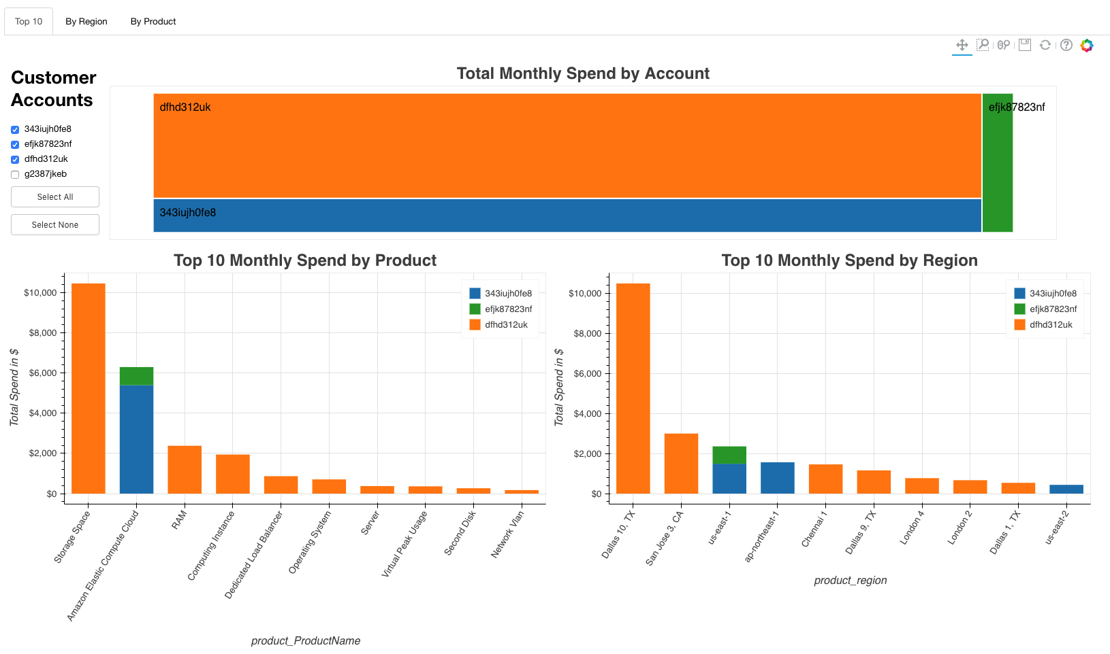
My Bokeh Example
https://github.ibm.com/Keri-Wheatley/ds-cam-dashboard/blob/master/bokeh_app.py

Slide 6
Definitions
Item | Definition
BokehJS | The JavaScript client library that actually renders the visuals and handles the UI interactions for plots. Primarily written in TypeScript.
Figure | Plot base
Glyph | Basic visual building blocks placed on the figure, such as bars, lines, circles, text, etc.
Tools | a number of interactive tools that can be used to report information, to change plot parameters such as zoom level or range extents, or to add, edit, or delete glyphs
Widgets | User interface elements outside of plots, such as buttons, dropdowns, etc.

Slide 7
Bokeh Server
The main purpose of Bokeh Server is to create the capability of synchronizing between Python and the browser. Capabilities:
  Respond to UI and tool events generated in a browser with computations or queries using the full power of Python.
  Automatically push server-side updates to the UI (i.e. widgets or plots in a browser).
  Use periodic, timeout, and asynchronous callbacks to drive streaming updates.

Slide 8
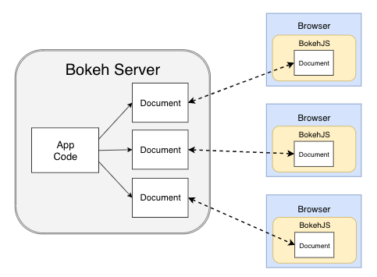
Bokeh Server
A Bokeh server (left) uses Application code to create Bokeh Documents. Every new connection from a browser (right) results in the Bokeh server creating a new document, just for that session.

Slide 9
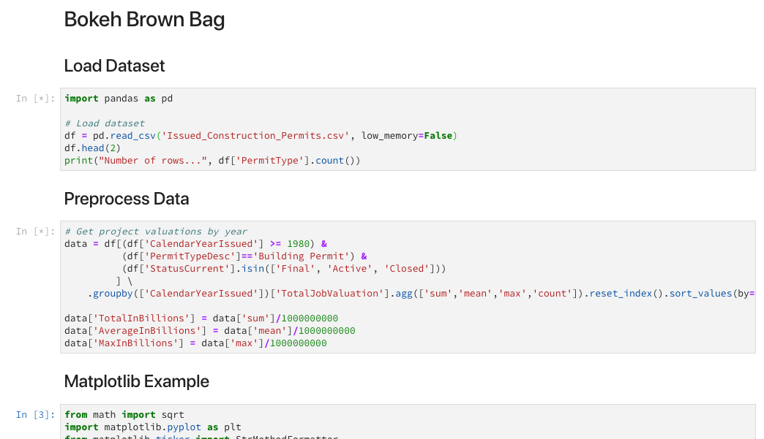
Live Tutorial
https://github.ibm.com/Keri-Wheatley/ds-bokeh-brown-bag/blob/master/Bokeh-Brown-Bag.ipynb

Slide 10
Bokeh Extensions
Why?
  Share visualizations with larger or broader audiences
  Enable login and other admin controls
  Embed visualization as component
  Enable HTTP/HTTPS
Web Frameworks
  Apache (See Bokeh docs: https://bokeh.pydata.org/en/latest/docs/user_guide/server.html#userguide-server-applications)
  Django
  Flask (Example here: https://github.ibm.com/Keri-Wheatley/ds-cam-dashboard/blob/master/flask_app.py)
  Nginx (See Bokeh docs: https://bokeh.pydata.org/en/latest/docs/user_guide/server.html#userguide-server-applications)
  Many more

Slide 11
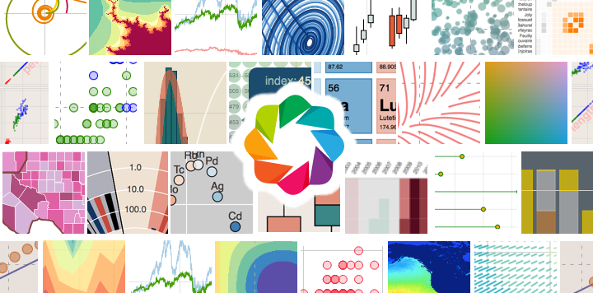
Thank you!
Questions?

