Slide 1
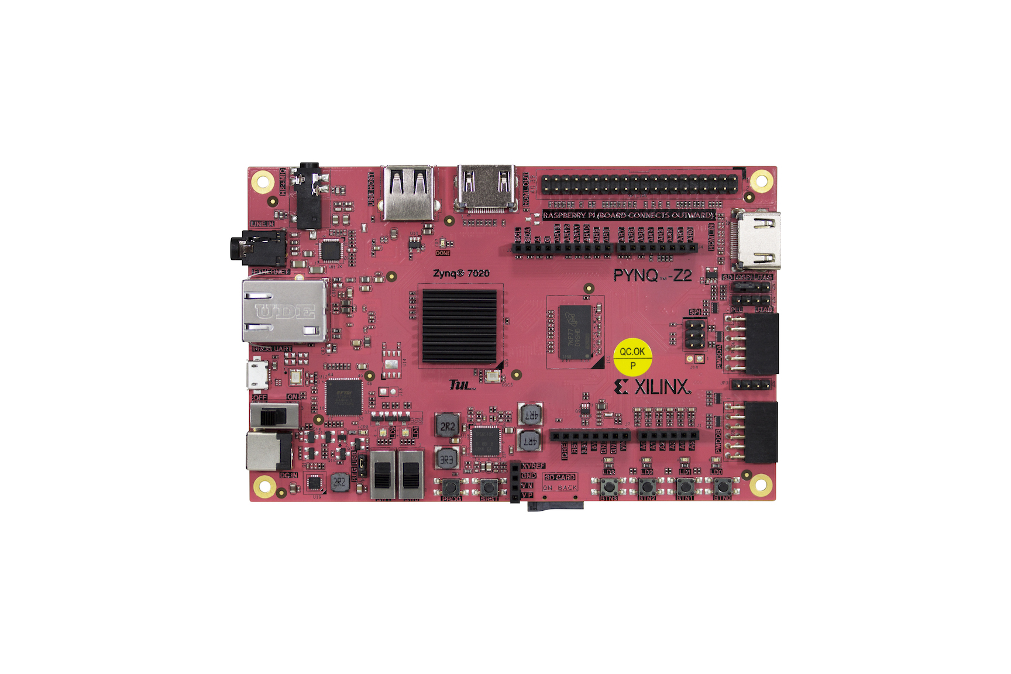
The PYNQ-Z2 is a Zynq development board designed to be used with the PYNQ™, an open-source framework.

Slide 2
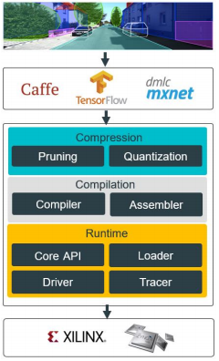
• A complete set of optimized tool chains, including compression, compilation and runtime.
• Lightweight C/C++ programming APIs.
• Easy-to-use with gradual learning curve
Notes:
Key highlights and features are listed below: Innovative full-stack solution for deep learning inference application development • A complete set of optimized tool chains, including compression, compilation and runtime. • Lightweight C/C++ programming APIs. • Easy-to-use with gradual learning curve

Slide 3
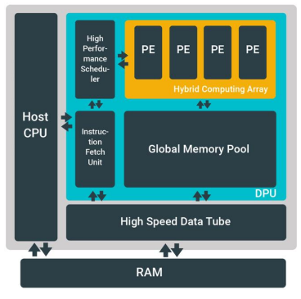
The DPU is designed to accelerate the computing workloads of deep learning inference algorithms widely adopted in various computer vision applications

Slide 4
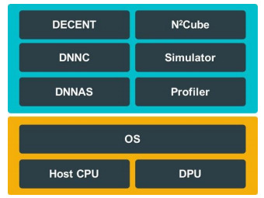
DNNDK is composed of Deep Compression Tool (DECENT), Deep Neural Network Compiler (DNNC), Deep Neural Network Assembler (DNNAS), Neural Network Runtime (N2Cube), DPU Simulator, and Profiler

Slide 5
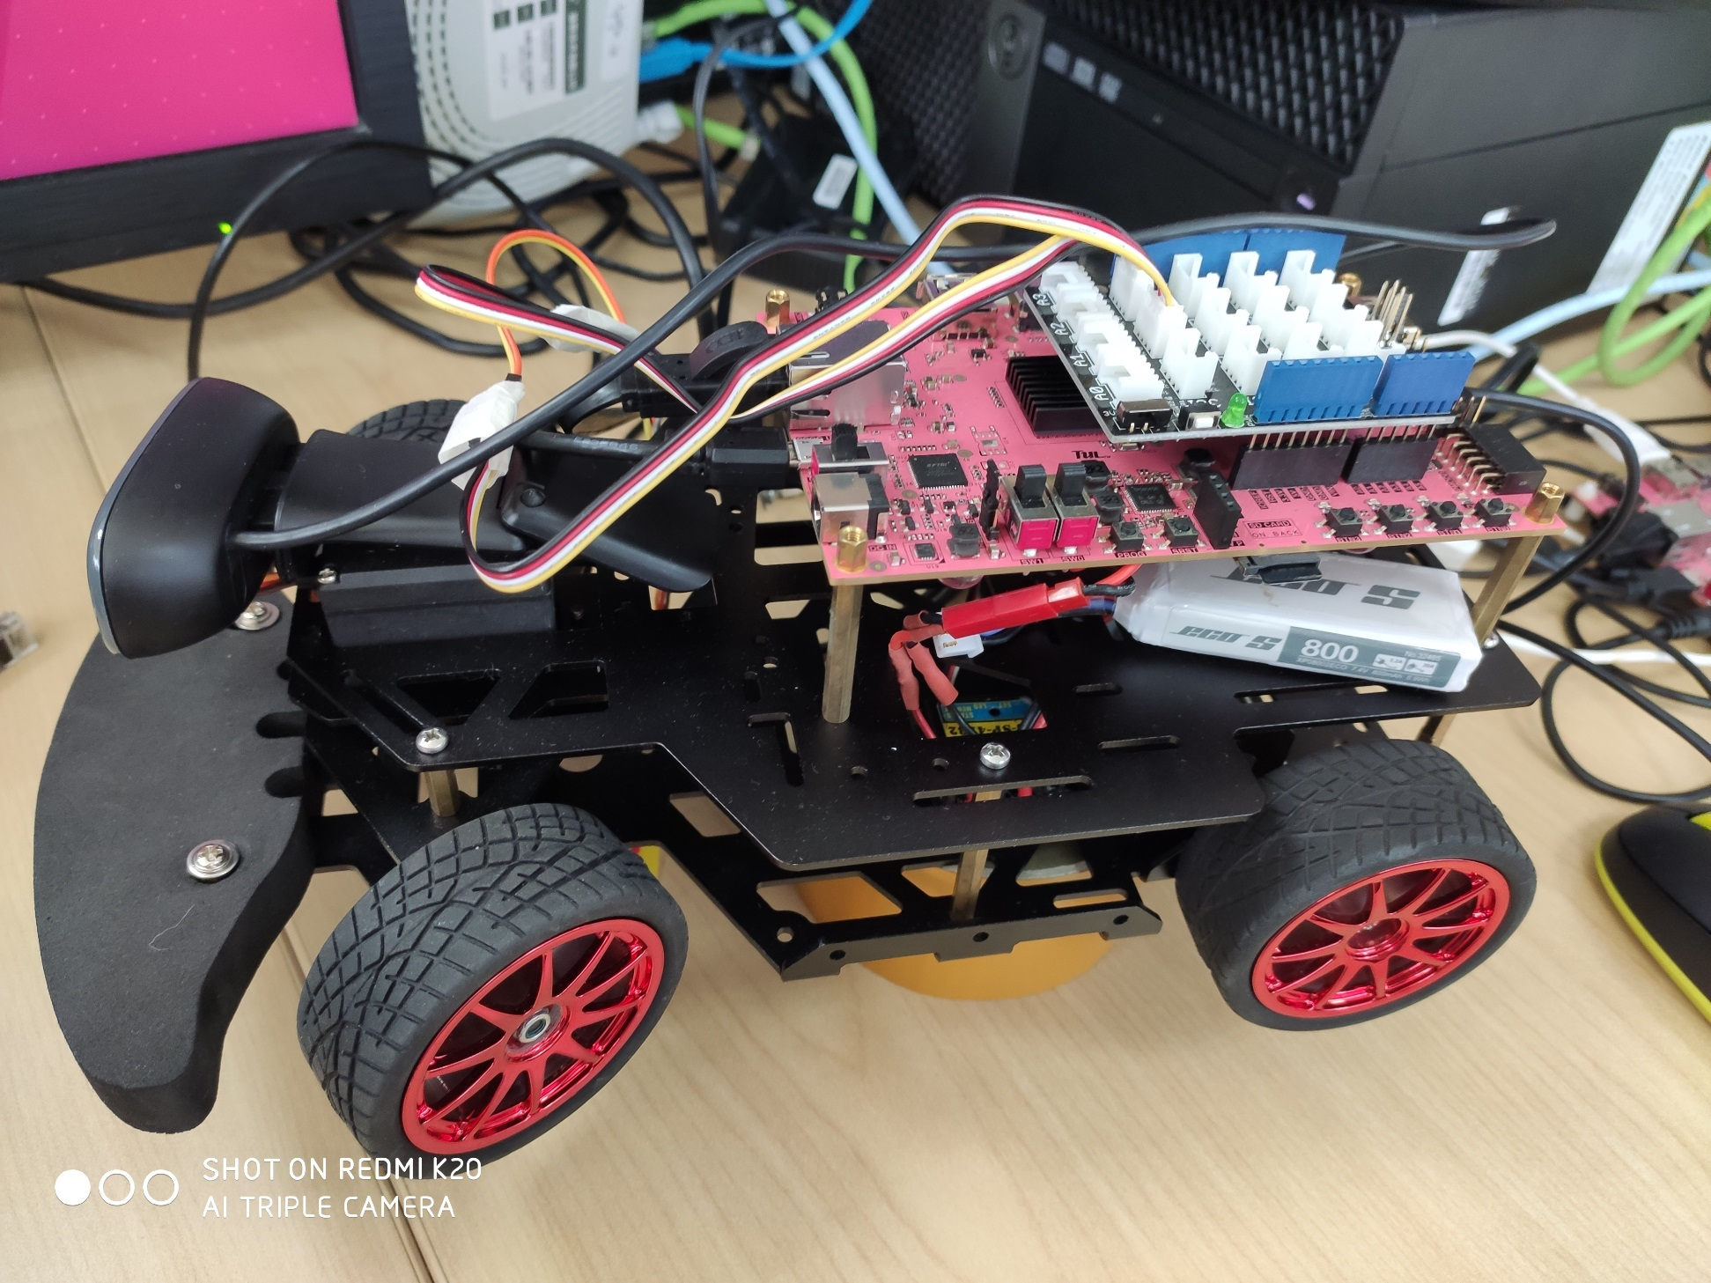
The car.

Slide 6
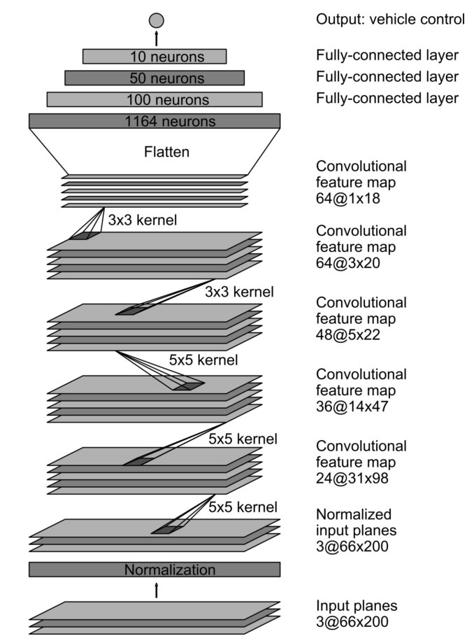
End-to-End Model
Input the image
Output the control command

Slide 7
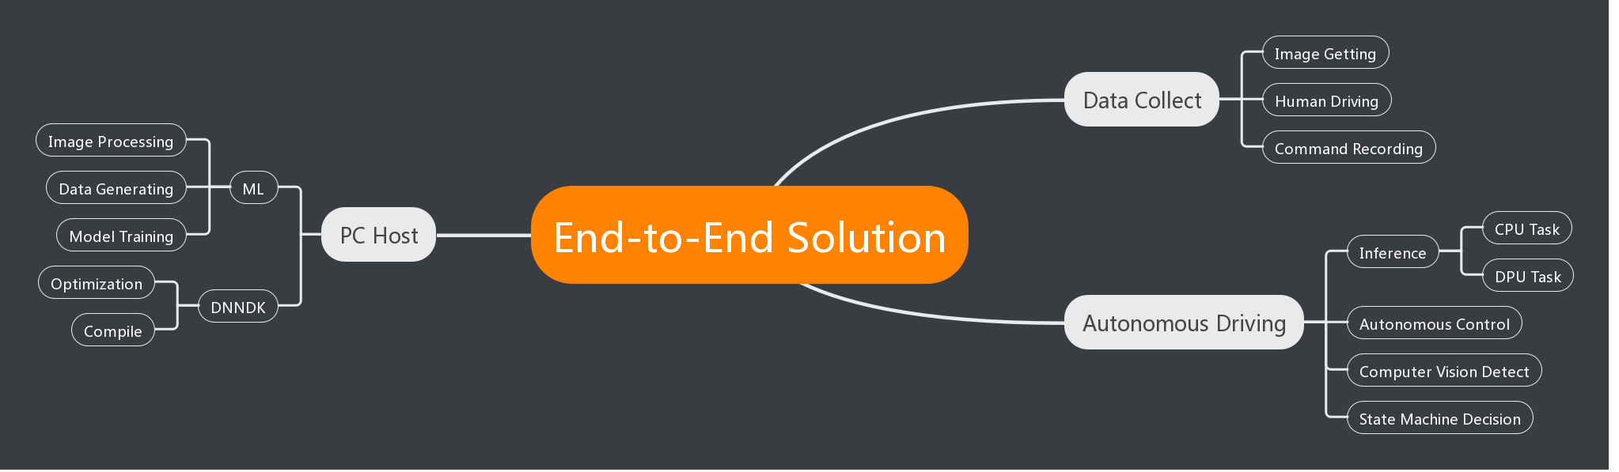
Project Structure

Slide 8
Easy to use and extend
Use DPU to accelerate
End-to-End solution

