Slide 1
arcgis online tech report
Tim Kerkhove
Crp 558

Slide 2
Background information
Launched in 2012 by ESRI
ESRI was founded in 1969 and currently holds the largest share of the global GIS market
Requires an individual user account to access functions
Organizations can pay for plans to be able to share and modify geospatial content among their members more efficiently
A paid subscription is necessary to perform geospatial analyses

Slide 3
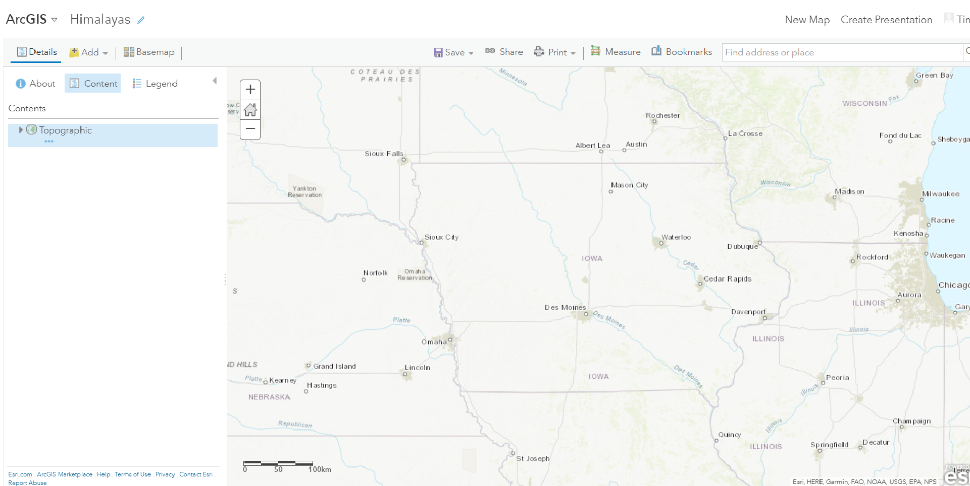
Basic functions
ArcGIS Online is a platform for digital cartography and geospatial analysis
Similar to ArcMap for Desktop but more limited in its analytical capabilities
A variety of base maps is available ranging from basic topographic maps to satellite imagery to Open Street Maps that we have used in class

Slide 4
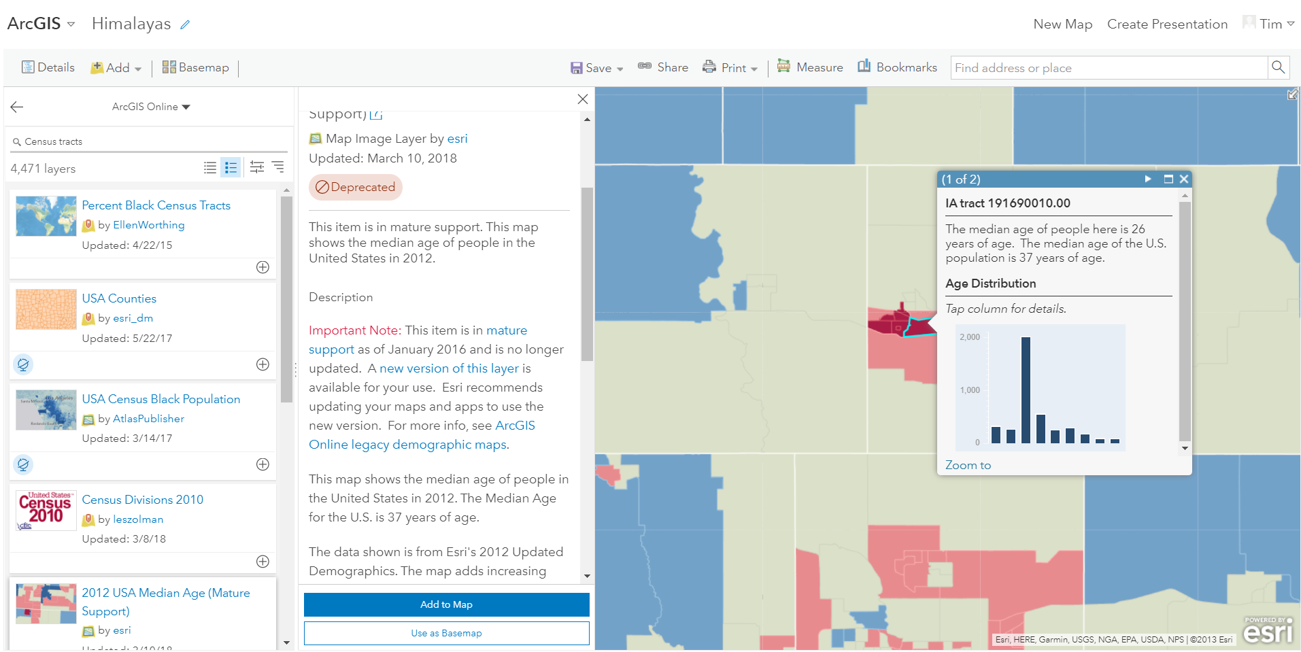
Data availability
Having an ArcGIS Online account also gives the user access to a vast library of both professionally- and user-generated data
The image to the left shows a map layer developed by ESRI using Census Bureau data illustrating the median age at different geographic levels depending on the level of map zoom. I accessed this layer by searching for “Census Tracts” in the layer search box. A sample of the other publicly available layers can be seen on the left side of the screen.

Slide 5
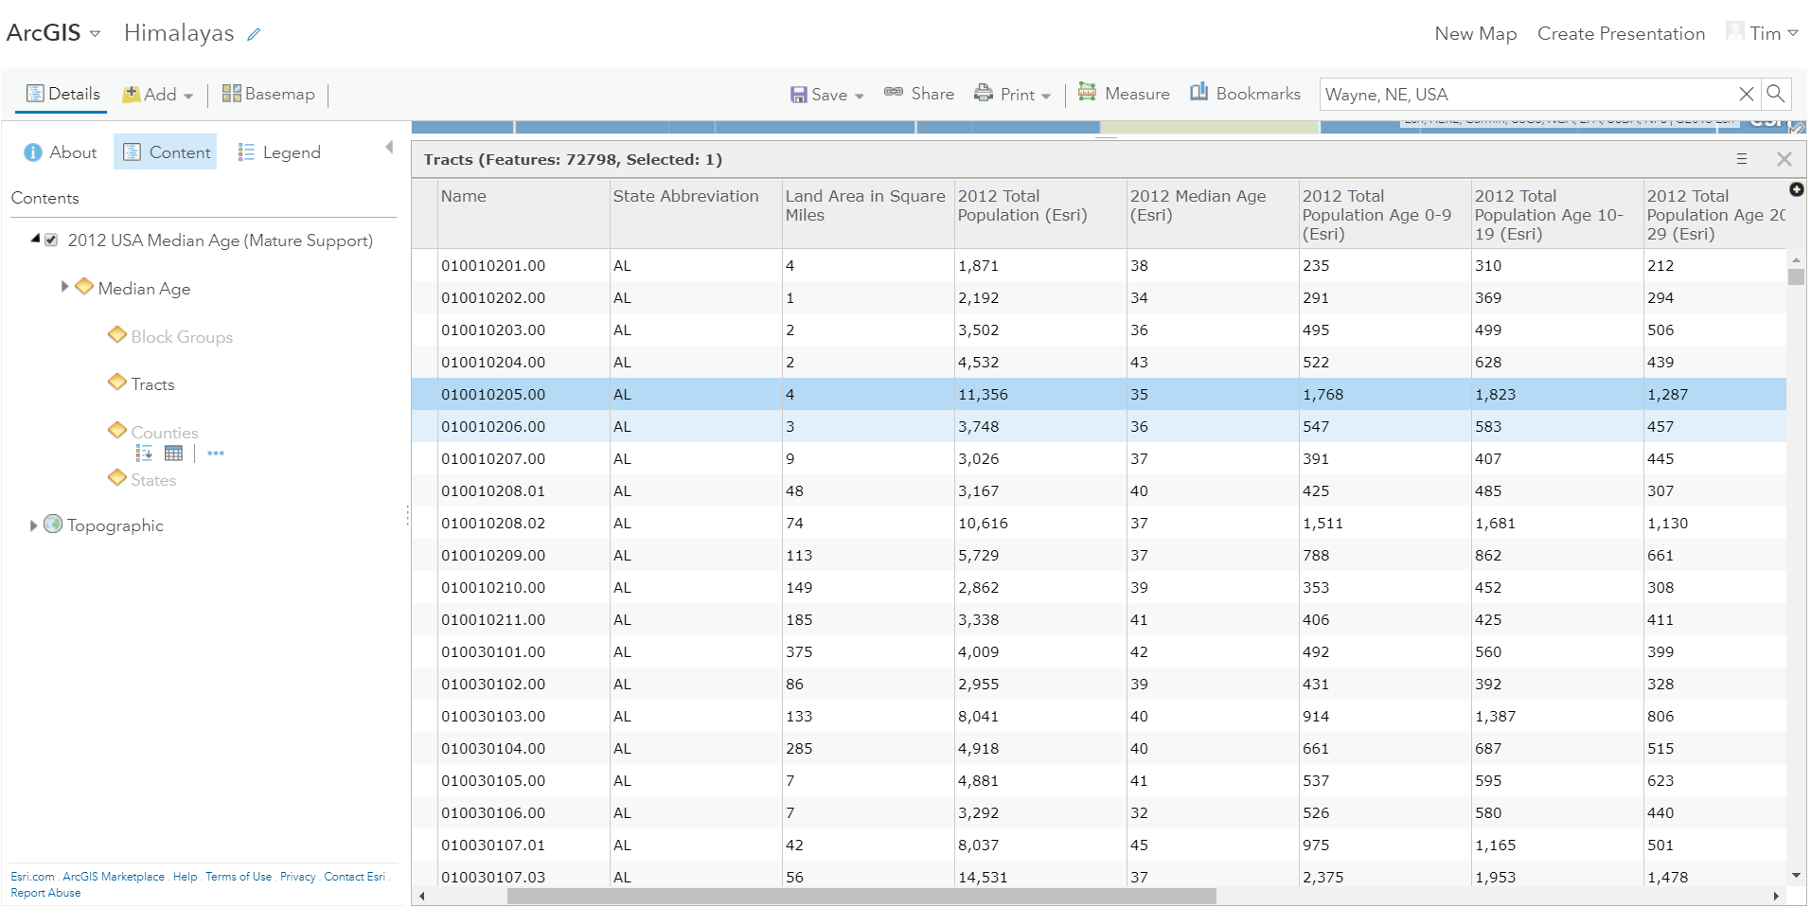
Data importing (And exporting)
Geospatial data can also be imported to ArcGIS Online using a properly formatted .csv file
The publisher of the layer decides whether the layer’s attributes can be edited by other users
This layer created by ESRI is not editable
Conversely, some data can also be exported to ArcGIS for desktop

Slide 6
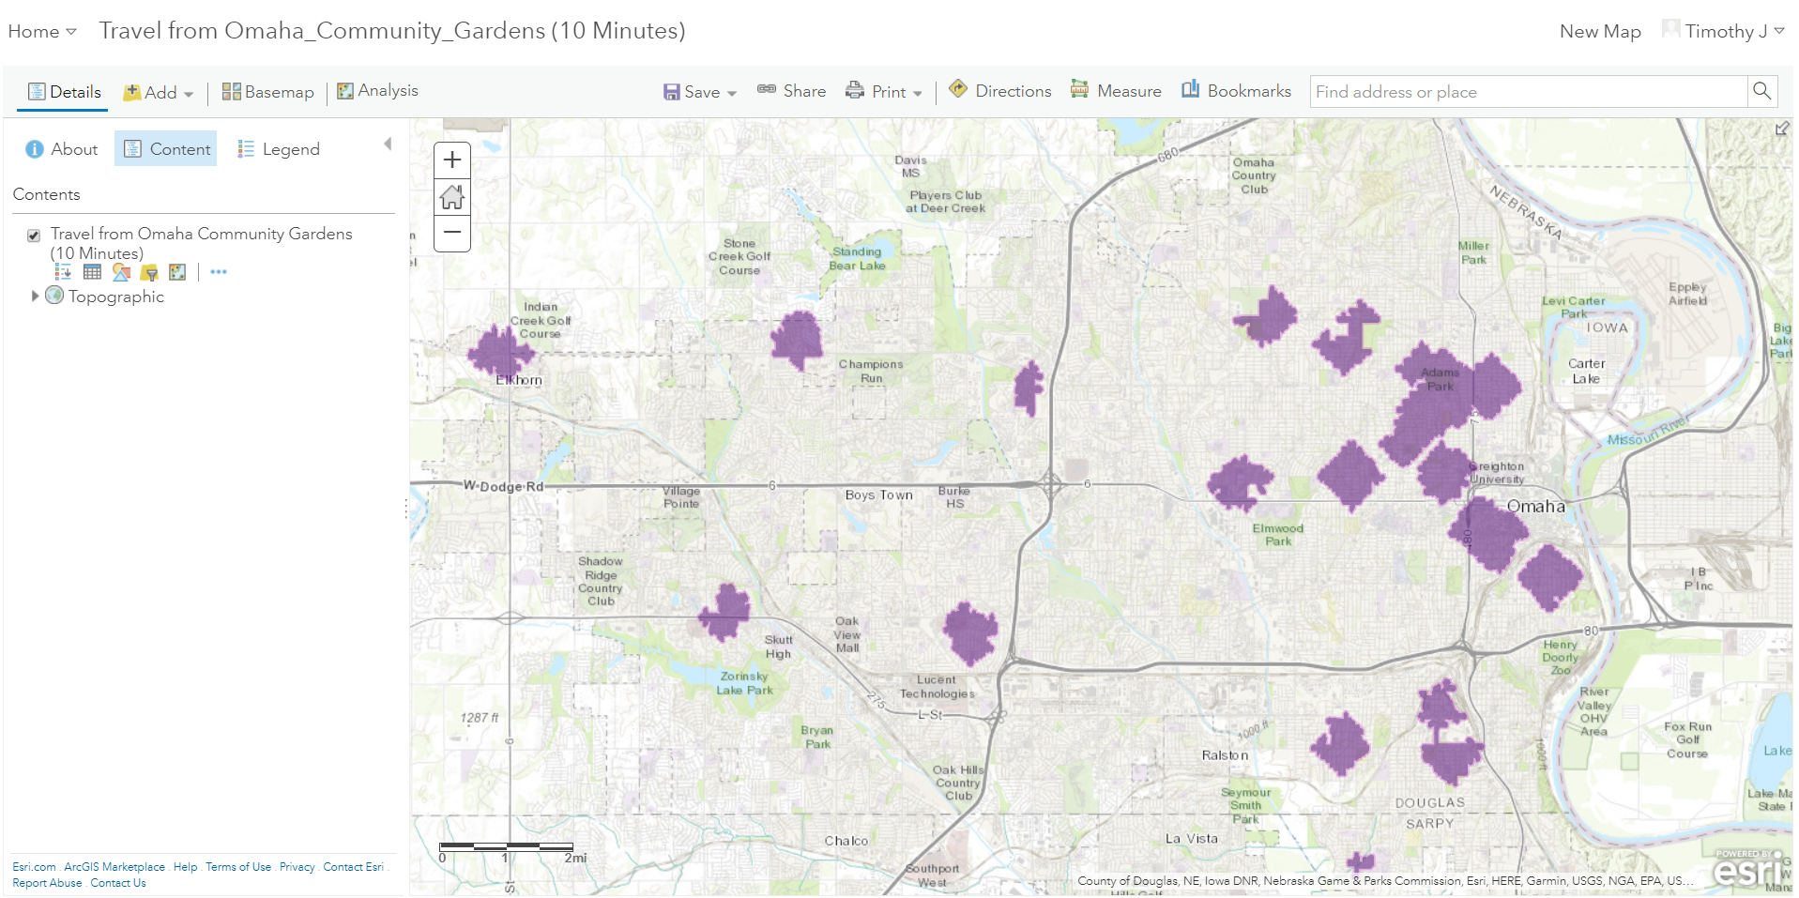
Geospatial analysis
Basic geospatial analysis can be performed in ArcGIS Online with a paid subscription or by being a member of a paying organization
Functions include:
Buffering
Clipping
Estimating Drive-times
Among other options
The adjacent image shows a 10-minute walk buffer I generated using a layer depicting community gardens in Omaha I created and imported

Slide 7
Coding application
Maps and map applications can be embedded in a webpage by placing them in the page’s HTML
ArcGIS Online will provide the code chunk so it can easily be copied and pasted into the HTML document
For example, this is the code I would place in an HTML document to embed a story map I created:
<iframe width="100%" height="800px" src="http://isugisf.maps.arcgis.com/apps/MapSeries/index.html?appid=dc29a5872e32440e9205a4d516ec9140" frameborder="0" scrolling="no"></iframe>

Slide 8
Project example
As alluded to in the previous slide, maps can be combined into a presentational format called a Story Map in ArcGIS Online
Here is an example of a story map I created about potential community garden locations in Ames
Click Here

Slide 9
limitations
As noted previously, ArcGIS Online has significantly fewer geospatial analysis tools, making ArcMap for Desktop preferable if the user wants to do more than basic functions like buffers or clipping
The analytical tools are only accessible to paying members/members of a paying organization. Given that much of ArcGIS Online’s appeal comes from the ease with which maps made in it can be shared within an organization, users not affiliated with an organization would likely prefer ArcGIS for Desktop since it has more analytical options

Slide 10
Conclusion
ArcGIS Online is a tool available to organizations to view and modify geospatial data in a user-friendly fashion
Layers can be imported from or exported to ArcGIS for desktop
Maps can be embedded in webpages by inserting a provided code into an HTML document
Story maps can be created as a shareable presentation format for multiple maps

