Slide 1
Multi-agent Democratic Gridworld
An anthological perspective
Andrea Longo
Reinforcement learning

Slide 2
In a grid world a ship is guided by the democratic vote of some agents within it, each agent is intent on reaching a specific cell

Slide 3
 |  | R2
 |  |  |  |  | R1
R3

Slide 4
Getting off
When an agent reach its goal it will not gain further rewards and cannot vote
Playoff
In case multiple directions gains the same number of votes the direction taken will be chosen randomly among those
Win away
The first cell for the ship cannot contain any reward

Slide 5
Goal
Restriction to spice it up
Learn a policy for each agent to make it reach its goal (hopefully quickly)
Use of single-agent reinforcement learning techniques readjusted to the multi-agent context
Evaluation
For each episode the optimality (total steps/steps of shortest path) will be the key measurement
Keeping track
The way in which cooperative or competitive dynamics are established
Setting alternative
Setting extensions
Tests are made either with random initial position or fixed at the middle
Multiple reward cells for each agent
Obstacles inside the grid
Competition between different agents
Agreement incentive - move 2 steps if all vote that direction

Slide 6
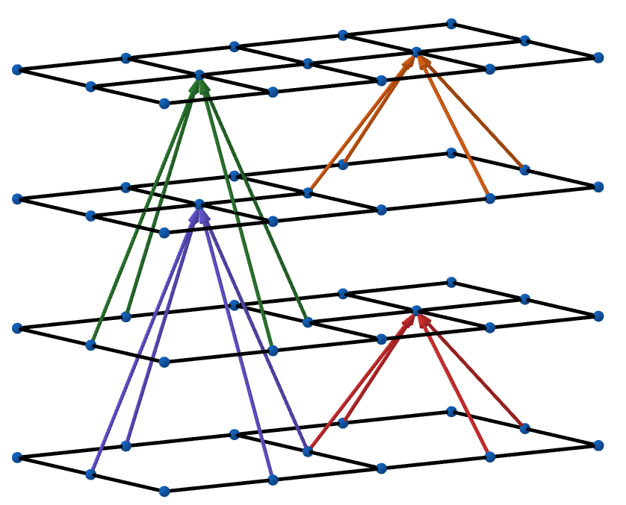
Intuition on state space
|S|= (X·Y)·2^{N}
|S|= X·Y
 | R1 |  | R2

Slide 7
Approaches
Collaborative
Planning + Value contamination
|S|= (X·Y)·2^{N}
Parametrized Value Iteration
Naive
Votes as Transition Probability
|S|= (X·Y)·2^{N}
Q-learning
Unstructured
Previous votes into states
|S|= (X·Y)·(2·5)^{N}
SARSA VFA with Neural Network

Slide 8
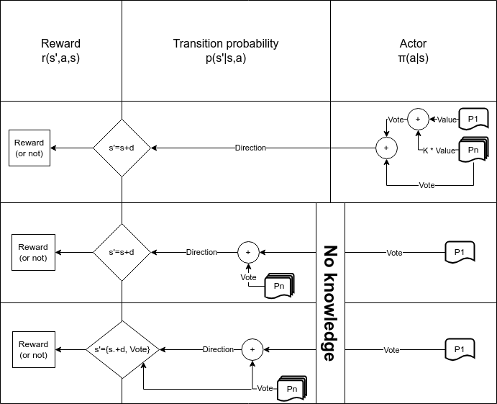

Slide 9
Configurations
Environment
Random initial state
3 Agents
10x10 Grid
Rewards
  Goal : 100
  Wall : -10
  Empty : -1
For all agents
Discount : 0.95
Evaluation episodes : 500
Collaborative Agents
V initialization : Empty reward
Naive agents
Epsilon : 0.1
Alpha : 0.1
Training episodes : 2000
Q initialization : Empty reward
Unstructured agents
Epsilon : 0.1
Alpha : 0.0001
Training episodes : 2000

Slide 10
Collaborative approach
Parametrized Value Iteration
Individual Value function construction is indipendent
simulating actions as direction taken, not votes
Contaminated Value function CVi = Ki·sumj != i(Vj)
with K ~ U(k_min, k_max)
Since V expresses only future rewards the adjusted policy is
Policyi(s) = argmaxa[sumi[Ri(s,a)] + ᵞ · CVi(s’(s,a))]

Slide 11
Notable attempt
Inside Value Iteration
Vi,t+1(s) = maxa[Ri(s,a) + ᵞ · Vi,t(s’(s,a))]
I tried with contamination during evaluation
Vi,t(s’(s,a)) += Ki·sumj != i[Vj,t(s’(s,a))]
But the underline Bellman Equation rarely converged with K!=0

Slide 12
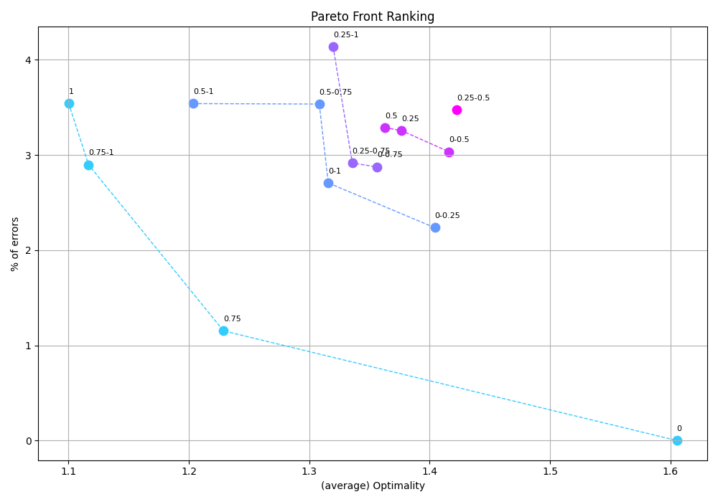
Best [k_min,k_max]
Results averaged over 100 test per configuration
(2500 tests of 500 evaluation episodes each)

Slide 13
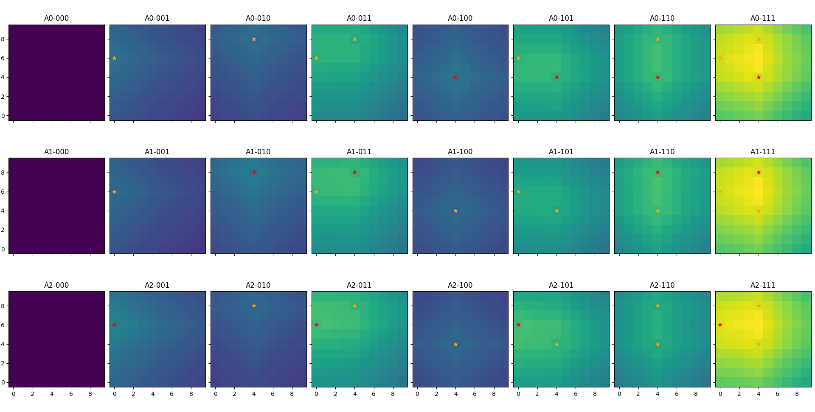
Contaminated values with K ~ U(0.75-1)

Slide 14
Naive Approach
Q-Learning
Agents constructs their own Qi(s,a) over the training episodes
after training the evaluation’s votes are greedy (no ε) and Q does not update
Votes are the actions
the democratic step is integrated as Transition probability
Rewards are individual
unlike the previous case

Slide 15
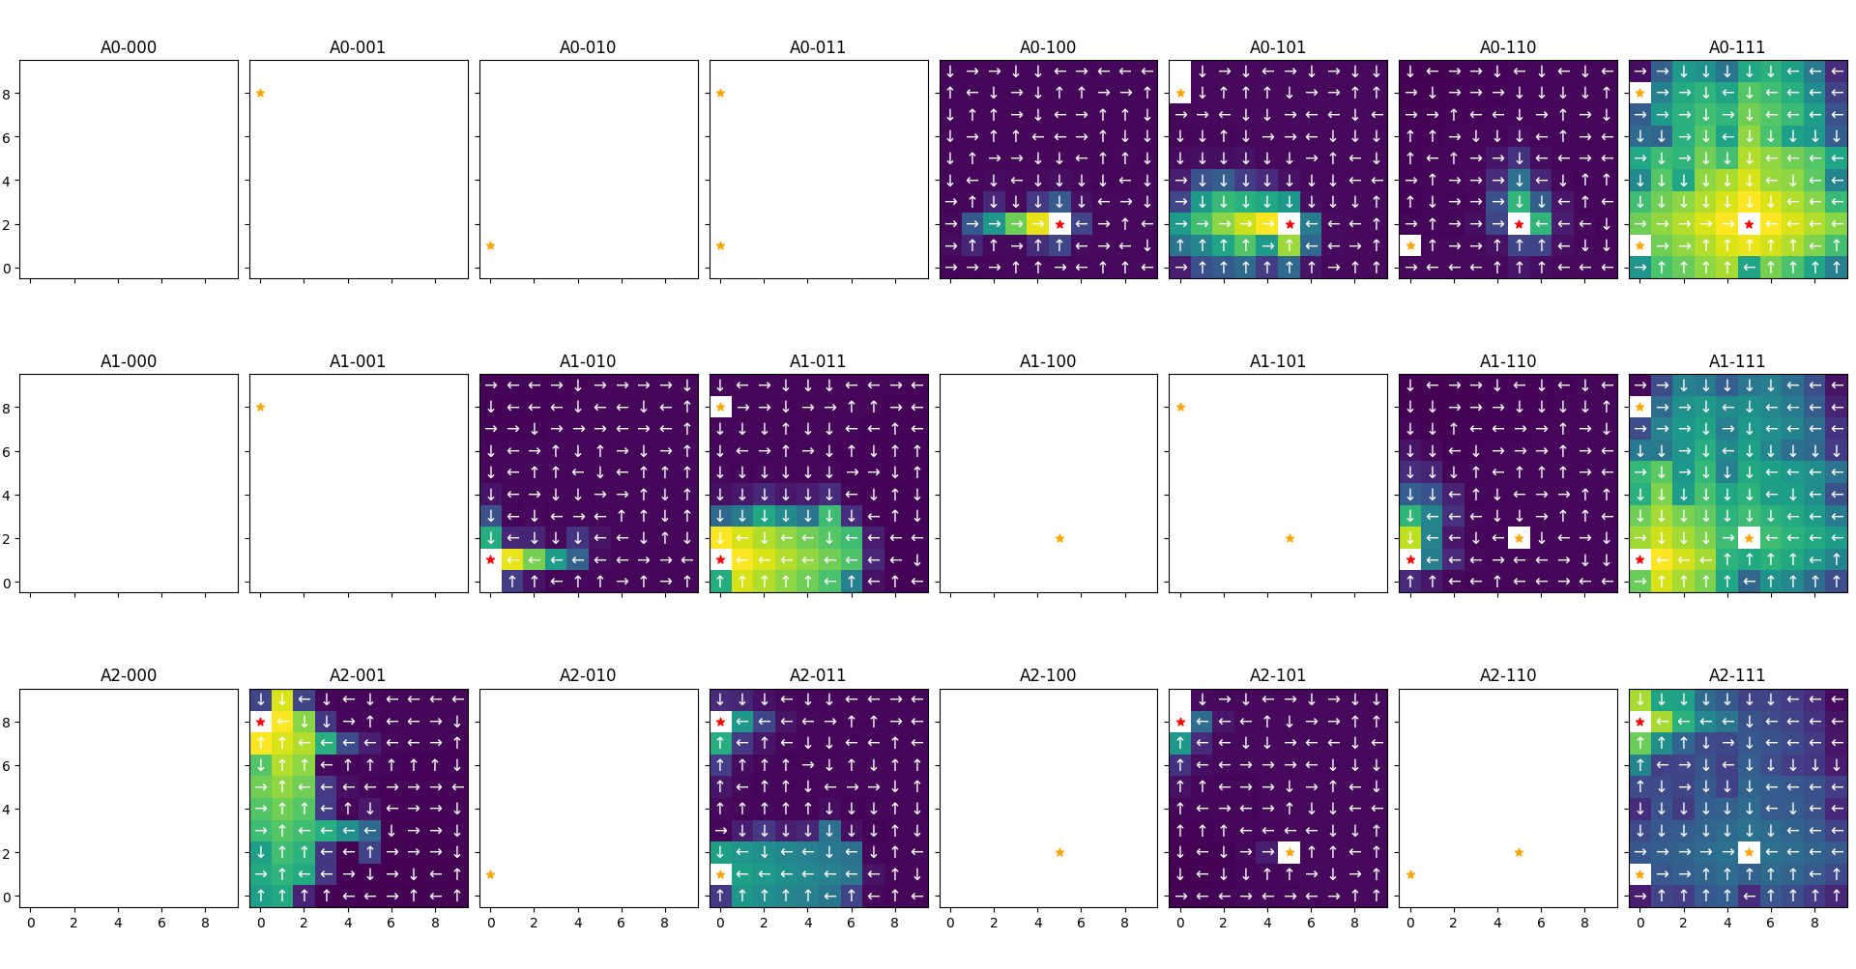
Q Function

Slide 16
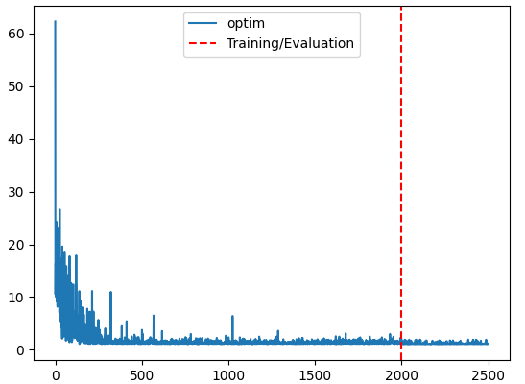
Optimality over episodes

Slide 17
Unstructured Approach
SARSA VFA with Neural Network
Features from states, previous votes, actions
feati→o-h(X) + o-h(Y) + o-h(alivesj != I) + lastVotes(actions) [+ o-h(actions)]
|feat| = width + height + (n_agents – 1) + 4 [+ 4]
NN from feat to o-h(actions)
ɑ = 1e-4 | loss = MSE | optim = SGD
SARSA was choosen as an on-policy algorithm
to prevent the deadly triad

Slide 18
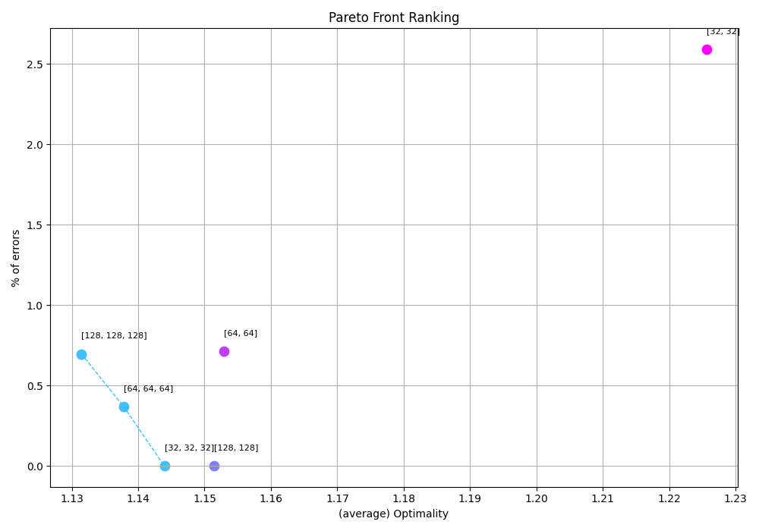
Best neural network shapes
Results averaged over 25 test per configuration
(150 tests of 2000 training and 500 evaluation episodes each)

Slide 19
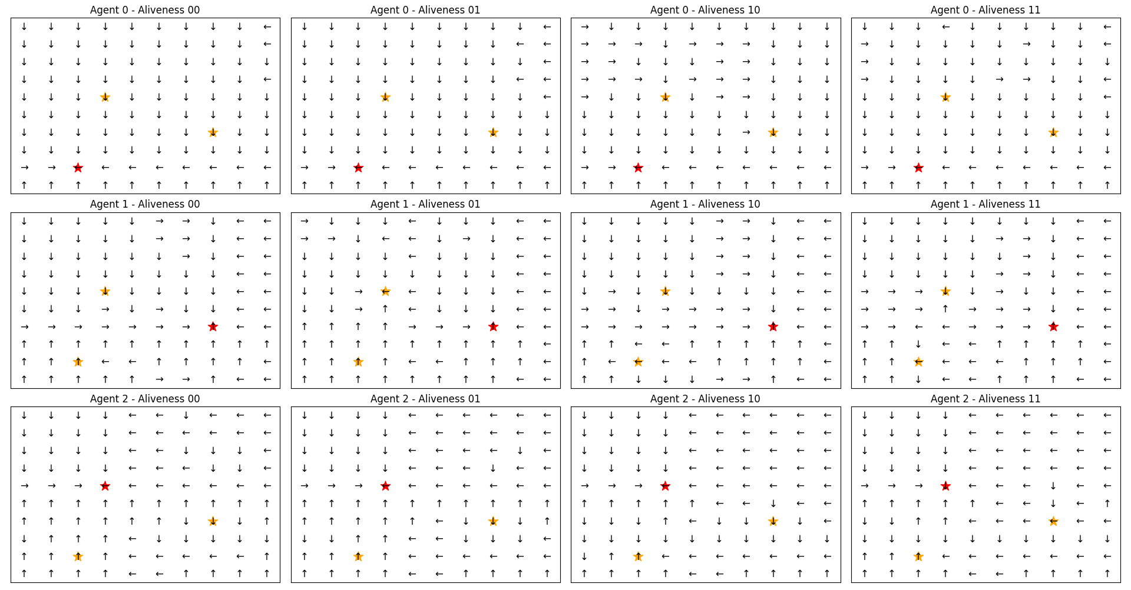
NN directions
(assuming average previous votes)

Slide 20
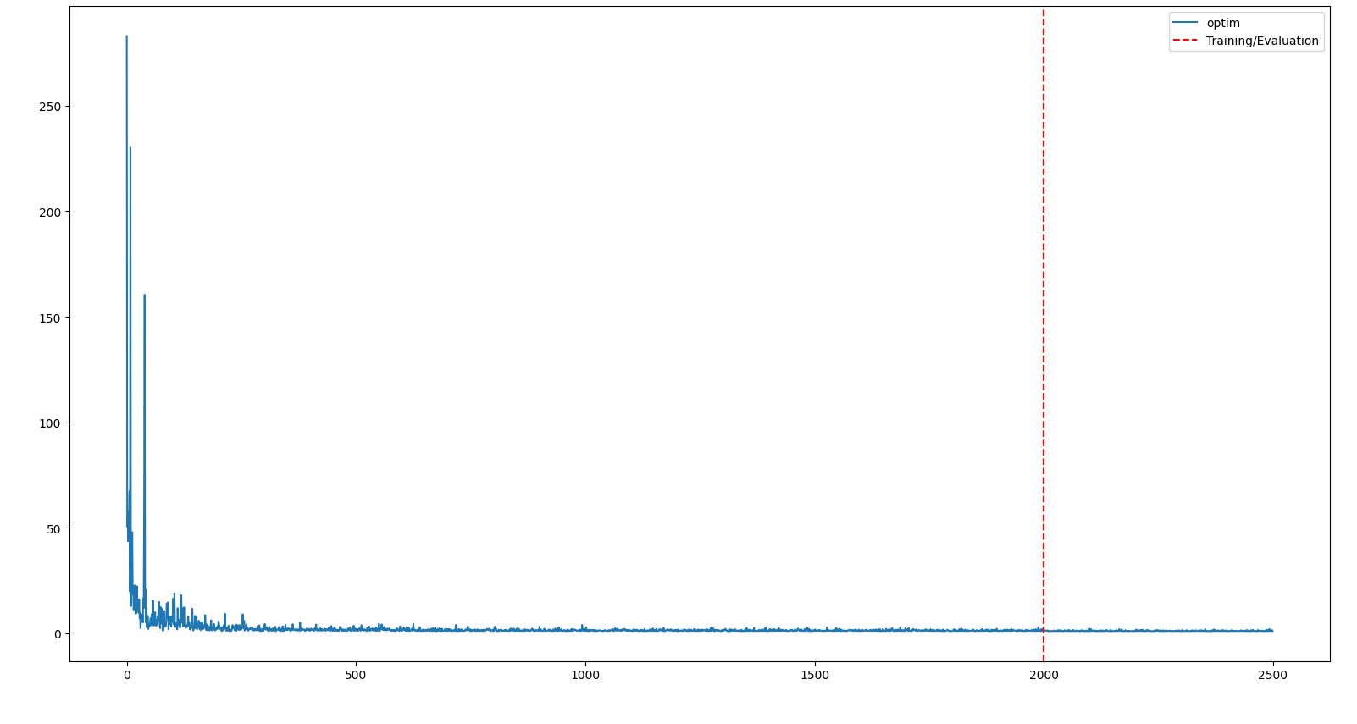
Optimality over episodes

Slide 21
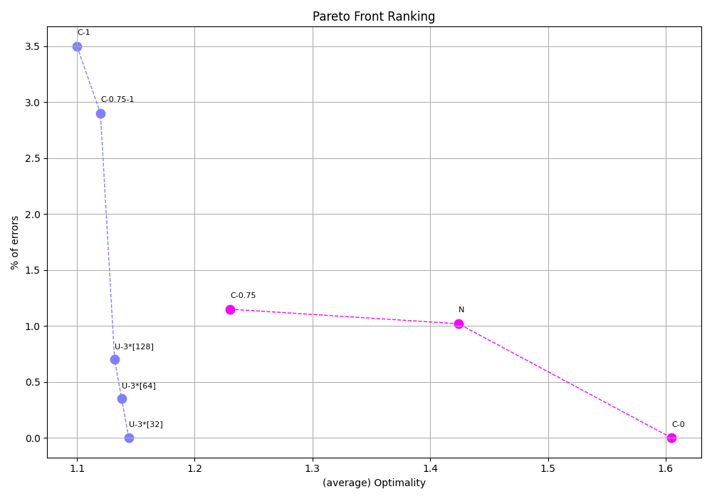
Conclusions

