Slide 1
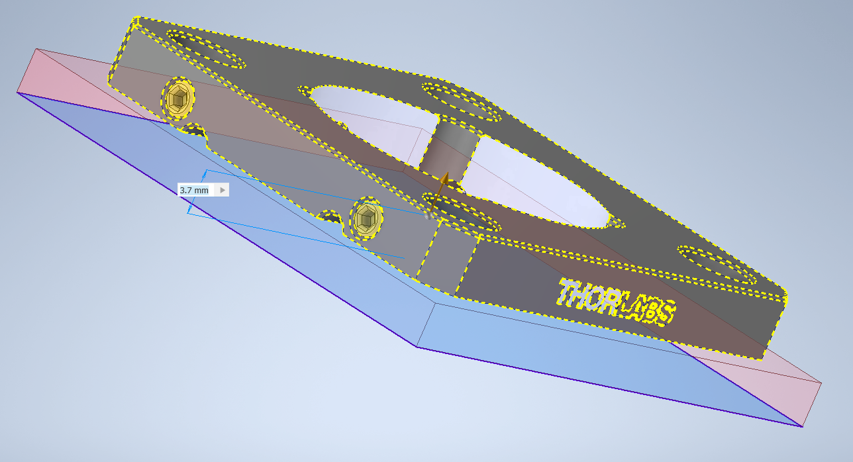
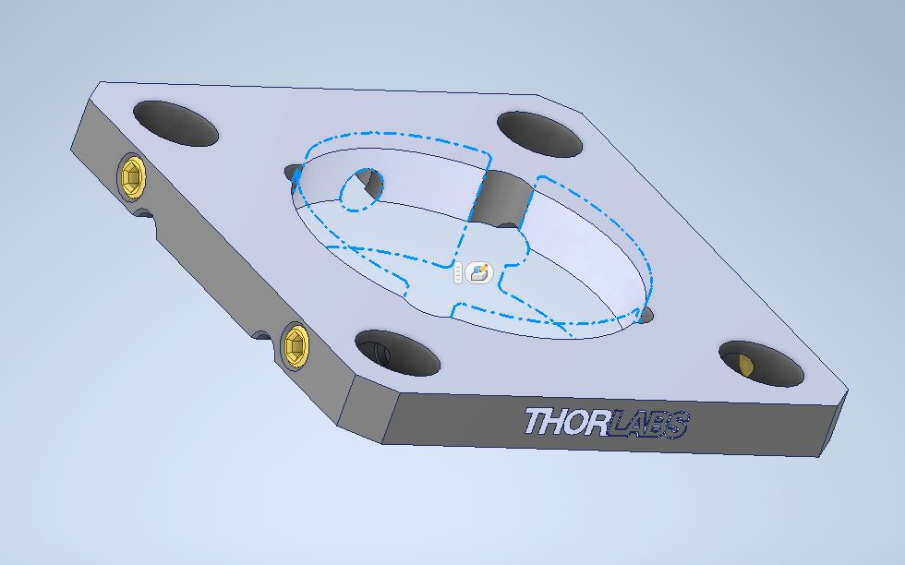
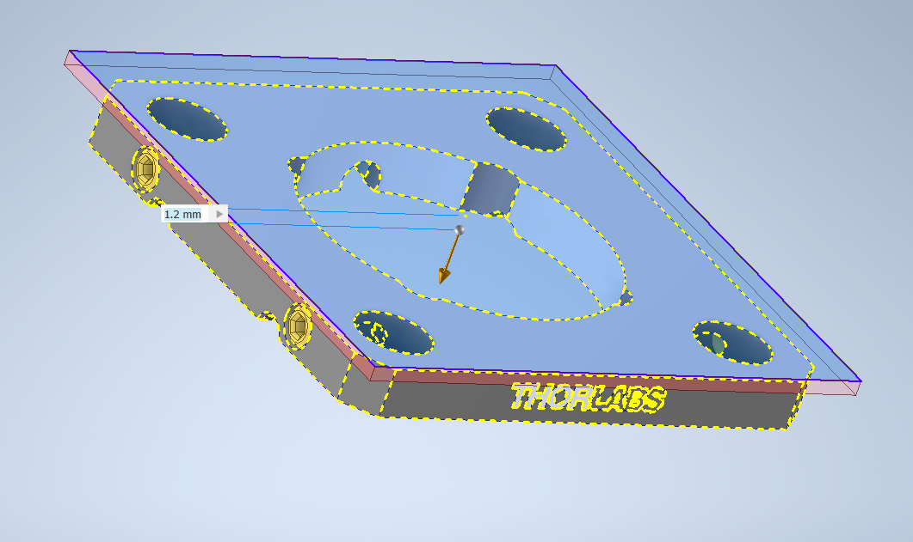
2 extrusions – 3.7 mm from bottom side
- 1.2 mm from top side
M25x0.75

