Slide 1
BJKST algorithm
BJKST algorithm
Stream Programming Project Assignment
E. Chmielewski
M.J. Błaszczak

Slide 2
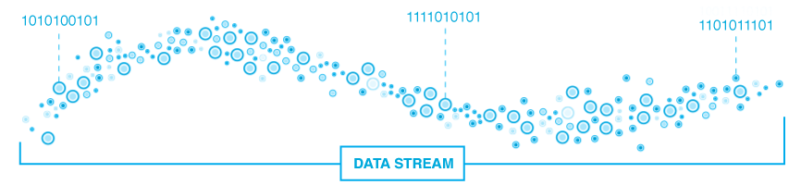
Problem – estimate a number of distinct elements
It is a measure of data dispersion (“spread out”)
Taking samples is misleading → tendency to pick frequent items
[1] “Data Stream Algorithms Lecture Notes”, Amit Chakrabarti
Fig. 1. Data stream, based on “What is data stream and how to use it”, www.onaudience.com

Slide 3
Model – vanilla streaming model
A stream with frequency vectors
Number of distinct elements in the stream
A task is to calculate for where
and an algorithm if
[1] “Data Stream Algorithms Lecture Notes”, Amit Chakrabarti

Slide 4
Algorithm 1\2 [The AMS99 “tidemark” algorithm ]
[1] “Data Stream Algorithms Lecture Notes”, Amit Chakrabarti

Slide 5
Algorithm 2\2 [The BJKST algorithm ]
“leveraged” version of the AMS99
[1] “Data Stream Algorithms Lecture Notes”, Amit Chakrabarti

Slide 6
Algorithm 2\2 [The BJKST algorithm ]
– universal constants to adjust estimation guarantee
Algorithm try to determine size of the bucket which:
      consists of all
      expectedly should fall into this bucket
      therefore estimated size of the stream is
Space complexity:
Optimality: the algorithm is close to optimal in its space usage
[1] “Data Stream Algorithms Lecture Notes”, Amit Chakrabarti

Slide 7
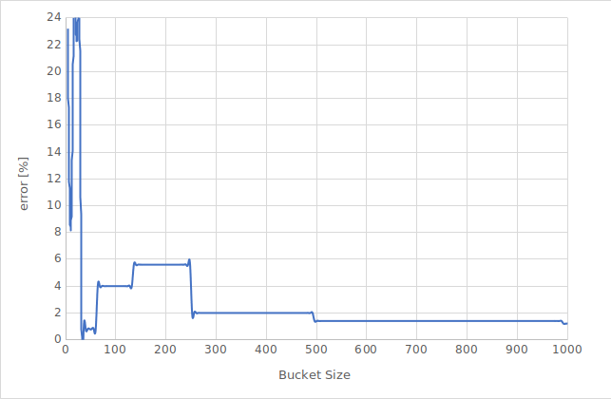
Algorithm 2\2 [The BJKST algorithm ]
unique elements: 1000
b: 10.11
epsilon: 0.5
bucket size: 4*c
[2] Results, E. Chmielewski, M.J. Błaszczak
Fig. 2. Estimation error depending on bucket size

Slide 8
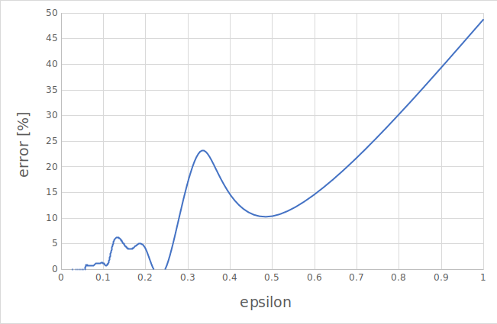
Algorithm 2\2 [The BJKST algorithm ]
unique elements: 1000
b: 10.11
c: 3.12
epsilon: 1/i
i from 1 to 50
[2] Results, E. Chmielewski, M.J. Błaszczak
Fig. 3. Estimation error depending on epsilon value

Slide 9
Thank you

