Slide 1
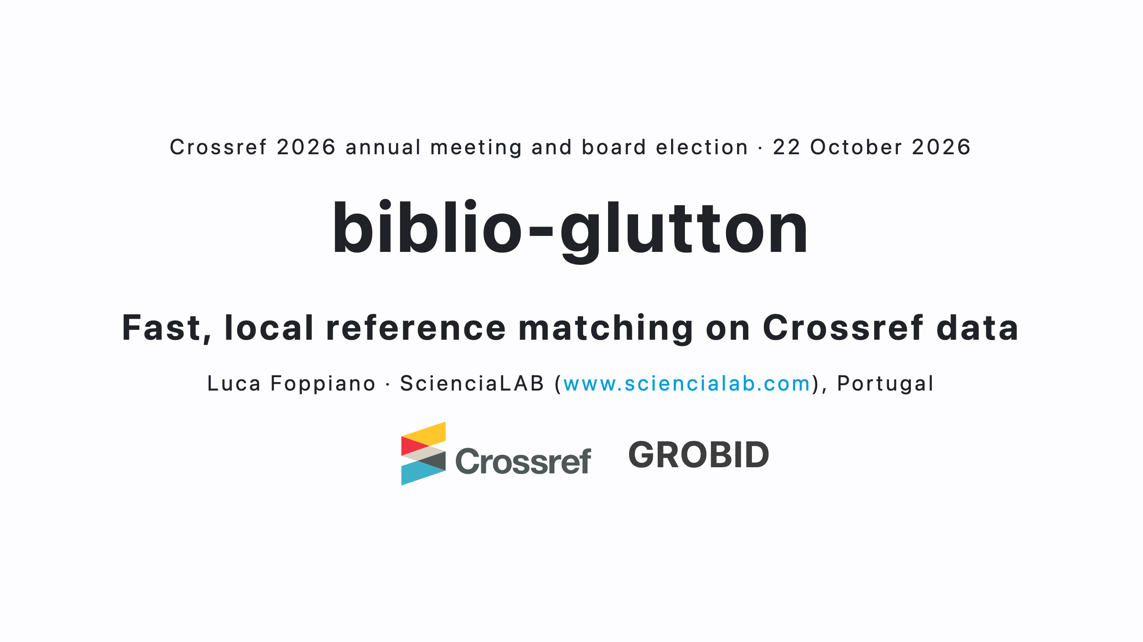
Notes:
About 1 minute.
- In a paper, a citation is just a string: authors, title, journal, year. Often abbreviated, sometimes wrong.
- Linking papers, counting citations, finding the open access copy, building knowledge graphs: all of it starts by resolving each string to a real record with a DOI.
- biblio-glutton does that resolution locally, fast and at scale.
- Outline: where the references come from (GROBID), why biblio-glutton, what it is, what we match against, the new version, future work.

Slide 2
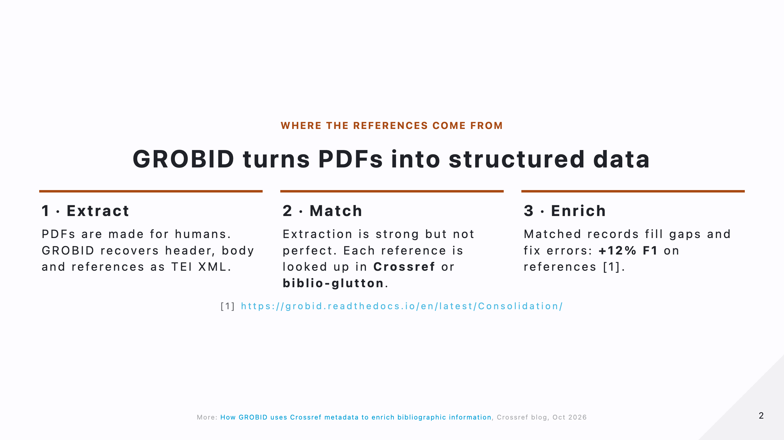
Notes:
About 1 minute.
- GROBID: open source machine learning library that reads scholarly PDFs and produces TEI XML.
- Extract: the header (title, authors, affiliations), the body, and the bibliography, with each reference split into fields: authors, title, journal, volume, pages, year.
- Match: parsing alone is not enough, the text can be wrong, abbreviated or garbled. So GROBID has a consolidation step: each reference, and the header, is checked against a metadata service.
- Out of the box that service is the public Crossref API. The alternative, the subject of this talk, is biblio-glutton, which you run yourself.
- Enrich: the matched record confirms the fields, completes them and adds the DOI: +12% F1 on references (GROBID consolidation documentation).
- More detail in the Crossref blog post of 6 October (link in the footer).

Slide 3
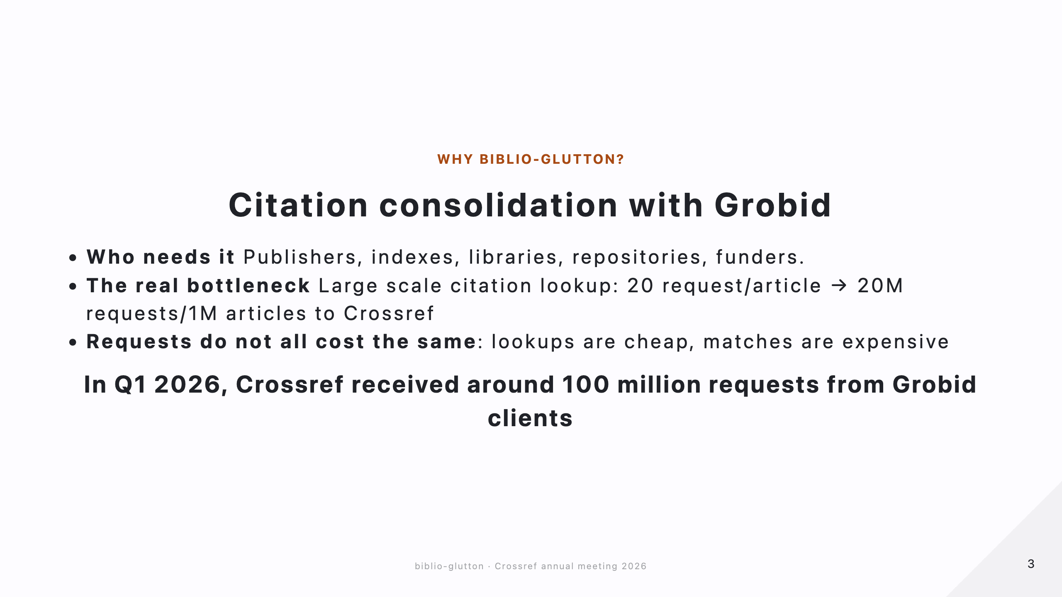
Notes:
About 1 minute.
- Who needs it: anyone turning PDFs into linked metadata: publishers, indexes, libraries, repositories, funders.
- The bottleneck is the references, not the header: one header per article, but around 20 references. 1 million articles means about 20 million requests.
- Not every request costs the same:
- lookup: "I have an identifier", a direct key read, cheap;
- match: "I have a messy citation", a search, candidate ranking and validation, expensive.
- Scale today: in Q1 2026 Crossref received around 100 million requests from GROBID clients (Crossref blog, 6 October).
- At that volume a local service makes sense: no network round trip, no rate limit, and less load on the public API.

Slide 4
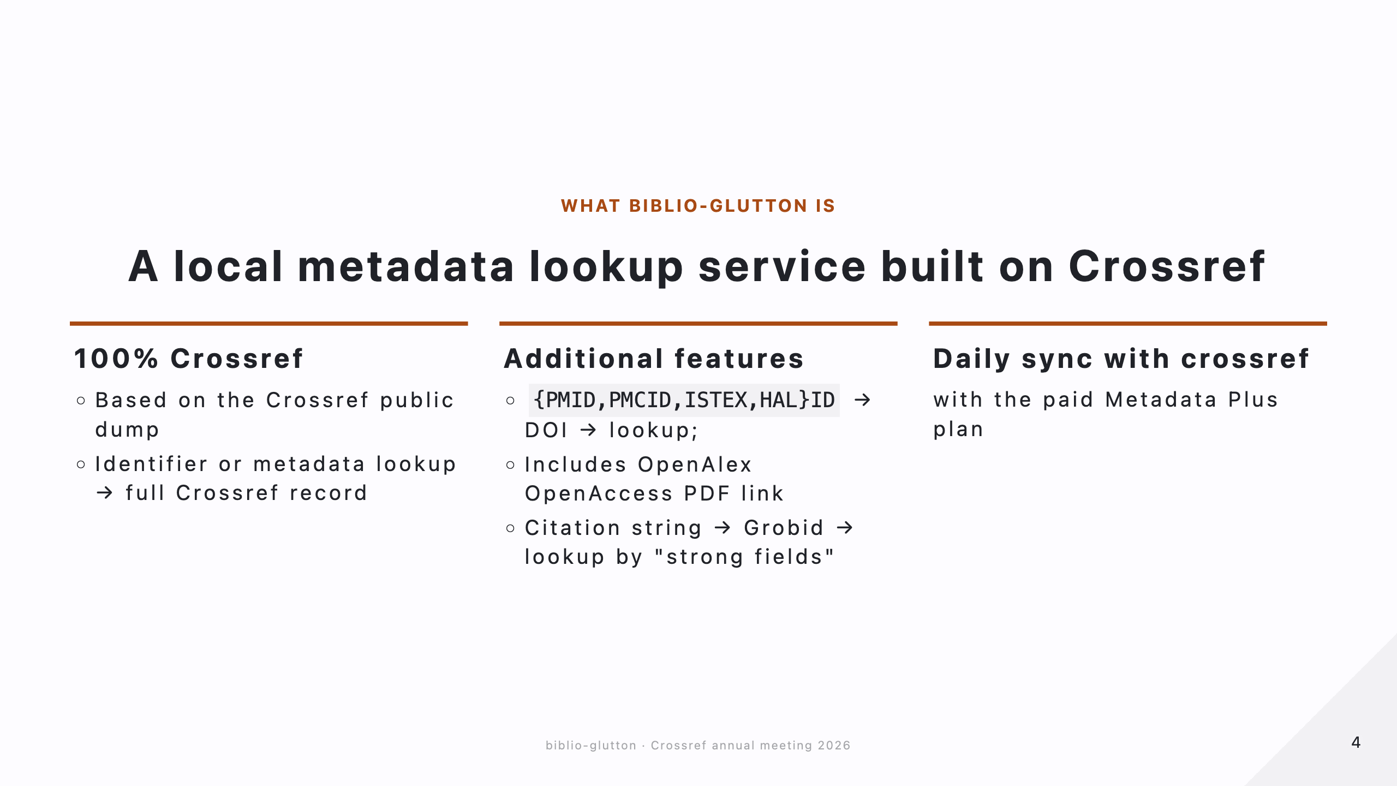
Notes:
About 1 minute.
- 100% Crossref: built from the Crossref public data dump. Give it an identifier or some metadata, get back the full Crossref record.
- How: records stored in LMDB, an embedded key-value store, so a lookup costs about a millisecond; matching goes through Elasticsearch.
- Additional features:
- PMID, PMCID, ISTEX and HAL identifiers resolve to a DOI, then to the full record; ROR identifiers resolve to the organization.
- Each record carries the open access PDF link from OpenAlex.
- A raw citation string is parsed by GROBID, then matched on "strong fields": title and first author, or journal, volume and first page.
- The best candidate is validated by string similarity; below the threshold the answer is "not found", never a wrong DOI.
- Sync: with the paid Crossref plan, daily updates keep the data current.
- Scales horizontally: more glutton servers behind a load balancer, more Elasticsearch nodes.

Slide 5
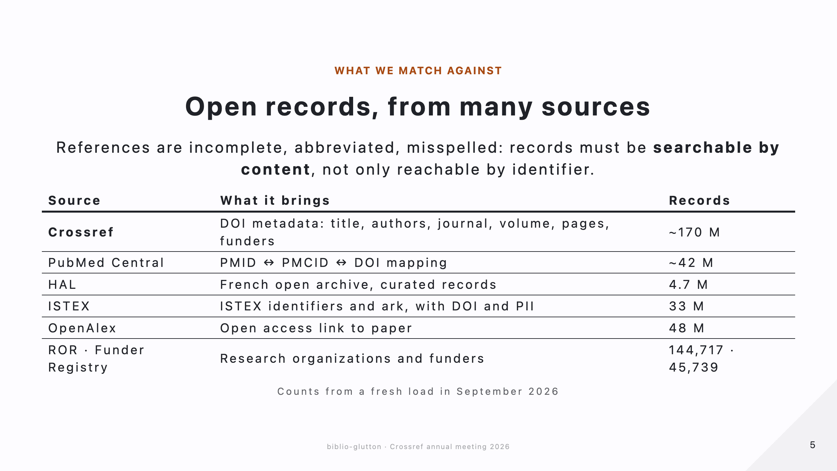
Notes:
About 1 minute.
- References are messy, so we cannot only look records up by identifier: we must search them by content (title, authors, journal). That is the difference between a key-value store and a matching service.
- Crossref is the backbone: about 170 million DOI records.
- PubMed Central: mapping between PMID, PMCID and DOI, about 42 million entries.
- HAL, the French open archive: 4.7 million curated records.
- ISTEX: the French platform for licensed publications; its identifiers and ark, linked to DOI and PII.
- OpenAlex: 48 million open access links, replacing Unpaywall.
- ROR and the Crossref Funder Registry: 144,717 organizations, 45,739 funders.
- All counts from a fresh load in September 2026.

Slide 6
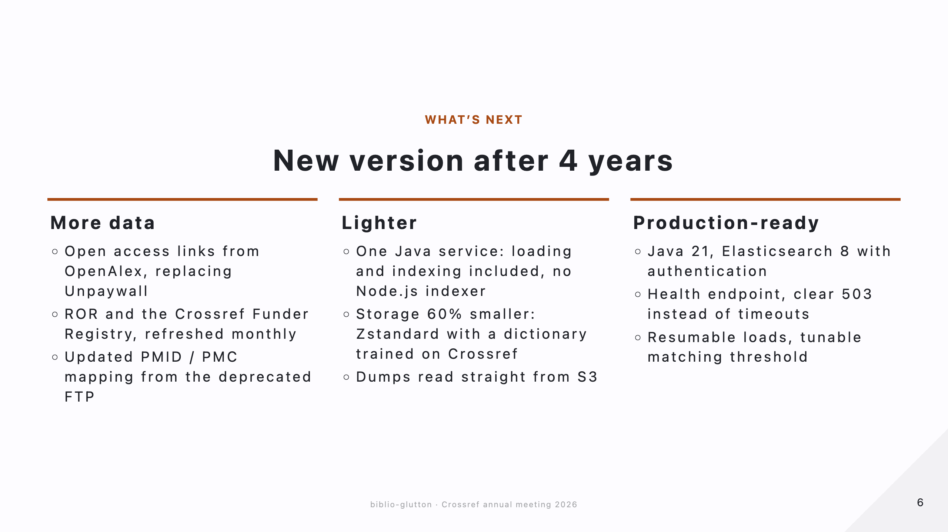
Notes:
About 1 minute.
- First new release in four years.
- More data:
- open access links from OpenAlex, replacing the old Unpaywall dump;
- organization and funder lookup from ROR and the Crossref Funder Registry, refreshed monthly;
- PMID / PMCID mapping updated, replacing the deprecated FTP source.
- Lighter:
- one Java service, loading and Elasticsearch indexing included; the previous version needed a separate Node.js indexer;
- records compressed with Zstandard and a dictionary trained on Crossref records: about 60% less storage, no measurable cost on lookups;
- dumps read straight from S3.
- Production-ready:
- Java 21, Elasticsearch 8 with authentication;
- a health endpoint, and a clear 503 when Elasticsearch is down instead of timeouts;
- loads that resume where they stopped, daily updates that always finish, a matching threshold you can tune.

Slide 7
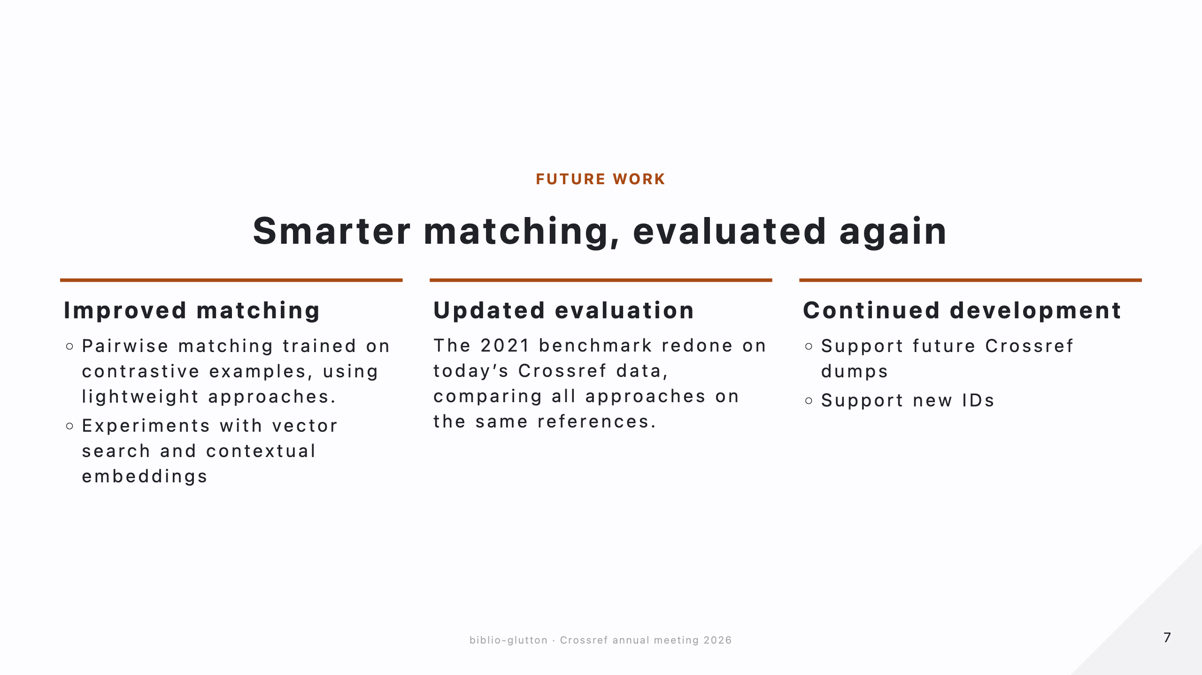
Notes:
About 1 minute.
- Improved matching:
- today the final decision is a single string-similarity threshold;
- instead, a pairwise model trained on contrastive examples (correct and incorrect reference-record pairs), kept lightweight;
- signals per candidate: title, author and journal similarity, the search score, exact match on year, volume, issue and first page;
- vector search with contextual embeddings, to find candidates that keyword search misses: abbreviated, translated or garbled titles. Still exploratory.
- Updated evaluation:
- the 2021 benchmark used 17,015 PubMed Central references and a Crossref index from September 2021 (back then: 2.7× faster than the Crossref API, F1 96.4 vs 95.7);
- redo it on today's Crossref data, all approaches on the same references, reproducible.
- Continued development: support future Crossref dumps, add new lookups as needs come up.

Slide 8
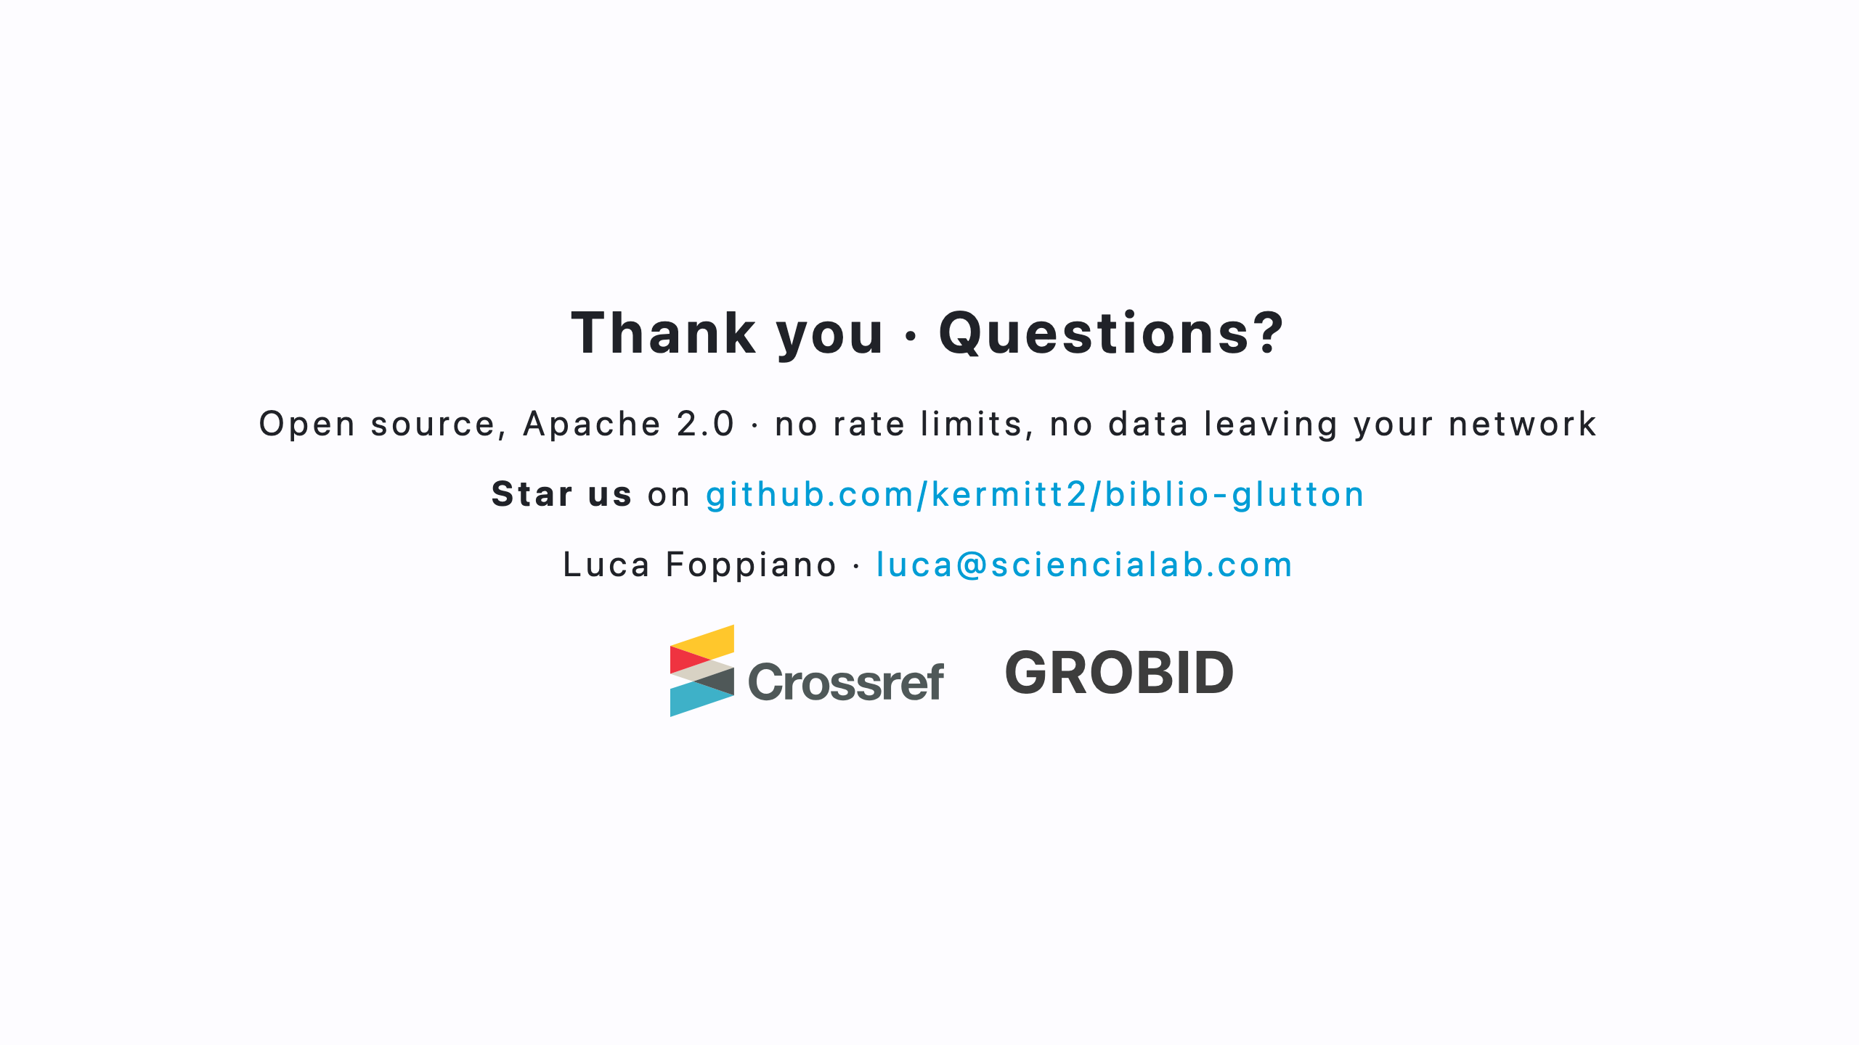
Notes:
- Open source, Apache 2.0: no rate limits, nothing leaves your network.
- Code on GitHub, a star helps; documentation at biblio-glutton.readthedocs.io.
- Thank you, happy to take questions.

