Slide 1
`timescale 1ns / 1ps
module riscv_demo (
input clk_i,
output [7:0] led_o,
input [2:0] button_i,
input uart_rx_i,
output uart_tx_o
);
wire lock_w;
wire [31:0] gpio_out_w;
soc #(
.MEM_SIZE(8192),
.FIRMWARE("../../firmware/test.mif")
) soc_i (
.clk_i(clk_i),
.reset_i(reset_r),
.lock_o(lock_w),
.uart_rx_i(uart_rx_i),
.uart_tx_o(uart_tx_o),
.gpio_in_i({ 30'h0, button_i[2:1] }),
.gpio_out_o(gpio_out_w)
);
assign led_o = gpio_out_w[7:0];
Orange color line is parameter of module.
reg [15:0] reset_cnt_r = 16'hffff;
reg reset_r = 1’b1;
always @(posedge clk_i) begin
if (0 == button_i[0]) begin
reset_r <= 1'b1;
reset_cnt_r <= 16'hffff;
end else if (reset_cnt_r > 0)
reset_cnt_r <= reset_cnt_r - 1'd1;
else
reset_r <= 0;
End
When button_i[0] is high, reset_r is always 1’b1 as it is initialized. When it is low, reset signal is triggered and then these signal is prolong after the button_i[0] is high.

Slide 2
wire [31:0] iaddr_w, irdata_w;
wire ird_w;
wire [31:0] daddr_w, dwdata_w, drdata_w;
wire [1:0] dsize_w;
wire drd_w;
wire dwr_w;
riscv_core #(
.PC_SIZE(16),
.RESET_SP(MEM_SIZE)
) core_i (
.clk_i(clk_i),
.reset_i(reset_i),
.lock_o(lock_o),
.iaddr_o(iaddr_w),
.irdata_i(irdata_w),
.ird_o(ird_w),
.daddr_o(daddr_w),
.dwdata_o(dwdata_w),
.drdata_i(drdata_w),
.dsize_o(dsize_w),
.drd_o(drd_w),
.dwr_o(dwr_w)
);

Slide 3
localparam N_SLAVES = 4;
wire [31:0] mem_addr_w, uart_addr_w, gpio_addr_w, timer_addr_w;
wire [31:0] mem_wdata_w, uart_wdata_w, gpio_wdata_w, timer_wdata_w;
wire [31:0] mem_rdata_w, uart_rdata_w, gpio_rdata_w, timer_rdata_w;
wire [1:0] mem_size_w, uart_size_w, gpio_size_w, timer_size_w;
wire mem_rd_w, uart_rd_w, gpio_rd_w, timer_rd_w;
wire mem_wr_w, uart_wr_w, gpio_wr_w, timer_wr_w;
wire mem_sel_w = (4'h0 == daddr_w[31:28]);
wire uart_sel_w = (4'h1 == daddr_w[31:28]);
wire gpio_sel_w = (4'h2 == daddr_w[31:28]);
wire timer_sel_w = (4'h3 == daddr_w[31:28]);
bus_mux #(
.N(N_SLAVES)
) bus_mux_i (
.clk_i(clk_i),
.reset_i(reset_i),
.ss_i({ mem_sel_w, uart_sel_w, gpio_sel_w, timer_sel_w }),
.m_addr_i(daddr_w),
.m_wdata_i(dwdata_w),
.m_rdata_o(drdata_w),
.m_size_i(dsize_w),
.m_rd_i(drd_w),
.m_wr_i(dwr_w),
.s_addr_o({ mem_addr_w, uart_addr_w, gpio_addr_w, timer_addr_w }),
.s_wdata_o({ mem_wdata_w, uart_wdata_w, gpio_wdata_w, timer_wdata_w }),
.s_rdata_i({ mem_rdata_w, uart_rdata_w, gpio_rdata_w, timer_rdata_w }),
.s_size_o({ mem_size_w, uart_size_w, gpio_size_w, timer_size_w }),
.s_rd_o({ mem_rd_w, uart_rd_w, gpio_rd_w, timer_rd_w }),
.s_wr_o({ mem_wr_w, uart_wr_w, gpio_wr_w, timer_wr_w })
);

Slide 4
memory #(
.SIZE(MEM_SIZE),
.FIRMWARE(FIRMWARE)
) memory_i (
.clk_i(clk_i),
.reset_i(reset_i),
.iaddr_i(iaddr_w),
.irdata_o(irdata_w),
.ird_i(ird_w),
.daddr_i(mem_addr_w),
.dwdata_i(mem_wdata_w),
.drdata_o(mem_rdata_w),
.dsize_i(mem_size_w),
.drd_i(mem_rd_w),
.dwr_i(mem_wr_w)
);
per_uart per_uart_i (
.clk_i(clk_i),
.reset_i(reset_i),
.addr_i(uart_addr_w),
.wdata_i(uart_wdata_w),
.rdata_o(uart_rdata_w),
.size_i(uart_size_w),
.rd_i(uart_rd_w),
.wr_i(uart_wr_w),
.uart_rx_i(uart_rx_i),
.uart_tx_o(uart_tx_o)
);
per_gpio per_gpio_i (
.clk_i(clk_i),
.reset_i(reset_i),
.addr_i(gpio_addr_w),
.wdata_i(gpio_wdata_w),
.rdata_o(gpio_rdata_w),
.size_i(gpio_size_w),
.rd_i(gpio_rd_w),
.wr_i(gpio_wr_w),
.gpio_in_i(gpio_in_i),
.gpio_out_o(gpio_out_o)
);
per_timer per_timer_i (
.clk_i(clk_i),
.reset_i(reset_i),
.addr_i(timer_addr_w),
.wdata_i(timer_wdata_w),
.rdata_o(timer_rdata_w),
.size_i(timer_size_w),
.rd_i(timer_rd_w),
.wr_i(timer_wr_w)
);

Slide 5
Memory
memory #(
.SIZE(MEM_SIZE),
.FIRMWARE(FIRMWARE)
) memory_i (
.clk_i(clk_i),
.reset_i(reset_i),
.iaddr_i(iaddr_w),
.irdata_o(irdata_w),
.ird_i(ird_w),
.daddr_i(mem_addr_w),
.dwdata_i(mem_wdata_w),
.drdata_o(mem_rdata_w),
.dsize_i(mem_size_w),
.drd_i(mem_rd_w),
.dwr_i(mem_wr_w)
);
`timescale 1ns / 1ps
module memory #(
parameter SIZE = 8192,
parameter FIRMWARE = ""
)(
input clk_i,
input reset_i,
input [31:0] iaddr_i,
output [31:0] irdata_o,
input ird_i,
input [31:0] daddr_i,
input [31:0] dwdata_i,
output [31:0] drdata_o,
input [1:0] dsize_i,
input drd_i,
input dwr_i
);
//-----------------------------------------------------------------------------
localparam
SIZE_BYTE = 2'd0,
SIZE_HALF = 2'd1,
SIZE_WORD = 2'd2;
localparam
DEPTH = $clog2(SIZE);
//-----------------------------------------------------------------------------
wire [31:0] dwdata_w =
(SIZE_BYTE == dsize_i) ? {4{dwdata_i[7:0]}} :
(SIZE_HALF == dsize_i) ? {2{dwdata_i[15:0]}} : dwdata_i; //arrange dwdata with Size
wire [3:0] dbe_byte_w =
(2'b00 == daddr_i[1:0]) ? 4'b0001 :
(2'b01 == daddr_i[1:0]) ? 4'b0010 :
(2'b10 == daddr_i[1:0]) ? 4'b0100 : 4'b1000;
//re arrange from 0 ~ 2 to 1 ~ 3
wire [3:0] dbe_half_w =
daddr_i[1] ? 4'b1100 : 4'b0011;
wire [3:0] dbe_w =
(SIZE_BYTE == dsize_i) ? dbe_byte_w :
(SIZE_HALF == dsize_i) ? dbe_half_w : 4'b1111;
wire [7:0] rdata_byte_w =
(2'b00 == daddr_r) ? drdata_w[7:0] :
(2'b01 == daddr_r) ? drdata_w[15:8] :
(2'b10 == daddr_r) ? drdata_w[23:16] : drdata_w[31:24]; //read a byte position select
wire [15:0] rdata_half_w =
daddr_r[1] ? drdata_w[31:16] : drdata_w[15:0];
//select 앞에 것 16비트를 취할지, 뒤 16비트를 취할지.
assign drdata_o =
(SIZE_BYTE == dsize_r) ? { 24'h0, rdata_byte_w } :
(SIZE_HALF == dsize_r) ? { 16'h0, rdata_half_w } : drdata_w;
//-----------------------------------------------------------------------------
reg [1:0] daddr_r;
reg [1:0] dsize_r;
always @(posedge clk_i) begin
if (reset_i) begin
daddr_r <= 2'b00;
dsize_r <= SIZE_BYTE;
end else begin
daddr_r <= daddr_i[1:0];
dsize_r <= dsize_i;
end
end
//-----------------------------------------------------------------------------
wire [31:0] drdata_w;
altsyncram altsyncram_i (
.clock0(clk_i),
.aclr0 (reset_i),
.address_a(iaddr_i[31:2]),
.data_a(32'h0),
.rden_a(ird_i),
.wren_a(1'b0),
.q_a(irdata_o),
.address_b(daddr_i[31:2]),
.byteena_b(dbe_w),
.data_b(dwdata_w),
.rden_b(drd_i),
.wren_b(dwr_i),
.q_b(drdata_w),
.aclr1(1'b0),
.addressstall_a(1'b0),
.addressstall_b(1'b0),
.byteena_a(1'b1),
.clock1(1'b1),
.clocken0(1'b1),
.clocken1(1'b1),
.clocken2(1'b1),
.clocken3(1'b1),
.eccstatus()
);
defparam
altsyncram_i.address_reg_b = "CLOCK0",
altsyncram_i.byteena_reg_b = "CLOCK0",
altsyncram_i.byte_size = 8,
altsyncram_i.clock_enable_input_a = "BYPASS",
altsyncram_i.clock_enable_input_b = "BYPASS",
altsyncram_i.clock_enable_output_a = "BYPASS",
altsyncram_i.clock_enable_output_b = "BYPASS",
altsyncram_i.indata_reg_b = "CLOCK0",
altsyncram_i.init_file = FIRMWARE,
altsyncram_i.intended_device_family = "MAX 10",
altsyncram_i.lpm_type = "altsyncram",
altsyncram_i.numwords_a = SIZE / 4,
altsyncram_i.numwords_b = SIZE / 4,
altsyncram_i.operation_mode = "BIDIR_DUAL_PORT",
altsyncram_i.outdata_aclr_a = "CLEAR0",
altsyncram_i.outdata_aclr_b = "CLEAR0",
altsyncram_i.outdata_reg_a = "UNREGISTERED", // "CLOCK0"
altsyncram_i.outdata_reg_b = "UNREGISTERED", // "CLOCK0"
altsyncram_i.power_up_uninitialized = "FALSE",
altsyncram_i.ram_block_type = "M9K",
altsyncram_i.read_during_write_mode_mixed_ports = "DONT_CARE",
altsyncram_i.read_during_write_mode_port_a = "NEW_DATA_WITH_NBE_READ",
altsyncram_i.read_during_write_mode_port_b = "NEW_DATA_WITH_NBE_READ",
altsyncram_i.widthad_a = DEPTH,
altsyncram_i.widthad_b = DEPTH,
altsyncram_i.width_a = 32,
altsyncram_i.width_b = 32,
altsyncram_i.width_byteena_a = 1,
altsyncram_i.width_byteena_b = 4,
altsyncram_i.wrcontrol_wraddress_reg_b = "CLOCK0";
endmodule

Slide 6
Memory
altsyncram altsyncram_i (
.clock0(clk_i),
.aclr0 (reset_i),
.address_a(iaddr_i[31:2]),
.data_a(32'h0),
.rden_a(ird_i),
.wren_a(1'b0),
.q_a(irdata_o),
.address_b(daddr_i[31:2]),
.byteena_b(dbe_w),
.data_b(dwdata_w),
.rden_b(drd_i),
.wren_b(dwr_i),
.q_b(drdata_w),
.aclr1(1'b0),
.addressstall_a(1'b0),
.addressstall_b(1'b0),
.byteena_a(1'b1),
.clock1(1'b1),
.clocken0(1'b1),
.clocken1(1'b1),
.clocken2(1'b1),
.clocken3(1'b1),
.eccstatus()
);

Slide 7
CORE
localparam
ALU_ADD = 4'd0,
ALU_SUB = 4'd1,
ALU_AND = 4'd2,
ALU_OR = 4'd3,
ALU_XOR = 4'd4,
ALU_SLT = 4'd5,
ALU_SLTU = 4'd6,
ALU_SHL = 4'd7,
ALU_SHR = 4'd8,
ALU_MULL = 4'd9,
ALU_MULH = 4'd10,
ALU_DIV = 4'd11,
ALU_REM = 4'd12,
ALU_NPC = 4'd13;
localparam
BR_NONE = 3'd0,
BR_JUMP = 3'd1,
BR_EQ = 3'd2,
BR_NE = 3'd3,
BR_LT = 3'd4,
BR_GE = 3'd5,
BR_LTU = 3'd6,
BR_GEU = 3'd7;
localparam
SIZE_BYTE = 2'd0,
SIZE_HALF = 2'd1,
SIZE_WORD = 2'd2;
localparam
ST_RESET = 2'd0,
ST_LOW = 2'd1,
ST_HIGH = 2'd2,
ST_UNALIGNED = 2'd3;

Slide 8
CORE
/*- Instruction Fetch State Machine -----------------------------------------*/
reg [1:0] if_state_r;
reg [15:0] if_buf_r;
always @(posedge clk_i) begin
if (reset_i) begin
if_state_r <= ST_RESET;
if_buf_r <= 16'h0;
end else if (branch_taken_w) begin
if_state_r <= jump_addr_w[1] ? ST_HIGH : ST_LOW;
end else if (id_exec_w)
case (if_state_r)
ST_RESET: begin
if_state_r <= ST_LOW;
end
ST_LOW: begin
if (if_lo_is_rvc_w && if_hi_is_rvc_w) begin
if_state_r <= ST_HIGH;
end else if (if_lo_is_rvc_w && if_hi_is_rv_w) begin
if_state_r <= ST_UNALIGNED;
if_buf_r <= irdata_i[31:16];
end
end
ST_HIGH: begin
if (if_hi_is_rv_w) begin // Only possible after a branch
if_state_r <= ST_UNALIGNED;
if_buf_r <= irdata_i[31:16];
end else begin
if_state_r <= ST_LOW;
end
end
ST_UNALIGNED: begin
if (if_hi_is_rv_w)
if_buf_r <= irdata_i[31:16];
else
if_state_r <= ST_HIGH;
end
endcase
end

Slide 9
CORE
/*- Address Counter ---------------------------------------------------------*/
reg [PC_SIZE-1:2] if_addr_r;
always @(posedge clk_i) begin
if (reset_i)
if_addr_r <= 'h0;
else if (ird_o)
if_addr_r <= if_next_addr_w + 'd1;
else if (branch_taken_w)
if_addr_r <= jump_addr_w[PC_SIZE-1:2];
end
wire [PC_SIZE-1:2] if_next_addr_w =
branch_taken_w ? jump_addr_w[PC_SIZE-1:2] : if_addr_r;
다음 엑세스할 주소가 바로 옆 번지인지, 또는 다른 위치의 번지인지를 알아서 처리
Ird_o가 1일 때, 그 다음 번지를 페치.
Ird_o가 0이고, branch_taken_w가 high일 때, 다른 위치를 페치

Slide 10
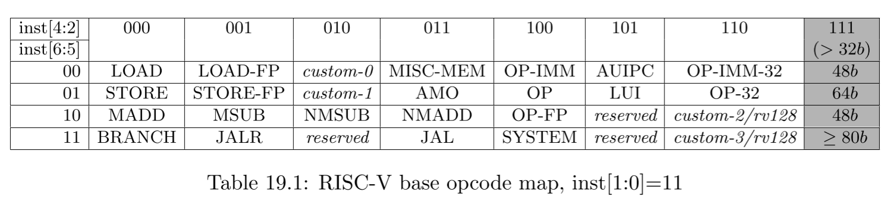






Instruction decoder
wire op_branch_w
wire op_load_w
wire op_store_w
wire op_alu_imm_w;
wire op_alu_reg_w
wire op_f7_main_w
wire op_f7_alt_w
wire op_f7_mul_w
= (7'b1100011 == op_w); = (7'b0000011 == op_w); = (7'b0100011 == op_w);
= (7'b0010011 == op_w); = (7'b0110011 == op_w); = (7'b0000000 == f7_w); = (7'b0100000 == f7_w); = (7'b0000001 == f7_w);
Opcodes with the lower two bits set correspond to instructions wider than 16 bits, including those in the base ISAs

Slide 11
Multiplier
wire mul_div_negative_w = (id_a_signed_r && id_ra_value_r[31]) ^ (id_b_signed_r && id_rb_value_r[31]);
‘*’와’/＇연산에서 결과가 음수가 나오는 경우를 나타내는 것. 둘이 서로 다른 부호일 때 1(결과마이너스)
wire [31:0] mul_div_a_w = (id_a_signed_r && id_ra_value_r[31]) ? -id_ra_value_r : id_ra_value_r;
wire [31:0] mul_div_b_w = (id_b_signed_r && id_rb_value_r[31]) ? -id_rb_value_r : id_rb_value_r;
연산할 데이터가 signed이면서, 부호 비트가 1인 경우(즉 signed일 때 마이너스)
알고리즘 이해에 도움이 되는 식 몇가지를 언급하면
5*4=5*(2+2)=5<<2
5*5=5*(4+1)
=5<<2+5<<1
always @(posedge clk_i) begin
if (reset_i) begin
mul_busy_r <= 1'b0;
mul_ready_r <= 1'b0;
mul_count_r <= 5'd0;
mul_res_r <= 64'h0;
end else begin
if (mul_busy_r) begin →지금 mul연산 중인 상태.(즉 busy상태)
mul_count_r <= mul_count_r - 5'd1;
mul_res_r <= { mul_sum_w, mul_res_r[31:1]
if (mul_count_r == 5'd0) begin
mul_busy_r <= 1'b0;
mul_ready_r <= 1'b1; →Multiply연산이 끝났으니, mul_res_r값이 Valid한 상태를 나타내는 펄스..
end (바로 다음 clock에서 0으로 죽음에 유의)
end else if (mul_ready_r) begin →mul_ready_r은 a pulse임.
mul_ready_r <= 1'b0;
end else if (mul_request_w) begin→mul_request가 트리거되면, mul_busy_r을 SET하여, 다음 클럭
mul_count_r <= 5'd31; 펄스에서 부터 윗 IF가 작동..
mul_busy_r <= 1'b1;
mul_res_r <= { 32'h0, mul_div_a_w }; 초기 result_r값으로 mul_div_a_w값을 Assign
end2
end
end
wire mul_request_w = (ALU_MULL == id_alu_op_r || ALU_MULH == id_alu_op_r);
→이부분이 좀더 공부가 필요한데, 아마 CPU 제어 신호가 아닐까 생각이 듬.
wire [32:0] mul_sum_w = { 1'b0, mul_res_r[63:32] } + { 1'b0, mul_res_r[0] ? mul_div_b_w : 32'h0 };
mul_res_r의 32비트 서부터 63비트 까지 값(즉 mul_sum_w에 해당하는 값)과 0번 째 비트 값을 따져서 mul_div_b_w를 더함
근데 좀 이해가 가지 않는 것이. 값 A번 만큼 값 B를 여러 번 더해야 하는 것 아닌가? 이 것 대로라면
값 A를 쉬프트해가며 마지막 비트가 1일 경우에만 B를 더하라는 것이 되기 떄문에, A*B가 아니라 A가 가지는 1의 비트들의 숫자 번 B를 더한 것이 되는데..

Slide 12
Multiplier Algorithm
0100
0101
always @(posedge clk_i) begin
if (mul_busy_r) begin
mul_count_r <= mul_count_r - 5'd1;
mul_res <= { mul_sum, mul_res[31:1] }
end else if (mul_request_w) begin
mul_count_r <= 5'd31..
mul_busy_r <= 1'b1;
mul_res <= { 32'h0, mul_A };
end
end
end
wire [32:0] mul_sum = { 1'b0, mul_res[63:32] } + { 1'b0, mul_res[0] ? mul_B : 32'h0 };
1?
Shift>>1

Slide 13
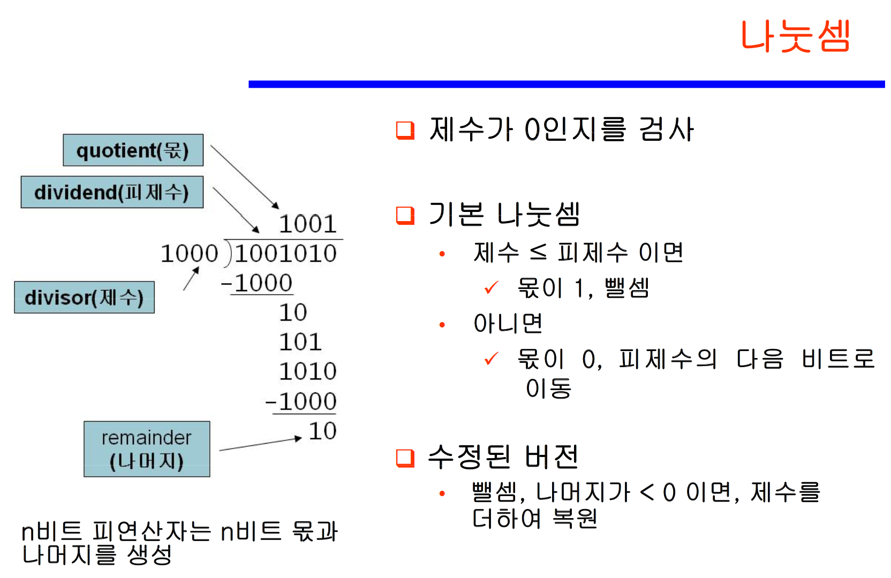
Divider
/*- Divider -----------------------------------------------------------------*/ div_a =1010, div_b=011
wire [32:0] sub = { 1'b0, rem[30:0], quot[31] } - { 1'b0, div_b };
wire [31:0] quotient = mul_div_negative_w ? -quot : quot;
wire [31:0] remainder = mul_div_negative_w ? -rem : rem;
always @(posedge clk_i) begin
end else begin
if (busy) begin
count <= count - 1;
quot <= { quot[30:0], !sub[32] }; 첨에 1000빼도 양수니까 1111… 나올텐데
어차피 위에서 보수 취하면 제대로 된 값 나올듯.
if (sub[32])⬅이거 Hoxy? Sign비트인가?
rem<= { rem[30:0], quot[31] }; 짜잔! 복원
else
rem <= sub[31:0]; sub의 본질은 결국 나머지에서
Devisor를 뺀 것을 다시 나머지에 저장하는 것
end else if (request) begin
count <= 5'd31;
busy <= 1'b1;
quot <=div_A;
rem <= 32'h0;
end
end
End;
Div_b를 빼서 음수면 즉, 부호비트가 1이면!
복원.

Slide 14
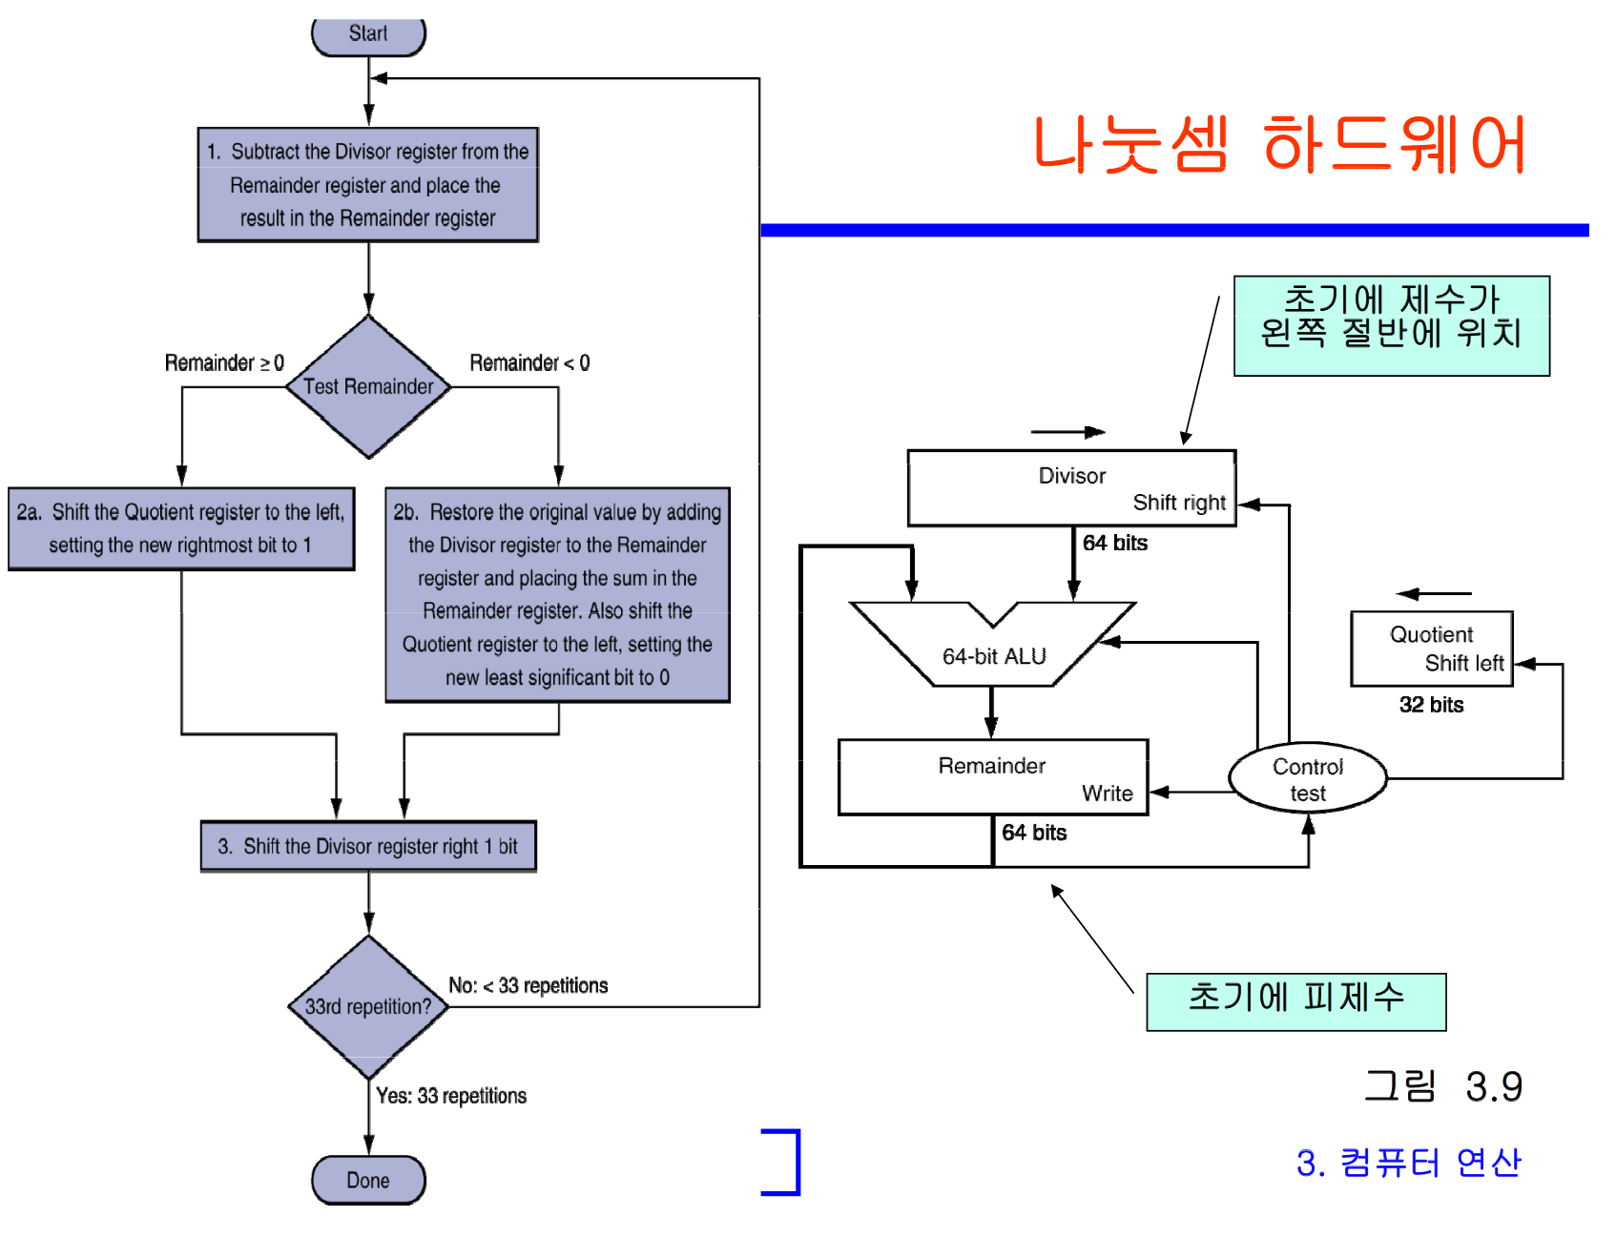
Divider
Div_b를 빼서 음수면 즉, 부호비트가 1이면!
복원.
/*- Divider -----------------------------------------------------------------*/ div_a =1010, div_b=011
wire [32:0] sub = { 1'b0, rem[30:0], quot[31] } - { 1'b0, div_b };
wire [31:0] quotient = mul_div_negative_w ? -quot : quot;
wire [31:0] remainder = mul_div_negative_w ? -rem : rem;
always @(posedge clk_i) begin
end else begin
if (busy) begin
count <= count - 1;
quot <= { quot[30:0], !sub[32] }; left-shift!-
if (sub[32])⬅이거 Hoxy? Sign비트인가?
rem<= { rem[30:0], quot[31] }; 짜잔! 복원
else
rem <= sub[31:0]; sub의 본질은 결국 나머지에서
Devisor를 뺀 것을 다시 나머지에 저장하는 것
end else if (request) begin
count <= 5'd31;
busy <= 1'b1;
quot <=div_A;
rem <= 32'h0;
end
end
End;

Slide 15
irdata_w
drdata_w
RISCV_CORE
Lock_o
Iaddr_w
Ird_w
Daddr_w
Dwdata_w
Dsize_w
Drd_w
Dwr_w

