Slide 1
Device Memory TCP 를 통한 효율적인 데이터 전송
발표자: 문연수

Slide 2
Host Memory
NIC
HDD / SSD
packet

Slide 3
Host Memory
NIC
HDD / SSD
packet

Slide 4
CPU
PCIe
switch
NIC
GPU
HDD / SSD

Slide 5
Requirements
NIC
Header split
Flow steering
RSS
GPU
dmabuf interface
System
page pool

Slide 6
NIC Setup
# enable header split
ethtool –G eth1 tcp-data-split on
# enable flow steering
ethtool –K eth1 ntuple on
# set RSS
ethtool –set-rxfh-indir eth1 equal 15
ethtool -N eth1 flow-type tcp4 ... queue 15

Slide 7
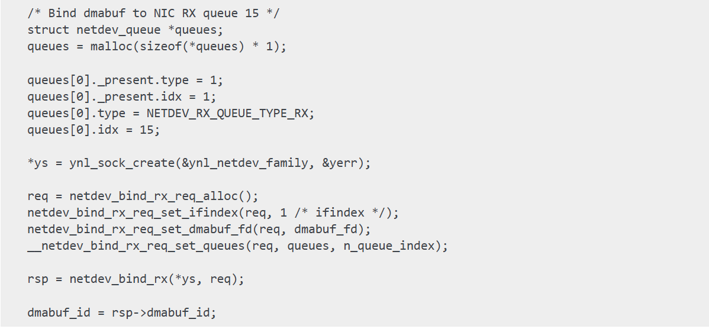
RX Side Programming #1. netlink configure

Slide 8
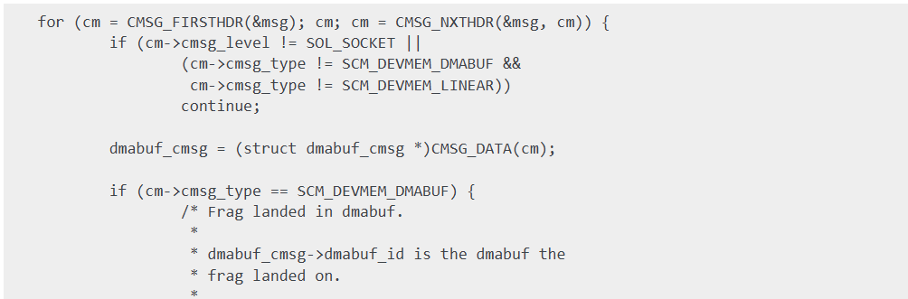
RX Side Programming #2. recvmsg()

Slide 9
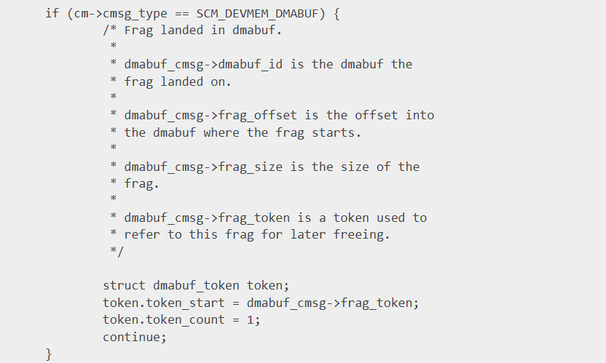
RX Side Programming #2. recvmsg()

Slide 10

RX Side Programming #3. setsockopt()

Slide 11
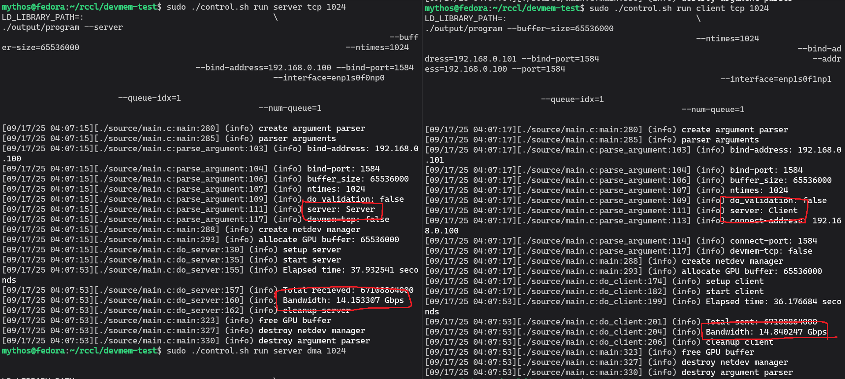
Profiling # 1. TCP/IP

Slide 12
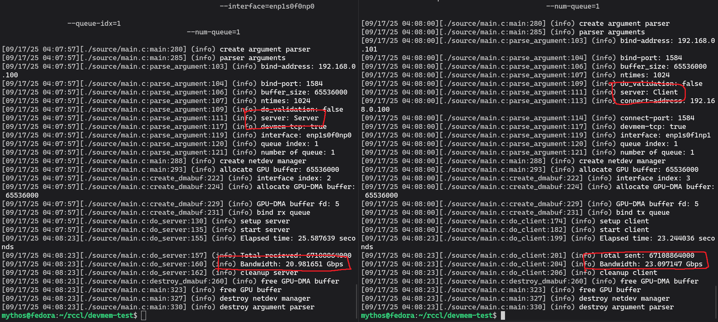
Profiling # 2. devmem tcp

Slide 13
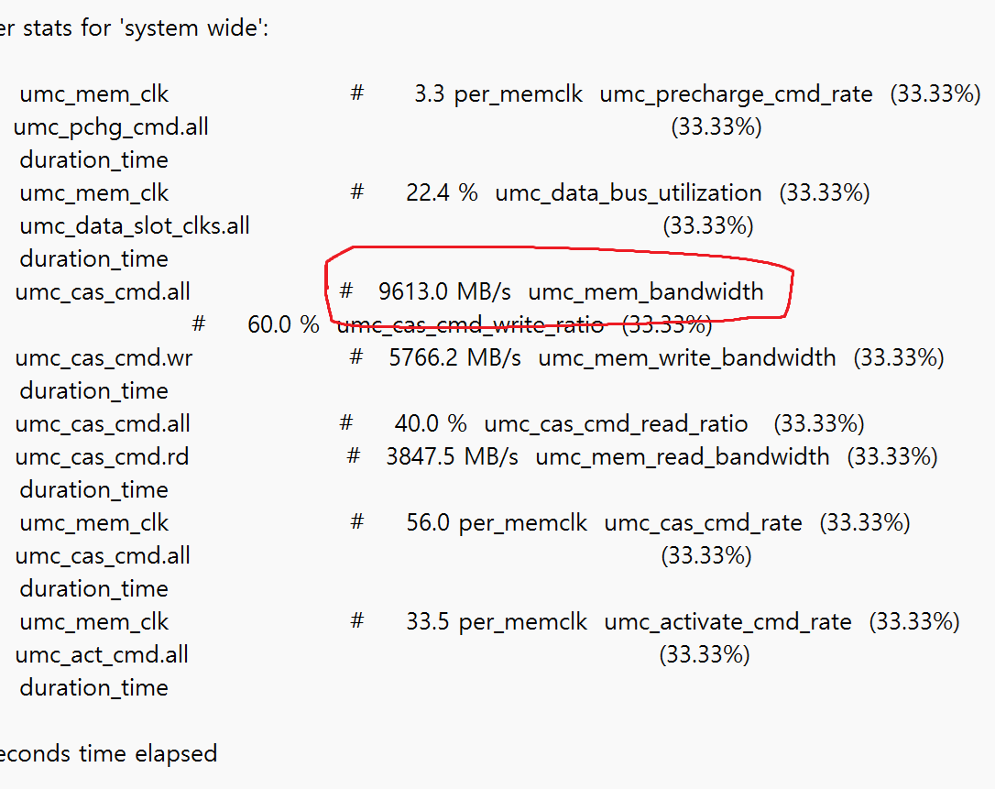
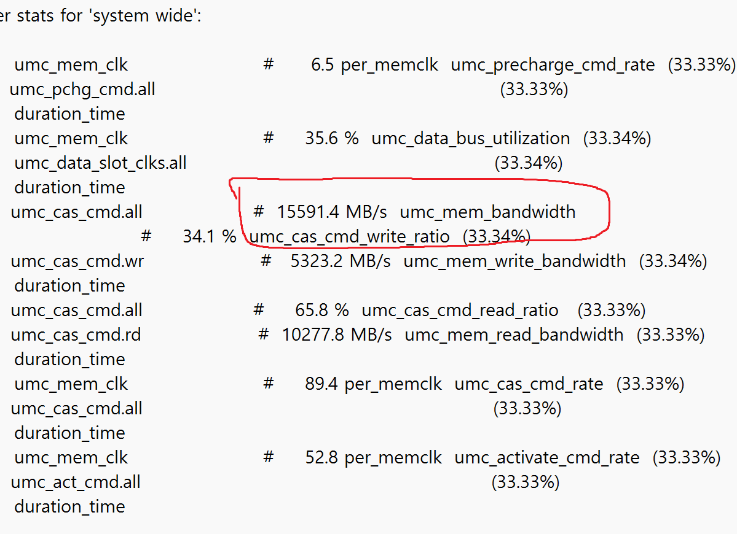
Profiling # 3. memory bandwidth
devmem tcp
TCP/IP

Slide 14
Q & A

