Slide 1
memory management lock contentions
Barry Song
July 5, 2026

Slide 2
mm locks
mmap_lock
lru lock
zone lock
anon_vma root lock

Slide 3
mmap_lock
PF by VMA lock
Per-VMA lock replaces mmap_lock in most places;
however, I/O wait triggers a page-fault retry, and that retry path still uses mmap_lock.
retry PF by vma-lock ? or,
entirely remove PF retry code ?
I/O
folio_
trylock
N
Y
release VMA lock
folio_wait_locked/folio_lock
retry PF by mmap_lock

Slide 4
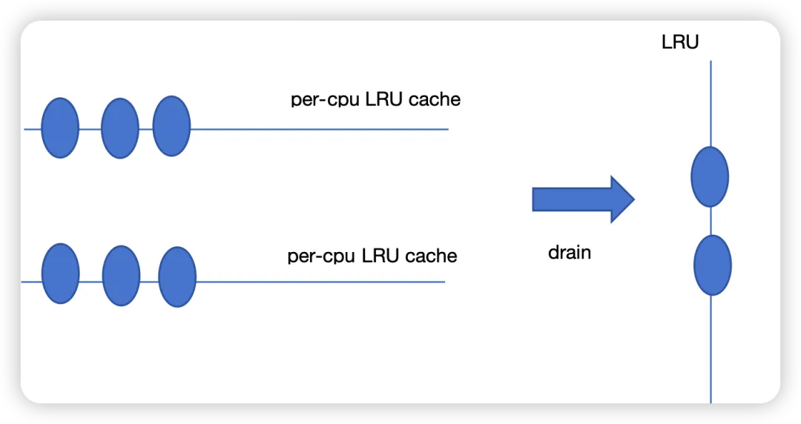
lru lock
JP Kobryn: mm/lruvec: preemptively free dead folios during lru_add drain
Usama Arif: mm/swap_state: remove unnecessary lru_add_drain() from readahead
Barry Song:
[PATCH v3 0/4] mm: drop redundant lru_add_drain in anon folio reuse paths
Barry Song:
[RFC PATCH] mm: allow smaller large folios to use lru_cache

Slide 5
zone lock
PCP
Kengfeng Wang:
[PATCH rfc 0/3] mm: allow more high-order pages stored on PCP lists
Wenchao Hao/Xueyuan Chen:
[PATCH v6 0/4] mm/zsmalloc: reduce lock contention in zs_free()
mm/zsmalloc: drop class lock before freeing zspage
Hongru Zhang:
[PATCH 0/3] mm: add per-migratetype counts to buddy allocator and optimize pagetypeinfo access

Slide 6
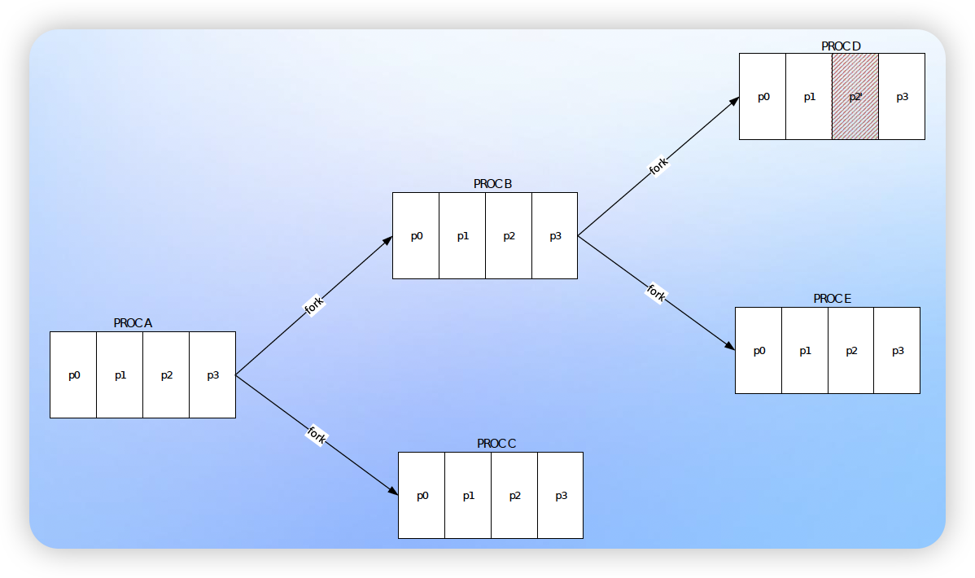
anon_vma->root->rwsem
Lorenzo Stoakes: rewrite rmap
Keeping COWs in context (a.k.a. anonymous reverse mapping)

