Slide 1
Run-Time Dynamic Linking for Reprogramming Wireless Sensor
Networks
  Adam Dunkels, Niclas Finne, Joakim Eriksson, Thiemo Voigt
  Swedish Institute of Computer Science
  ACM SenSys 2006

Slide 2
The setting: software updates in sensor networks
We are here
Operating system with loadable native code modules

Slide 3
We all have our own way of doing loadable modules
Contiki [EmNetS 2004]
  Statically linked modules, relocation at run-time
SOS [MobiSys 2005]
  Modules with position independent code
Why not just do it the standard “Linux” way?
  Run-time linking of ELF files
  Availability of tools, knowledge
Are we compelled to do it our own way?
Or do we choose to do it our own way?
Can we even do it the “Linux” way in microsensor networks?
  Given the severe resource constraints: 2k RAM, 60k ROM
If we could, what would the overhead be?

Slide 4
What we’ve done
Developed a dynamic linker for Contiki
  Link, relocate, load standard ELF files
CVM (Contiki VM) – a virtual machine
  Typical, stack-based virtual machine
  Compiler for a subset of Java
Java virtual machine
  Ported the leJOS Java VM to Contiki

Slide 5
Conclusions
Proof of concept: dynamic linking of ELF files is possible and feasible for sensor networks
  Code size < 2k, memory size < 100 bytes
  Acceptable transmission overhead (ELF size factor 3)
Communication is by far the dominating factor
  Energy consumption for the dynamic linking is low
Depending on the scenario, combinations may be the most efficient
  Virtual machine code with dynamically loaded native libraries

Slide 6
The details…

Slide 7
Reprogramming methods
Virtual machines, script languages
Native code
  Full image replacement
    The default method for many embedded systems, TinyOS
  Delta/diff-based approaches
    Compare two versions of the compiled code, transmit only the changes
    Need to know both versions
  Loadable modules
    Requires support from operating system

Slide 8
Loadable modules
ROM
RAM
Loadable
module
RAM
Loadable
module
System
core
System
core

Slide 9
Linking, relocation, loading
ROM
Loading
Linking
Relocation
RAM
0x2300
jmp 0x2300
while(1) {
send();
}
void send()
{
/* … */
}
0x164b
0x0000
call 0x164b
call 0x0000
jmp 0x0000
Loadable
module
System
core

Slide 10
Linking, relocation, loading
ROM
Loading
0x2300
call 0x164b
jmp 0x2300
Loadable
module
void send()
{
/* … */
}
0x164b
System
core

Slide 11
Static pre-linking, position independent code
ROM
Static pre-linking
  Do all linking at compile time
  Must know all core addresses at compile time
  All nodes must be exactly the same
    Configuration management nightmare
  Contiki [EmNetS 2004]
Position-independent code
  No need for relocation
  Only works on certain CPU architectures
  Limitations on module size
  SOS [Mobisys 2005]
0x2300
call 0x164b
jmp 0x2300
Loadable
module
void send()
{
/* … */
}
0x164b
System
core

Slide 12
Dynamic linking needs meta-data
ROM
Addresses of all locations that needs to be patched
The names of called functions and accessed variables
Symbol table in core
ELF – Executable Linkable Format
  Contains code, data, relocation/linking information, referenced symbols
  Standard format for Linux, Solaris, FreeBSD, …
  The output format from gcc (.o files)
  Many tools available
0x2300
call 0x164b
jmp 0x2300
Loadable
module
void send()
{
/* … */
}
0x164b
System
core

Slide 13
“ELF16”
The obvious problem with ELF files:
  ELF (ELF32) uses 32-bit structures
  Lots of “air” in an ELF file for a 16-bit CPU
The obvious optimization:
  “ELF16” – (Compact ELF) like ELF but with 16-bit structures
  The dynamic loader works with both ELF32 and “ELF16” file – only the structure definitions are different

Slide 14
The virtual machines
CVM – Contiki VM
  A stack-based, typical virtual machine
  A compiler for a subset of Java
The leJOS Java VM
  Adapted to run in ROM
  Executes Java byte code
    Bundled .class files

Slide 15
So how well does it work?

Slide 16
Memory footprint
ROM size of dynamic linker
  ~ 2k code
  ~ 4k symbol table
    Full Contiki system, automatically generated
Dynamic linking feasible for memory-constrained systems
  But CVM is better
Module | ROM | RAM
Static loader | 670 | 0
Dynamic linker | 5694 | 78
CVM | 1344 | 8
Java VM | 13284 | 59

Slide 17
Quantifying the energy consumption
Measure the energy consumption:
  Radio reception, measured on CC2420, TR1001
    A lower bound, based on average Deluge overhead
  Storing data to EEPROM
  Linking, relocating object code
  Loading code into flash ROM
  Executing the code
Two boards: ESB, Telos Sky (both MSP430)

Slide 18
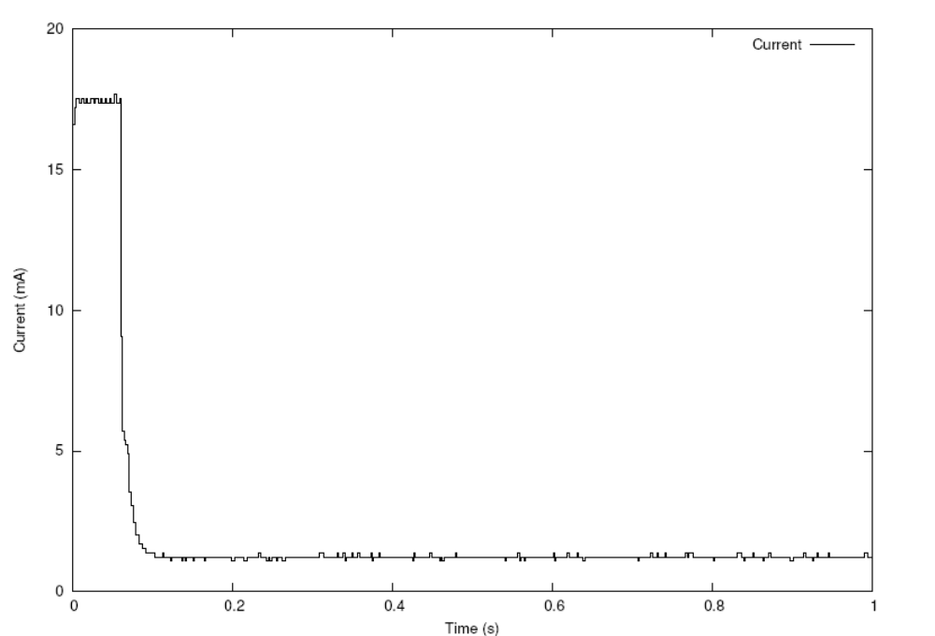
Receiving 1000 bytes with the CC2420

Slide 19
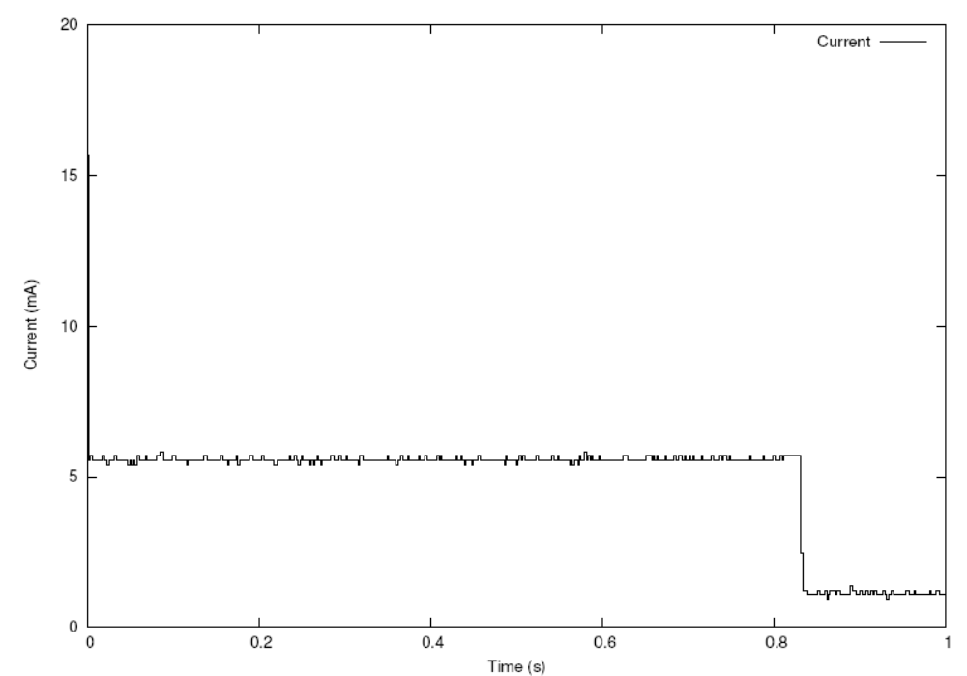
Receiving 1000 bytes with the TR1001

Slide 20
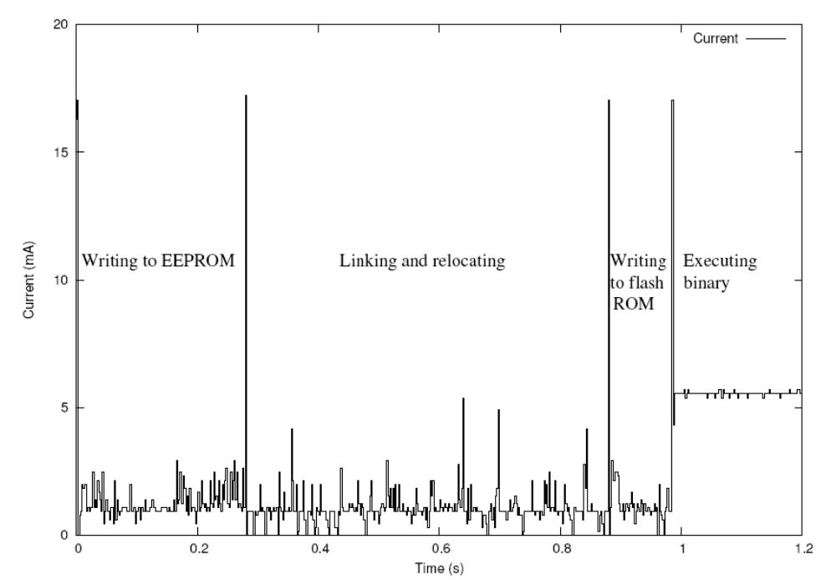
Energy consumption of the dynamic linker

Slide 21
Loading, linking native code vs virtual machine code
 | ELF | “ELF16” | CVM | Java
Size | 1824 | 968 | 123 | 1356
Reception | 29 | 12 | 2 | 22
Storing | 2 | 1 | 0 | 0
Linking | 3 | 3 | 0 | 0
Loading | 1 | 1 | 0 | 5
Total | 35 | 17 | 2 | 27
Object tracking application

Slide 22
ELF file size
 | Code | Data | ELF | ELF size factor | “ELF16” | “ELF16” size factor
Blinker | 130 | 14 | 1056 | 7.3 | 361 | 2.5
Object tracker | 344 | 22 | 1824 | 5.1 | 968 | 2.7
Code propagator | 2184 | 10 | 5696 | 2.6 | 3686 | 1.7
Flood/converge | 4298 | 42 | 8456 | 1.9 | 5399 | 1.2
Average ELF overhead 3, average “ELF16” overhead 1

Slide 23
Running native code vs virtual machine code
8x8 vector convolution
  Computationally “heavy”
Object tracking application
  Uses native code library
  Most of the code is spent running native code
 | Time (ms) | Energy (mJ)
Native | 0.67 | 0.00075
CVM | 58.52 | 0.065
Java | 65.6 | 0.073
 | Time (ms) | Energy (mJ)
Native | 0.479 | 0.00054
CVM | 0.845 | 0.00095
Java | 1.79 | 0.0020

Slide 24
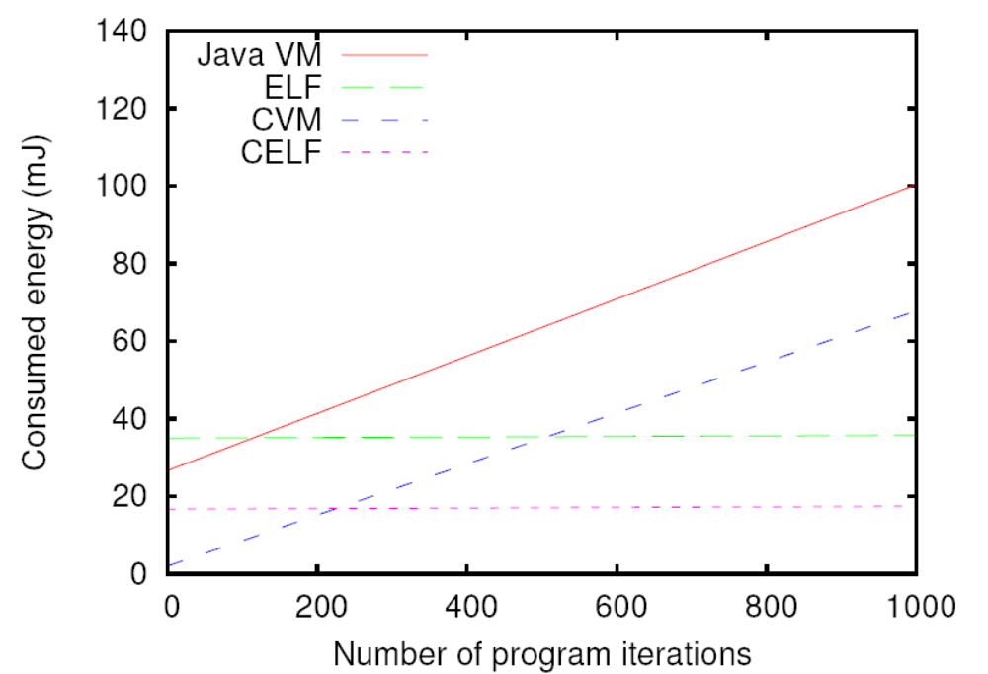
Break even points, vector convolution
“ELF16”

Slide 25
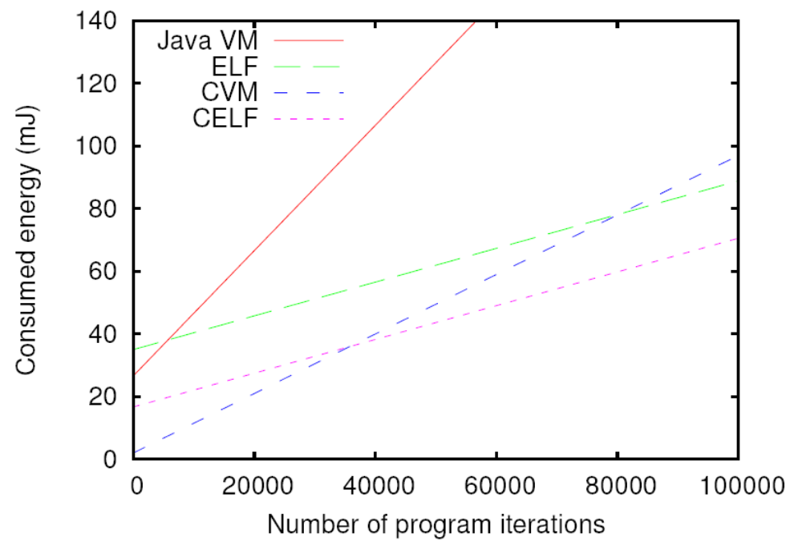
Break-even points, object tracking
“ELF16”

Slide 26
Conclusions
Dynamic loading of native code in standard ELF files is feasible in sensor networks
  The overhead lies in the transmission, not the linking
    Code size ~2k, memory size < 100 bytes
  ELF format has ~ 300% overhead
    (“ELF16” has ~ 100% overhead)
  Sometimes other factors outweigh the energy overhead
    Availability of tools
Dynamically linked native code vs virtual machines
  Combinations: virtual machine code with dynamically linked native code

Slide 27
Questions?

Slide 28
Full image replacement
Blinker application
  Module 150 bytes
  ELF file 1k
  Full system 20k
2000% energy overhead
 | Dynamic linking (mJ) | Full image (mJ)
Receive | 17 | 330
Store | 1.1 | 22
Link | 1.4 | 0
Load | 0.45 | 72
Total | 20 | 424

Slide 29
Portability of the dynamic linker
Dynamic linker consists of two parts
  Generic ELF code
  Architecture specific relocation and loading code
 | Lines of code, total | Lines of code, relocation function
Generic | 292 | -
MSP430 | 45 | 8
AVR | 143 | 104

Slide 30
Scenarios for software updates
Software development for sensor networks
  Small updates, often, at any level, programs short-lived
Sensor network test-beds
  Large updates, seldom, at the application level, programs long-lived
Fixing bugs
  Small updates, seldom, at any level, programs long-lived
Application reconfiguration
  Very small updates, seldom, at the application level, programs long-lived
Dynamic applications
  Small updates, often, at the application level, programs long-lived

